Slide 1
A Tutorial on Spiking Neural P Systems
Sergey VERLAN
University of Paris-Est Creteil

Slide 2
History
P systems – Gh. Paun – 1998.
Spiking P systems – Ionescu et al 2006.
Popular by 2010.
Still popular in 2019…
More than 30 papers

Slide 3
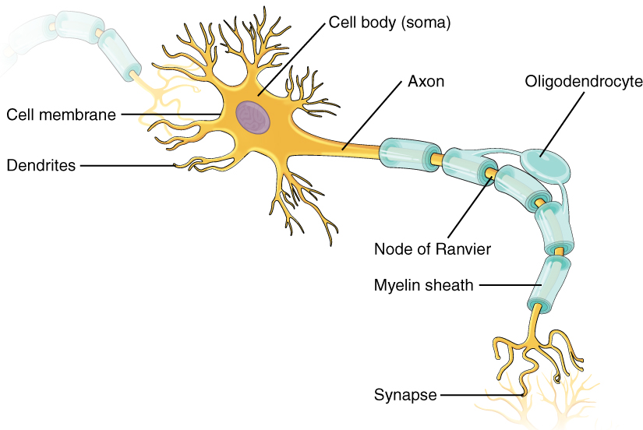
Neurons in Biology
Can emit/receive electrical impulses of same intensity and length (spikes).
Usually is excited by several spikes until a threshold is reached, then it spikes.
When a spike is emitted the neuron is closed for a refractory period (not allowing to receive/emit spikes).
The length of an axon can induce a time delay.
The neurons are not synchronized!

Slide 4











Spiking Neural P Systems (1)
Directed graph structure (of synapses). Each node is called a neuron and denoted by $σ_{i}$.
A single symbol a used to define the quantity of spikes in each neuron.
The initial quantity of spikes in each neuron ($n_{i}$).
1
$$a^{2}$$
$$a^{2} / a→a;0$$
$$a→λ$$
3
$$a^{3}$$
$$a^{3}→a;0$$
$$a→a;1$$
2
$$a^{2}→λ$$
$$a$$
$$a→a;0$$
$$a→a;1$$

Slide 5
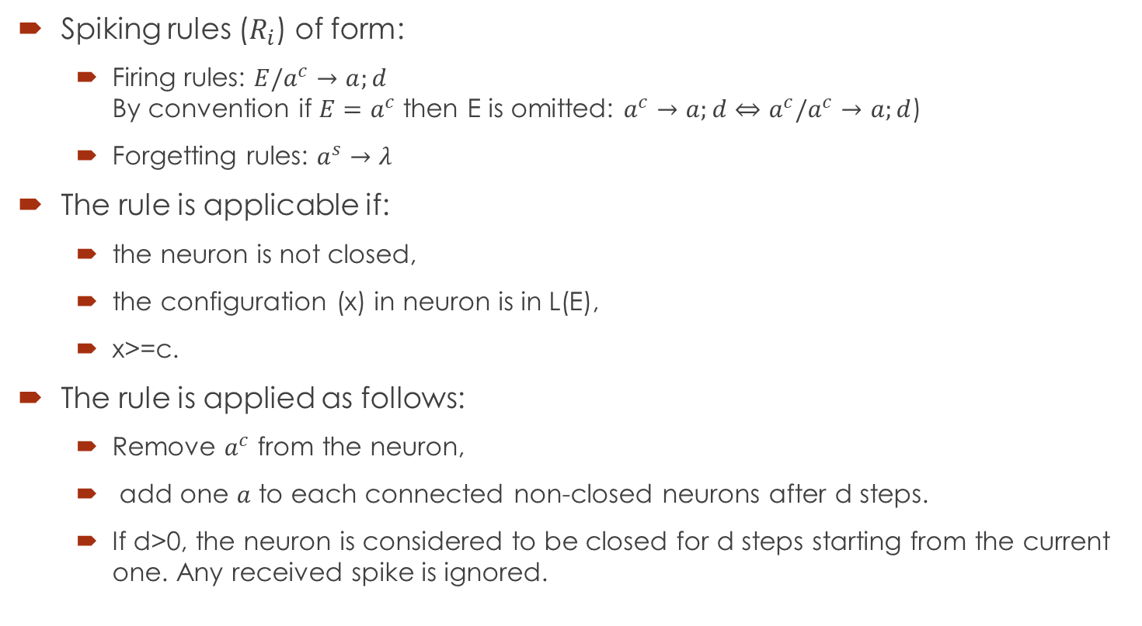
Spiking Neural P Systems (2)
Spiking rules ($R_{i}$) of form:
Firing rules: $E/a^{c}→a;d$ By convention if $E=a^{c}$ then E is omitted: $a^{c}→a;d⇔a^{c}/a^{c}→a;d$)
Forgetting rules: $a^{s}→λ$
The rule is applicable if:
the neuron is not closed,
the configuration (x) in neuron is in L(E),
x>=c.
The rule is applied as follows:
Remove $a^{c}$ from the neuron,
add one $a$ to each connected non-closed neurons after d steps.
If d>0, the neuron is considered to be closed for d steps starting from the current one. Any received spike is ignored.

Slide 6
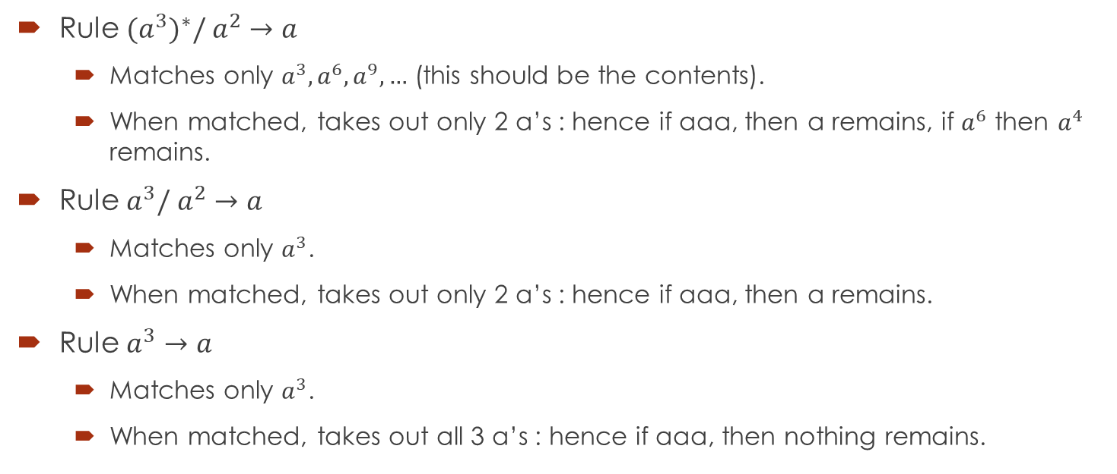
Example
Rule ${(a}^{3})^{∗}/ a^{2}→a$
Matches only $a^{3}, a^{6}, a^{9},…$ (this should be the contents).
When matched, takes out only 2 a’s : hence if aaa, then a remains, if $a^{6}$ then $a^{4}$ remains.
Rule $a^{3}/ a^{2}→a$
Matches only $a^{3}$.
When matched, takes out only 2 a’s : hence if aaa, then a remains.
Rule $a^{3}→a$
Matches only $a^{3}$.
When matched, takes out all 3 a’s : hence if aaa, then nothing remains.

Slide 7
Execution strategy
For each neuron select an applicable rule. If there are several applicable rules, then chose one non-deterministically.
Apply all selected rules in parallel.

Slide 8





Example
Time
m1
m2
m3
Out
1
0
2
1
3
-
$$a^{2}$$
$$a$$
1
2
1
2
1
$$a^{2} / a→a;0$$
$$a→λ$$
3
2
2
1
2
0
$$a^{3}$$
$$a$$
$$a^{2}$$
$$a^{3}→a;0$$
a
3
2
1
2
0
$$a→a;1$$
4
1
0
1
0
2
$$a^{2}→λ$$
$$a$$
5
1
0
0
0
$$a→a;0$$
6
0
0
0
1
$$a→a;1$$
From Handbook of Membrane computing, 2009

Slide 9
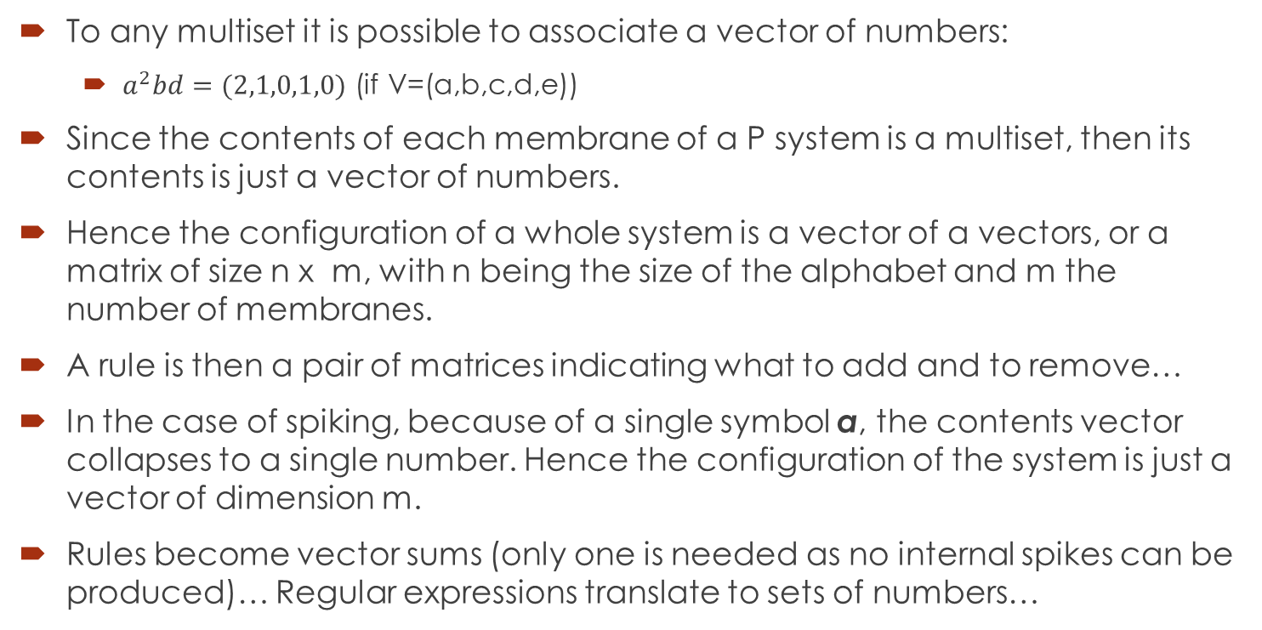
Vectors of numbers
To any multiset it is possible to associate a vector of numbers:
$a^{2}bd=(2,1,0,1,0)$ (if V=(a,b,c,d,e))
Since the contents of each membrane of a P system is a multiset, then its contents is just a vector of numbers.
Hence the configuration of a whole system is a vector of a vectors, or a matrix of size n x m, with n being the size of the alphabet and m the number of membranes.
A rule is then a pair of matrices indicating what to add and to remove…
In the case of spiking, because of a single symbol a, the contents vector collapses to a single number. Hence the configuration of the system is just a vector of dimension m.
Rules become vector sums (only one is needed as no internal spikes can be produced)… Regular expressions translate to sets of numbers…

Slide 10







Example
Time | m1 | m2 | m3 | Out
0 | 2 | 1 | 3 | -
1 | 2 | 1 | 2 | 1
2 | 2 | 1 | 2 | 0
3 | 2 | 1 | 2 | 0
4 | 1 | 0 | 1 | 0
5 | 1 | 0 | 0 | 0
6 | 0 | 0 | 0 | 1
1
$$a^{2}$$
$$a^{2} / a→a;0$$
$$a→λ$$
3
$$a^{3}$$
$$a^{3}→a;0$$
$$a→a;1$$
2
$$a^{2}→λ$$
$$a$$
$$a→a;0$$
$$a→a;1$$
Initial configuration (2,1,3,0)
Formal framework for SNP systems!
Rules:
$$1.1:(\{2\},∅,∅,∅)/(−1,1,1,0)$$
$$2.1:(∅,\{1\}, ∅,∅)/(1,−1,1,0)$$
$$3.1:(∅,∅,\{3\},∅)/(0,0,−3,1)$$
$$1.2:(\{1\},∅,∅,∅)/(−1,0,0,0)$$
$$2.2:\left(∅,\left\{1\right\}, ∅,∅\right)/\left(1,−1,1,0\right);1$$
$$3.2:\left(∅,∅,\left\{1\right\},∅\right)/\left(0,0,−1,1\right);1$$
$$3.3:(∅,∅,\{2\},∅)/(0,0,−2,0)$$

Slide 11
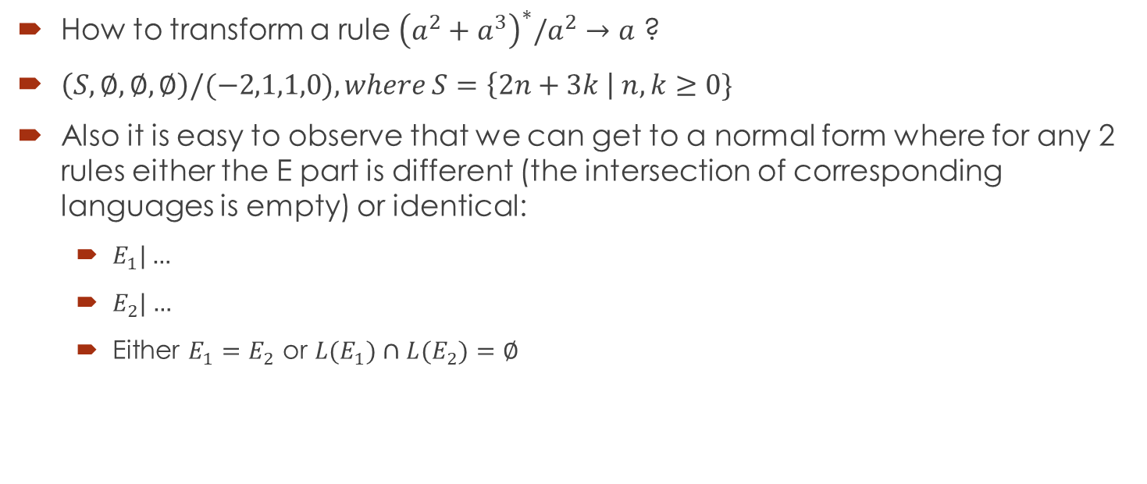
And the regular expression ?
How to transform a rule ${\left(a^{2}+a^{3}\right)}^{∗}/a^{2}→a$ ?
$\left(S,∅,∅, ∅\right)/(−2,1,1,0), where S=\left\{2n+3k \right| n,k≥0\}$
Also it is easy to observe that we can get to a normal form where for any 2 rules either the E part is different (the intersection of corresponding languages is empty) or identical:
$E_{1}|…$
$E_{2}|…$
Either $E_{1}=E_{2}$ or ${L(E}_{1})∩{L(E}_{2})=∅$

Slide 12
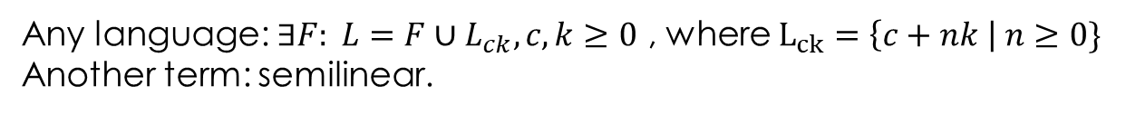
Regular expression over one-letter alphabet
…
…
Any language: $∃F: L=F∪L_{ck}, c,k≥0$ , where $L_{ck}=\left\{c+nk \right| n≥0\}$
Another term: semilinear.

Slide 13
Remarks about delay and forgetting rules
The delay can always be removed.
However, this is a functional, but not structural transformation (this means that it is possible to write down a system without delay computing the same result).
A similar statement holds about forgetting rules.
In practice – not trivial, as the algorithm should be completely redesigned.

Slide 14









Example
1
1
$$a^{2}$$
$$a^{2}$$
$$a^{2} / a→a;0$$
$$a^{2} / a→a$$
$$a→λ$$
3
$$a→λ$$
3
$$a^{3}$$
$$a^{3}$$
$$a^{3}→a;0$$
$$a^{3}→a$$
$$a→a;1$$
$$a→a$$
$$a^{2}→λ$$
2
$$a^{2}→λ$$
2
$$a^{2}$$
$$a$$
$$a→a;0$$
$$a^{2}/a→a$$
$$a→a;1$$
$$a^{2}→a$$
Time | M1 | m2 | m3 | Out
0 | 2 | 2 | 3 | -
1 | 2 | 2 | 2 | 1
2 | 2 | 2 | 2 | 0
3 | 2 | 2 | 2 | 0
4 | 2 | 1 | 2 | 0
5 | 1 | 1 | 1 | 0
6 | 0 | 0 | 0 | 1
Time | M1 | m2 | m3 | Out
0 | 2 | 1 | 3 | -
1 | 2 | 1 | 2 | 1
2 | 2 | 1 | 2 | 0
3 | 2 | 1 | 2 | 0
4 | 1 | 0 | 1 | 0
5 | 1 | 0 | 0 | 0
6 | 0 | 0 | 0 | 1
$$a→λ$$

Slide 15
Result and Input/Output
There are several ways to consider result in SNP systems:
Traditional P systems manner – number of spikes in some membrane (not very used).
Generating systems – use a spiking train (binary sequence) for the output
Consider the time between two spikes at the output neuron. Out = 0001000001000 – 1 spike, 0 not spike, value 5 (distance 6, encode 0 by 1).
Can use a more complex functions like skip several spikes, use vectors, several output neurons etc.
The input can also be handled in a similar manner:
Traditional: the input is instantiated as the number of spikes in the input neuron.
Using a spiking train to input one (or more) input(s).
Usually, one also requires the halting (the system should additionally have no rules applicable). In this case accepting SNP systems are obtained.
Can be used as infinite transducer: input an infinite spiking train and output an infinite spiking train…

Slide 16




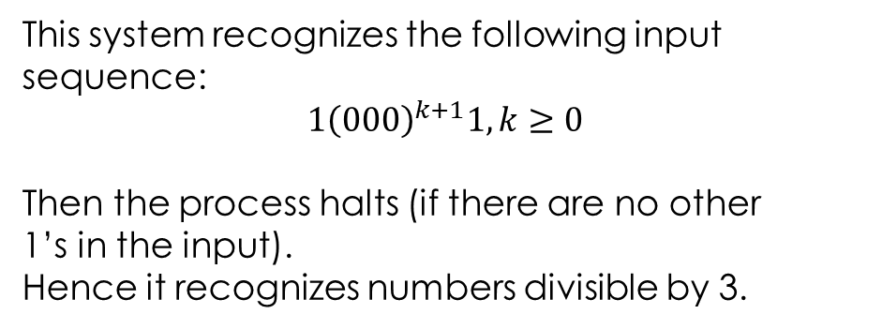
Example
t | M1 | m2 | m3 | m4
0 | 0 | 0 | 2 | 0
1 | 0 | 0 | 2 | 0
2 | 1 | 0 | 2 | 0
3 | 0 | 1 | 2 | 1
4 | 0 | 1 | 3 | 0
5 | 0 | 0 | 1 | 0
6 | 0 | 0 | 0 | 1
7 | 0 | 1 | 0 | 0
8 | 0 | 0 | 1 | 0
9 | 1 | 0 | 0 | 1
10 | 0 | 2 | 0 | 1
11 | 0 | 3 | 0 | 0
12 | 0 | 0 | 0 | 0
1
$$a→a$$
2
3
$$a^{2}$$
4
$$a→a$$
$$a→a$$
$$a→a$$
$$a^{3}→λ$$
$$a^{3}→λ$$
$$a^{2}→a$$
This system recognizes the following input sequence:
$$1{\left(000\right)}^{k+1}1, k≥0$$
Then the process halts (if there are no other 1’s in the input).
Hence it recognizes numbers divisible by 3.

Slide 17





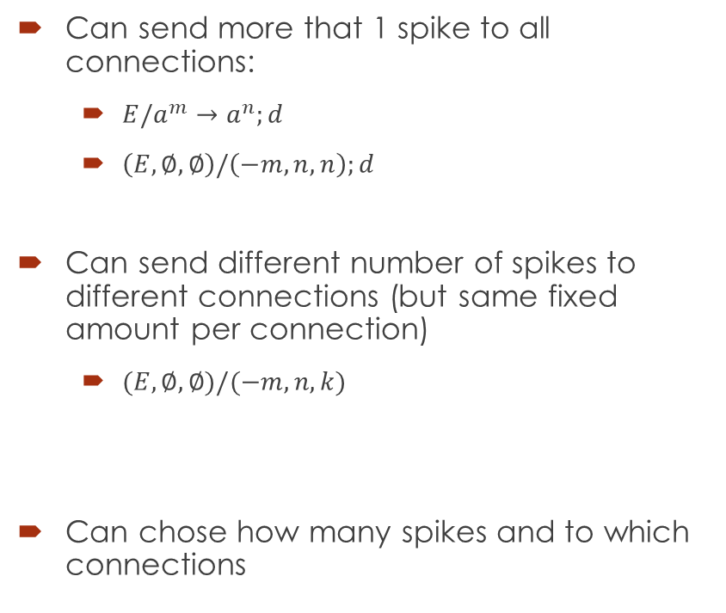







Extended rules
$$a^{n}$$
Can send more that 1 spike to all connections:
$E/a^{m}→a^{n};d$
$\left(E,∅,∅\right)/\left(−m,n,n\right);d$
Can send different number of spikes to different connections (but same fixed amount per connection)
$(E,∅,∅)/(−m,n,k)$
Can chose how many spikes and to which connections
$${E/a}^{m}→a^{n}$$
$$a^{n}$$
$$n$$
$$a^{n}$$
$$k$$
$${E/a}^{m}→a$$
$$a^{k}$$
$$a^{n} or a^{p}$$
$$(E,ℕ,ℕ)/(−m,n,k)$$
$$(E,ℕ,ℕ)/(−m,p,q)$$
$$a^{k} or a^{q}$$

Slide 18
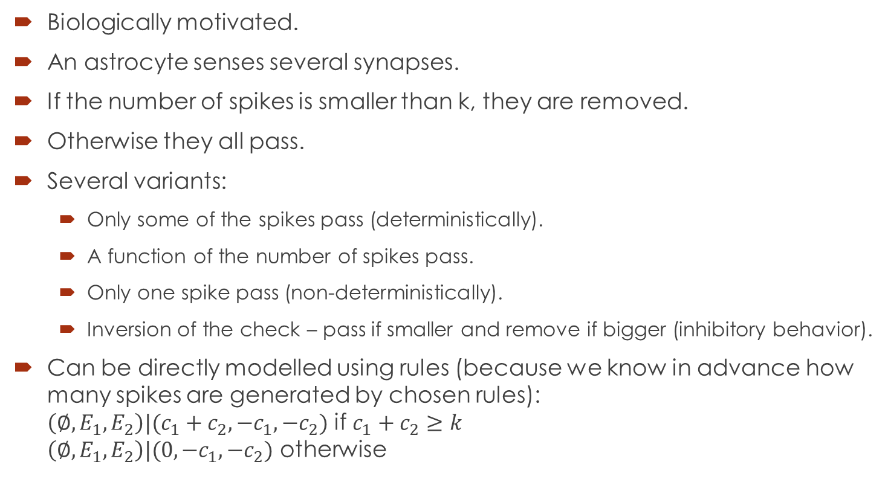
Astrocytes
Biologically motivated.
An astrocyte senses several synapses.
If the number of spikes is smaller than k, they are removed.
Otherwise they all pass.
Several variants:
Only some of the spikes pass (deterministically).
A function of the number of spikes pass.
Only one spike pass (non-deterministically).
Inversion of the check – pass if smaller and remove if bigger (inhibitory behavior).
Can be directly modelled using rules (because we know in advance how many spikes are generated by chosen rules): $\left({∅, E}_{1},E_{2}\right)|(c_{1}+c_{2},−c_{1},−c_{2})$ if $c_{1}+c_{2}≥k$ $\left({∅, E}_{1},E_{2}\right)|(0,−c_{1},−c_{2})$ otherwise
k

Slide 19
Main results with SNP systems
In most of the cases computational completeness is obtained…
Whatever variant – small number of neurons, rules, restricted types of rules etc.
However, there are often trade-offs between different parameters.

Slide 20
Programming using SNP
SNP are programmed using number relations.
For extended systems this is done directly, for ordinary ones it needs intermediate neurons to multiply the output (any extended-rule SNP can be simulated by ordinary SNP with a 2-step slowdown).
Example: 3-steps countdown

Slide 21



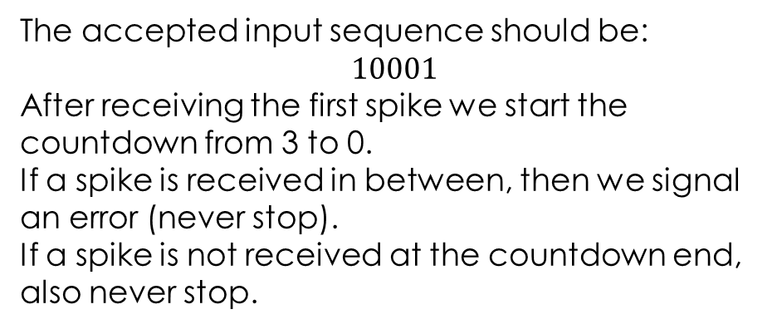





Example : 3-step countdown
The accepted input sequence should be:
$$10001$$
After receiving the first spike we start the countdown from 3 to 0.
If a spike is received in between, then we signal an error (never stop).
If a spike is not received at the countdown end, also never stop.
Error cases for N-1,N-3,N-5,N-8
Sufficient to take N=9:
1
$$a→a$$
Countdown: N=N-2
If a spike arrives, then error on N-1
2
2
$$a^{9}$$
$$a^{9}$$
$$a→a$$
$$a→a$$
$$a^{2}→λ$$
$$a^{2}→λ$$
0 | 1 | 0 | 0 | 0 | 1 | 0 | 0
N | N | N+1 | N-2 | N-4 | N-6 | N-7 | 0
$$a^{3}→a$$
$$a^{3}→a$$
$$a^{4}→a$$
$$a^{4}→a$$
$${a^{5}/a}^{3}→a$$
$${a^{5}/a}^{3}→a$$
$$a^{6}→a$$
$$a^{6}→a$$
$${a^{7}/a}^{3}→a$$
$${a^{7}/a}^{3}→a$$
Start countdown
Stop countdown
& check
$$a^{8}→a$$
$$a^{8}→a$$
$${a^{10}/a}^{4}→a$$
$${a^{10}/a}^{4}→a$$

Slide 22
Back to the execution strategy
Since there is a finite number of rules in each neuron and a finite number of neurons:
SNP system can be seen as a purely catalytic P system.
By considering all possible combinations of rules together with the corresponding forbidding expressions it is possible to show that spiking is sequential if considering general type of rules.
So, sequential SNP (where only one neuron fires at each step) is in fact catalytic mode with a single partition…

Slide 23
Other execution strategies
Maximally parallel ?
Minimally parallel
Bounded parallelism
…

Slide 24
Some existing variants

Slide 25
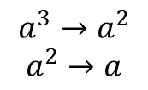


Rules on synapses
$$aaa$$
$$a^{3}→a^{2}$$
$$a^{2}→a$$
Can apply either rule 1 or rules 2,3
$$a→a^{2}$$
Being able to synchronously apply rules from different synapses, just corresponds to the maximally parallel execution of rules.

Slide 26
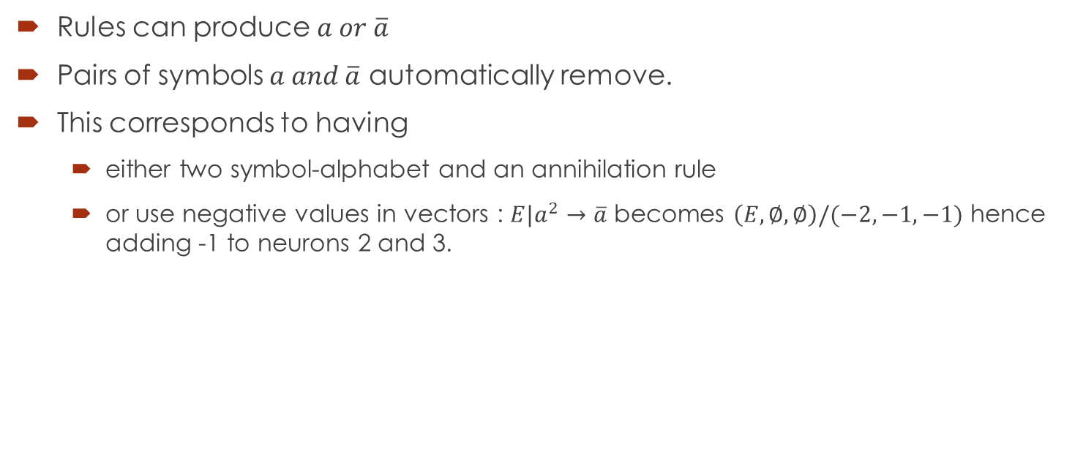
Anti-spikes
Rules can produce $a or \overline{a}$
Pairs of symbols $a and \overline{a}$ automatically remove.
This corresponds to having
either two symbol-alphabet and an annihilation rule
or use negative values in vectors : $E|a^{2}→\overline{a}$ becomes $\left(E,∅,∅\right)/(−2,−1,−1)$ hence adding -1 to neurons 2 and 3.

Slide 27
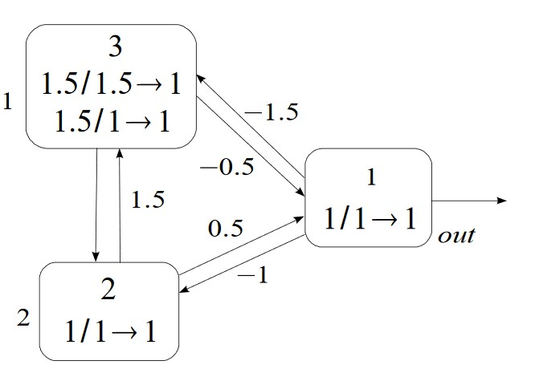
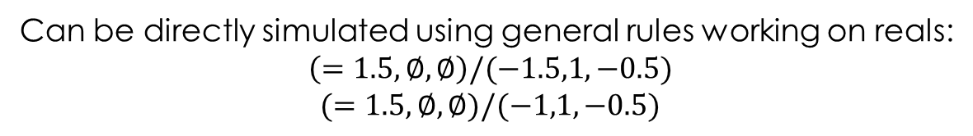
Real weights and thresholds
From Wang et al, 2009
If the current value is equal to the “threshold” number, then one spike is emitted, arriving to the other membrane multiplied by the weight.
If the current value is greater – nothing happens.
If it is smaller – than becomes 0.
Can be directly simulated using general rules working on reals:
$$\left(=1.5,∅,∅\right)/(−1.5,1,−0.5)$$
$$(=1.5,∅,∅)/(−1,1,−0.5)$$

Slide 28
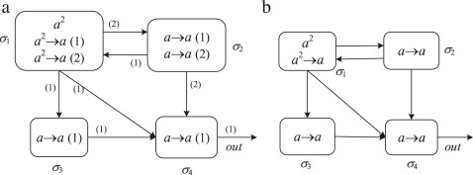
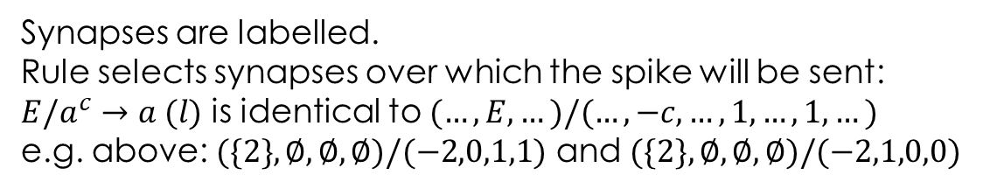
Multiple channels SNP
Synapses are labelled.
Rule selects synapses over which the spike will be sent:
$E/a^{c}→a (l)$ is identical to $(…,E,…)/(…,−c,…,1,…,1,…)$
e.g. above: $(\{2\},∅,∅,∅)/(−2,0,1,1)$ and $(\{2\},∅,∅,∅)/(−2,1,0,0)$

Slide 29


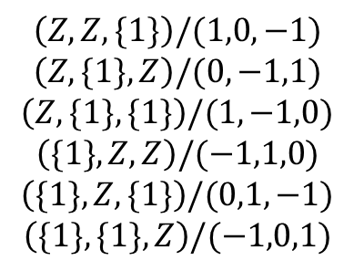
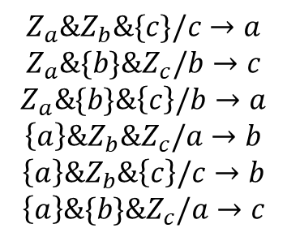

Transitional P Systems
Since the SNP system can be described by a vector, one can consider it as a multiset.
Then SNP system (without delays) becomes a transitional P system (with regular expression check on rules).
1
2
3
$$a→a$$
$$a→a$$
$$a→a$$
Let $Z=N∖\{1\}$
$$\left(Z,Z,\{1\}\right)/(1,0,−1)$$
$$\left(Z,\{1\},Z\right)/(0,−1,1)$$
$$\left(Z,\{1\},\{1\}\right)/(1,−1,0)$$
$$\left(\{1\},Z,Z\right)/(−1,1,0)$$
$$\left(\{1\},Z,\{1\}\right)/(0,1,−1)$$
$$\left(\{1\},\{1\},Z\right)/(−1,0,1)$$
$$Z_{a}\&Z_{b}\&\{c\}/c→a$$
$$Z_{a}\&\{b\}\&Z_{c}/b→c$$
$$Z_{a}\&\{b\}\&\left\{c\right\}/b→a$$
$$\left\{a\right\}\&Z_{b}\&Z_{c}/a→b$$
$$\left\{a\right\}\&Z_{b}\&\left\{c\right\}/c→b$$
$$\left\{a\right\}\&\{b\}\&Z_{c}/a→c$$
It is known that
simpler rules yield
to universality

Slide 30
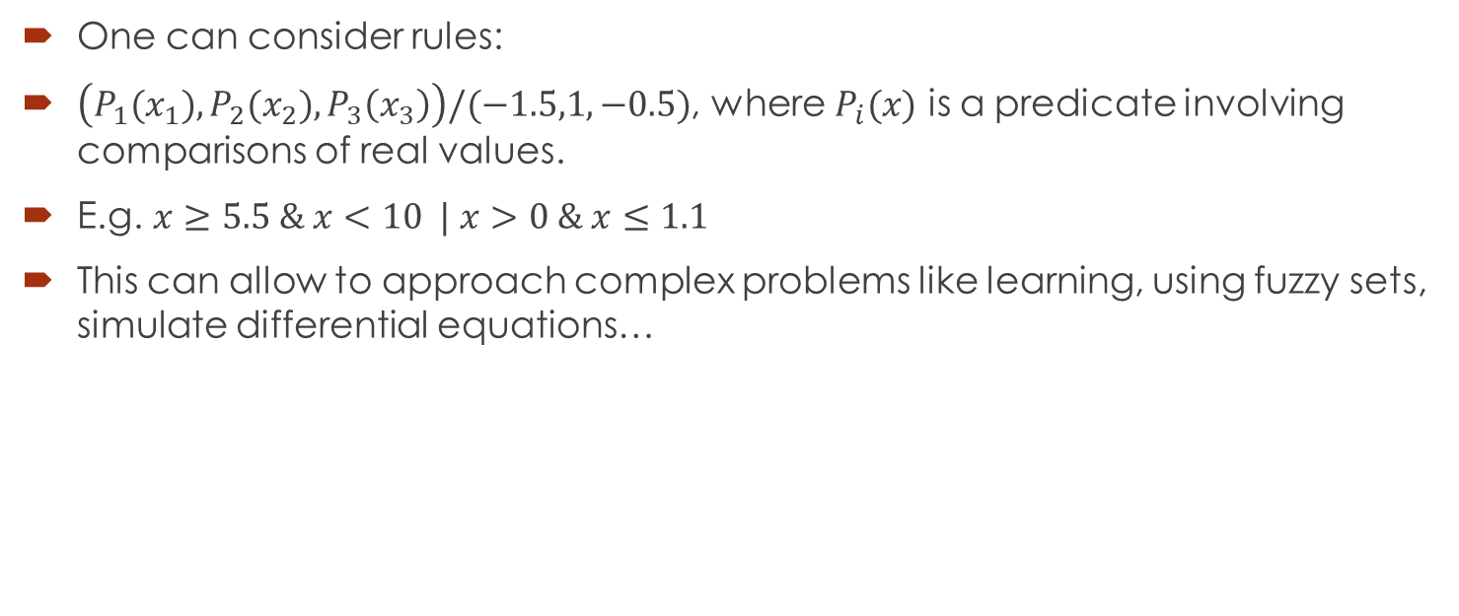
Back to real numbers
One can consider rules:
$\left(P_{1}(x_{1}),P_{2}(x_{2}),P_{3}\left(x_{3}\right)\right)/(−1.5,1,−0.5)$, where $P_{i}(x)$ is a predicate involving comparisons of real values.
E.g. $x≥5.5 \& x<10 | x>0 \& x≤1.1$
This can allow to approach complex problems like learning, using fuzzy sets, simulate differential equations…

Slide 31
Conclusions
SNP systems have a very simple configuration (a vector).
However, the trade-off are the complicated expressions (especially for the absence check).
Many proposed variants borrow standard techniques and extensions from MC area.

