Slide 1
A Formal Framework for Static (Tissue) P Systems
Rudolf Freund and Sergey Verlan
Presented by: Ren Tristan A. de la Cruz

Slide 2
Models of Computation

Slide 3
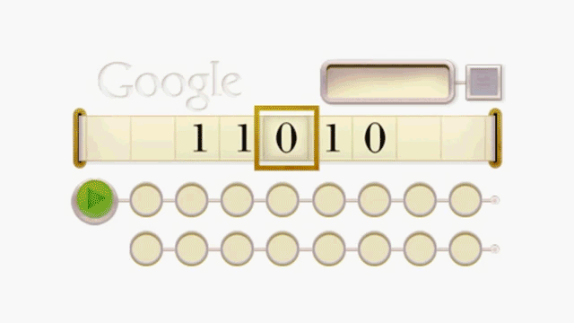
Turing Machine (1936)
https://te.xel.io/posts/2017-02-27-the-turing-network-a-thought-experiment-for-quantum-computing.html

Slide 4
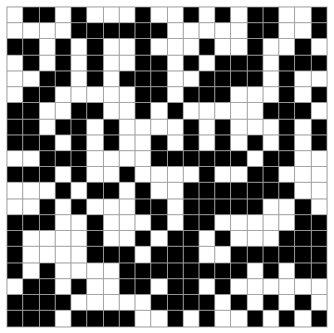
Cellular Automata (1940s)
https://giphy.com/gifs/programming-automata-cellular-s1WbnYEoHbbmE

Slide 5
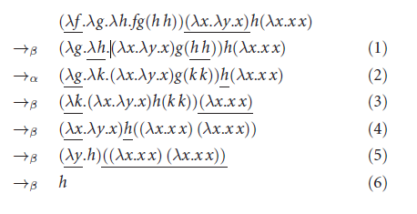
Lambda Calculus (1930s)
https://cs.stackexchange.com/questions/102732/beta-reduction-order-in-lambda-calulus

Slide 6
Register Machine (1960s)
Registers
0
1
0
2
0
3
Set
Of
Instructions
0
4
0
5
I₁:(ADD(1),I_{1,}I₂)
I₂:(SUB(2),I_{1,}I₃)
I₃:(ADD(7),I_{3,}I₄)
….
0
6
0
7
0
8

Slide 7
Membrane Computing &
P Systems

Slide 8
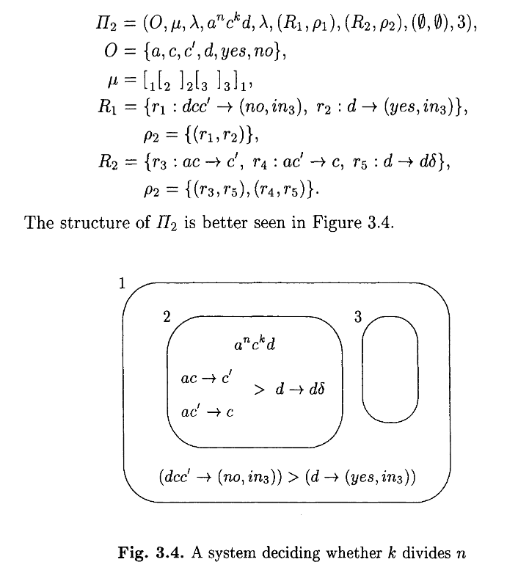
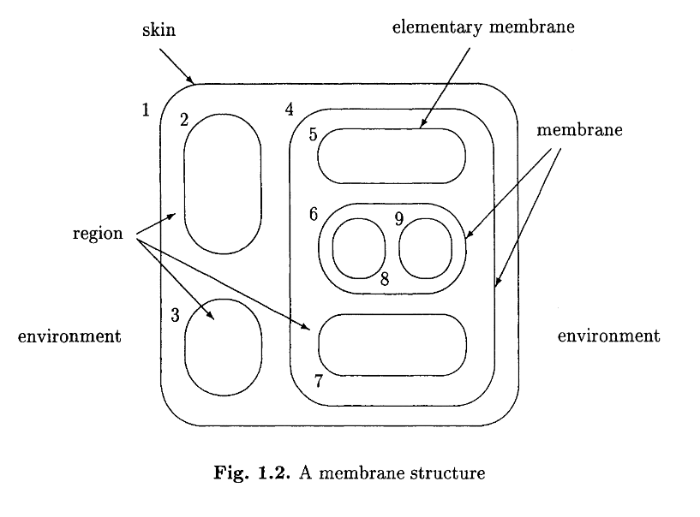
Cell-Like P Systems

Slide 9
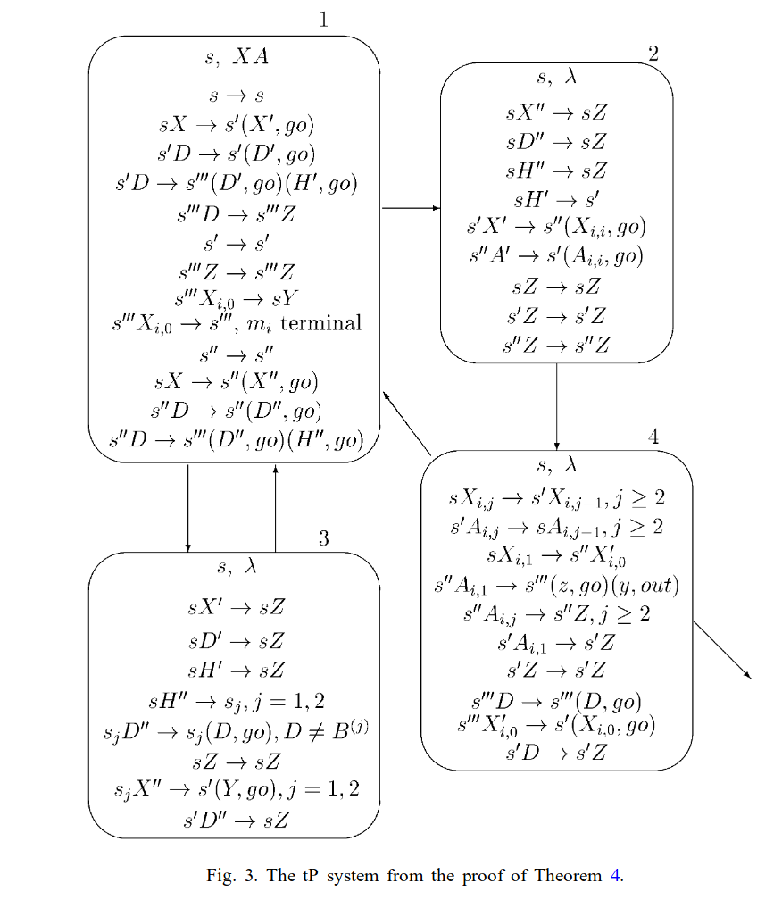
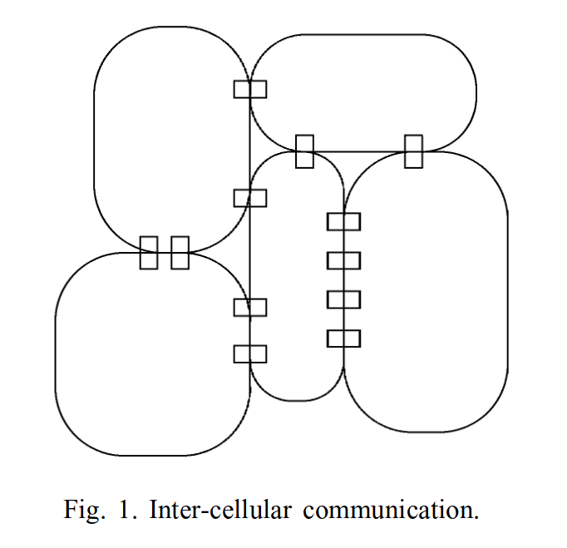
Tissue-Like P Systems

Slide 10
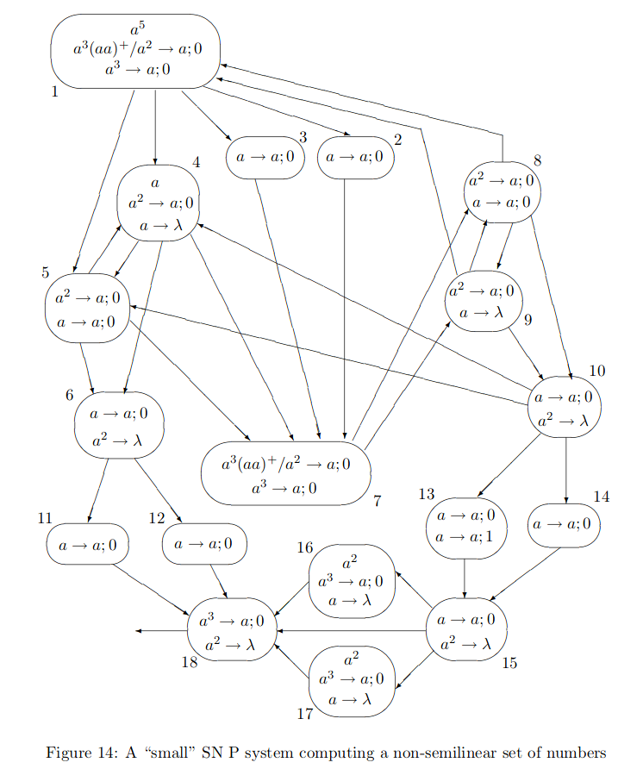
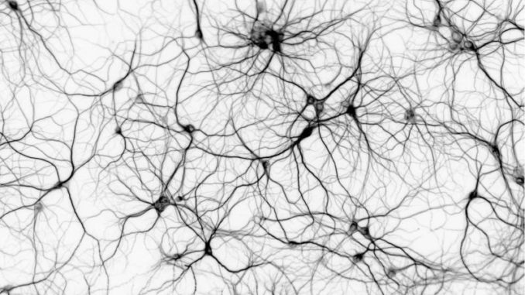
Neural-Like P Systems

Slide 11
Formal Framework

Slide 12
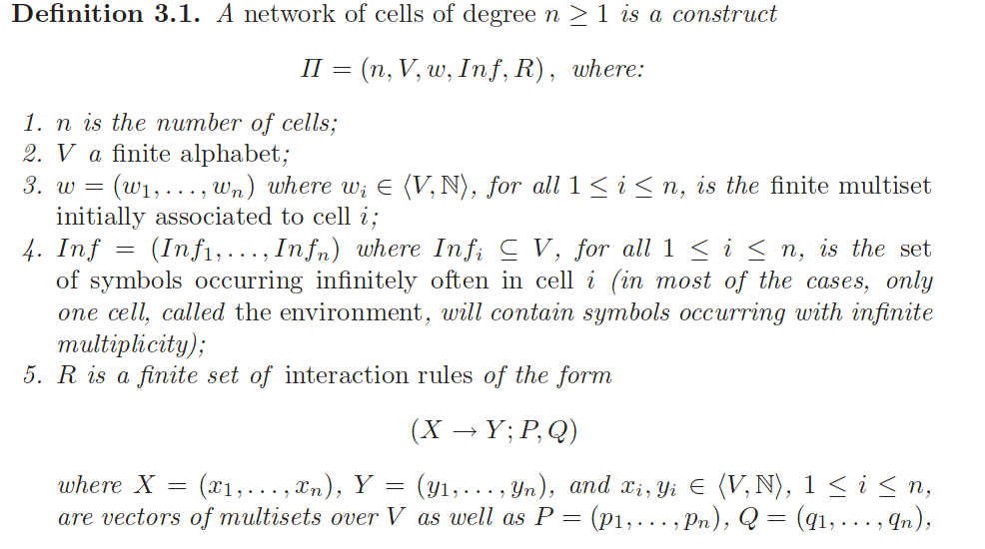
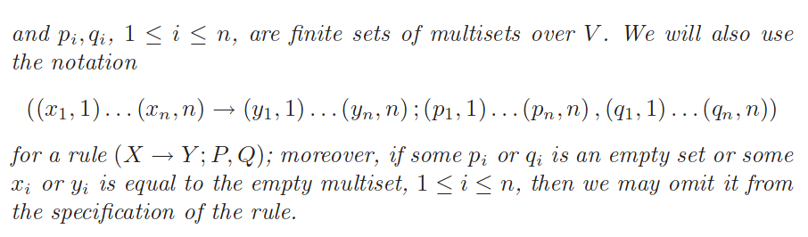
Network of Cells/Membranes

Slide 13
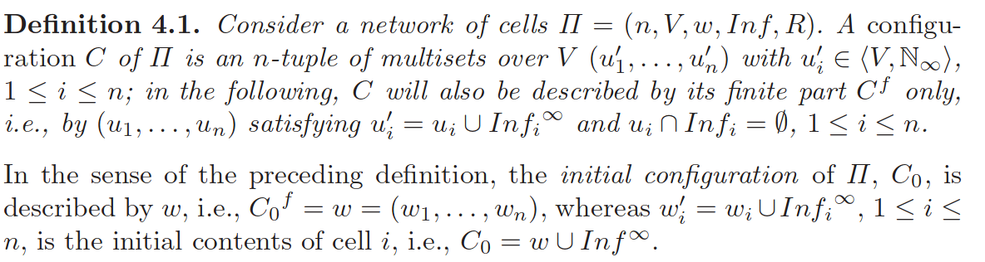
Configuration

Slide 14
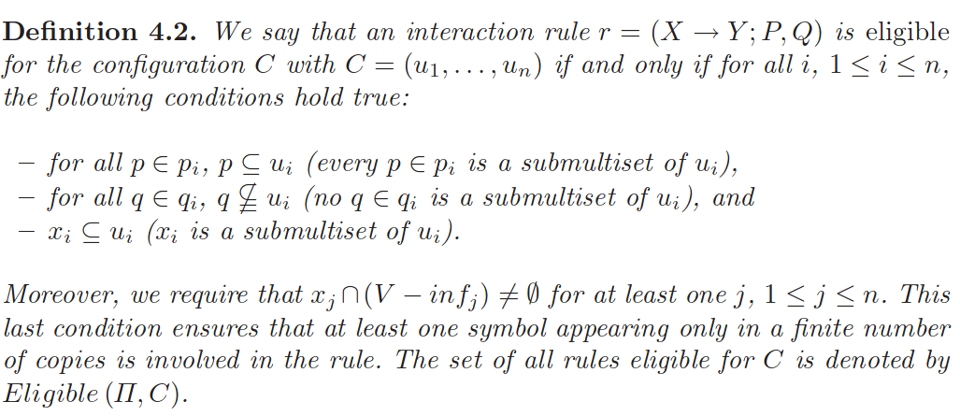
Eligible Rules

Slide 15
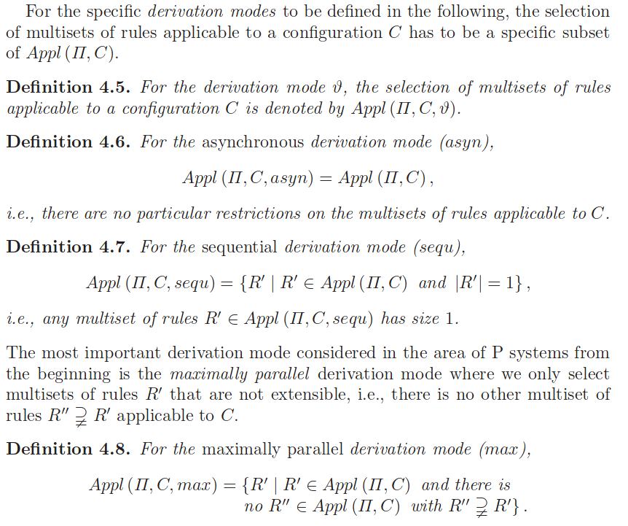
Derivation Modes

Slide 16
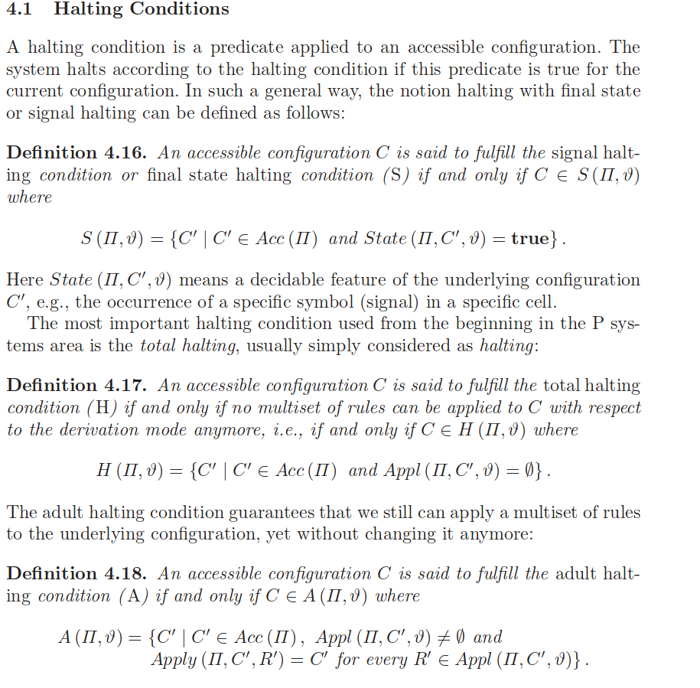
Halting Conditions

Slide 17
Remarks

