Slide 1
Introduction to Formal Frameworks for P-Systems
Theory Days – Day 2
2020 June 24
Ren Tristan A. de la Cruz

Slide 2
Membrane Computing & P Systems
Membrane Computing – Field of Theoretical CS (Natural Computing)
Membrane computing studies different models of computation known as
P Systems
P Systems:
- distributed parallel computing devices
- biologically-inspired
- use the idea of membranes (and cells) to compartmentalize space
- related to multiset rewriting systems

Slide 3
P Systems – Membrane Structure
Tree Representation
Visual Representation
0
4
1
1
2
5
2
6
3
0
4
5
6
Balanced Brackets
Representation
[₀ [₁]₁ [₂]₂ [₃ [₄]₄ [₅]₅ [₆]₆ ]₃ ]₀
[1] Păun, G.. 1998. Computing with Membranes. In Technical Report. Turku Centre for Computer Science.

Slide 4
P Systems – Multisets of Objects
Alphabet / Set of Objects
O = {a,b,c}
Sample Multisets over O
aaaabbcc = {a,a,a,a,b,b,c,c} = a⁴b²c²
abbccc = {a,b,b,c,c,c} = a¹b²c³
ac = {a,c} = a¹c¹= a¹b⁰c¹

Slide 5
P Systems – Multisets in Membranes
aaaabbbcc
O = {a,b,c,d}
bcc
1
bbdd
4
5
abcd
2
aacccc
6
3
0

Slide 6
P Systems – Multiset Rewriting
Alphabet / Set of Objects
O = {a,b,c}
aaaabbcc
bc → aaa
a⁷bc
acc
ac → bb
bbc
aabbbccc
ab → aab
aaabbbccc

Slide 7
P Systems – Multiset Rewriting
Alphabet / Set of Objects
O = {a,b,c}
x2
aaaabbcc
bc → aaa
a¹⁰
acc
ac → bb
bbc
aabbbccc
ab → aab
aaaabbbccc
x2

Slide 8
P Systems and Formal Frameworks (FFs)
P Systems with Active Membranes [2,3]
Spiking Neural P (SN P) Systems [5]
FF2 for Dynamic P System [7]
1998
2003
2007
2019
1999
2001
2006
2013
Tissue P Systems [4]
FF1 for Static P System [6]
FF3 for SN P System [8]
P Systems [1]
[1] Păun, G.. 1998. Computing with Membranes. In Technical Report. Turku Centre for Computer Science.
[2] Păun, G.. 1999. P Systems with Active Membranes: Attacking NP-Complete Problems. In Centre for Discrete Mathematics and Theoretical Computer Science (CDMTCS-102) – Research Report Series
[3] Păun, G.. 2001. P Systems with Active Membranes: Attacking NP-Complete Problems. In Journal of Automata, Languags, and Combinatorics. vol.6, issue 1 (January 2001), 75-90.
[4] Martín-Videa, C., Păun, G., Pazos, J., Rodríguez-Patón, A.. 2003. Tissue P Systems. In Theoretical Computer Science. Elsevier.
[5] Ionescu, M., Păun, G., Yokomori, T.. 2006. Spiking Neural P Systems. In Fundamenta Informaticae. vol 71, issue 2,3 (February 2006), 279-308.
[6] Freund R., Verlan S. 2007. A Formal Framework for Static (Tissue) P Systems. In: Eleftherakis G., Kefalas P., Păun G., Rozenberg G., Salomaa A. (eds) Membrane Computing. WMC 2007. Lecture Notes in Computer Science, vol 4860. Springer, Berlin, Heidelberg
[7] Freund, R., Pérez-Hurtado, I., Riscos-Núñez, A., Verlan, S.. 2013. A Formalization of Membrane Systems with Dynamically Evolving Structures. In International Journal of Computer Mathematics, 90:4, 801-815
[8] Verlan, S., Freund, R., Alhazov, A., Pan, L.. 2008. A Formal Framework for Spiking Neural P Systems. In Proceedings of 20th Conference on Membrane Computing (CMC20)

Slide 9
P Systems
O = {a,b,c,d}
a
aaaabbbcc
aaabb
→
d
2
3
2
3
1
1
0
0
Rule in Membrane 1: abcc → (a, out)(d, in₃)
[abcc]₁ → [a]₀ [d]₃
[1] Păun, G.. 1998. Computing with Membranes. In Technical Report. Turku Centre for Computer Science.

Slide 10
P Systems
O = {a,b,c,d}
aa
aaaabbbcc
aab
→
dd
2
3
2
3
1
1
0
0
Rule in Membrane 1: abc → (a, out)(d, in₃)
x2
[abc]₁ → [a]₀ [d]₃
x2
[1] Păun, G.. 1998. Computing with Membranes. In Technical Report. Turku Centre for Computer Science.

Slide 11
P Systems
O = {a,b,c,d}
cc
aaaabbbcc
abbd
→
2
3
2
3
1
1
0
0
Rule in Membrane 1: aaabcc →(cc, out)(d, here)
[aabcc]₁ → [cc]₀ [d]₁
[1] Păun, G.. 1998. Computing with Membranes. In Technical Report. Turku Centre for Computer Science.

Slide 12
P Systems
O = {a,b,c,d}
aaaabbbcc
aabcc
→
d
d
2
3
2
3
1
0
0
Rule in Membrane 1: aabbcc→(d,in₂)(d,in₃)ẟ
[aabbcc]₁ → [d]₂ [d]₃ [ẟ]₁
[1] Păun, G.. 1998. Computing with Membranes. In Technical Report. Turku Centre for Computer Science.

Slide 13
P Systems with Active Membranes
O = {a,b,c,d}
P = {+,-,0}
abbcc
+
bbccc
+
bbccd
-
→
h
h
h
[a]_{h}⁺ → [c]_{h}⁺ [d]_{h}⁻
[2] Păun, G.. 1999. P Systems with Active Membranes: Attacking NP-Complete Problems. In Centre for Discrete Mathematics and Theoretical Computer Science (CDMTCS-102) – Research Report Series
[3] Păun, G.. 2001. P Systems with Active Membranes: Attacking NP-Complete Problems. In Journal of Automata, Languags, and Combinatorics. vol.6, issue 1 (January 2001), 75-90.

Slide 14
P Systems with Active Membranes
O = {a,b,c}
[a]_{h}⁰ → [b]_{h}⁰ [c]_{h}⁰
P = {+,-,0}
bbb
0
abb
0
h
h
bbc
0
aab
0
h
h
0
0
bbc
abc
h
h
bcc
0
0
h
aaa
h
0
bbc
abc
0
h
h
bcc
0
aac
0
h
h
bcc
0
acc
0
h
h
ccc
0
h

Slide 15
(Static) Tissue P Systems
1
2
aabbbcccc
aacc
b
3
abc
4
[4] Martín-Videa, C., Păun, G., Pazos, J., Rodríguez-Patón, A.. 2003. Tissue P Systems. In Theoretical Computer Science. Elsevier.

Slide 16
(Static) Tissue P Systems
1
2
aabbbcccc
3
4
Rule in Cell 1: aa→(bb, here)(ac, go)
[4] Martín-Videa, C., Păun, G., Pazos, J., Rodríguez-Patón, A.. 2003. Tissue P Systems. In Theoretical Computer Science. Elsevier.

Slide 17
(Static) Tissue P Systems
1
2
bbbbbcccc
ac
3
4
Rule in Cell 1: aa→(bb, here)(ac, go)
[4] Martín-Videa, C., Păun, G., Pazos, J., Rodríguez-Patón, A.. 2003. Tissue P Systems. In Theoretical Computer Science. Elsevier.

Slide 18
(Static) Tissue P Systems
1
2
bbbbbcccc
ac
ac
3
ac
4
Rule in Cell 1: aa→(bb, here)(ac, go)
[4] Martín-Videa, C., Păun, G., Pazos, J., Rodríguez-Patón, A.. 2003. Tissue P Systems. In Theoretical Computer Science. Elsevier.

Slide 19
Spiking Neural P Systems
O = {a}
a - spike
1
2
a³
a¹
7
a¹
a⁷
3
t=0
a⁵
6
a⁴
a²
4
5
Rule in Neuron 1: a³/a²→ a: 3
[5] Ionescu, M., Păun, G., Yokomori, T.. 2006. Spiking Neural P Systems. In Fundamenta Informaticae. vol 71, issue 2,3 (February 2006), 279-308.

Slide 20
Spiking Neural P Systems
O = {a}
a - spike
1
2
a¹
a¹
7
a¹
a⁷
3
t=0
a⁵
6
a⁴
a²
4
5
Rule in Neuron 1: a³/a²→ a: 3
[5] Ionescu, M., Păun, G., Yokomori, T.. 2006. Spiking Neural P Systems. In Fundamenta Informaticae. vol 71, issue 2,3 (February 2006), 279-308.

Slide 21
Spiking Neural P Systems
O = {a}
a - spike
1
2
a¹
a¹
7
a¹
a⁷
3
t=1
a⁵
6
a⁴
a²
4
5
Rule in Neuron 1: a³/a²→ a: 3
[5] Ionescu, M., Păun, G., Yokomori, T.. 2006. Spiking Neural P Systems. In Fundamenta Informaticae. vol 71, issue 2,3 (February 2006), 279-308.

Slide 22
Spiking Neural P Systems
O = {a}
a - spike
1
2
a¹
a¹
7
a¹
a⁷
3
t=2
a⁵
6
a⁴
a²
4
5
Rule in Neuron 1: a³/a²→ a: 3
[5] Ionescu, M., Păun, G., Yokomori, T.. 2006. Spiking Neural P Systems. In Fundamenta Informaticae. vol 71, issue 2,3 (February 2006), 279-308.

Slide 23
Spiking Neural P Systems
O = {a}
a - spike
1
2
a¹
a²
7
a²
a⁷
3
t=3
a⁶
6
a⁴
a²
4
5
Rule in Neuron 1: a³/a²→ a: 3
[5] Ionescu, M., Păun, G., Yokomori, T.. 2006. Spiking Neural P Systems. In Fundamenta Informaticae. vol 71, issue 2,3 (February 2006), 279-308.

Slide 24
P Systems and Formal Frameworks (FFs)
P Systems with Active Membranes [2,3]
Spiking Neural P (SN P) Systems [5]
FF2 for Dynamic P System [7]
1998
2003
2007
2019
1999
2001
2006
2013
Tissue P Systems [4]
FF1 for Static P System [6]
FF3 for SN P System [8]
P Systems [1]
[1] Păun, G.. 1998. Computing with Membranes. In Technical Report. Turku Centre for Computer Science.
[2] Păun, G.. 1999. P Systems with Active Membranes: Attacking NP-Complete Problems. In Centre for Discrete Mathematics and Theoretical Computer Science (CDMTCS-102) – Research Report Series
[3] Păun, G.. 2001. P Systems with Active Membranes: Attacking NP-Complete Problems. In Journal of Automata, Languags, and Combinatorics. vol.6, issue 1 (January 2001), 75-90.
[4] Martín-Videa, C., Păun, G., Pazos, J., Rodríguez-Patón, A.. 2003. Tissue P Systems. In Theoretical Computer Science. Elsevier.
[5] Ionescu, M., Păun, G., Yokomori, T.. 2006. Spiking Neural P Systems. In Fundamenta Informaticae. vol 71, issue 2,3 (February 2006), 279-308.
[6] Freund R., Verlan S. 2007. A Formal Framework for Static (Tissue) P Systems. In: Eleftherakis G., Kefalas P., Păun G., Rozenberg G., Salomaa A. (eds) Membrane Computing. WMC 2007. Lecture Notes in Computer Science, vol 4860. Springer, Berlin, Heidelberg
[7] Freund, R., Pérez-Hurtado, I., Riscos-Núñez, A., Verlan, S.. 2013. A Formalization of Membrane Systems with Dynamically Evolving Structures. In International Journal of Computer Mathematics, 90:4, 801-815
[8] Verlan, S., Freund, R., Alhazov, A., Pan, L.. 2008. A Formal Framework for Spiking Neural P Systems. In Proceedings of 20th Conference on Membrane Computing (CMC20)

Slide 25
Formal Framework 1 – Network of Cells
Network of Cells: Π = (n, V, w, Inf, R) n – Number of Cells
V – Alphabet of Objects w = (w₁,…,w_{i} ,…,w_{n}) – Vector of Multisets w_{i} – Multiset in Cell i
Inf = (Inf₁,…,Inf_{i},…,Inf_{n}) – Vector of Sets
Inf_{i} – Set of objects ocurring infinitely often in Cell i
R – Set of Rules

Slide 26
Formal Framework 1 – Network of Cells
R
w₁ , Inf₁
w_{i} , Inf_{i}
w_{n} , Inf_{n}
….
….
1
i
n
Π = (n=3, v={a,b,c,d}, w={ab,bc,cc}, Inf=({d},{},{a,b}), R)
R
ab , d∞
bc
cc , a∞b∞
1
2
3

Slide 27
Formal Framework 1 – Network of Cells
R
w₁ , Inf₁
w_{i} , Inf_{i}
w_{n} , Inf_{n}
….
….
1
i
n
Π = (n=3, v={a,b,c,d}, w={ab,bc,cc}, Inf=({d},{},{a,b}), R)
R
abd∞
bc
a∞ b∞c²
1
2
3

Slide 28
Formal Framework 1 – Interactive Rule
R = {r}
r = X → Y; P, Q;
X=(x₁,…,x_{n}) – vector of multisets to be consumed
Y=(y₁,…,y_{n}) – vector of multisets to be produced.
P = (p₁,…,p_{n}) – vector of required multisets.
Q = (q₁,…,q_{n}) – vector of forbidden multisets.
x₁, y₁, p₁,q₁
x_{i}, y_{i}, p_{i},q_{i}
x_{n}, y_{n}, p_{n},q_{n}
….
….
1
i
n
[x₁]₁…[x_{n}]_{n} → [y₁]₁...[y_{n}]_{n}; [p₁]₁…[p_{n}]_{n}, [q₁]₁...[q_{n}]_{n};

Slide 29
Formal Framework 1 – Interactive Rule
Π = (n=3, v={a,b,c,d}, w={...}, Inf=({},{},{}), R)
aaaaa
bbbbb
ccccc
1
2
3
consume
[a]₁[bb]₂[ccc]₃ → [c]₁[aa]₂[bbb]₃;
produce
aaaac
aabbb
bbbcc
1
2
3

Slide 30
Formal Framework 1 – Interactive Rule
Π = (n=3, v={a,b,c,d}, w={...}, Inf=({},{},{}), R)
aaaaa
bbbbb
ccccc
1
2
3
check
availability
consume
[aaa]₁ → [d]₂[dd]₃; [bb]₂[ccc]₃;
produce
aa
bbbbbd
cccccdd
1
2
3

Slide 31
Formal Framework 1 – Interactive Rule
Π = (n=3, v={a,b,c,d}, w={...}, Inf=({},{},{}), R)
aaaaa
bbbbb
ccccc
1
2
3
x
check
availability
to consume
[aaa]₁ → [d]₂[dd]₃; [bbd]₂[ccc]₃;
The rule is NOT eligible since multiset bbd is required to be in cell 2.
aaaaa
bbbbb
ccccc
1
2
3

Slide 32
Formal Framework 1 – Interactive Rule
Π = (n=3, v={a,b,c,d}, w={...}, Inf=({},{},{}), R)
aaaaa
bbbbb
ccccc
1
2
3
check
availability
check
absence
consume
[aaa]₁ → [d]₂[dd]₃; [bb]₂ , [d]₂[d]₃;
produce
aa
bbbbbd
cccccdd
1
2
3

Slide 33
Formal Framework 1 – Interactive Rule
Π = (n=3, v={a,b,c,d}, w={...}, Inf=({},{},{}), R)
aaaaa
bbbbb
ccccd
1
2
3
check
availability
check
absence
x
consume
[aaa]₁ → [d]₂[dd]₃; [bb]₂ , [d]₂[d]₃;
The rule is NOT eligible since multiset d is forbidden in cell 3.
aa
bbbbb
ccccd
1
2
3

Slide 34
Formal Framework 1 – Rule Eligibility
r = X → Y; P, Q;
X=(x₁,…,x_{n}) – vector of multisets to be consumed
Y=(y₁,…,y_{n}) – vector of multisets to be produced.
P = (p₁,…,p_{n}) – vector of required multisets.
Q = (q₁,…,q_{n}) – vector of forbidden multisets.
C^{f} =
w₁
w_{i}
w_{n}
….
….
1
i
n
r =
x₁, y₁, p₁,q₁
x_{i}, y_{i}, p_{i},q_{i}
x_{n}, y_{n}, p_{n},q_{n}
….
….
1
i
n
x_{i}⊆w_{i}
p_{i}⊆w_{i}
q_{i}⊄w_{i}
Conditions for
Rule Eligibility:

Slide 35
Formal Framework 1 – Applicable Multiset of Rules
aaaaa
bbbbb
ccccc
1
2
3
Eligible Rules:
Applicable Multiset of Rules:
R₁’ = { r₁, r₁ }
R₅’ = { r₃ }
r₁: [aa]₁ → [dd]₂;
R₂’ = { r₁, r₂ }
R₆’ = { r₁ }
r₂: [b]₂ → [d]₁[d]₃;
R₃’ = { r₂, r₂, r₂, r₂, r₂ }
R₃’ = { r₂, r₂, r₂, r₂, r₂ }
r₃: [aaa]₁[cccc]₃ → [bb]₂;
R₄’ = { r₁, r₁, r₂, r₂, r₂, r₂, r₂ }
R₇’ = { r₂ }
Non-applicable Multiset of Rules:
R₈’ = { r₃, r₃ }
R₉’ = { r₁, r₁, r₃}
R₁₀’ = { r₂, r₂, r₂,r₂, r₂, r₂ }

Slide 36
Formal Framework 1 – Derivation Modes
aaaaa
bbbbb
ccccc
1
2
3
Eligible Rules:
Applicable Multisets of Rules:
r₁: [aa]₁ → [dd]₂;
R₁’ = { r₁, r₁ }
R₅’ = { r₃ }
R₂’ = { r₁, r₂ }
R₆’ = { r₁ }
r₂: [b]₂ → [d]₁[d]₃;
R₃’ = { r₂, r₂, r₂, r₂, r₂ }
R₃’ = { r₂, r₂, r₂, r₂, r₂ }
r₃: [aaa]₁[cccc]₃ → [bb]₂;
R₄’ = { r₁, r₁, r₂, r₂, r₂, r₂, r₂ }
R₇’ = { r₂ }
Which of the applicable multisets or rules should be used?

Slide 37
Formal Framework 1 – Derivation Mode - Sequential
aaaaa
bbbbb
ccccc
1
2
3
Eligible Rules:
Applicable Multisets of Rules:
r₁: [aa]₁ → [dd]₂;
R₁’ = { r₁, r₁ }
R₅’ = { r₃ }
R₂’ = { r₁, r₂ }
R₆’ = { r₁ }
r₂: [b]₂ → [d]₁[d]₃;
R₃’ = { r₂, r₂, r₂, r₂, r₂ }
R₃’ = { r₂, r₂, r₂, r₂, r₂ }
r₃: [aaa]₁[cccc]₃ → [bb]₂;
R₄’ = { r₁, r₁, r₂, r₂, r₂, r₂, r₂ }
R₇’ = { r₂ }
Usable Multisets in Sequential Mode:
R₆’ = { r₁ }
R₇’ = { r₂ }
R₅’ = { r₃ }

Slide 38
Formal Framework 1 – Derivation Mode – Asynchronous
aaaaa
bbbbb
ccccc
1
2
3
Eligible Rules:
Applicable Multisets of Rules:
r₁: [aa]₁ → [dd]₂;
R₁’ = { r₁, r₁ }
R₅’ = { r₃ }
R₂’ = { r₁, r₂ }
R₆’ = { r₁ }
r₂: [b]₂ → [d]₁[d]₃;
R₃’ = { r₂, r₂, r₂, r₂, r₂ }
R₃’ = { r₂, r₂, r₂, r₂, r₂ }
r₃: [aaa]₁[cccc]₃ → [bb]₂;
R₄’ = { r₁, r₁, r₂, r₂, r₂, r₂, r₂ }
R₇’ = { r₂ }
Usable Multisets in Asynchronous Mode:
Any applicable multiset R’

Slide 39
Formal Framework 1 – Derivation Mode – Maximally Parallel
aaaaa
bbbbb
ccccc
1
2
3
Eligible Rules:
Applicable Multisets of Rules:
r₁: [aa]₁ → [dd]₂;
R₁’ = { r₁, r₁ }
R₅’ = { r₃ }
R₂’ = { r₁, r₂ }
R₆’ = { r₁ }
r₂: [b]₂ → [d]₁[d]₃;
R₃’ = { r₂, r₂, r₂, r₂, r₂ }
R₃’ = { r₂, r₂, r₂, r₂, r₂ }
r₃: [aaa]₁[cccc]₃ → [bb]₂;
R₄’ = { r₁, r₁, r₂, r₂, r₂, r₂, r₂ }
R₇’ = { r₂ }
Usable Multisets in Maximally Parallel Mode:
R₄’ = { r₁, r₁, r₂, r₂, r₂, r₂, r₂ }
R₈’ = { r₁, r₃, r₂, r₂, r₂, r₂, r₂ }

Slide 40
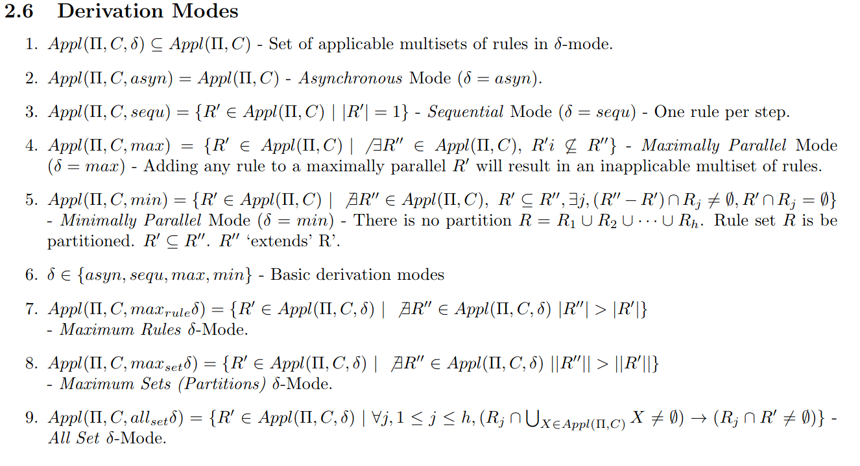
Formal Framework 2 – Derivation Mode

Slide 41
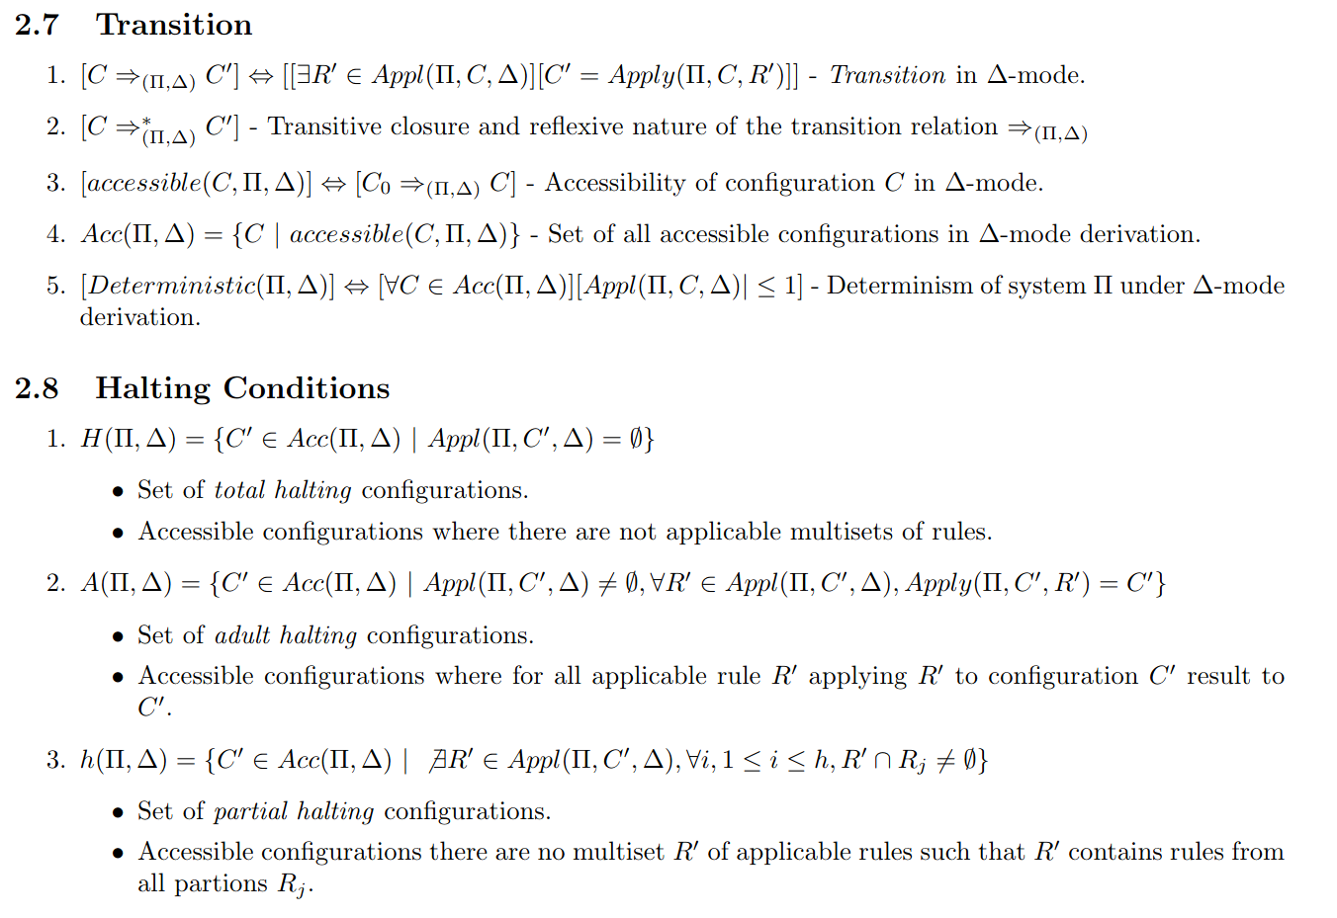
Formal Framework 2 – Transition & Halting Conditions

Slide 42
Preview of Formal Framework 2

Slide 43
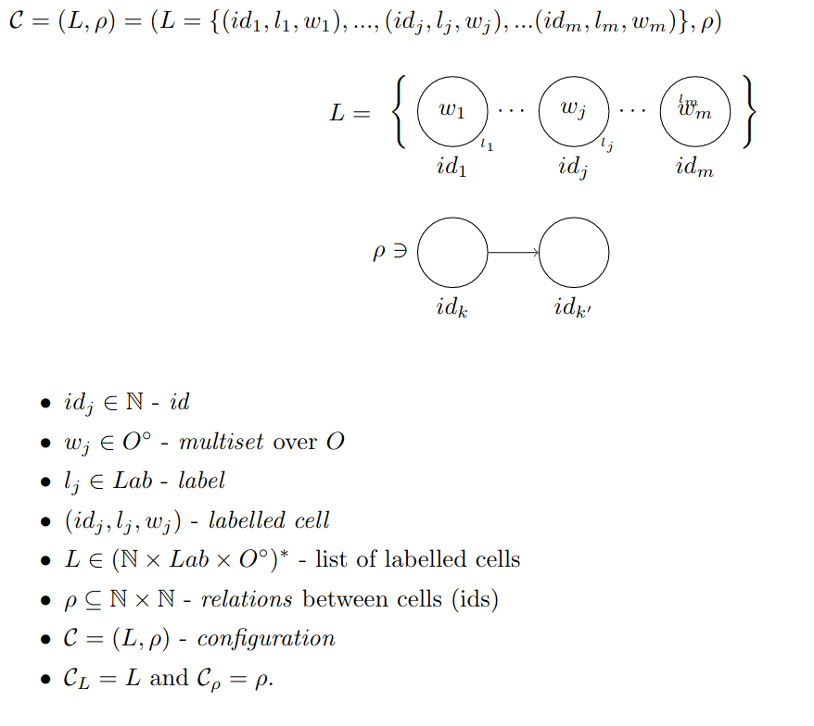
Preview: Formal Framework 2 - Configuration

Slide 44
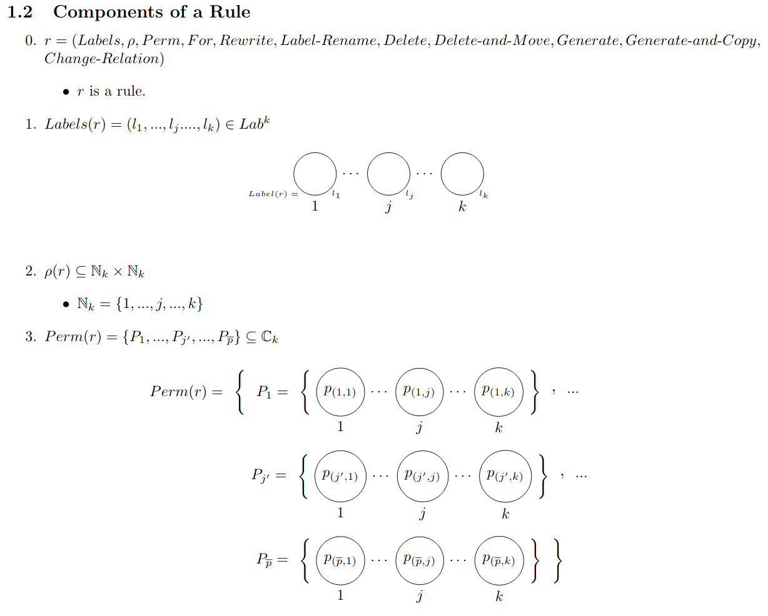
Preview: Formal Framework 2 - Rule

Slide 45
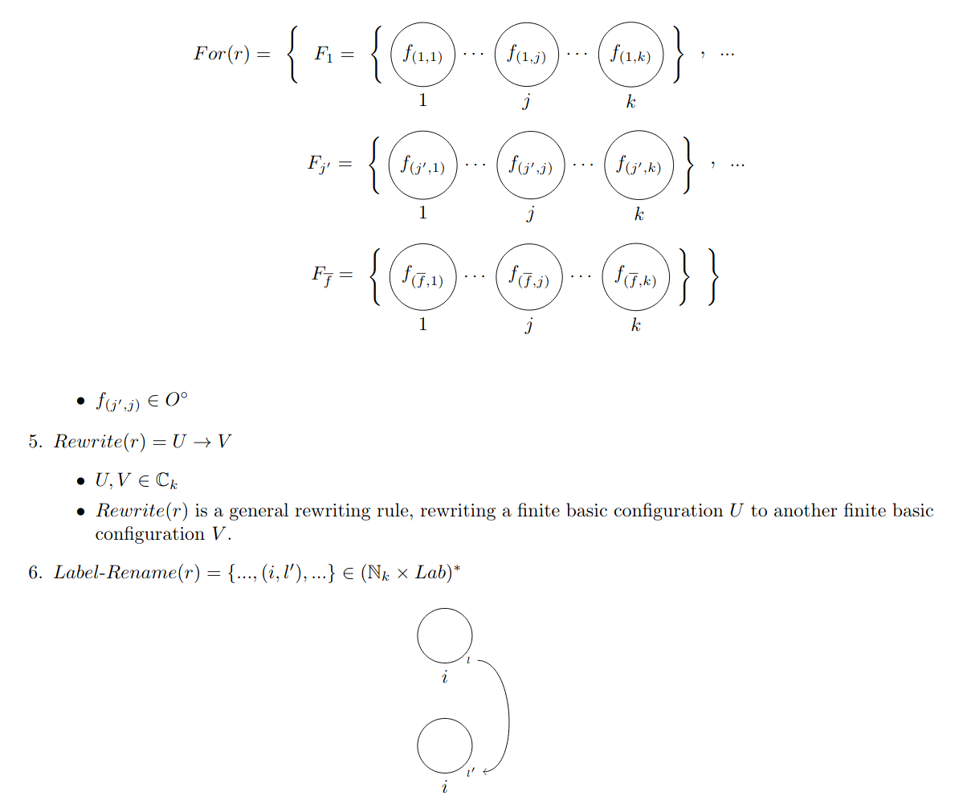
Preview: Formal Framework 2 - Rule

Slide 46
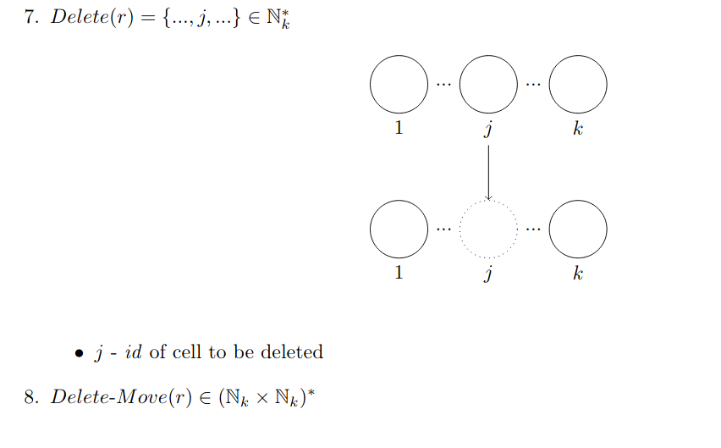
Preview: Formal Framework 2 - Rule

Slide 47
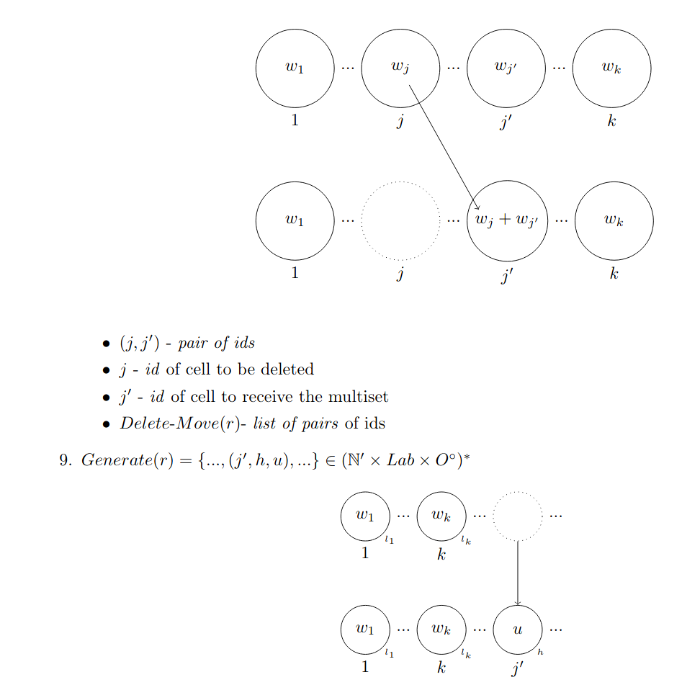
Preview: Formal Framework 2 - Rule

Slide 48
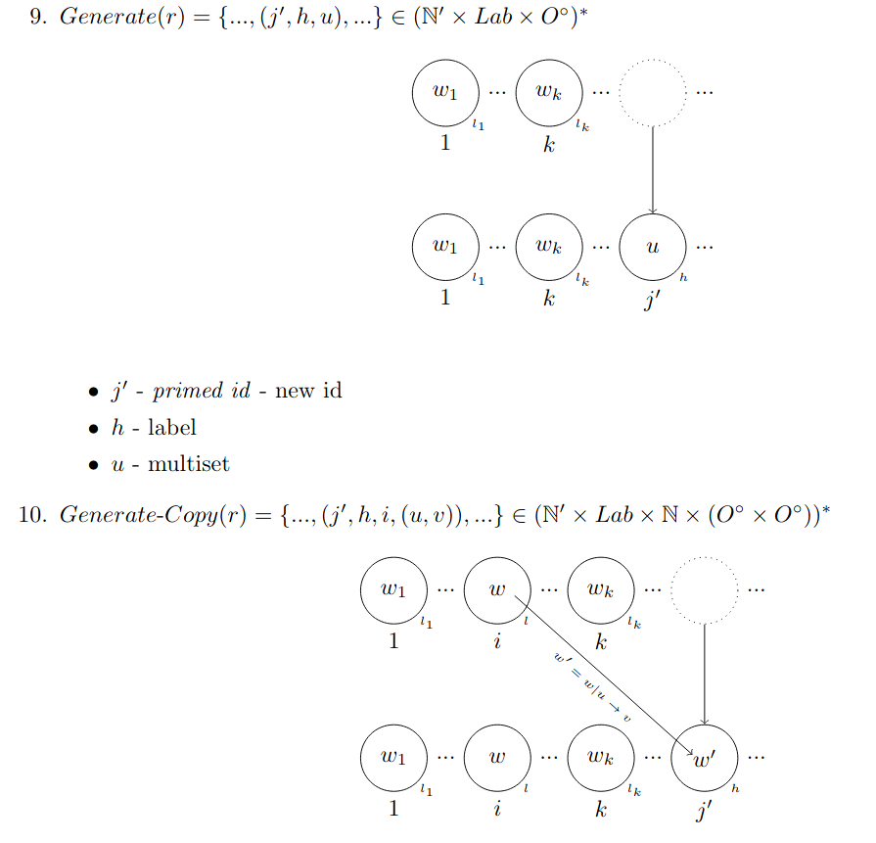
Preview: Formal Framework 2 - Rule

Slide 49
Preview of Formal Framework 3

Slide 50
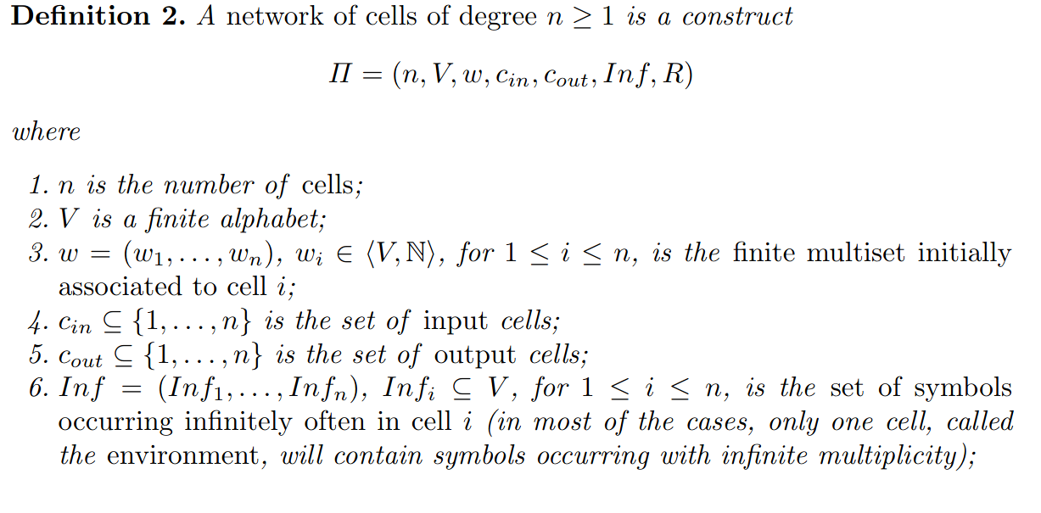
Preview: Formal Framework 3 – Network of Cells

Slide 51
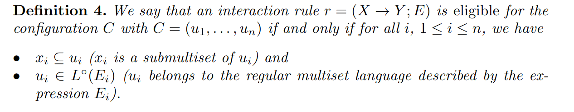
Preview: Formal Framework 3 – Interactive Rules

Slide 52
Formal Framework - Research Approaches
FF→P: Help answer open problems
Possible P Systems
Formal
Framework
Existing P
P Systems
P->FF: Improve the framework
P->FF: Improve the framework

Slide 53
Formal Framework – Research Ideas
1. Merge the dynamic formal framework with the SNP formal framework . (FF)
2. Conjecture: Many SNP system variants are ‘equivalent’. Use formal framework to check if this is true. (FF→ P).
3. Extentend the formal framework to handle self-modifying P systems. (P→FF).
4. Check if “all” P systems if they can be represented using formal framework. Extend the framework if needed. (P→ FF)
5. Reformulate rule representation as bottom-up instead of top down. (FF)

