Slide 1
Using the Formal Framework for P Systems
Sergey Verlan
University of Paris EsT

Slide 2
What is the formal framework (quiz)?
Is this a definition/model for P systems?
No. The formal framework is a concrete variant/series of P systems. Sometimes it is called the network of cells.
Does it define the semantics of P systems?
No. At least not directly.
What is it for?
We can encode most of variants of P systems in the formal framework yielding a bisimulation. Moreover, in most cases it is a strong bisimulation i.e. 1 step in the original system is done by 1 step in the formal framework.
How this can be done?
The form of the configuration and of rules are close to the multiset rewriting and generalizes most common configurations changes in P systems.
Is this approach new?
No, a similar approach is used when translating to multiset rewriting.
Why it is called formal framework?
In most of the cases the simulated P system is a restriction of the formal framework.
Many generic notions expressed in FF can be incorporated/interpreted in the original system due to bisimulation.
Notes:
Speak about NC when working with a concrete case (basically rules & config). FF in a more general setup – it has more variants.

Slide 3
What the formal framework can be used for?
Understand the functioning of some variant of P systems.
Compare variants of P systems.
Explain points that can have different interpretations.
Extend variants of P systems with new features.
There is a list of features defined for the formal framework and due to the bisimulation they can be interpreted directly in the corresponding P system, e.g. derivation modes.

Slide 4
A definition of a P system Π
The configuration.
The initial configuration.
The set of rules.
The following functions:
Applicable(Π,C,δ) the set of multisets of rules of Π applicable in the configuration C, according to the derivation mode δ.
Apply(Π,C,R) the configuration obtained by the (parallel) application of the multiset of rules R to the configuration C.
Halt(Π,C,δ) a predicate that yields true if C is a halting configuration of Π evolving in the derivation mode δ.
Result(Π,C) a function giving the result of the computation of , when the halting configuration C has been reached

Slide 5
Formal framework: the configuration
In the static case (FF1):
A vector of cells.
Each cell has an unique identifier id and contains a multiset of objects called contents, e.g. (1,abbc).
In the dynamic case (FF2):
A list of cells.
Each cell is a triple consisting of id, contents and label, e.g. (1,h,abbc).
The current structure is kept separately as a binary relation.
So the dynamic case is an extension of the static one and conversely, the static is a restriction of the dynamic one.
Cells can contain infinite multisets. However, it is possible to accommodate the definitions such that the configuration would keep only the finite part of the cell.

Slide 6
Formal framework: rules (static case)
XY;[P];[Q]
X,Y – vectors of multisets
P,Q – finite sets of multisets (permitting and forbidding contexts)
another notation:
(1,x₁)…(n,x_{n}) (1,y₁)…(n,y_{n}); [{(1,p₁)…(n,p_{n})}, …]; [{(1,f₁)…(n,f_{n})}, ...]
Semantics: rewrite X by Y if all elements of P and none of Q are present.

Slide 7
Example
(a,c,λ,λ,λ)  (c,λ,λ,a,b,λ); [{(b,λ,λ,λ,λ)}]; [{(λ,λ,d,λ,λ)}]
(1,a)(2,c)  (1,c)(4,a)(5,b); [{(1,b)}]; [{(3,d)}]
b
b
a
1
4
c
2
5
a
3

Slide 8
Formal framework: semantics
Applicable(Π,C,δ)
An algorithm is used to compute Applicable(Π,C,asyn), which is then (set-)restricted according to δ.
Examples of δ: max, seq, min, min_{k},… (more than 10 modes)
Apply(Π,C,R)
The application is performed using an algorithm. In the dynamic case there are several variants.
Halt(Π,C,δ)
Generic. Several examples include total halting (no rule is applicable), signal halting (the configuration has some properties) and adult halting (no changes in the configuration occur).
Result(Π,C)
Generic. Generally is the contents of some cell.
Notes:
Modes and modifiers

Slide 9
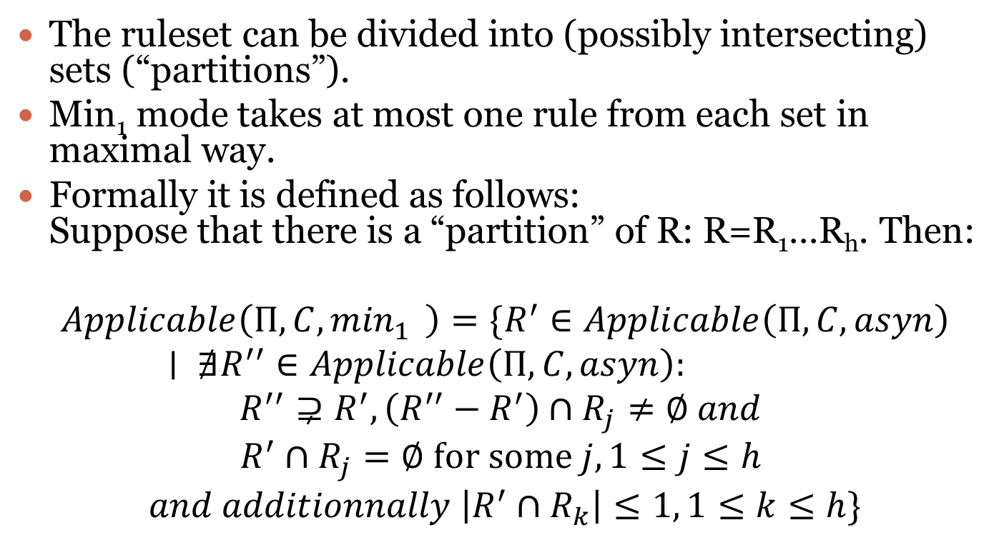
Min₁ mode
The ruleset can be divided into (possibly intersecting) sets (“partitions”).
Min₁ mode takes at most one rule from each set in maximal way.
Formally it is defined as follows: Suppose that there is a “partition” of R: R=R₁…R_{h}. Then:
$$Applicable\left(Π,C,\min_{1}{ }\right)=\{R^{′}∈Applicable\left(Π,C,asyn\right)∣ ∄R^{′′}∈Applicable\left(Π,C,asyn\right):$$
$$R^{′′}⊋R^{′}, \left(R^{′′}−R^{′}\right)∩R_{j}≠∅ and$$
$$R^{′}∩R_{j}=∅ \text{for} \text{some} j, 1≤j≤h$$
$$and additionnally \left|R^{′}∩R_{k}\right|≤1, 1≤k≤h\}$$

Slide 10
Min₁ mode

Slide 11
Msmin₁ mode
The partitions are of 2 types: 1-partitions and *-partitions.
In msmin₁ mode at most one rule is taken from each partition, in maximal way.
For 1-partitions the rule is considered in the multiset manner and for *-partitions the rule is considered in the set manner (if taken shall be used in an arbitrary but maximal number of times).

Slide 12
Formal framework vs multiset rewriting
Any variant of static P systems can be seen as multiset rewriting: an object x in membrane i corresponds to a symbol x_{i} and each rule moving or rewriting x in membrane i, can be rewritten as corresponding multiset rewriting involving x_{i}.
Example:
bc
b₁c₁a₃
a₃b₁->a₁b₃
1
a
2
3
(a,out;b,in)

Slide 13
Formal framework vs multiset rewriting
However, considering a P system like a multiset rewriting loses the important structural information.
Example: try to figure out what happens in this system: a₁b₂→a₂b₁, a₁c₂→a₂c₁, a₂c₃→a₃c₂, a₂b₃→a₃b₂, a₃c₁→a₁c₃, a₃b₁→a₁b₃
The formal framework groups the information in cells/membranes, does a group rewriting and represents the structure of the P system separately.
So it is extremely close to the multiset rewriting, it just reorders objects and rules.
This permits to keep the information about the static structure: rules induce a hypergraph. The communication graph can be deduced from this hypergraph.

Slide 14
Example
(1,a)(2,b)→(2,a)(1,b)
(1,a)(2,c)→(2,a)(1,c)
(2,a)(3,c)→(3,a)(2,c)
(2,a)(3,b)→(3,a)(2,b)
(3,a)(1,c)→(1,a)(3,c)
(3,a)(1,b)→(1,a)(3,b)
c
a
b
a
a
a
2
c
a
b
b
a
b
b
a
1
3
c
a
a₁b₂→a₂b₁, a₁c₂→a₂c₁, a₂c₃→a₃c₂,
a₂b₃→a₃b₂, a₃c₁→a₁c₃, a₃b₁→a₁b₃

Slide 15
Formal framework vs multiset rewriting
Similar approach is used in Petri Nets:
a
b
c
2
aabc→cde
d
e

Slide 16
Implementing different features
We present how to implement in FF the following features:
Membrane thickness.
Membrane polarization/labels.
Rule priorities.
Dissolution.
Flattening.
New derivation modes.

Slide 17
Membrane thickness/polarization/label
The above notions all relate to the property of a membrane to be in some finite state. So a special object related to this state ( and present in the membrane) can represent it. All rules involving the membrane will additionally have a permitting context (promoter) containing the corresponding state object.
In the latest version of the FF (FF2), the membrane state is an explicit part of the configuration, so no special object is needed.

Slide 18
Rule priorities
Priorities: a strict partial order relation P between rules. (r₁,r₂)∈P (or r₁>r₂) means that r₁ has a higher priority than r₂.
Usage: in the multiset of rules if a rule with higher priority is applicable, then no rule of a lower priority can be taken.
Can be translated to FF:
Using forbidding conditions if the priority is strong: r₁>r₂ corresponds indeed to two rules: r₁ and r₂ enriched with the forbidding sets of all rules r > r₂.
In the weak variant using a special derivation mode that keeps track of the ordering.
Notes:
Have a discussion about priority: applicability of one rule cannot be used for non-max modes, so define it for a group of rules
Rudi: FF for reg rewriting

Slide 19
Rule priorities: examples
aabbc
1: ab→cd
<
3: bc→aa
2: ac→bd
11
12
weak
13
3
2
strong

Slide 20
Dissolution of membranes
If only dissolution is used (no creation/division of membranes) then it is obvious that such a system has a finite number of possible membrane structures. By assigning a number to each of these structures and by using a permitting (or forbidding) context and subset construction, it is possible to mimic the effect of the dissolution.
Example:

Slide 21
Dissolution: General algorithm
s₀s₁s₂
c
a
a→aa
a
ac→λ
s₀s₁s₂
0
1
2
a→bδ
2
(2,a)→(2,aa);[{(0,s₂)}]
s₀s₁
(0,s₂)(2,a) →(0,b)
da→#
bc→#
#→#
(1,c)→(1,cc);[{(0,s₁)}]
s₀s₂
(0,s₁)(1,c) →(0,d)
c→cc
c
(0,ac) →λ;[{(0,s₀)}]
(0,a)(1,c) →λ;[{(0,s₀)}];[{(0,s₂)}]
(0,c)(2,a) →λ;[{(0,s₀)}];[{(0,s₁)}]
(1,c)(2,a) →λ;[{(0,s₀)}];[{(0,s₁)(0,s₂)}]
c→dδ
s₀
1
(0,da) →(0,#);[(0,s₀)]
…
(0,bc) →(0,#);[(0,s₀)]
…
(0,#) →(0,#);[(0,s₀)]
…
0

Slide 22
Dissolution: special cases
s₁
c
a
a→aa
a
s₁
0
1
2
ac→λ
a→bδ
2
(2,a)→(2,aa);[{(0,s₁)}]
(2,a)→(2,aa);[{(0,s₃)}]
s₂
da→#
bc→#
#→#
(0,s₁)(2,a) →(0,bs₂)
s₃
(0,s₃)(2,a) →(0,bs₄)
c→cc
c
(1,c)→(1,cc);[{(0,s₁)}]
(1,c)→(1,cc);[{(0,s₂)}]
c→dδ
s₄
1
(0,s₁)(1,c) →(0,ds₃)
(0,s₂)(1,c) →(0,ds₄)
0
(0,s₁)(1,c)(2,a) →(0,bds₄)
(0,a)(1,c) → λ[{(0,s₃)}]
…
Notes:
New variant?: dissolving 2, but cannot dissolve 1 because the object s1 is already used
Special cases 100% working when state change is linear: cannot delete more than one node in a step
A dissolution rule is indeed a cooperative rule
3rd variant – wo state cooperation, but in several steps

Slide 23
Flattening P systems
Flattening a P system means reducing it to one membrane (still remaining in the same model?).
Because of the 1-to-1 relation with multiset rewriting it is obvious that the flattening is trivial – it just corresponds to the multiset rewriting.
If the dissolution is present the rules have to additionally use a permitting (or a set of forbidding) context(s) in order to represent the current membrane structure.
Notes:
Really trivial?

Slide 24
Several levels transition modes
There are interesting modes that operate on two levels:
Micro steps: transition done in some basic mode.
Macro steps: micro-steps done in some basic mode. (sequence, matrix, t)
In a general way: (r* & r,(r^{T} & r²)^{T})*

Slide 25
New derivation modes
In order to define a new derivation mode it is sufficient to provide a set restriction for asyn mode. Then, because of the bisimulation, the definition can be immediately interpreted in the corresponding P system.
Example:
symport/antiport with a mode that ensures that a cell (not the membrane) is used sequentially, only in a single operation.
Solution: partition rules such that a rule involving cell i, will be a part of partition i. Hence, each rule will be in two partitions.
Then apply min₁ mode with the obtained partitions.
Use at most one rule from each partition in maximal (non-extendable) mode.

Slide 26
Applications
We consider 5 examples of the application of the FF:
Pure catalytic (compare)
Symport/antiport (extend)
P colonies (understand)
Probabilistic P systems (extend)
Active membranes (explain)
Notes:
Understand the functioning of some variant of P systems.
Compare variants of P systems.
Explain points that can have different interpretations.
Extend variants of P systems with new features.

Slide 27
Compare

Slide 28
Catalytic P systems
abc
aac
c
a
b→aa
a
0
1
2
3
4
a→bc
3
aac
c
4
2
ca→cb_{in}d_{in4}b_{out}e_{out}e_{here}
(1,ca)→(0,be)(1,ce)(4,bd)
(1,ca)→(0,be)(1,ce)(3,b)(4,d)
1
abc
(0,cb)→(0,c)(2,a)
cb→ca_{in2}
(3,a)→(3,bc)
Use at most one rule from each partition in maximal (non-extendable) set or multiset mode.
0
(3,b)→(3,aa)
¹P1:
(1,a)→(0,be)(1,e)(4,bd)
(1,a)→(0,be)(1,e)(3,b)(4,d)
*P3:
(3,a)→(3,bc)
msmin₁
_{or mixed}
¹P2:
(0,b)→(0,c)(2,a)
*P4:
(3,b)→(3,aa)
Notes:
Tree structure, maximal parallelism, total halting, the result is the number of objects in the skin/output membrane modulo the number of catalysts.
Hypergraph structure…

Slide 29
Catalytic P systems: remarks
So catalytic P systems evolving in max || mode are equal to context-free transitional P systems working in msmin₁ mode, where the 1-“partitions” correspond to catalysts and *-“partitions” to each context-free rule.
It can be also considered as a mixed mode: min₁ for partitions and max for a special group of rules.
Pure catalytic P systems have the number of (1-)partitions equal to the number of catalysts and no *-partitions (so pure min₁).
Clearly pure catalytic are weaker, so context-free rules add more complexity.
Notes:
Note about converse.

Slide 30
Extend

Slide 31
Symport/antiport
aab
aab
bba
c
dbaa
X
1
2
3
4
5
1
bba
c
2
3
(bb,in)
(c,out;ab,in)
dbaa
(1,ab) (3,c)->(1,c)(3,ab)
(4,a)->(2,a)
(2,bb)->(4,bb)
(2,bb)->(5,bb)
4
5
(a,out)
Notes:
In tissue case rules are associated to the edges. Clearly this can be done in P case. Clearly NC represents this.

Slide 32
Symport/antiport: extending
Membrane permeability: a symport rule can modify the membane permeability (with δ,τ). If the membrane is in state 2, then no antiport rule involving this membrane can be used. Only one permeability changing rule per membrane is allowed.
Maximal objects: at each step if there are several maximally parallel evolutions choose the one having the maximal number of objects involved.
Dissolution: Symport/antiport rules can dissolve the corresponding membrane.

Slide 33
Symport/antiport: solution
For each membrane i consider an object in cell i taken from the triple (D_{i},N_{i},C_{i}) indicating the state of the membrane (dissolved, normal, closed).
Each symport rule having δ,τ will modify this object (going to the left or right in the above sequence) and each antiport rule will check the permitting context if it is in state N. Exemple: i: (ab,out);τ will correspond to: (i,abN)->(i,C)(j,ab) and (i,abC)->(i,C)(j,ab)
The dissolution is handled by subset construction using the general algorithm.
The derivation mode is max_{obj}msmin₁, where the partitions of msmin₁ are the following:
All rules changing the state of the membrane i go to the same 1-partition
Each rule that does not change the state of a membrane forms a *-partition.

Slide 34
Understand

Slide 35
P colonies
a→b a⬄b
r₁/r₂
n agents (cells).
Each agent contains k symbols.
The environment contains e∝.
Rules are either point mutations, or exchange with environment, or a priority.
A program is a group of k rules.
Each agent i has m_{i} programs.
Mode:
Maximal parallelism
Sequential
Result: number of symbols f in the environment.
e∝
a₁…a_{k}
p₁…p_{mi}

Slide 36
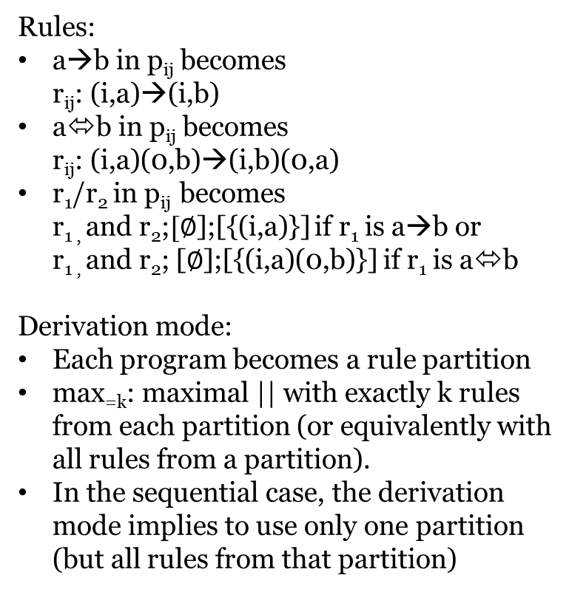
P colonies: transforming to FF (1)
Rules:
a→b in p_{ij} becomes r_{ij}: (i,a)→(i,b)
a⬄b in p_{ij} becomes r_{ij}: (i,a)(0,b)→(i,b)(0,a)
r₁/r₂ in p_{ij} becomes r_{1 ,} and r₂;$[∅$];[{(i,a)}] if r₁ is a→b or r_{1 ,} and r₂; [$∅$];[{(i,a)(0,b)}] if r₁ is a⬄b
Derivation mode:
Each program becomes a rule partition
max_{=k}: maximal || with exactly k rules from each partition (or equivalently with all rules from a partition).
In the sequential case, the derivation mode implies to use only one partition (but all rules from that partition)
1
0
3
2
Notes:
Priority: check: c1: a<->b/a->b, c2: x<->b then either a<->b or a->b & x<->b
Definition: r1/r2: if the rule r1 can be applied then it must be applied; if not, then rule r2 must be performed. Problem as (1) r2 might not be applicable, (2) looks like a weak priority (3) what to do if r1 applicable, but blocked by another /r rule ?

Slide 37
Example
r₁₁₁: (1,a)→(1,b)
r₁₁₂: (1,a)(0,e)→(1,e)(0,a)
aa
p₁₁: a→b, a⬄e
p₁₂: a→c, a⬄e
p₁₃: b→a, e→a
r₁₂₁: (1,a)→(1,c)
r₁₂₂: (1,a)(0,e)→(1,e)(0,a)
e∝
1
r₁₃₁: (1,b)→(1,a)
r₁₃₂: (1,e)→(1,a)
aa
1
p₃₁:e⬄a, e⬄b
p₃₂:b→f, a→b
p₃₃:f⬄a, b→b ee
ee
p₂₁:b⬄e, e→b
be
3
r₂₁₁: (2,b)(0,e)→(2,e)(0,b)
r₂₁₂: (2,e)→(2,b)
0
3
r₃₁₁: (3,e)(0,a)→(3,a)(0,e)
r₃₁₂: (3,e)(0,b)→(3,b)(0,e)
be
2
r₃₂₁: (3,b)→(3,f)
r₃₂₂: (3,a)→(3,b)
2
r₃₃₁: (3,f)(0,a)→(3,a)(0,f)
r₃₃₂: (3,b)→(3,b)

Slide 38
Going further
Derivation mode: group rules (corresponding to programs), maximal parallelism, but all rules from a group shall be used.
Since working with one symbol, the group r₁₁₁: (1,a)→(1,b) r₁₁₂: (1,a)(0,e)→(1,e)(0,a) is equivalent to r₁₁: (1,aa)(0,e)→(1,be)(0,a)
So a program corresponds to a more complicated rule, and k is the size of the LHS (equal to RHS).
Then the evolution is just maximally parallel.

Slide 39
Back to the example
r₁₁: (1,aa) (0,e)→(1,be)(0,a)
aa
r₁₂: (1,aa)(0,e)→(1,ce)(0,a)
r₁₃: (1,be)→(1,aa)
1
ee
0
3
r₂₁: (2,be)(0,e)→(2,be)(0,b)
r₃₁: (3,ee)(0,ab)→(3,ab)(0,ee)
be
r₃₂: (3,ab)→(3,fb)
r₃₃: (3,bf)(0,a)→(3,ab)(0,f)
2

Slide 40
Going even further
Since the number of combinations of objects in an agent is finite, it can be represented by a single symbol, the state. Symbol e can be ignored.
r₁₁: (1,s1) →(1,s2)(0,a)
s1
r₁₂: (1,s1)→(1,s3)(0,a)
r₁₃: (1,s2)→(1,s1)
1
So we get cooperative rewriting with size at most k+1 and forbidding conditions
s4
s1: aa
s2: be
s3: ce
s4: ee
s5: ab
s6: bf
0
3
r₂₁: (2,s2)→(2,s2)(0,b)
r₃₁: (3,s4)(0,ab)→(3,s5)
s2
r₃₂: (3,s5)→(3,s6)
r₃₃: (3,s6)(0,a)→(3,s5)(0,f)
2
Notes:
Can also be considered as a n-state catalytic P system or as a special variant of active membranes []h u -> []h’ v

Slide 41
Going even further (2)
In order to highlight the original semantics, we can use catalysts:
A rule r₁₁: (1,s1) →(1,s2)(0,a) becomes c₁s₁ →c₁s₂a
So, a restricted variant of the model corresponds to a specific pure catalytic P system.

Slide 42
Transposing results
From the results on P colonies we get:
Pure catalytic with 1 catalyst and size=2 not RE.
Pure catalytic with size 1, unbounded catalysts & max 6 rules per catalyst = RE.
From the results on catalytic P systems we get:
NPCol_{par}(3,3,*)=RE (Size: 3, 3 agents, nb of progr.: *)
Other results:
NPCol(*,1,*) not RE (because it is pure sequential multiset rewriting)

Slide 43
Extending the base model with probabilities

Slide 44
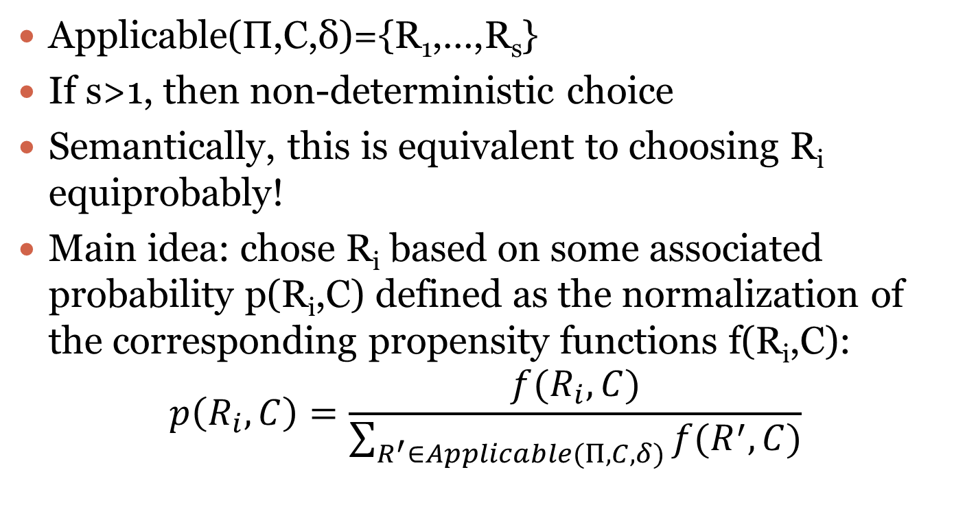
Extending with probabilities
Applicable(Π,C,δ)={R₁,…,R_{s}}
If s>1, then non-deterministic choice
Semantically, this is equivalent to choosing R_{i} equiprobably!
Main idea: chose R_{i} based on some associated probability p(R_{i},C) defined as the normalization of the corresponding propensity functions f(R_{i},C):
$$p\left(R_{i},C\right)=\frac{f(R_{i},C)}{\sum_{R^{′}∈Applicable(Π, C, δ)}{f(R^{′},C)}}$$

Slide 45
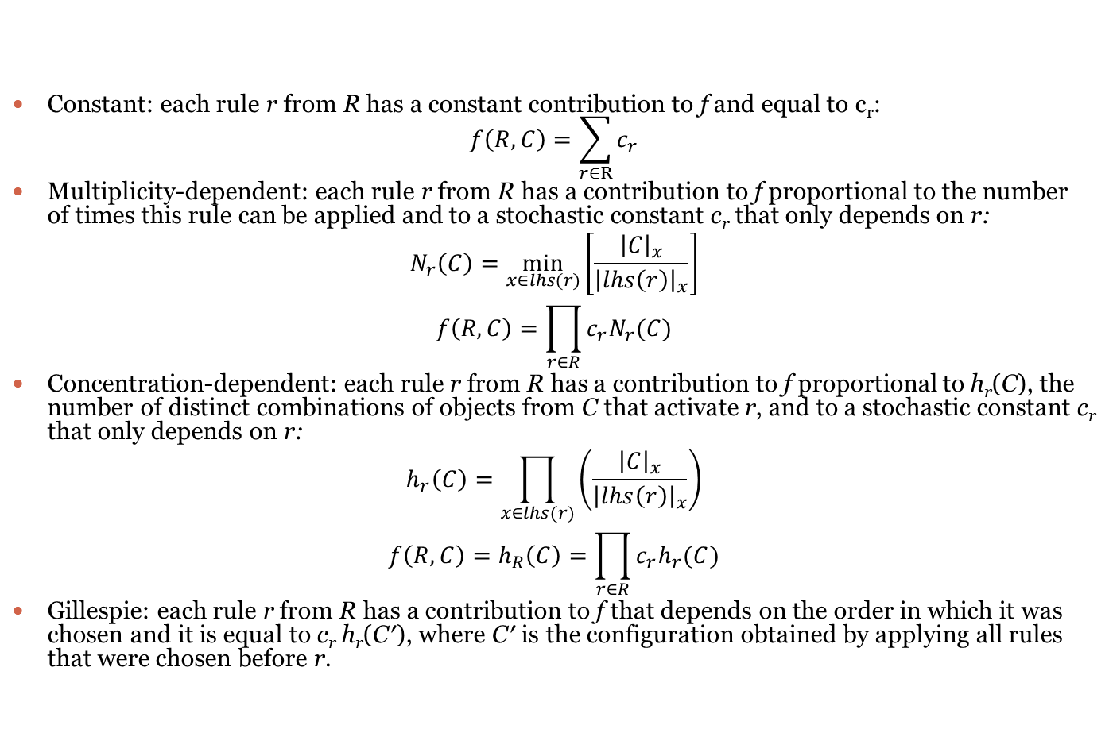
Strategies for computing f(R,C)
Constant: each rule r from R has a constant contribution to f and equal to c_{r}: $f\left(R,C\right)=\sum_{r∈R}{c_{r}}$
Multiplicity-dependent: each rule r from R has a contribution to f proportional to the number of times this rule can be applied and to a stochastic constant c_{r} that only depends on r:
$$N_{r}\left(C\right)=\min_{x∈lhs(r)}\left[\frac{{\left|C\right|}_{x}}{{\left|lhs\left(r\right)\right|}_{x}}\right]$$
$$f\left(R,C\right)=\prod_{r∈R}{c_{r}N_{r}(C)}$$
Concentration-dependent: each rule r from R has a contribution to f proportional to h_{r}(C), the number of distinct combinations of objects from C that activate r, and to a stochastic constant c_{r} that only depends on r:
$$h_{r}\left(C\right)=\prod_{x∈lhs(r)}{\left(\frac{{\left|C\right|}_{x}}{{\left|lhs\left(r\right)\right|}_{x}}\right)}$$
$$f\left(R,C\right)=h_{R}\left(C\right)=\prod_{r∈R}{c_{r}h_{r}(C)}$$
Gillespie: each rule r from R has a contribution to f that depends on the order in which it was chosen and it is equal to c_{r} h_{r}(C′), where C′ is the configuration obtained by applying all rules that were chosen before r.

Slide 46
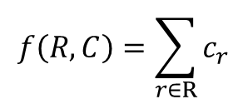
Strategies for computing f(R,C): constant
Each rule r from R has a constant contribution to f and equal to c_{r}
R=
n₁
n₂
n_{k}
r₁
r₂
…
r_{k}
c₁
c₂
c_{k}
$$f\left(R,C\right)=\sum_{r∈R}{c_{r}}$$

Slide 47
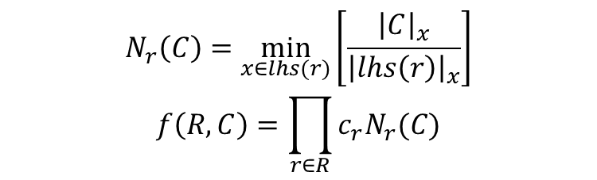
Strategies for computing f(R,C): multiplicity-dependent
Each rule r from R has a contribution to f proportional to the
number of times this rule can be applied and to a stochastic
constant c_{r} that only depends on r:
R=
n₁
n₂
n_{k}
r₁
r₂
…
r_{k}
c₁
c₂
c_{k}
$$N_{r}\left(C\right)=\min_{x∈lhs(r)}\left[\frac{{\left|C\right|}_{x}}{{\left|lhs\left(r\right)\right|}_{x}}\right]$$
$$f\left(R,C\right)=\prod_{r∈R}{c_{r}N_{r}(C)}$$

Slide 48
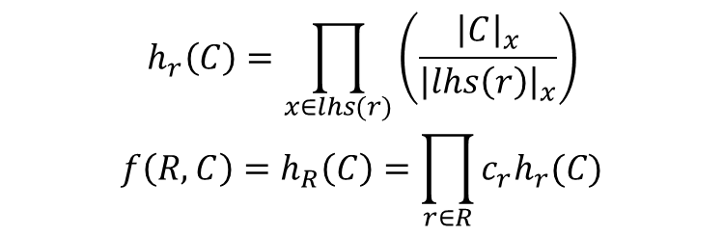
Strategies for computing f(R,C): concentration-dependent
Each rule r from R has a contribution to f proportional to h_{r}(C),
the number of distinct combinations of objects from C that activate r,
and to a stochastic constant c_{r} that only depends on r:
R=
n₁
n₂
n_{k}
r₁
r₂
…
r_{k}
aab activates 2 times for ab
h₁(C)
h₂(C)
h_{k}(C)
c₁
c₂
c_{k}
$$h_{r}\left(C\right)=\prod_{x∈lhs(r)}{\left(\frac{{\left|C\right|}_{x}}{{\left|lhs\left(r\right)\right|}_{x}}\right)}$$
$$f\left(R,C\right)=h_{R}\left(C\right)=\prod_{r∈R}{c_{r}h_{r}(C)}$$

Slide 49
Strategies for computing f(R,C): Gillespie
Each rule r from R has a contribution to f that depends on the order
in which it was chosen and it is equal to c_{r} h_{r}(C′), where C′ is
the configuration obtained by applying all rules that were chosen before r:
R=
n₁
n₂
n_{k}
r₁
r₂
…
r_{k}
h₁(C)
h₂(C₁)
h_{k}(C₂)
c₁
c₂
c_{k}
A notion of time can be considered.

Slide 50
Probabilities and the derivation mode
The derivation mode is independent from the probability!
Applicable(Π,C,δ)={R₁,…,R_{s}}
Traditionally δ=seq (sequential), i.e. 1 rule is applied at a time.
When δ=max, DPP systems are obtained (with concentration-dependent strategy)
Chose rules according to the concentration-dependent probability until the maximality is reached
Probabilistic Functional Extended P Systems : multiplicity-dependent strategy for a maximally parallel derivation mode
What about other derivation modes ? E.g. Gillespie with different δ: probably variants of tau-leaping and even multi-compartmental.
FF gives a way to generalize Gillespie to a group of rules.

Slide 51
P systems with dynamically evolving structure

Slide 52
P systems with dynamically evolving structure
The structure is explicit (a binary relation). We consider it as the parent or communication relation, but this can be e.g. the brother/sister relation.
The configuration is a list of cells (id, label, contents) and the current structure (relation).
Rules are expressed in terms of pattern-matching : so the applicability is done in two steps:
Find the matching structure
Verify the objects on the matched region.
Key point: the applicability is checked for a group of rules.

Slide 53
Matching the structure
h1
h2
h3
h1
h1
h3
h2
h3
h2
In the tissue case non-trees can be matched

Slide 54
Applicability/application stage 2
On the matched structures (for a group of rules):
Check preconditions (permitting/forbidding)
Apply rewriting
Create new membranes (eventually duplicating existing ones)
Delete membranes (eventually moving the contents)
The order is important: we assume RCD, but other orders are possible yielding different results.
Example: in RDC order deleted membranes cannot be copied to newly created ones.
In CDR order the newly duplicated membranes get the “old” contents, before rewriting.
Notes:
In RDC order it is not possible to copy deleted membranes
In CDR order the membranes get “old” contents, before rewriting

Slide 55
Application stage 3
Change the structure locally (on the matched part) or globally using a graph transducer:
In P case the transducer is trivial – insertion and deletion of edges
In tissue case can be more complex, e.g. simulate α- and β- reductions of the λ-calculus (like in Margenstern et al.)

Slide 56
Taxonomy
A rule has 11 components…
In most of the cases they are empty.
So we indicate which components are used:
R: rewriting
L: label change
C: membrane creation
D: membrane deletion
P: P systems case (the relation is a graph)
E.g. PCR rule

Slide 57
Examples
Rewriting: [a->b]_{h}
R rule: (h), RW: (1,a)->(1,b)
Communication: [a]_{h}->[]_{h1}b
PLR rule: LAB=(h,p), RW: (1,a)->(2,b), LC={(1,h1)}
Dissolution: [a]_{h}->b
PD rule: LAB=(h,p), RW: (1,a)->(1,b), DEL&MOV(1,2)

Slide 58
Examples
Membrane division: [a]_{h}->[b]_{h1}[c]_{h2}
PCD rule: LAB=(h,p), GEN&COPY(1’,h1,1,a->b), GEN&COPY(2’,h2,1,a->c), DEL(1), TRANS: INS-EDGE(1’,2), INS-EDGE(2’,2)
Membrane creation: [a->[u]_{h1} ]_{h2}
RC rule: LAB=(h2), REL=∅, RW: (1,a)->(1,λ), GEN(1’,h1,u), TRANS: INS-EDGE(1’,1)

Slide 59
Examples
Strong division:
[ [ ]_{h1} ... [ ]_{hk} [ ]_{hk+1} ... [ ]_{hn} ]_{h} → [ [ ]_{h1} ... [ ]_{hk} ]_{h} [ [ ]_{hk+1} ... [ ]_{hn} ]_{h}
C rule:
LAB=(h1,..,hn,h,p), REL=(i,n+1), 1<=i<=n, (h,p) GEN(1’,h,λ)
TRANS: INS-EDGE(1’,p), INS-EDGE(i,1’), DEL-EDGE(i,1) 1<=i<=k
p
h
h1
h2
…
hn

Slide 60
Examples
Super division: []_{h} -> [+]_{h1} [-]_{h2} [0]_{h3}
PCL rule:
LAB=(h,p), LC={(1,h1)}, GEN(1’,h2,λ), GEN(2’,h3,λ)
TRANS: INS-EDGE(1’,p), INS-EDGE(2’,p) INS-EDGE(i,1’), DEL-EDGE(i,1), for i: lab(i)=+ INS-EDGE(i,2’), DEL-EDGE(i,1), for i: lab(i)=0

Slide 61
Derivation modes
Based on Applicable it is possible to define derivation modes. However, additional possibilities related to instances of rules may be investigated.
Remarks:
The “maximally parallel” derivation mode for active membranes is not really maximally parallel.
More precisely it is min₁ for rules involving membranes and max otherwise, so it can be seen as msmin₁.
Similar to catalytic P systems, so interesting links can be done.
Membrane label induces cooperation (a promoter/permitting context).
In the min case for active membranes a combination of min₁ and min shall be used, but there remain questions:
“If at least a rule can be used, at least one rule must be used”? (prohibits competition).
Should the membrane and rewriting rules be separated? (2+ app.)
Notes:
Min1 ~ a kind of weak priority

Slide 62
Active membranes
The current definition of the derivation mode allows only one rule per membrane (except rewriting).
Why not allowing several communication or division rules to happen in parallel?
Using FF2 this can be done in a non-ambiguous way.
The algorithm specifies the way to apply the rules, which is a global application in RCD order. Other modes can exist (and that are not covered) like applying from inside-out.

Slide 63
Conclusion
FF is a useful tool to understand, review and extend others work.
It permits to ask, answer and raise questions related to the semantics of some model.
It allows to quickly enhance a model with a different derivation mode or halting condition.
Permits to relate (apparently) different models of P systems and also multiset-rewriting based models.

Slide 64
Discuss with Rudi
Group multiset rewriting
Communication graph/membrane structure.
Priorities (2 cases: forb & mode)
Dissolution: general & particular cases
Flattening – real definition & variants
Active membranes & derivation modes.
Notes:
Active 1. inner to out step by step, or first rw, then membrane
Active: weak priority on rules that involve membranes from 1 membrane (rel is r>r1 for all r,r1 even itself)

Slide 65
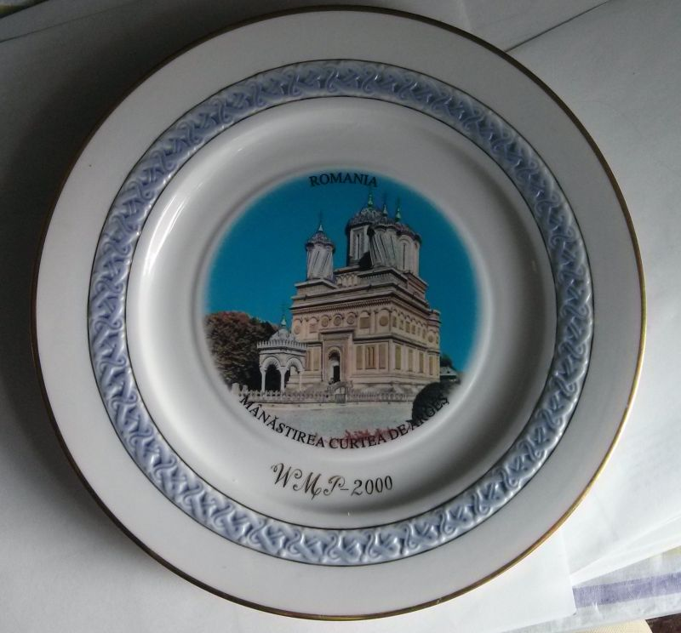
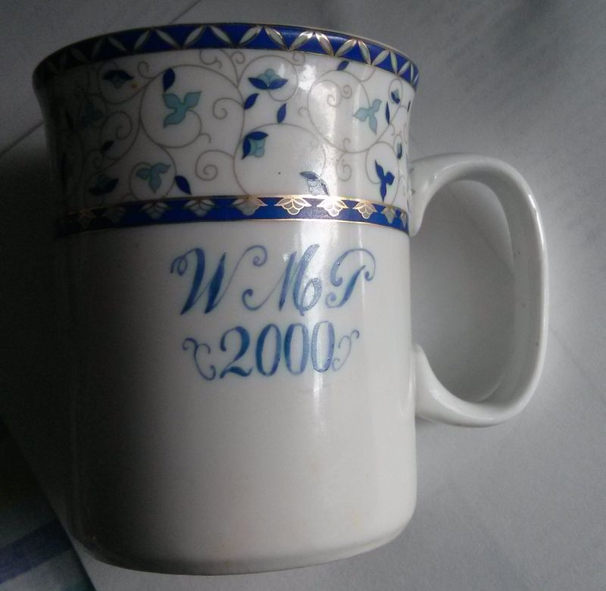
CMC14 – the story of membranes is not ended

