Slide 1

A formal framework for definition and analysis of P systems
Sergey Verlan
University of Paris EsT

Slide 2
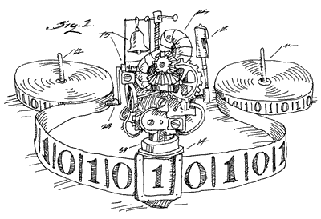
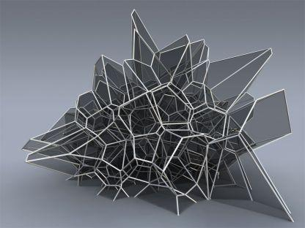
Models of Computing
Number-based models (manipulated objects have no structure).
Register machines, Petri nets, etc
String-based models (manipulated objects have a linear structure).
Automata, formal grammars, Turing machines, 1D-cellular automata, etc
Structure-based models (manipulated objects have an arbitrary structure).
Graph rewriting, tree automata
Generally, rewriting-based models

Slide 3
Multiset rewriting
While in the case of structured objects several encodings are possible, there is only one possibility for number-based models.
Hence, all of them are the same, the underlying operation makes only the difference for the descriptional complexity.
We will use the term multiset rewriting.

Slide 4
Models
Static P systems
Multiset rewriting
Petri nets
Vector addition systems
Register machines
Counter automata
Population protocols
Data structure: multiset
aab⁵c ( ≡ (2,5,1,0) )
Operation: (controlled, parallel) multiset rewriting with an eventual predicate check on the configuration.
u→v|_{¬q}
Basically inclusion, sum and difference of multisets.

Slide 5
Why use so many formalisms?
Multiset rewriting: chemical and biological modelling
Petri nets: modeling
Vector addition systems: decidability properties
P systems: spatial aspects, semantics, restrictions, computational completeness
Population protocols: distributed algorithms
Register machines: universality

Slide 6
Sequential rule application
a->bc
aab->ab
b->aa
starting multiset aabbc:
VAS:
(1,0,0,-1,-1, 0,0) (-1,0,0,1,0,1,1)
(0,1,0,-1,-2,-1,0) (0,-1,0,1, 1,1,0)
(0,0,1,-1, 0,-1,0) (0,0,-1,1, 2,0,0)
RM:
JZ A, :ZA
DEC A
INC B
INC C
PN:
a
a
b
b
a
b
b
c
c
a
a
b
b
c
c
a
2
a
a
a
b
a
b
c
b
Notes:
Rules a->bc & aab->ab & b->aa, starting word aabbc: aabbc => ab³cc or => abbc or => a⁴bc

Slide 7
Parallel rule application
Applying rules in parallel…
a->bc
aab->ab
b->aa
starting multiset aabbc:
a
a
a
a
b
b
c
c
c
r₁²r₃²
a
a
a
b
b
c
r₂r₃
aaabbcc
r₁r₃
aaaabc
r₃²
…
Notes:
1133 23

Slide 8
Derivation modes
The strategy of rule application is called a derivation mode (in PN terms it is step semantics).
In formal terms it is a set restriction of Applicable(Π,C), which is the set of multisets of applicable rules of system Π in configuration C.
Some common modes (r₁: a->bc, r₂: aab->ab, r₃: b->aa):
Asynchronous (no restriction)
r₁, r₂, r₃, r₁r₁, r₁r₃, r₂r₃, r₃r₃, r₁r₁r₃, r₁r₃r₃, r₁r₁r₃r₃
Sequential (consider only multisets of size one)
ab³c² (r₁), ab²c (r₂) and a⁴bc (r₃)
Maximally parallel (consider only non-extensible multisets = no rule is applicable anymore)
a⁴b²c³ (r₁r₁r₃r₃) and a³b²c (r₂r₃)
Parikh vectors of Lindenmayer systems.
Set-maximally parallel (maximally parallel, but at most one rule of each kind = no unused rule is applicable anymore)
a³b³c² (r₁r₃) and a³b²c (r₂r₃)

Slide 9
Examples of definition
$Applicable\left(Π,C,max\right)=\left\{R∈Applicable\left(Π,C\right)\right|$ $∄R′∈Applicable(Π,C) s.t. R⊊R′ \}$
r₁, r₂, r₃, r₁r₁, r₁r₃, r₂r₃, r₃r₃, r₁r₁r₃, r₁r₃r₃, r₁r₁r₃r₃
$Applicable\left(Π,C,smax\right)=\left\{R∈Applicable\left(Π,C\right)\right|$ $R=set\left(R\right) and ∄R^{′}∈Applicable\left(Π,C\right), R^{′}=set(R^{′}) s.t. R⊊R′ \}$
where set(R) is the operation that replaces by 1 any positive multiplicity of an element from R.

Slide 10
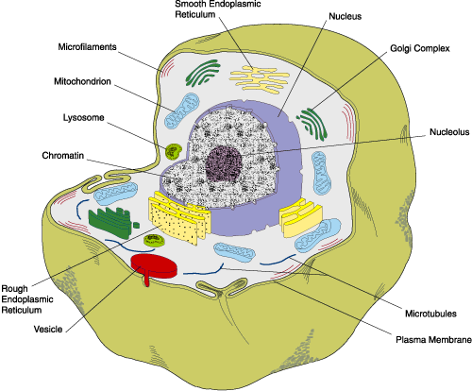
Structure (distributed rewriting)
Appeared due to the needs of biological modelling.
The chemical operations are spatially located.
Somehow it is a continuation of FLT research on distributed rewriting.
Membrane computing (P systems) explicitly concentrates on the structure (change) and distributed rewriting.
Notes:
Tree-like (graph-like) membrane structure.
Multisets of objects (corresponding to chemicals) in the regions (cells).
Multiset rewriting evolution rules (in or on membranes).
Distribution of the results among several nodes.
(Maximally) parallel non-deterministic evolution.
Global clock.
Result: contents of a membrane.

Slide 11
P systems vs Multiset rewriting
Every (static) P system is a multiset rewriting system!
The (flattening) transformation may be done by associating the membrane number to the objects and transforming rules accordingly.
a₁->a₂
a₁->a₃
a₂c₂->a₁C₁C₁
a₃b₃->a₁B₁B₁
a
b
b
b
c
c
c
c
ab->a_{out}B_{out}B_{out}
a->a_{in}
3
ac->a_{out}C_{out}C_{out}
2
a->a_{out}
1
Initially: a₁c₂c₂c₂c₂b₃b₃b₃

Slide 12
Why then use P systems?
As previously said any variant of static P systems can be seen as multiset rewriting.
However, considering a P system like a multiset rewriting loses the important structural information.
Example: try to figure out what happens in this system: a₁b₂→a₂b₁, a₁c₂→a₂c₁, a₂c₃→a₃c₂, a₂b₃→a₃b₂, a₃c₁→a₁c₃, a₃b₁→a₁b₃
Similar approach is used in Petri nets
a
b
c
2
aabc→cde
d
e

Slide 13
Example
(1,a)(2,b)→(2,a)(1,b)
(1,a)(2,c)→(2,a)(1,c)
(2,a)(3,c)→(3,a)(2,c)
(2,a)(3,b)→(3,a)(2,b)
(3,a)(1,c)→(1,a)(3,c)
(3,a)(1,b)→(1,a)(3,b)
c
a
b
a
b
a
2
c
a
b
a
b
a
1
3
c
a
a₁b₂→a₂b₁, a₁c₂→a₂c₁, a₂c₃→a₃c₂,
a₂b₃→a₃b₂, a₃c₁→a₁c₃, a₃b₁→a₁b₃

Slide 14
What is the formal framework (quiz)?
What is it?
It is a model of distributed multiset rewriting which cares about locations. The structure of the system is defined by the hypergraph induced by rules. This is the most general variant of distributed multiset rewriting (generalizing P systems, VAS, Petri nets, register machines, population protocols, etc).
Is this a definition/model for P systems?
No. The formal framework is a concrete variant/series of P systems. Sometimes it is called the network of cells.
Does it define the semantics of P systems?
No. At least not directly.
What is it for?
We can encode most of variants of P systems in the formal framework yielding a bisimulation. Moreover, in most cases it is a strong bisimulation i.e. 1 step in the original system is done by 1 step in the formal framework.
How this can be done?
The form of the configuration and of rules are close to the multiset rewriting and generalizes most common configurations changes in P systems.
Why it is called formal framework?
In most of the cases the simulated P system is a restriction of the formal framework.
Many generic notions expressed in FF can be incorporated/interpreted in the original system due to bisimulation.
Notes:
Speak about NC when working with a concrete case (basically rules & config). FF in a more general setup – it has more variants.

Slide 15
Milestones
2006-2007: Hypergraph structure (Generalized communicating P systems).
2007: Introduction of FF (with R. Freund) in order to correctly define the minimal parallelism.
By 2009: Systemized existing features in P systems and also proposed many new ideas.
2010: Parts of Handbook on MC are written using it.
2011-2013: Formalized the dynamical structure P systems (with R. Freund, I. Pérez-Hurtado and A. Riscos-Núñez).
2012: Introduced smax (flat mode).
2012: Used for the construction of fast hardware implementations.
By 2013: Considered probabilities, explained many variants of P systems, have shown links to other multiset-based models & PN, etc
2015: Generalization for abelian groups.
2016-2017: Several results on bi-simulations.

Slide 16

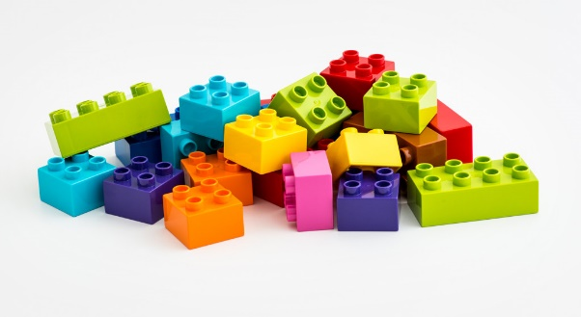


How to define a P system ?
Give the structure.
Explain what means a configuration and give the initial configuration.
Explain what means a rule and give the set of rules.
Explain how a transition step is performed:
Which rules can be applied.
Which rules are applied.
How the rules are applied.
Explain when to stop.
Explain what means the result of the computation.
We would like to have a framework for the definition in order not to repeat the same all the times
Main idea: generalize everything
Notes:
Of course this is for computational variants of P systems.

Slide 17
Formal framework: details
Configuration:
A vector of cells.
Each cell has an unique identifier id and contains a multiset of objects called contents, e.g. (1,abbc).
Cells can contain infinite multisets.
Rules:
XY;[P];[Q]
X,Y – vectors of multisets
P,Q – finite sets of multisets (permitting and forbidding contexts)
another notation:
(1,x₁)…(n,x_{n}) (1,y₁)…(n,y_{n}); [{(1,p₁)…(n,p_{n})}, …]; [{(1,f₁)…(n,f_{n})}, ...]
Semantics: rewrite X by Y if all elements of P and none of Q are present.
Structure
The hypergraph induced by the rules.
Here we present the static case.
A similar formalism exists for the case
of the dynamic structure

Slide 18
Example
(a,c,λ,λ,λ)  (c,λ,λ,a,b,λ); [{(b,λ,λ,λ,λ)}]; [{(λ,λ,d,λ,λ)}]
(1,a)(2,c)  (1,c)(4,a)(5,b); [{(1,b)}]; [{(3,d)}]
b
b
a
1
4
c
2
5
a
3
Notes:
Difference to PN: context conditions

Slide 19
Formal framework: semantics
Applicable(Π,C,δ)
The set of multisets of rules of Π applicable in the configuration C, according to the derivation mode δ.
Computed in 2 steps: an algorithm computes Applicable(Π,C,asyn), which is then (set-)restricted according to δ.
Examples of δ: max, seq, min, min_{k}, la, … (more than 10 modes)
Apply(Π,C,R)
The configuration obtained by the (parallel) application of the multiset of rules R to the configuration C.
The application is performed using an algorithm. In the dynamic case there are several variants.
Halt(Π,C,δ)
The predicate that yields true if C is a halting configuration of Π evolving in the derivation mode δ.
Generic. Several examples include total halting (no rule is applicable), signal halting (the configuration has some properties) and adult halting (no changes in the configuration occur).
Result(Π,C)
The function giving the result of the computation of Π, when the halting configuration C has been reached.
Generic. Generally is the contents of some cell. Other examples: terminal, finite ignoring.
Notes:
Modes and modifiers

Slide 20
Formal framework: usage
Understand the functioning of some variant of P systems.
Compare variants of P systems.
Explain points that can have different interpretations.
Extend variants of P systems with new features.
There is a list of features defined for the formal framework and due to the bisimulation they can be interpreted directly in the corresponding P system, e.g. derivation modes or halting conditions.
Notes:
Give examples orally:
Compare – diff models
Interpretations: min ||, dynamic, P systems not formal
Extension: easy to incorporate, e.g membrane dissolution

Slide 21
Understand

Slide 22
Example: Purely catalytical P systems
abc
aac
c
a
cb→caa
a
0
1
2
3
4
ca→cbb
3
aac
c
4
2
ca→cb_{in}d_{in4}b_{out}e_{out}e_{here}
(1,ca)→(0,be)(1,ce)(4,bd)
(1,ca)→(0,be)(1,ce)(3,b)(4,d)
1
abc
(0,cb)→(0,c)(2,a)
cb→ca_{in2}
(3,ca)→(3,cbb)
Use at most one rule from each membrane in maximal (non-extendable) set mode.
0
(3,cb)→(3,caa)
P1:
(1,a)→(0,be)(1,e)(4,bd)
(1,a)→(0,be)(1,e)(3,b)(4,d)
P3:
(3,a)→(3,bb)
min₁
(3,b)→(3,aa)
P2:
(0,b)→(2,a)
Notes:
Tree structure, maximal parallelism, total halting, the result is the number of objects in the skin/output membrane modulo the number of catalysts.
Hypergraph structure…

Slide 23



Evolutionary symport/antiport
Evolution:
a->u
$$\left(i,a\right)→(i,u)$$
Symport:
(i,x,j)
$$\left(i,x\right)→(j,x)$$
Antiport:
(i,x/y,j)
$$\left(i,u\right)(j,y)→(i,y)(j,x)$$

Slide 24

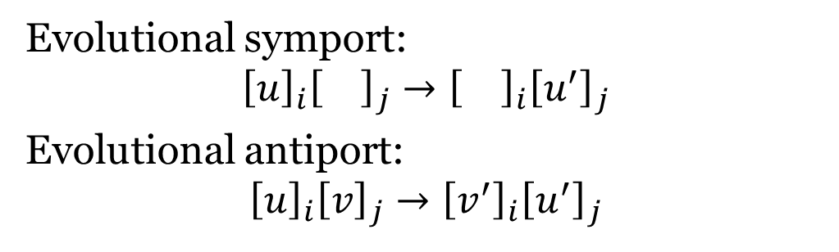

Evolutional symport/antiport
Evolutional symport:
$${\left[u\right]}_{i}{\left[\right]}_{j}→{\left[\right]}_{i}{\left[u^{′}\right]}_{j}$$
Evolutional antiport:
$${\left[u\right]}_{i}{\left[v\right]}_{j}→{\left[v^{′}\right]}_{i}{\left[u^{′}\right]}_{j}$$
$$\left(i,u\right)→(j,u^{′})$$
$$\left(i,u\right)(j,v)→(i,v^{′})(j,u^{′})$$
So:
$$\left(i,u\right)\left(j,v\right)→\left(i,u^{′}\right)\left(j,v^{′}\right), u∈V^{+}, v,u^{′},v′∈V^{∗}$$
Hence ordinary cooperative rewriting involving 2 cells

Slide 25
Example: population protocols
Model of sensor networks used to study the population dynamics in the context of distributed algorithmics
Agents with limited capabilities: pq->p’q’
Fairness condition: for all configurations C that appear infinitely often in the execution, if C is predecessor of a configuration C’, then C’ appears infinitely often in the execution.
The result: the consensus value of the configuration (after stabilization)
A predicate is computable by PP iff it is semilinear (= predicates on counts of input agents definable in 1st-order Presburger arithmetic).
C
C'

Slide 26
Translation to the formal framework
The structure is the same, so a rule pq->p’q’ becomes (p,●)(q,●)->(p’,●)(q’,●)
The fairness condition is achieved by using an appropriate scheduler: a random-pairing scheduler corresponding to the Gillespie SSA algorithm (used to simulate biochemical reactions).
Hence the evolution of the system can be described by a set of ODE’s simulating a set of reactions under the mass action law.
Reverse problem can be also considered: for a given set of ODE’s construct a system that approximates it when the population size goes to infinity.
Notes:
SSA: gives a way to simulate a continuous-time Markov chain with the states corresponding to the configurations of and with transitions between states corresponding to a single application of a rule
The environment add more power

Slide 27
Implementing different features
We showed how to implement in FF the following features:
Membrane thickness.
Membrane polarization/labels.
Rule priorities.
Dissolution.
Flattening.
New derivation modes.

Slide 28
Flattening P systems
Flattening a P system means reducing it to one membrane (still remaining in the same model?).
Because of the 1-to-1 relation with multiset rewriting it is obvious that the flattening is trivial – it just corresponds to the multiset rewriting.
If the dissolution is present the rules have to additionally use a permitting (or a set of forbidding) context(s) in order to represent the current membrane structure.
Notes:
Really trivial?

Slide 29
Spiking
It does not fit into the FF model for 2 reasons:
FF uses simpler contextual conditions (permitting and forbidding).
By replacing them with a regular contextual check, spiking rules then can be trivially simulated.
The functioning of spiking is done in a transducer manner (consuming input and producing output, maybe simultaneously).
This needs additional adaptation to FF (which can be relatively simply done, but would unnecessarily complicate all other definitions and constructions).

Slide 30
Bisimulation

Slide 31
P colonies
p₁₁: a→b, a⬄e
p₁₂: a→c, a⬄e
p₁₃: b→a, e→a
a→b a⬄b
n agents (cells).
Each agent contains k symbols.
The environment contains e∝.
Rules are either point mutations, or exchange with environment.
A program is a group of k rules.
When a program is applied, all its rules are applied.
Each agent i has m_{i} programs.
Mode (at the level of cells):
Maximal parallelism
Sequential
Result: number of symbols f in the environment.
e∝
e∝
aa
p₃₁:e⬄a, e⬄b
p₃₂:b→f, a→b
p₃₃:f⬄a, b→b ee
1
a₁…a_{k}
p₁…p_{mi}
p₂₁:b⬄e, e→b
be
3
2

Slide 32
P colonies: transforming to FF (1)
Rules:
a→b in p_{ij} becomes r_{ij}: (i,a)→(i,b)
a⬄b in p_{ij} becomes r_{ij}: (i,a)(0,b)→(i,b)(0,a)
Derivation mode:
Each program becomes a group of rules
max_{=k}: maximally || with exactly k rules from each group (or equivalently with all rules from a group).
In the sequential case, the derivation mode implies to use only one group (but all rules from that group)
1
0
3
2
p₁₁: a→b, a⬄e
p₁₂: a→c, a⬄e
p₁₃: b→a, e→a
e∝
aa
1
p₃₁:e⬄a, e⬄b
p₃₂:b→f, a→b
p₃₃:f⬄a, b→b ee
p₂₁:b⬄e, e→b
be
3
2
Notes:
Priority: check: c1: a<->b/a->b, c2: x<->b then either a<->b or a->b & x<->b
Definition: r1/r2: if the rule r1 can be applied then it must be applied; if not, then rule r2 must be performed. Problem as (1) r2 might not be applicable, (2) looks like a weak priority (3) what to do if r1 applicable, but blocked by another /r rule ?

Slide 33
Example
r₁₁₁: (1,a)→(1,b)
r₁₁₂: (1,a)(0,e)→(1,e)(0,a)
aa
p₁₁: a→b, a⬄e
p₁₂: a→c, a⬄e
p₁₃: b→a, e→a
r₁₂₁: (1,a)→(1,c)
r₁₂₂: (1,a)(0,e)→(1,e)(0,a)
e∝
1
r₁₃₁: (1,b)→(1,a)
r₁₃₂: (1,e)→(1,a)
aa
1
p₃₁:e⬄a, e⬄b
p₃₂:b→f, a→b
p₃₃:f⬄a, b→b ee
ee
p₂₁:b⬄e, e→b
be
3
r₂₁₁: (2,b)(0,e)→(2,e)(0,b)
r₂₁₂: (2,e)→(2,b)
0
3
r₃₁₁: (3,e)(0,a)→(3,a)(0,e)
r₃₁₂: (3,e)(0,b)→(3,b)(0,e)
be
2
r₃₂₁: (3,b)→(3,f)
r₃₂₂: (3,a)→(3,b)
2
r₃₃₁: (3,f)(0,a)→(3,a)(0,f)
r₃₃₂: (3,b)→(3,b)

Slide 34
Refining derivation mode
Derivation mode: group rules (corresponding to programs), maximal parallelism, but all rules from a group shall be used.
Since working with one symbol, the group r₁₁₁: (1,a)→(1,b) r₁₁₂: (1,a)(0,e)→(1,e)(0,a) is equivalent to r₁₁: (1,aa)(0,e)→(1,be)(0,a)
So a program corresponds to a more complicated rule, and k is the size of the LHS (equal to RHS).
Then the evolution is just maximally parallel.

Slide 35
Back to the example
r₁₁: (1,aa) (0,e)→(1,be)(0,a)
p₁₁: a→b, a⬄e
p₁₂: a→c, a⬄e
p₁₃: b→a, e→a
aa
e∝
r₁₂: (1,aa)(0,e)→(1,ce)(0,a)
r₁₃: (1,be)→(1,aa)
1
aa
1
p₃₁:e⬄a, e⬄b
p₃₂:b→f, a→b
p₃₃:f⬄a, b→b ee
ee
p₂₁:b⬄e, e→b
be
3
0
3
r₃₁: (3,ee)(0,ab)→(3,ab)(0,ee)
2
be
r₃₂: (3,ab)→(3,fb)
r₃₃: (3,bf)(0,a)→(3,ab)(0,f)
2
r₂₁: (2,be)(0,e)→(2,be)(0,b)

Slide 36



Going even further
Since the number of combinations of objects in an agent is finite, it can be represented by a single symbol, the state. Symbol e can be ignored.
r₁₁: (1,aa) (0,e)→(1,be)(0,a)
r₁₁: (1,s1) →(1,s2)(0,a)
r₁₁: $s_{1}→s_{2}a$
s1
aa
r₁₂: (1,s1)→(1,s3)(0,a)
r₁₂: $s_{1}→s_{3}a$
r₁₂: (1,aa)(0,e)→(1,ce)(0,a)
r₁₃: (1,be)→(1,aa)
r₁₃: (1,s2)→(1,s1)
r₁₃: $s_{3}→s_{1}$
1
So we get multistable catalytic
rewriting
s4
s1: aa
s2: be
s3: ce
s4: ee
s5: ab
s6: bf
s7: be
0
3
r₂₁: (2,s7)→(2,s7)(0,b)
r₃₁: (3,s4)(0,ab)→(3,s5)
s2
r₃₂: (3,s5)→(3,s6)
r₃₃: (3,s6)(0,a)→(3,s5)(0,f)
2
Notes:
Can also be considered as a n-state catalytic P system or as a special variant of active membranes []h u -> []h’ v

Slide 37
Multi-stable catalytical P systems
There are several variants of each catalyst (equivalently there are groups of catalysts).
A catalyst can also evolve within these variants.
This corresponds to a catalyst having a state.
The number of possible states of a catalyst is called its period.

Slide 38
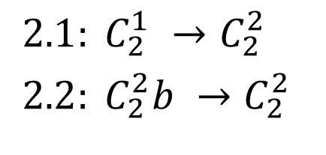
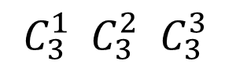
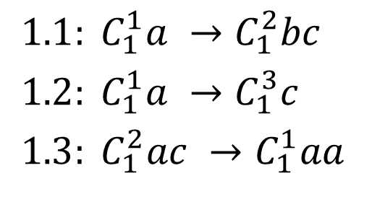
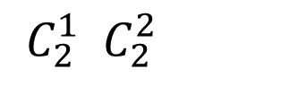
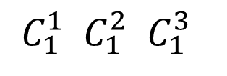
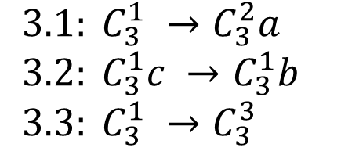
Example
$1.1: C_{1}^{1}a →C_{1}^{2}bc$
$1.2: C_{1}^{1}a →C_{1}^{3}c$
$1.3: C_{1}^{2}ac →C_{1}^{1}aa$
$2.1: C_{2}^{1} →C_{2}^{2}$
$2.2: C_{2}^{2}b →C_{2}^{2}$
$3.1: C_{3}^{1} →C_{3}^{2}a$
$3.2: C_{3}^{1}c →C_{3}^{1}b$
$3.3: C_{3}^{1} →C_{3}^{3}$
$C_{1}^{1} C_{1}^{2} C_{1}^{3}$
$C_{2}^{1} C_{2}^{2}$
$C_{3}^{1} C_{3}^{2} C_{3}^{3}$

Slide 39





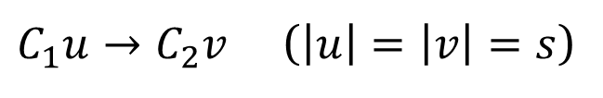
Going from multistable catalysts to P colonies
$C_{1}u→C_{2}v$ ($\left|u\right|=\left|v\right|=s$)
Code $C_{2}⊇u$ and
Code $C_{1}⊇v$
Code of C₂
Code of C₁
v
u
$$v_{1}…v_{s}$$
$$d_{1}^{′}…d_{m}^{′}$$
$$u_{1}…u_{s}$$
$$d_{1}…d_{m}$$
1
0
$$v_{1}↔u_{1}, …, v_{s}↔u_{s}, d_{1}→d_{1}^{′}, …, d_{m}→d_{m}^{′}$$
The codes of catalysts can be obtained using integer linear programming

Slide 40
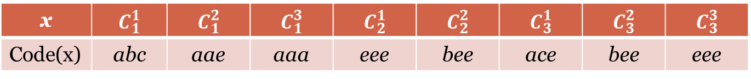
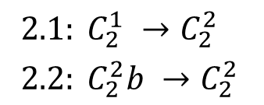

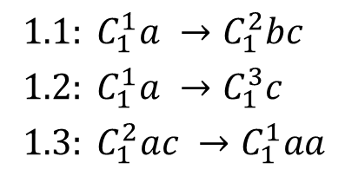


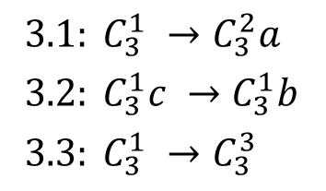
Example (2)
$1.1: C_{1}^{1}a →C_{1}^{2}bc$
$1.2: C_{1}^{1}a →C_{1}^{3}c$
$1.3: C_{1}^{2}ac →C_{1}^{1}aa$
$$p_{11}:b↔a, c↔e, a→a$$
$$p_{12}:a↔c, b→b, c→c$$
$$p_{13}:a↔a, a↔c, e→e$$
abc
e∝
$$p_{31}:a↔e, c→b, e→e$$
$$p_{32}:a↔e, e→a, e→e$$
$$p_{33}:a→e, c→e, e→e$$
eee
$2.1: C_{2}^{1} →C_{2}^{2}$
$2.2: C_{2}^{2}b →C_{2}^{2}$
1
$$p_{21}:e→b, e→e,e→e$$
$$p_{22}:e↔b, b→e, e→e$$
eee
3
$3.1: C_{3}^{1} →C_{3}^{2}a$
$3.2: C_{3}^{1}c →C_{3}^{1}b$
$3.3: C_{3}^{1} →C_{3}^{3}$
2
x | $$C_{1}^{1}$$ | $$C_{1}^{2}$$ | $$C_{1}^{3}$$ | $$C_{2}^{1}$$ | $$C_{2}^{2}$$ | $$C_{3}^{1}$$ | $$C_{3}^{2}$$ | $$C_{3}^{3}$$
Code(x) | abc | aae | aaa | eee | bee | ace | bee | eee

Slide 41
Extend

Slide 42
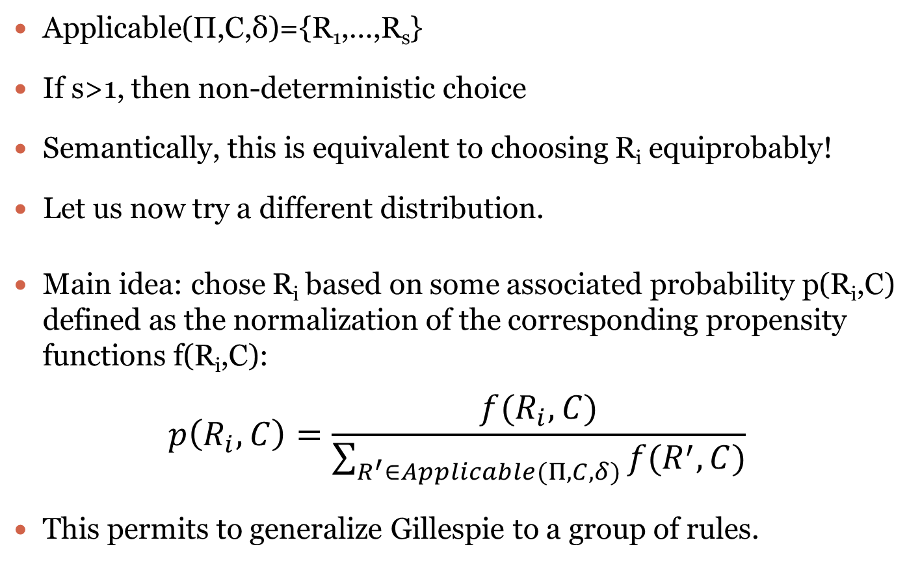
Example: extending with probabilities
Applicable(Π,C,δ)={R₁,…,R_{s}}
If s>1, then non-deterministic choice
Semantically, this is equivalent to choosing R_{i} equiprobably!
Let us now try a different distribution.
Main idea: chose R_{i} based on some associated probability p(R_{i},C) defined as the normalization of the corresponding propensity functions f(R_{i},C):
$$p\left(R_{i},C\right)=\frac{f(R_{i},C)}{\sum_{R^{′}∈Applicable(Π, C, δ)}{f(R^{′},C)}}$$
This permits to generalize Gillespie to a group of rules.

Slide 43
Strategies for computing f(R,C)
Constant: each rule r from R has a constant contribution to f and equal to c_{r}: $f\left(R,C\right)=\sum_{r∈R}{c_{r}}$
Multiplicity-dependent: each rule r from R has a contribution to f proportional to the number of times this rule can be applied and to a stochastic constant c_{r} that only depends on r:
$$N_{r}\left(C\right)=\min_{x∈lhs(r)}\left[\frac{{\left|C\right|}_{x}}{{\left|lhs\left(r\right)\right|}_{x}}\right]$$
$$f\left(R,C\right)=\prod_{r∈R}{c_{r}N_{r}(C)}$$
Concentration-dependent: each rule r from R has a contribution to f proportional to h_{r}(C), the number of distinct combinations of objects from C that activate r, and to a stochastic constant c_{r} that only depends on r:
$$h_{r}\left(C\right)=\prod_{x∈lhs(r)}{\left(\frac{{\left|C\right|}_{x}}{{\left|lhs\left(r\right)\right|}_{x}}\right)}$$
$$f\left(R,C\right)=h_{R}\left(C\right)=\prod_{r∈R}{c_{r}h_{r}(C)}$$
Gillespie: each rule r from R has a contribution to f that depends on the order in which it was chosen and it is equal to c_{r} h_{r}(C′), where C′ is the configuration obtained by applying all rules that were chosen before r.
aab activates 2 times for ab

Slide 44
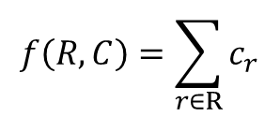
Strategies for computing f(R,C): constant
Each rule r from R has a constant contribution to f and equal to c_{r}
R=
n₁
n₂
n_{k}
r₁
r₂
…
r_{k}
c₁
c₂
c_{k}
$$f\left(R,C\right)=\sum_{r∈R}{c_{r}}$$

Slide 45
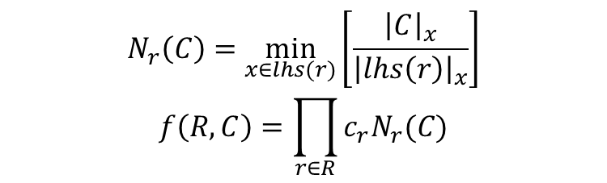
Strategies for computing f(R,C): multiplicity-dependent
Each rule r from R has a contribution to f proportional to the
number of times this rule can be applied and to a stochastic
constant c_{r} that only depends on r:
R=
n₁
n₂
n_{k}
r₁
r₂
…
r_{k}
c₁
c₂
c_{k}
$$N_{r}\left(C\right)=\min_{x∈lhs(r)}\left[\frac{{\left|C\right|}_{x}}{{\left|lhs\left(r\right)\right|}_{x}}\right]$$
$$f\left(R,C\right)=\prod_{r∈R}{c_{r}N_{r}(C)}$$

Slide 46
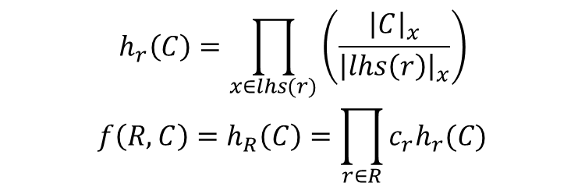
Strategies for computing f(R,C): concentration-dependent
Each rule r from R has a contribution to f proportional to h_{r}(C),
the number of distinct combinations of objects from C that activate r,
and to a stochastic constant c_{r} that only depends on r:
R=
n₁
n₂
n_{k}
r₁
r₂
…
r_{k}
aab activates 2 times for ab
h₁(C)
h₂(C)
h_{k}(C)
c₁
c₂
c_{k}
$$h_{r}\left(C\right)=\prod_{x∈lhs(r)}{\left(\frac{{\left|C\right|}_{x}}{{\left|lhs\left(r\right)\right|}_{x}}\right)}$$
$$f\left(R,C\right)=h_{R}\left(C\right)=\prod_{r∈R}{c_{r}h_{r}(C)}$$

Slide 47
Strategies for computing f(R,C): Gillespie
Each rule r from R has a contribution to f that depends on the order
in which it was chosen and it is equal to c_{r} h_{r}(C′), where C′ is
the configuration obtained by applying all rules that were chosen before r:
R=
n₁
n₂
n_{k}
r₁
r₂
…
r_{k}
h₁(C)
h₂(C₁)
h_{k}(C₂)
c₁
c₂
c_{k}
A notion of time can be considered.

Slide 48
Probabilities and the derivation mode
The derivation mode is independent from the probability!
Applicable(Π,C,δ)={R₁,…,R_{s}}
Traditionally δ=seq (sequential), i.e. 1 rule is applied at a time.
When δ=max, DPP systems are obtained (with concentration-dependent strategy)
Chose rules according to the concentration-dependent probability until the maximality is reached
Probabilistic Functional Extended P Systems : multiplicity-dependent strategy for a maximally parallel derivation mode
Other derivation modes can be considered: e.g. Gillespie with different δ gives variants of tau-leaping.
Hence, FF gives a way to generalize Gillespie to a group of rules.

Slide 49
Example: going beyond integers
Mathematically, a multiset is a function f:A→N
What if we replace it by f:A→G, where G is a group?
We obtain interesting unusual cases with negative objects and rules applicable groupwise, but not individually.
Another interesting consequence is the possibility to represent objects directly, instead of their integer encoding.
A big challenge is to correctly define unbounded modes (e.g. maximally parallel).
It translates in a finiteness condition on linear combinations within a finite ball.
We showed that if G is a totally ordered abelian group then it is possible to define an unbounded mode iff G is Archimedean.
This makes G isomorphic to Z^{n}
u
w
Notes:
Easier transformation Diff. Eq. => membrane systems

Slide 50
Dynamically evolving structure

Slide 51
P systems with dynamically evolving structure
The structure is explicit (a binary relation). We consider it as the parent or communication relation, but this can be e.g. the brother/sister relation.
The configuration is a list of cells (id, label, contents) and the current structure (relation).
Rules are expressed in terms of pattern-matching : so the applicability is done in two steps:
Find the matching structure
Verify the objects on the matched region.
Key point: the applicability is checked for a group of rules.

Slide 52
Matching the structure
h1
h2
h3
h1
h1
h3
h2
h3
h2
In the tissue case non-trees can be matched

Slide 53
Applicability/application stage 2
On the matched structures (for a group of rules):
Check preconditions (permitting/forbidding)
Apply rewriting
Create new membranes (eventually duplicating existing ones)
Delete membranes (eventually moving the contents)
The order is important: we assume RCD, but other orders are possible yielding different results.
Example: in RDC order deleted membranes cannot be copied to newly created ones.
In CDR order the newly duplicated membranes get the “old” contents, before rewriting.
Notes:
In RDC order it is not possible to copy deleted membranes
In CDR order the membranes get “old” contents, before rewriting

Slide 54
Application stage 3
Change the structure locally (on the matched part) or globally using a graph transducer:
In P case the transducer is trivial – insertion and deletion of edges
In tissue case can be more complex, e.g. simulate α- and β- reductions of the λ-calculus (like in Margenstern et al.)

Slide 55
Taxonomy
A rule has 11 components…
In most of the cases they are empty.
So we indicate which components are used:
R: rewriting
L: label change
C: membrane creation
D: membrane deletion
P: P systems case (the relation is a graph)
E.g. PCR rule

Slide 56
Examples
Rewriting: [a->b]_{h}
R rule: (h), RW: (1,a)->(1,b)
Communication: [a]_{h}->[]_{h1}b
PLR rule: LAB=(h,p), RW: (1,a)->(2,b), LC={(1,h1)}
Dissolution: [a]_{h}->b
PD rule: LAB=(h,p), RW: (1,a)->(1,b), DEL&MOV(1,2)

Slide 57
Examples
Membrane division: [a]_{h}->[b]_{h1}[c]_{h2}
PCD rule: LAB=(h,p), GEN&COPY(1’,h1,1,a->b), GEN&COPY(2’,h2,1,a->c), DEL(1), TRANS: INS-EDGE(1’,2), INS-EDGE(2’,2)
Membrane creation: [a->[u]_{h1} ]_{h2}
RC rule: LAB=(h2), REL=∅, RW: (1,a)->(1,λ), GEN(1’,h1,u), TRANS: INS-EDGE(1’,1)

Slide 58
Conclusion
FF is a useful tool to understand, review and extend others work on multiset-rewriting based models.
It allows to situate a newly developed model with respect to existing ones.
It permits to ask, answer and raise questions related to the semantics of some model.
It allows to quickly enhance a model with a different derivation mode or halting condition.
Permits to relate (apparently) different models of P systems and also multiset-rewriting based models.

Slide 59
Final remarks
FF is a very useful tool and not too difficult to learn and manipulate.
If you still have difficulties in expressing your model, do not hesitate to contact me.

Slide 60
UCNC 2018, MCU 2018
Unconventional Computing and Natural Computing (UCNC 2018 ) and Machines, Computations and Universality (MCU 2018) will be held in Fontainebleau (Paris region) in the last week of June 2018: 25/06/2018-29/06/2018
Also there will be a Membrane Computing workshop associated to UCNC (and organized by Rudi).

Slide 61
非常感谢你的关注
Notes:
Thank you a lot (very much) for your attention

