Slide 1
Bi-simulation Between P Colonies and P Systems with Multi-stable Catalysts
Erzsébet Csuhaj-Varjú
Eötvös Loránd University
Sergey Verlan
UniversitÉ Paris EsT

Slide 2
Bisimulation
P colonies
Multistable catalytic P systems
Formal framework for P systems

Slide 3
What is the formal framework (quiz)?
What is it?
It is a model of distributed multiset rewriting which cares about locations. The structure of the system is defined by the hypergraph induced by rules. This is the most general variant of distributed multiset rewriting (generalizing P systems, VAS, Petri nets, register machines, population protocols, etc).
Is this a definition/model for P systems?
No. The formal framework is a concrete variant/series of P systems. Sometimes it is called the network of cells.
Does it define the semantics of P systems?
No. At least not directly.
What is it for?
We can encode most of variants of P systems in the formal framework yielding a bisimulation. Moreover, in most cases it is a strong bisimulation i.e. 1 step in the original system is done by 1 step in the formal framework.
How this can be done?
The form of the configuration and of rules are close to the multiset rewriting and generalizes most common configurations changes in P systems.
Why it is called formal framework?
In most of the cases the simulated P system is a restriction of the formal framework.
Many generic notions expressed in FF can be incorporated/interpreted in the original system due to bisimulation.
Notes:
Speak about NC when working with a concrete case (basically rules & config). FF in a more general setup – it has more variants.

Slide 4
What the formal framework can be used for?
Understand the functioning of some variant of P systems.
Compare variants of P systems.
Explain points that can have different interpretations.
Extend variants of P systems with new features.
There is a list of features defined for the formal framework and due to the bisimulation they can be interpreted directly in the corresponding P system, e.g. derivation modes.

Slide 5
Formal framework: details
Configuration:
A vector of cells.
Each cell has an unique identifier id and contains a multiset of objects called contents, e.g. (1,abbc).
Cells can contain infinite multisets.
Rules:
XY;[P];[Q]
X,Y – vectors of multisets
P,Q – finite sets of multisets (permitting and forbidding contexts)
another notation:
(1,x₁)…(n,x_{n}) (1,y₁)…(n,y_{n}); [{(1,p₁)…(n,p_{n})}, …]; [{(1,f₁)…(n,f_{n})}, ...]
Semantics: rewrite X by Y if all elements of P and none of Q are present.
Here we present the static case.
A similar formalism exists for the case
of the dynamic structure

Slide 6
Example
(a,c,λ,λ,λ)  (c,λ,λ,a,b,λ); [{(b,λ,λ,λ,λ)}]; [{(λ,λ,d,λ,λ)}]
(1,a)(2,c)  (1,c)(4,a)(5,b); [{(1,b)}]; [{(3,d)}]
b
b
a
1
4
c
2
5
a
3
Notes:
Difference to PN: context conditions

Slide 7
A definition of a P system Π
The configuration.
The initial configuration.
The set of rules.
The following functions:
Applicable(Π,C,δ) the set of multisets of rules of Π applicable in the configuration C, according to the derivation mode δ.
Apply(Π,C,R) the configuration obtained by the (parallel) application of the multiset of rules R to the configuration C.
Halt(Π,C,δ) a predicate that yields true if C is a halting configuration of Π evolving in the derivation mode δ.
Result(Π,C) a function giving the result of the computation of , when the halting configuration C has been reached

Slide 8
Formal framework: semantics
Applicable(Π,C,δ)
An algorithm is used to compute Applicable(Π,C,asyn), which is then (set-)restricted according to δ.
Examples of δ: max, seq, min, min_{k},… (more than 10 modes)
Apply(Π,C,R)
The application is performed using an algorithm. In the dynamic case there are several variants.
Halt(Π,C,δ)
Generic. Several examples include total halting (no rule is applicable), signal halting (the configuration has some properties) and adult halting (no changes in the configuration occur).
Result(Π,C)
Generic. Generally is the contents of some cell.
Notes:
Modes and modifiers

Slide 9
Purely catalytical P systems
abc
aac
c
a
cb→caa
a
0
1
2
3
4
ca→cbb
3
aac
c
4
2
ca→cb_{in}d_{in4}b_{out}e_{out}e_{here}
(1,ca)→(0,be)(1,ce)(4,bd)
(1,ca)→(0,be)(1,ce)(3,b)(4,d)
1
abc
(0,cb)→(0,c)(2,a)
cb→ca_{in2}
(3,ca)→(3,cbb)
Use at most one rule from each membrane in maximal (non-extendable) set mode.
0
(3,cb)→(3,caa)
P1:
(1,a)→(0,be)(1,e)(4,bd)
(1,a)→(0,be)(1,e)(3,b)(4,d)
P3:
(3,a)→(3,bb)
min₁
P2:
(0,b)→(2,a)
P4:
(3,b)→(3,aa)
Notes:
Tree structure, maximal parallelism, total halting, the result is the number of objects in the skin/output membrane modulo the number of catalysts.
Hypergraph structure…

Slide 10
Multi-stable catalytical P systems
There are several variants of each catalyst (equivalently there are groups of catalysts).
A catalyst can also evolve within these variants.
This corresponds to a catalyst having a state.
The number of possible states of a catalyst is called its period.

Slide 11
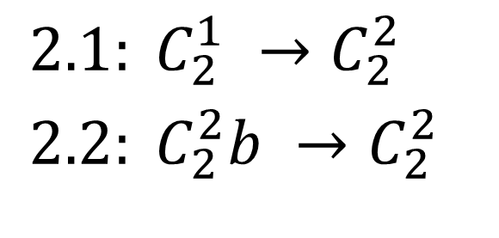
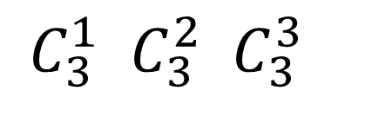
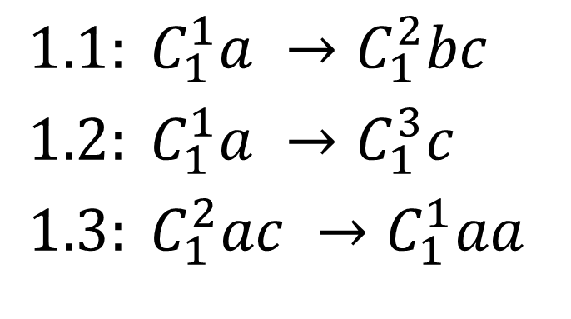
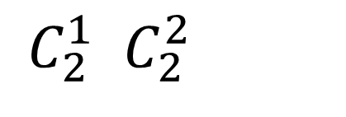
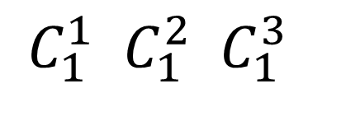
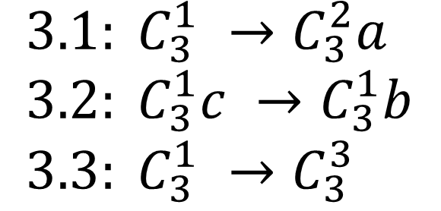
Example
$1.1: C_{1}^{1}a →C_{1}^{2}bc$
$1.2: C_{1}^{1}a →C_{1}^{3}c$
$1.3: C_{1}^{2}ac →C_{1}^{1}aa$
$2.1: C_{2}^{1} →C_{2}^{2}$
$2.2: C_{2}^{2}b →C_{2}^{2}$
$3.1: C_{3}^{1} →C_{3}^{2}a$
$3.2: C_{3}^{1}c →C_{3}^{1}b$
$3.3: C_{3}^{1} →C_{3}^{3}$
$C_{1}^{1} C_{1}^{2} C_{1}^{3}$
$C_{2}^{1} C_{2}^{2}$
$C_{3}^{1} C_{3}^{2} C_{3}^{3}$

Slide 12
P colonies
n agents (cells).
Each agent contains k symbols.
The environment contains e∝.
Rules are either point mutations, or exchange with environment, or a priority between 2 rules.
A program is a group of k rules.
When a program is applied, all its rules are applied.
Each agent i has m_{i} programs.
Mode (at the level of cells):
Maximal parallelism
Sequential
Result: number of symbols f in the environment.
p₁₁: a→b, a⬄e
p₁₂: a→c, a⬄e
p₁₃: b→a, e→a
a→b a⬄b
r₁/r₂
e∝
e∝
aa
a₁…a_{k}
1
p₃₁:e⬄a, e⬄b
p₃₂:b→f, a→b
p₃₃:f⬄a, b→b ee
p₁…p_{mi}
p₂₁:b⬄e, e→b
be
3
2

Slide 13
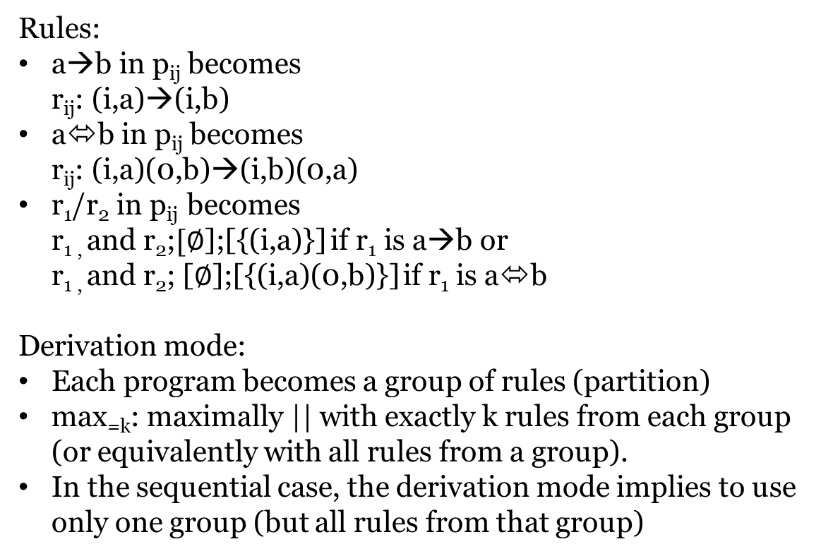
P colonies: transforming to FF (1)
Rules:
a→b in p_{ij} becomes r_{ij}: (i,a)→(i,b)
a⬄b in p_{ij} becomes r_{ij}: (i,a)(0,b)→(i,b)(0,a)
r₁/r₂ in p_{ij} becomes r_{1 ,} and r₂;$[∅$];[{(i,a)}] if r₁ is a→b or r_{1 ,} and r₂; [$∅$];[{(i,a)(0,b)}] if r₁ is a⬄b
Derivation mode:
Each program becomes a group of rules (partition)
max_{=k}: maximally || with exactly k rules from each group (or equivalently with all rules from a group).
In the sequential case, the derivation mode implies to use only one group (but all rules from that group)
1
0
3
2
p₁₁: a→b, a⬄e
p₁₂: a→c, a⬄e
p₁₃: b→a, e→a
e∝
aa
1
p₃₁:e⬄a, e⬄b
p₃₂:b→f, a→b
p₃₃:f⬄a, b→b ee
p₂₁:b⬄e, e→b
be
3
2
Notes:
Priority: check: c1: a<->b/a->b, c2: x<->b then either a<->b or a->b & x<->b
Definition: r1/r2: if the rule r1 can be applied then it must be applied; if not, then rule r2 must be performed. Problem as (1) r2 might not be applicable, (2) looks like a weak priority (3) what to do if r1 applicable, but blocked by another /r rule ?

Slide 14
Example
r₁₁₁: (1,a)→(1,b)
r₁₁₂: (1,a)(0,e)→(1,e)(0,a)
p₁₁: a→b, a⬄e
p₁₂: a→c, a⬄e
p₁₃: b→a, e→a
aa
e∝
r₁₂₁: (1,a)→(1,c)
r₁₂₂: (1,a)(0,e)→(1,e)(0,a)
1
r₁₃₁: (1,b)→(1,a)
r₁₃₂: (1,e)→(1,a)
aa
1
p₃₁:e⬄a, e⬄b
p₃₂:b→f, a→b
p₃₃:f⬄a, b→b ee
ee
3
p₂₁:b⬄e, e→b
be
3
0
r₂₁₁: (2,b)(0,e)→(2,e)(0,b)
r₂₁₂: (2,e)→(2,b)
r₃₁₁: (3,e)(0,a)→(3,a)(0,e)
r₃₁₂: (3,e)(0,b)→(3,b)(0,e)
r₃₂₁: (3,b)→(3,f)
r₃₂₂: (3,a)→(3,b)
2
be
r₃₃₁: (3,f)(0,a)→(3,a)(0,f)
r₃₃₂: (3,b)→(3,b)
2

Slide 15
Refining derivation mode
Derivation mode: group rules (corresponding to programs), maximal parallelism, but all rules from a group shall be used.
Since working with one symbol, the group r₁₁₁: (1,a)→(1,b) r₁₁₂: (1,a)(0,e)→(1,e)(0,a) is equivalent to r₁₁: (1,aa)(0,e)→(1,be)(0,a)
So a program corresponds to a more complicated rule, and k is the size of the LHS (equal to RHS).
Then the evolution is just maximally parallel.

Slide 16
Back to the example
aa
r₁₁: (1,aa) (0,e)→(1,be)(0,a)
p₁₁: a→b, a⬄e
p₁₂: a→c, a⬄e
p₁₃: b→a, e→a
e∝
r₁₂: (1,aa)(0,e)→(1,ce)(0,a)
1
r₁₃: (1,be)→(1,aa)
aa
1
p₃₁:e⬄a, e⬄b
p₃₂:b→f, a→b
p₃₃:f⬄a, b→b ee
ee
0
3
p₂₁:b⬄e, e→b
be
3
be
r₃₁: (3,ee)(0,ab)→(3,ab)(0,ee)
r₃₂: (3,ab)→(3,fb)
2
2
r₃₃: (3,bf)(0,a)→(3,ab)(0,f)
r₂₁: (2,be)(0,e)→(2,be)(0,b)

Slide 17



Going even further
Since the number of combinations of objects in an agent is finite, it can be represented by a single symbol, the state. Symbol e can be ignored.
r₁₁: (1,aa) (0,e)→(1,be)(0,a)
s1
aa
r₁₁: (1,s1) →(1,s2)(0,a)
r₁₁: $s_{1}→s_{2}a$
r₁₂: (1,aa)(0,e)→(1,ce)(0,a)
r₁₂: (1,s1)→(1,s3)(0,a)
r₁₂: $s_{1}→s_{3}a$
r₁₃: (1,be)→(1,aa)
1
1
r₁₃: (1,s2)→(1,s1)
r₁₃: $s_{2}→s_{1}$
s4
s1: aa
s2: be
s3: ce
s4: ee
s5: ab
s6: bf
s7: be
So we get multistable catalytic
rewriting
0
3
r₂₁: (2,s7)→(2,s7)(0,b)
r₃₁: (3,s4)(0,ab)→(3,s5)
s2
r₃₂: (3,s5)→(3,s6)
r₃₃: (3,s6)(0,a)→(3,s5)(0,f)
2
Notes:
Can also be considered as a n-state catalytic P system or as a special variant of active membranes []h u -> []h’ v

Slide 18





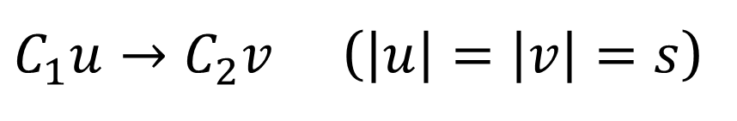
Going from multistable catalysts to P colonies
$C_{1}u→C_{2}v$ ($\left|u\right|=\left|v\right|=s$)
Code $C_{2}⊇u$ and
Code $C_{1}⊇v$
Code of C₂
Code of C₁
v
u
$$v_{1}…v_{s}$$
$$d_{1}^{′}…d_{m}^{′}$$
$$u_{1}…u_{s}$$
$$d_{1}…d_{m}$$
1
0
$$v_{1}↔u_{1}, …, v_{s}↔u_{s}, d_{1}→d_{1}^{′}, …, d_{m}→d_{m}^{′}$$

Slide 19
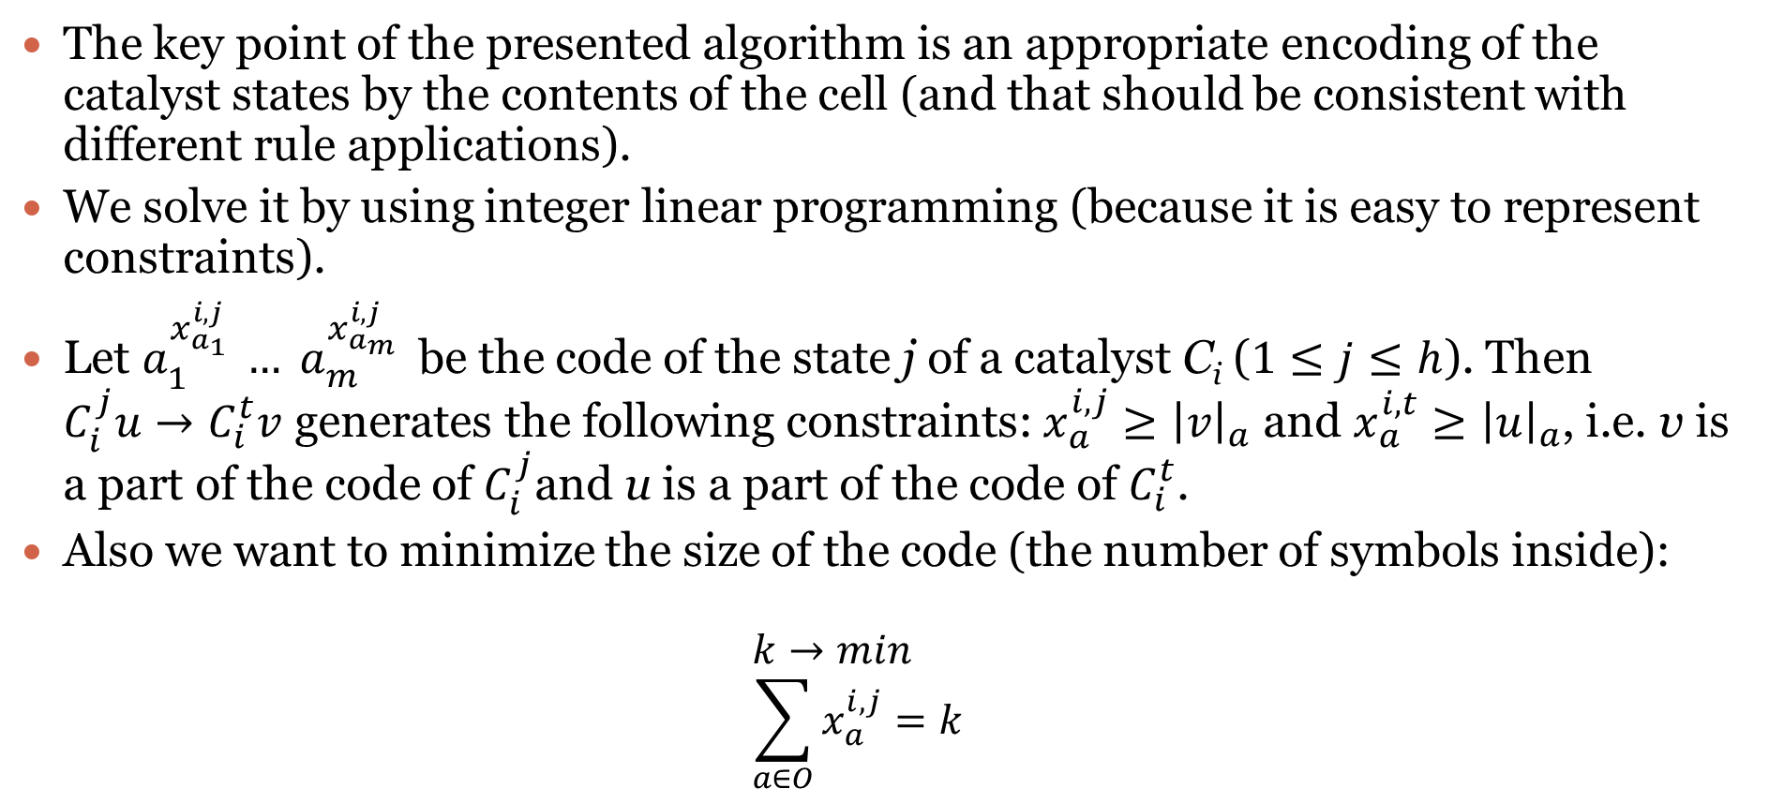
Getting the codes of the catalysts
The key point of the presented algorithm is an appropriate encoding of the catalyst states by the contents of the cell (and that should be consistent with different rule applications).
We solve it by using integer linear programming (because it is easy to represent constraints).
Let $a_{1}^{x_{a_{1}}^{i,j} }… a_{m}^{x_{a_{m}}^{i,j} }$ be the code of the state j of a catalyst C_{i} ($1≤j≤h$). Then $C_{i}^{j}u→C_{i}^{t}v$ generates the following constraints: $x_{a}^{i,j}≥{\left|v\right|}_{a}$ and $x_{a}^{i,t}≥{\left|u\right|}_{a}$, i.e. v is a part of the code of $C_{i}^{j}$and u is a part of the code of $C_{i}^{t}$.
Also we want to minimize the size of the code (the number of symbols inside): $k→min$ $\sum_{a∈O}{x_{a}^{i,j}=k}$

Slide 20
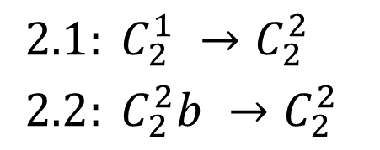

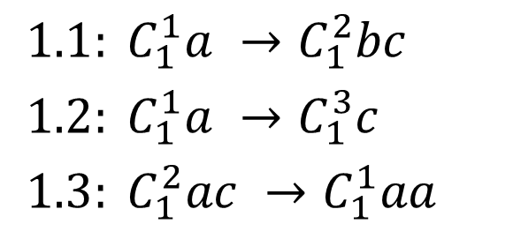


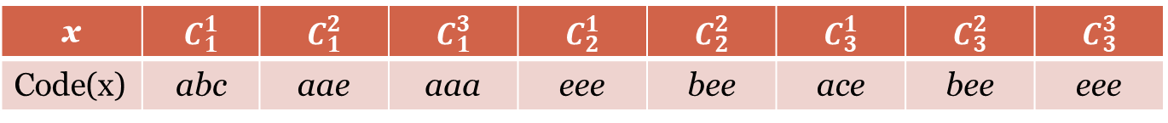
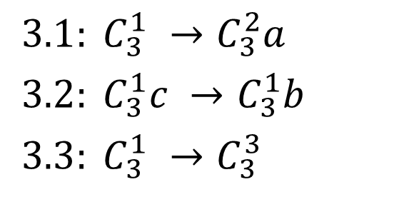
Example
$$e$$
$1.1: C_{1}^{1}a →C_{1}^{2}bc$
$1.2: C_{1}^{1}a →C_{1}^{3}c$
$1.3: C_{1}^{2}ac →C_{1}^{1}aa$
$3.1: C_{3}^{1} →C_{3}^{2}a$
$3.2: C_{3}^{1}c →C_{3}^{1}b$
$3.3: C_{3}^{1} →C_{3}^{3}$
$$e$$
x
$2.1: C_{2}^{1} →C_{2}^{2}$
$2.2: C_{2}^{2}b →C_{2}^{2}$
$$e$$
x | $$C_{1}^{1}$$ | $$C_{1}^{2}$$ | $$C_{1}^{3}$$ | $$C_{2}^{1}$$ | $$C_{2}^{2}$$ | $$C_{3}^{1}$$ | $$C_{3}^{2}$$ | $$C_{3}^{3}$$
Code(x) | abc | aae | aaa | eee | bee | ace | bee | eee

Slide 21
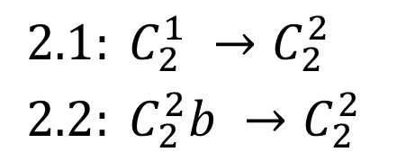

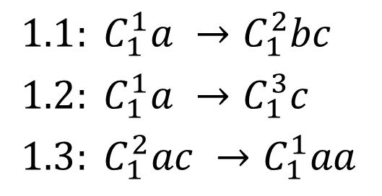


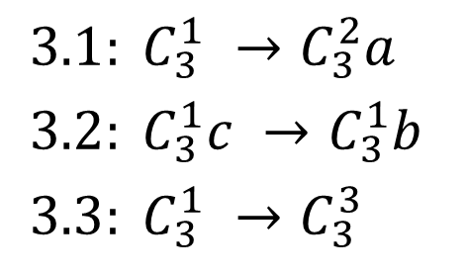
Example (2)
$1.1: C_{1}^{1}a →C_{1}^{2}bc$
$1.2: C_{1}^{1}a →C_{1}^{3}c$
$1.3: C_{1}^{2}ac →C_{1}^{1}aa$
$$p_{11}:b↔a, c↔e, a→a$$
$$p_{12}:a↔c, b→b, c→c$$
$$p_{13}:a↔a, a↔c, e→e$$
abc
e∝
$$p_{31}:a↔e, c→b, e→e$$
$$p_{32}:a↔e, e→a, e→e$$
$$p_{33}:a→e, c→e, e→e$$
eee
$2.1: C_{2}^{1} →C_{2}^{2}$
$2.2: C_{2}^{2}b →C_{2}^{2}$
1
$$p_{21}:e→b, e→e,e→e$$
$$p_{22}:e↔b, b→e, e→e$$
eee
3
$3.1: C_{3}^{1} →C_{3}^{2}a$
$3.2: C_{3}^{1}c →C_{3}^{1}b$
$3.3: C_{3}^{1} →C_{3}^{3}$
2

Slide 22
Conclusion
Using FF as intermediate model we showed a bi-simulation between P colonies and P systems with multistable catalysts. So, in some sense this is the same model.
Results from P colonies can be translated to catalysts and back (e.g. universality with a two bistable catalysts, or universal P colony with 3 cells and constant contents).
Some features of P colonies become natural and standard (e.g. evolving environment is just a catalytic system).
More generally:
FF is a useful tool to understand, review and extend others work.
It permits to ask, answer and raise questions related to the semantics of some model.
It allows to quickly enhance a model with a different derivation mode or halting condition.
Permits to relate (apparently) different models of P systems and also multiset-rewriting based models.

Slide 23

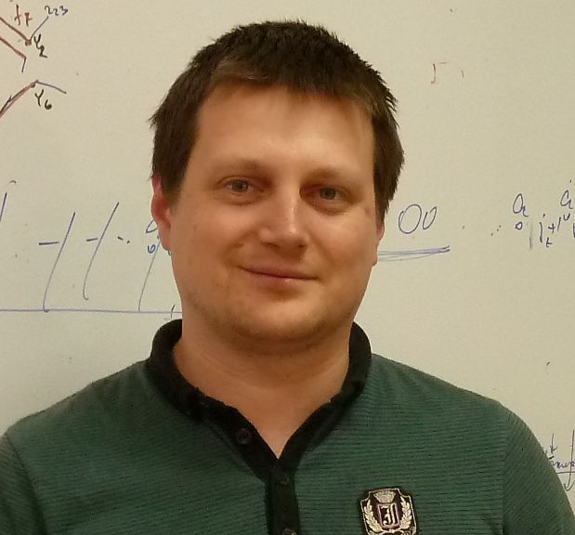


Thank you for your attention
Erzsébet Csuhaj-Varjú
Eötvös Loránd University
Hungary
Sergey VerlaN
UniversitÉ Paris Est
France

Slide 24
UCNC 2018, MCU 2018
UCNC 2018 and MCU 2018 will be held in Fontainebleau (Paris region) in the period: 25/06/2018-29/06/2018
Also there will be a Membrane Computing workshop associated to UCNC (and organized by Rudi).

Slide 25
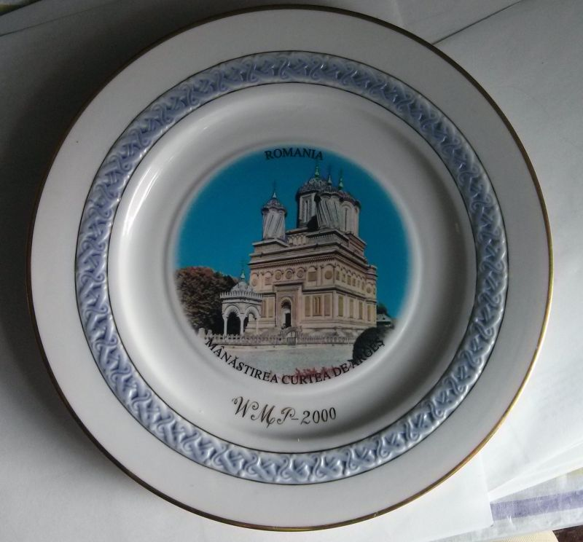
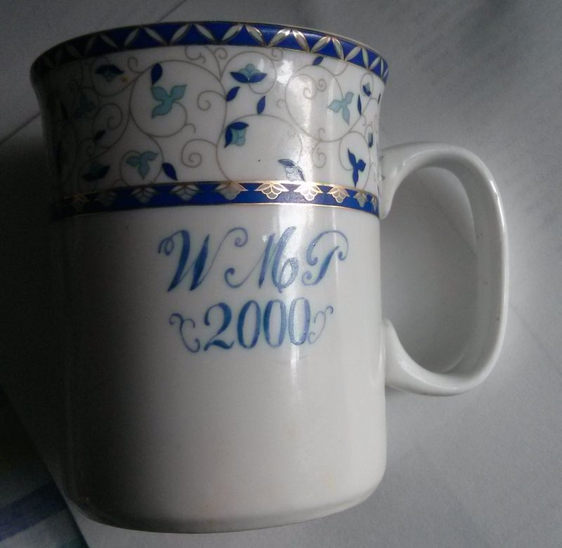
CMC18 – the story of membranes is not ended

