Slide 1
A Formal Framework for Spiking P systems
Sergey VERLAN, Rudolf FREUND, Artiom ALHAZOV, Linqiang PAN

Slide 2
A Short Introduction to the Formal Framework (FF)
FF is a powerful tool allowing to understand, relate and extend different models of P systems and other multiset rewriting-based models like Petri nets.
Composed from
The core model (network of cells)
Mechanism to define the semantics.
The semantics is defined by an algorithm that has parameters allowing to accommodate for different cases.
Generally, yields a strong bisimulation between the considered P systems model and the instance of the FF.

Slide 3
Formal Framework: ingredients
Network of cells
Network of cells
(structure & rules)
Set of multisets of applicable rules computation
Configuration
Rule applicability
Derivation mode
Derivation mode: set restriction
Halting condition
Halting condition: recursive predicate
Result acquisition
Result acquisition: recursive function

Slide 4
Formal framework: semantics
X
1. Compute all applicable multisets of rules
Rule 1
Rule 2
2. Restrict according to the derivation mode
Rule 4
Rule 1
Rule 3
3. Apply to the current configuration
4. Verify if the system should halt
Rule 5
5. If not, then loop 1-4
6. If yes, then get the result
Halt?
Result
Configuration (vector of multisets)

Slide 5
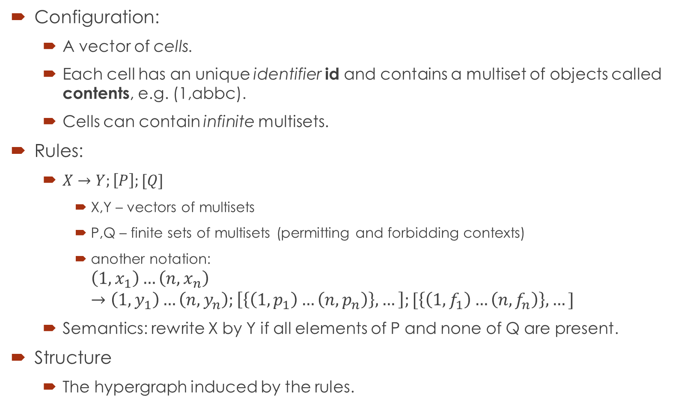
Network of cells: structure & rules
Configuration:
A vector of cells.
Each cell has an unique identifier id and contains a multiset of objects called contents, e.g. (1,abbc).
Cells can contain infinite multisets.
Rules:
$X→Y;\left[P\right];[Q]$
X,Y – vectors of multisets
P,Q – finite sets of multisets (permitting and forbidding contexts)
another notation:
$$\left(1,x_{1}\right)…\left(n,x_{n}\right)→\left(1,y_{1}\right)…\left(n,y_{n}\right);\left[\left\{\left(1,p_{1}\right)…\left(n,p_{n}\right)\right\},…\right];[\left\{\left(1,f_{1}\right)…\left(n,f_{n}\right)\right\},…]$$
Semantics: rewrite X by Y if all elements of P and none of Q are present.
Structure
The hypergraph induced by the rules.
b
c
1
a
a
4
c
2
b
d
5
3

Slide 6
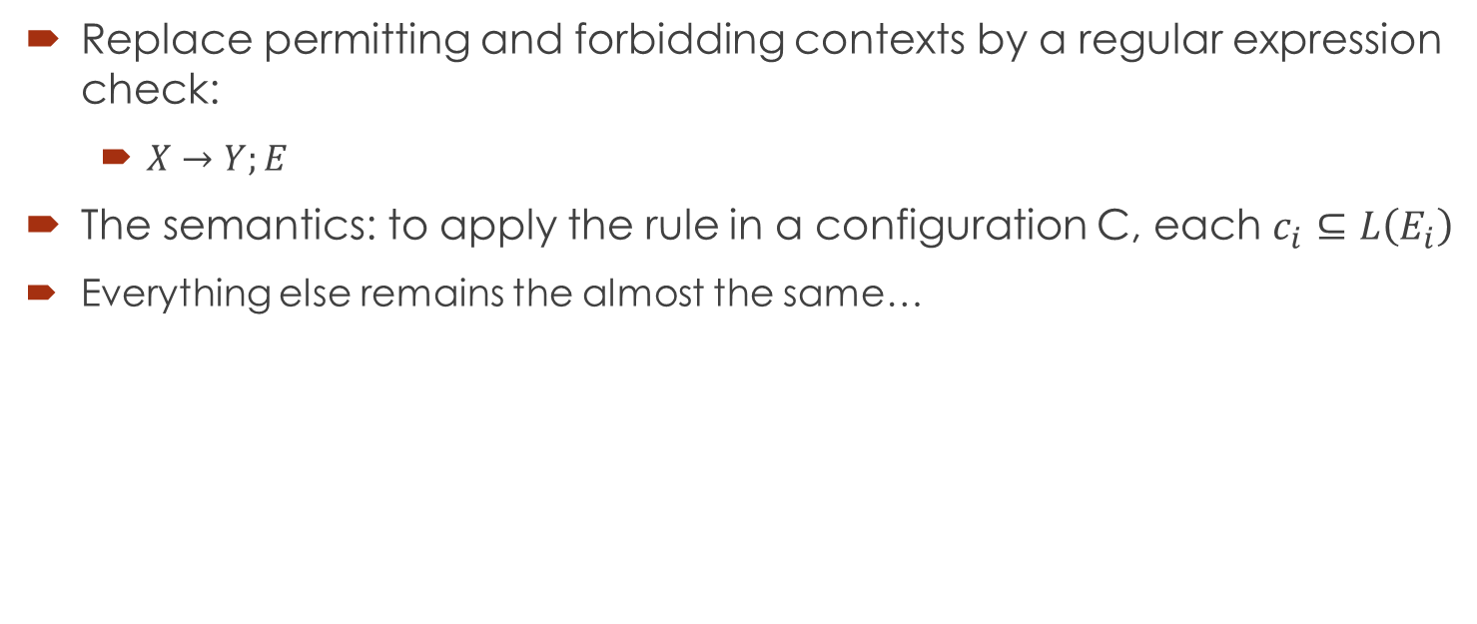
Extension for Spiking
Replace permitting and forbidding contexts by a regular expression check:
$X→Y;E$
The semantics: to apply the rule in a configuration C, each $c_{i}⊆L\left(E_{i}\right)$
Everything else remains the almost the same…

Slide 7
Input and Output
Usually P systems are used as generators or recognizers.
In this case the paradigm is to start from an initial configuration and stop when the halting condition is achieved.
In the spiking case many models act as transducers: basically they perform an infinite computation (which may have only a finite non-empty portion).
We introduce (relatively complex) notions of input and output in order to be able to deal with such cases.
However, we gave corresponding definitions for the common cases, so it is sufficient just to refer to them (without giving the full definition).

Slide 8
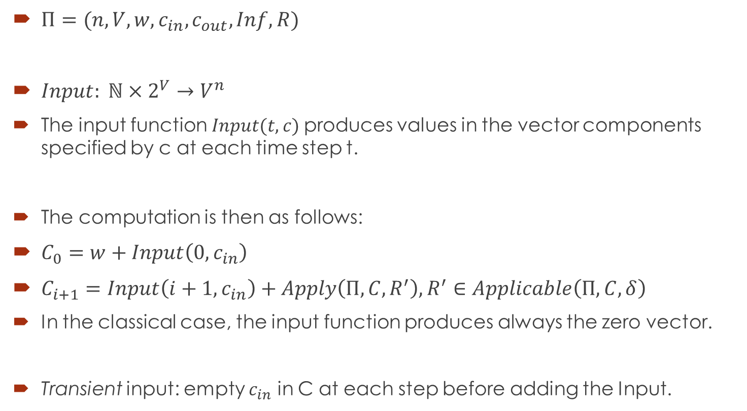
Input
$Π=(n,V,w,c_{in}, c_{out}, Inf,R)$
$Input: ℕ×2^{V}→V^{n}$
The input function $Input(t,c)$produces values in the vector components specified by c at each time step t.
The computation is then as follows:
$C_{0}=w+Input\left(0,c_{in}\right)$
$C_{i+1}=Input\left(i+1,c_{in}\right)+Apply\left(Π, C,R^{′}\right), R^{′}∈Applicable\left(Π,C,δ\right)$
In the classical case, the input function produces always the zero vector.
Transient input: empty $c_{in}$ in C at each step before adding the Input.

Slide 9

Example: spiking train input
It is a function that satisfies the following property:
$∃t_{1},t_{2}>0, t_{1}<t_{2}:$ $Input\left(t,c\right)≠\overline{0}, t∈\left\{t_{1},t_{2}\right\} and$ $Input\left(t,c\right)=\overline{0} otherwise$

Slide 10
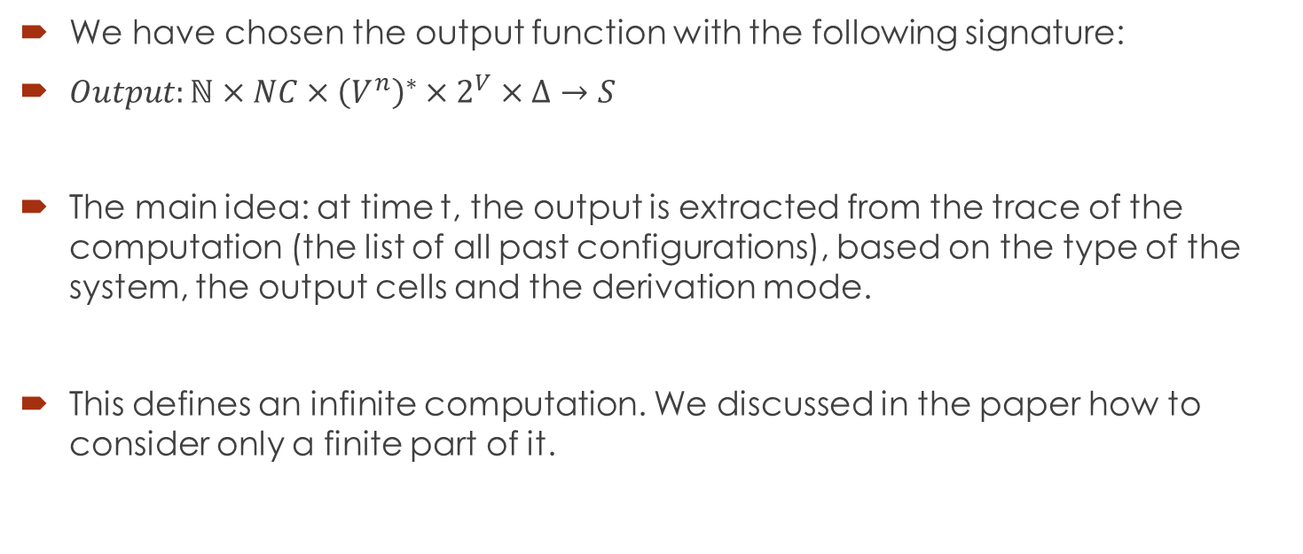
Output
We have chosen the output function with the following signature:
$Output:ℕ×NC×{\left(V^{n}\right)}^{∗}×2^{V}×Δ→S$
The main idea: at time t, the output is extracted from the trace of the computation (the list of all past configurations), based on the type of the system, the output cells and the derivation mode.
This defines an infinite computation. We discussed in the paper how to consider only a finite part of it.

Slide 11










Spiking Neural P Systems
A single symbol a used to define the quantity of spikes in each neuron.
Rules may have a delay (but which is shown to be not necessary).
Only one rule per neuron is executed (at most).
1
$$a^{2}$$
$$a^{2} / a→a;0$$
$$a→λ$$
3
$$a^{3}$$
$$a^{3}→a;0$$
$$a→a;1$$
2
$$a^{2}→λ$$
$$a$$
$$a→a;0$$
$$a→a;1$$

Slide 12
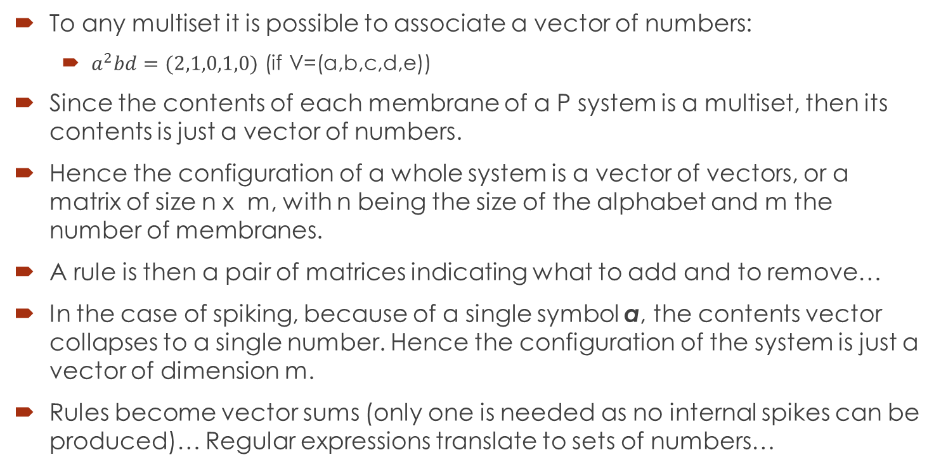
Vectors of numbers
To any multiset it is possible to associate a vector of numbers:
$a^{2}bd=(2,1,0,1,0)$ (if V=(a,b,c,d,e))
Since the contents of each membrane of a P system is a multiset, then its contents is just a vector of numbers.
Hence the configuration of a whole system is a vector of vectors, or a matrix of size n x m, with n being the size of the alphabet and m the number of membranes.
A rule is then a pair of matrices indicating what to add and to remove…
In the case of spiking, because of a single symbol a, the contents vector collapses to a single number. Hence the configuration of the system is just a vector of dimension m.
Rules become vector sums (only one is needed as no internal spikes can be produced)… Regular expressions translate to sets of numbers…

Slide 13












Example
Time | m1 | m2 | m3 | Out
0 | 2 | 1 | 3 | -
1 | 2 | 1 | 2 | 1
2 | 2 | 1 | 2 | 0
3 | 2 | 1 | 2 | 0
4 | 1 | 0 | 1 | 0
5 | 1 | 0 | 0 | 0
6 | 0 | 0 | 0 | 1
1
$$a^{2}$$
$$a^{2} / a→a;0$$
$$a→λ$$
3
$$a^{3}$$
$$a^{3}→a;0$$
$$a→a;1$$
2
$$a^{2}→λ$$
$$a$$
$$a→a;0$$
$$a→a;1$$
Initial configuration (2,1,3,0)
Rules:
$$1.1:(\{2\},ℕ,ℕ,ℕ)/(−1,1,1,0)$$
$$2.1:(ℕ,\{1\},ℕ,ℕ)/(1,−1,1,0)$$
$$3.1:(ℕ,ℕ,\{3\},ℕ)/(0,0,−3,1)$$
$$1.2:(\{1\},ℕ,ℕ,ℕ)/(−1,0,0,0)$$
$$2.2:\left(ℕ,\left\{1\right\},ℕ,ℕ\right)/\left(1,−1,1,0\right);1$$
$$3.2:\left(ℕ,ℕ,\left\{1\right\},ℕ\right)/\left(0,0,−1,1\right);1$$
$$3.3:(ℕ,ℕ,\{2\},ℕ)/(0,0,−2,0)$$

Slide 14
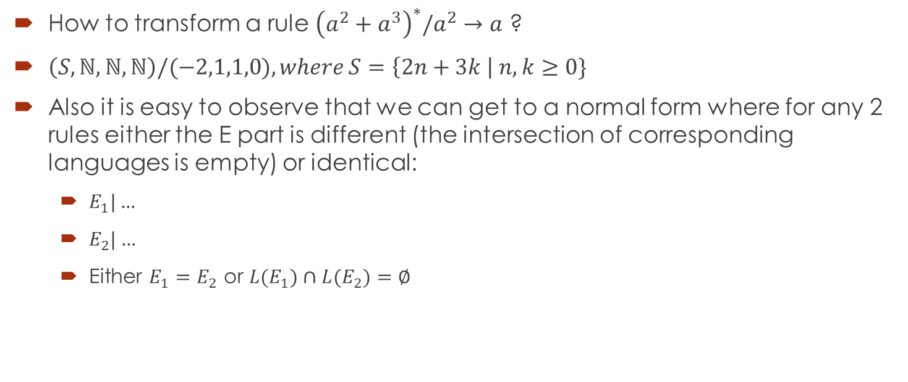
And the regular expression ?
How to transform a rule ${\left(a^{2}+a^{3}\right)}^{∗}/a^{2}→a$ ?
$\left(S,ℕ,ℕ,ℕ\right)/(−2,1,1,0), where S=\left\{2n+3k \right| n,k≥0\}$
Also it is easy to observe that we can get to a normal form where for any 2 rules either the E part is different (the intersection of corresponding languages is empty) or identical:
$E_{1}|…$
$E_{2}|…$
Either $E_{1}=E_{2}$ or ${L(E}_{1})∩{L(E}_{2})=∅$

Slide 15
Remarks about delay and forgetting rules
The delay can always be removed.
However, this is a functional, but not structural transformation (this means that it is possible to write down a system without delay computing the same result).
A similar statement holds about forgetting rules.
In practice – not trivial, as the algorithm should be completely redesigned.

Slide 16
Back to the execution strategy
Since there is a finite number of rules in each neuron and a finite number of neurons:
SNP system can be seen as a purely catalytic P system.
So, sequential SNP (where only one neuron fires at each step) is in fact catalytic mode with a single partition…
By considering all possible combinations of rules together with the corresponding forbidding expressions it is possible to show that spiking is sequential if considering general type of rules from the FF.

Slide 17
Other execution strategies
Maximally parallel ?
Minimally parallel
Bounded parallelism
…

Slide 18
Some existing variants

Slide 19





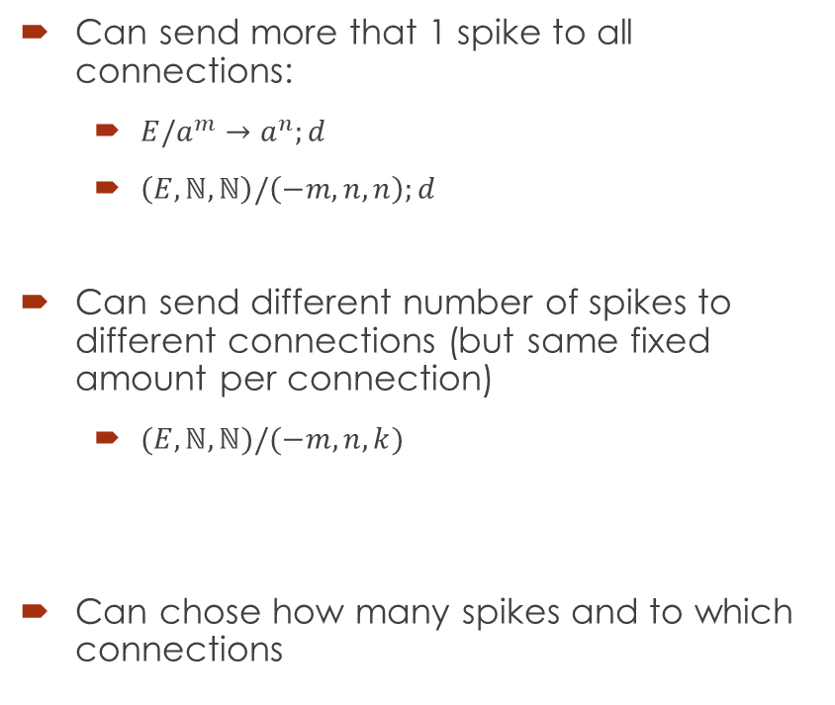







Extended rules
$$a^{n}$$
Can send more that 1 spike to all connections:
$E/a^{m}→a^{n};d$
$\left(E,ℕ,ℕ\right)/\left(−m,n,n\right);d$
Can send different number of spikes to different connections (but same fixed amount per connection)
$(E,ℕ,ℕ)/(−m,n,k)$
Can chose how many spikes and to which connections
$${E/a}^{m}→a^{n}$$
$$a^{n}$$
$$n$$
$$a^{n}$$
$$k$$
$${E/a}^{m}→a$$
$$a^{k}$$
$$a^{n} or a^{p}$$
$$(E,ℕ,ℕ)/(−m,n,k)$$
$$(E,ℕ,ℕ)/(−m,p,q)$$
$$a^{k} or a^{q}$$

Slide 20
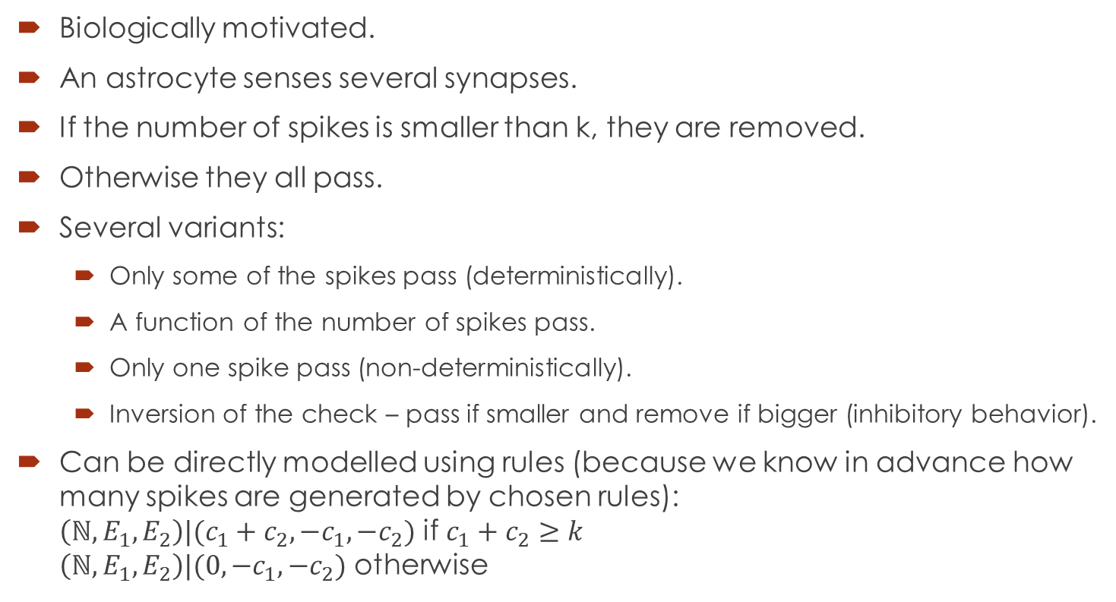
Astrocytes
Biologically motivated.
An astrocyte senses several synapses.
If the number of spikes is smaller than k, they are removed.
Otherwise they all pass.
Several variants:
Only some of the spikes pass (deterministically).
A function of the number of spikes pass.
Only one spike pass (non-deterministically).
Inversion of the check – pass if smaller and remove if bigger (inhibitory behavior).
Can be directly modelled using rules (because we know in advance how many spikes are generated by chosen rules): $\left({ℕ, E}_{1},E_{2}\right)|(c_{1}+c_{2},−c_{1},−c_{2})$ if $c_{1}+c_{2}≥k$ $\left({ℕ, E}_{1},E_{2}\right)|(0,−c_{1},−c_{2})$ otherwise
k

Slide 21
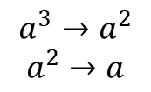


Rules on synapses
$$aaa$$
$$a^{3}→a^{2}$$
$$a^{2}→a$$
Can apply either rule 1 or rules 2,3
$$a→a^{2}$$
Being able to synchronously apply rules from different synapses, just corresponds to the maximally parallel execution of rules.

Slide 22
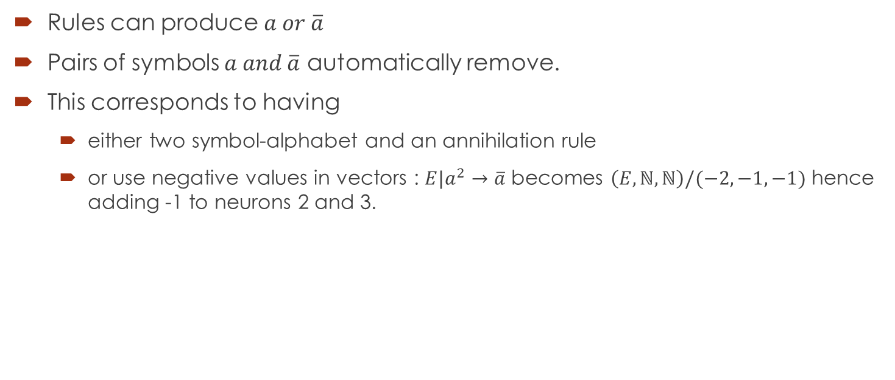
Anti-spikes
Rules can produce $a or \overline{a}$
Pairs of symbols $a and \overline{a}$ automatically remove.
This corresponds to having
either two symbol-alphabet and an annihilation rule
or use negative values in vectors : $E|a^{2}→\overline{a}$ becomes $\left(E,ℕ,ℕ\right)/(−2,−1,−1)$ hence adding -1 to neurons 2 and 3.

Slide 23
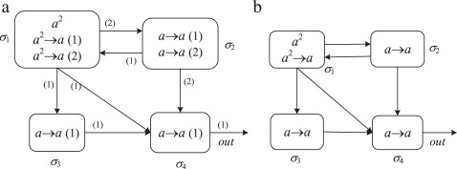
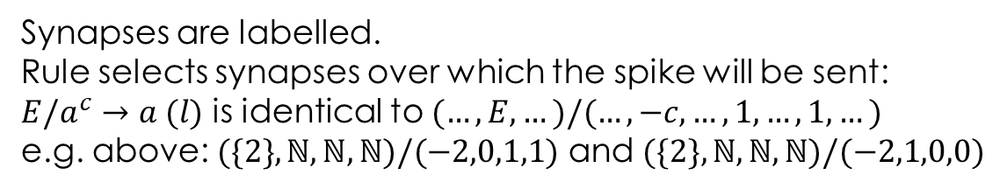
Multiple channels SNP
Synapses are labelled.
Rule selects synapses over which the spike will be sent:
$E/a^{c}→a (l)$ is identical to $(…,E,…)/(…,−c,…,1,…,1,…)$
e.g. above: $(\{2\},ℕ,ℕ,ℕ)/(−2,0,1,1)$ and $(\{2\},ℕ,ℕ,ℕ)/(−2,1,0,0)$

Slide 24
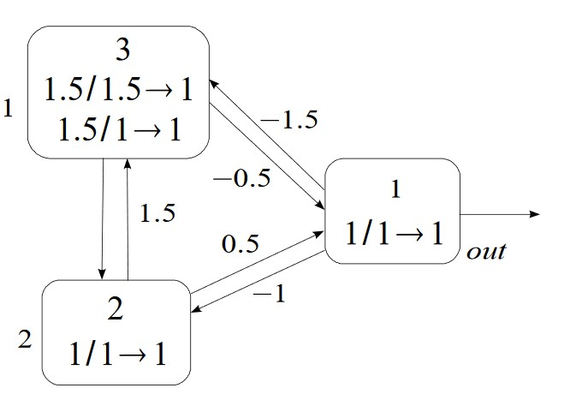
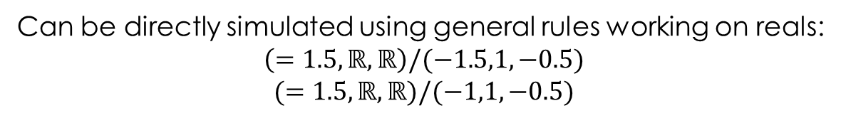
Real weights and thresholds
From Wang et al, 2009
If the current value is equal to the “threshold” number, then one spike is emitted, arriving to the other membrane multiplied by the weight.
If the current value is greater – nothing happens.
If it is smaller – than becomes 0.
Can be directly simulated using general rules working on reals:
$$\left(=1.5,ℝ,ℝ\right)/(−1.5,1,−0.5)$$
$$(=1.5,ℝ,ℝ)/(−1,1,−0.5)$$

Slide 25
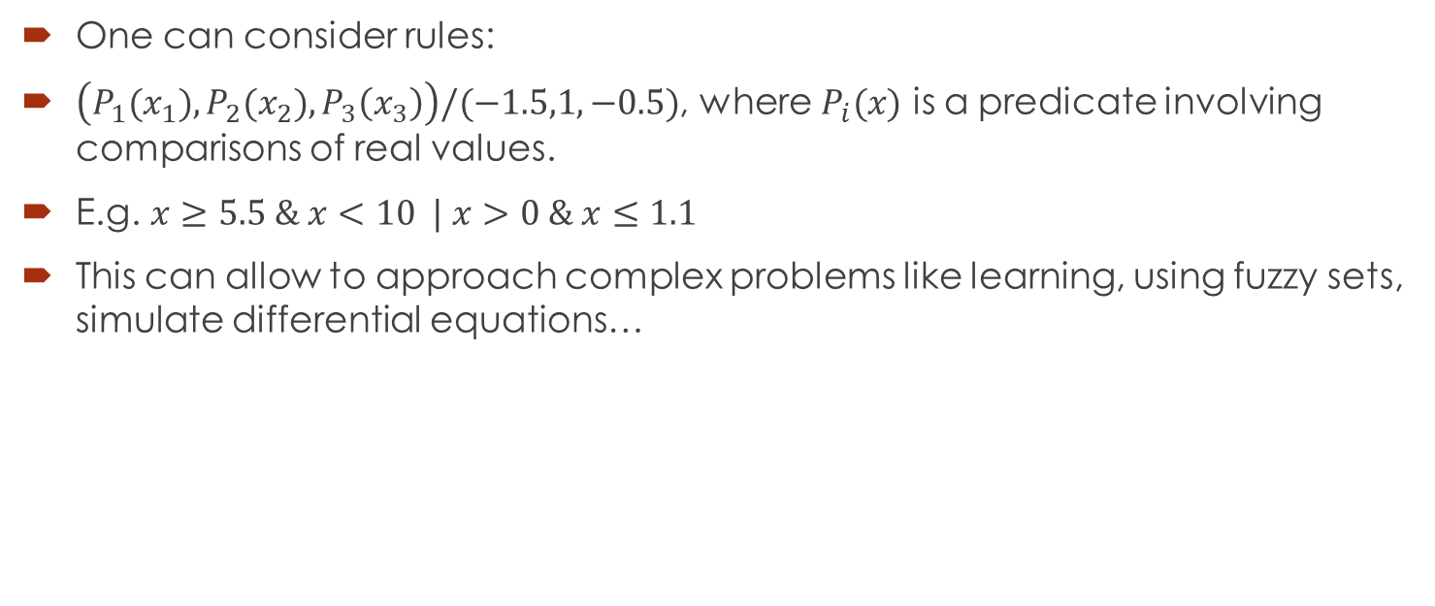
Back to real numbers
One can consider rules:
$\left(P_{1}(x_{1}),P_{2}(x_{2}),P_{3}\left(x_{3}\right)\right)/(−1.5,1,−0.5)$, where $P_{i}(x)$ is a predicate involving comparisons of real values.
E.g. $x≥5.5 \& x<10 | x>0 \& x≤1.1$
This can allow to approach complex problems like learning, using fuzzy sets, simulate differential equations…

Slide 26
Conclusions
We extended the formal framework with:
New types of rules (using regular expressions)
New input procedure.
New output procedure.
Then SNP systems can be easily described.
Because of one-letter alphabet, a simpler description can be used, which basically corresponds to vector addition systems with a regular condition check.
Standard SNP corresponds to a (sequential) VAS with regular expression check.
Existing variants of SNP can be easily described.

