Slide 1
Formal Framework: Twelve Years Later
Sergey Verlan
University of Paris EsT

Slide 2
Formal framework : the beginning
First thoughts:
Hypergraph structure in generalized communication model in 2005-2006.
R. Freund’s work on partial halting 2006-2007.
Motivation:
The ambiguity of the minimal parallelism concept.
Genesis:
The discussions with R. Freund in 2007 at BWMC5.
The formal framework was introduced in 2007 as a tool to formally express the structure and the functioning of a P system.
The obtained result is generic and can be applied to models that are not necessarily P systems (e.g. Petri nets).

Slide 3
Formal framework: Quiz (1/2)
What is it?
A family of models of distributed multiset rewriting which care about locations. This is the most general variant of distributed multiset rewriting (generalizing P systems, VAS, Petri nets, register machines, population protocols, etc).
Is this a definition/model for P systems?
No. The core of formal framework (the network of cells) can be seen as a concrete variant/series of P systems.
Does it define the semantics of P systems?
No. At least not directly.

Slide 4
Formal framework: Quiz (2/2)
What is it for?
For most of variants of P systems we can easily construct a model in the formal framework that bisimulates it. Moreover, in most cases it is a strong bisimulation i.e. 1 step in the original system is done by 1 step in the formal framework.
How this can be done?
The form of the configuration and of rules are close to the multiset rewriting and generalizes most common configurations changes in P systems.
Why it is called formal framework?
?
In most of the cases the simulated P system is a restriction of the formal framework.
Many generic notions expressed in FF can be incorporated/interpreted in the original system due to bisimulation.

Slide 5
Bisimulation
One of the important properties of FF is that for any P system it is possible to write a FF model that in most cases strongly bisimulates it.
Two models linked by a bisimulation can be seen as identical!
In most of the cases there is a direct correspondence between rules.
Formal Framework
Network of cells
Derivation mode
Halting
Result
P system
FF model
Bisimulation
Notes:
Two models linked by a bisimulation can be seen as identical.

Slide 6
Formal framework: ideas
In order to formally define a P system we need to:
Give the structure.
Explain what means a configuration and give the initial configuration.
Explain what means a rule and give the set of rules.
Explain how a transition step is performed:
Which rules can be applied.
Which rules are applied.
How the rules are applied.
Explain when to stop.
Explain what means the result of the computation.
In most of the cases the definitions are highly repetitive. The framework should give a way not to repeat the same all the times
Notes:
Of course this is for computational variants of P systems.

Slide 7
Formal Framework: ingredients
Network of cells
Network of cells
(structure & rules)
Set of multisets of applicable rules computation
Configuration
Rule applicability
Derivation mode
Derivation mode: set restriction
Halting condition
Halting condition: recursive predicate
Result acquisition
Result acquisition: recursive function

Slide 8
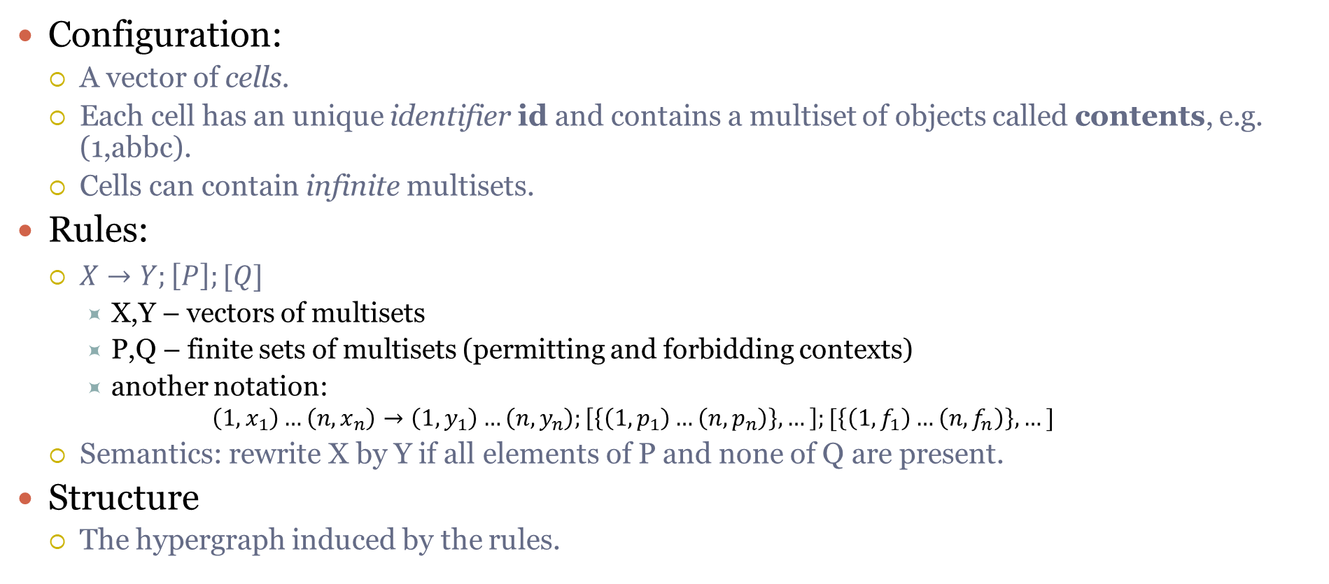
Network of cells: structure & rules
Configuration:
A vector of cells.
Each cell has an unique identifier id and contains a multiset of objects called contents, e.g. (1,abbc).
Cells can contain infinite multisets.
Rules:
$X→Y;\left[P\right];[Q]$
X,Y – vectors of multisets
P,Q – finite sets of multisets (permitting and forbidding contexts)
another notation:
$$\left(1,x_{1}\right)…\left(n,x_{n}\right)→\left(1,y_{1}\right)…\left(n,y_{n}\right);\left[\left\{\left(1,p_{1}\right)…\left(n,p_{n}\right)\right\},…\right];[\left\{\left(1,f_{1}\right)…\left(n,f_{n}\right)\right\},…]$$
Semantics: rewrite X by Y if all elements of P and none of Q are present.
Structure
The hypergraph induced by the rules.
b
c
1
a
a
4
c
2
b
d
5
3

Slide 9
Example
$$\left(a,c,λ,λ,λ\right)→\left(c,λ,λ,a,b,λ\right);[\{(b,λ,λ,λ,λ)\}]; [\{(λ,λ,d,λ,λ)\}]$$
$$\left(1,a\right)\left(2,c\right)→(1,c)(4,a)(5,b); [\{(1,b)\}]; [\{(3,d)\}]$$
b
b
c
1
a
4
a
c
2
b
d
5
3
Notes:
Difference to PN: context conditions

Slide 10
Formal framework: semantics
X
Rule 1
Rule 2
1. Compute all applicable multisets of rules
Rule 4
Rule 1
Rule 3
2. Restrict according to the derivation mode
3. Apply to the current configuration
4. Verify if the system should halt
Rule 5
5. If not, then loop 1-4
Halt?
6. If yes, then get the result
Result
Configuration (vector of multisets)

Slide 11
Derivation modes
In formal terms it is a set restriction of Applicable(Π,C,asyn), which is the set of multisets of applicable rules of system Π in configuration C.
Some common modes (r₁: a->bc, r₂: aab->ab, r₃: b->aa, multiset: aabbc):
Asynchronous (no restriction)
r₁, r₂, r₃, r₁r₁, r₁r₃, r₂r₃, r₃r₃, r₁r₁r₃, r₁r₃r₃, r₁r₁r₃r₃
Sequential (consider only multisets of size one)
r₁, r₂ and r₃
Maximally parallel (consider only non-extensible multisets = no rule is applicable anymore)
r₁r₁r₃r₃ and r₂r₃
Set-maximally parallel or flat (maximally parallel, but at most one rule of each kind = no unused rule is applicable anymore)
r₁r₃ and r₂r₃

Slide 12
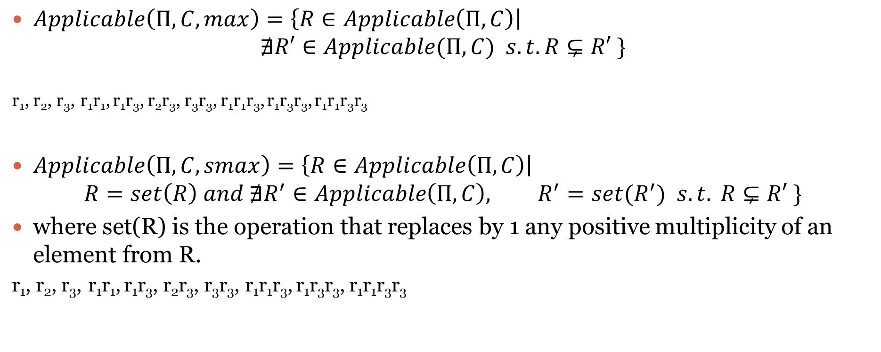
Examples of definition
$Applicable\left(Π,C,max\right)=\left\{R∈Applicable\left(Π,C\right)\right|$ $∄R′∈Applicable(Π,C) s.t. R⊊R′ \}$
r₁, r₂, r₃, r₁r₁, r₁r₃, r₂r₃, r₃r₃, r₁r₁r₃, r₁r₃r₃, r₁r₁r₃r₃
$Applicable\left(Π,C,smax\right)=\left\{R∈Applicable\left(Π,C\right)\right|$ $R=set\left(R\right) and ∄R^{′}∈Applicable\left(Π,C\right), R^{′}=set(R^{′}) s.t. R⊊R′ \}$
where set(R) is the operation that replaces by 1 any positive multiplicity of an element from R.
r₁, r₂, r₃, r₁r₁, r₁r₃, r₂r₃, r₃r₃, r₁r₁r₃, r₁r₃r₃, r₁r₁r₃r₃

Slide 13
Formal framework: usage
Understand the functioning of some variant of P systems.
Compare and relate variants of P systems.
Explain points that can have different interpretations.
Extend variants of P systems with new features.
There is a list of features defined for the formal framework and due to the bisimulation they can be interpreted directly in the corresponding P system, e.g. derivation modes or halting conditions.
Notes:
Give examples orally:
Compare – diff models
Interpretations: min ||, dynamic, P systems not formal
Extension: easy to incorporate, e.g membrane dissolution

Slide 14
Understand

Slide 15
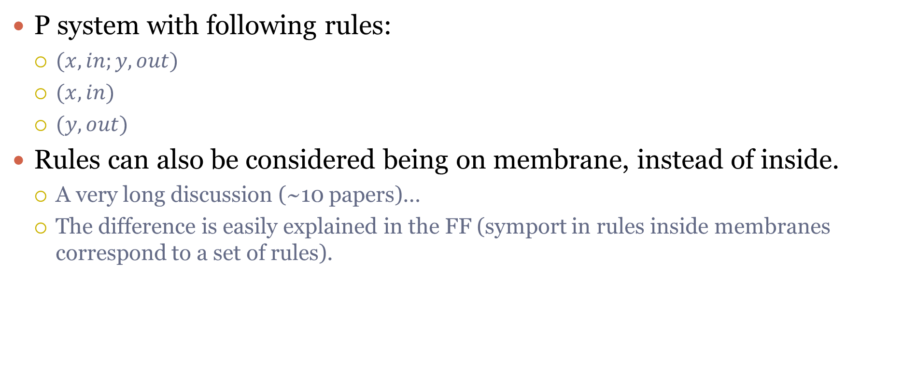
Symport/antiport
P system with following rules:
$(x,in;y,out)$
$(x,in)$
$(y,out)$
Rules can also be considered being on membrane, instead of inside.
A very long discussion (~10 papers)…
The difference is easily explained in the FF (symport in rules inside membranes correspond to a set of rules).
x
y
Notes:
Long discussion about on or in membrane…

Slide 16





Translation to FF
B∞
B
$$A^{4}$$
(A,out;BB,in)
0
1
2
B
$$A^{4}$$
$$\left(1,A\right)→(0,A)(1,BB)$$
(B, in; A, out)
(B,out)
$$\left(1,B\right)(2,A)→(2,B)(1,A)$$
2
$$(2,B)→(1,B)$$
1
Derivation mode: maximal parallelism

Slide 17
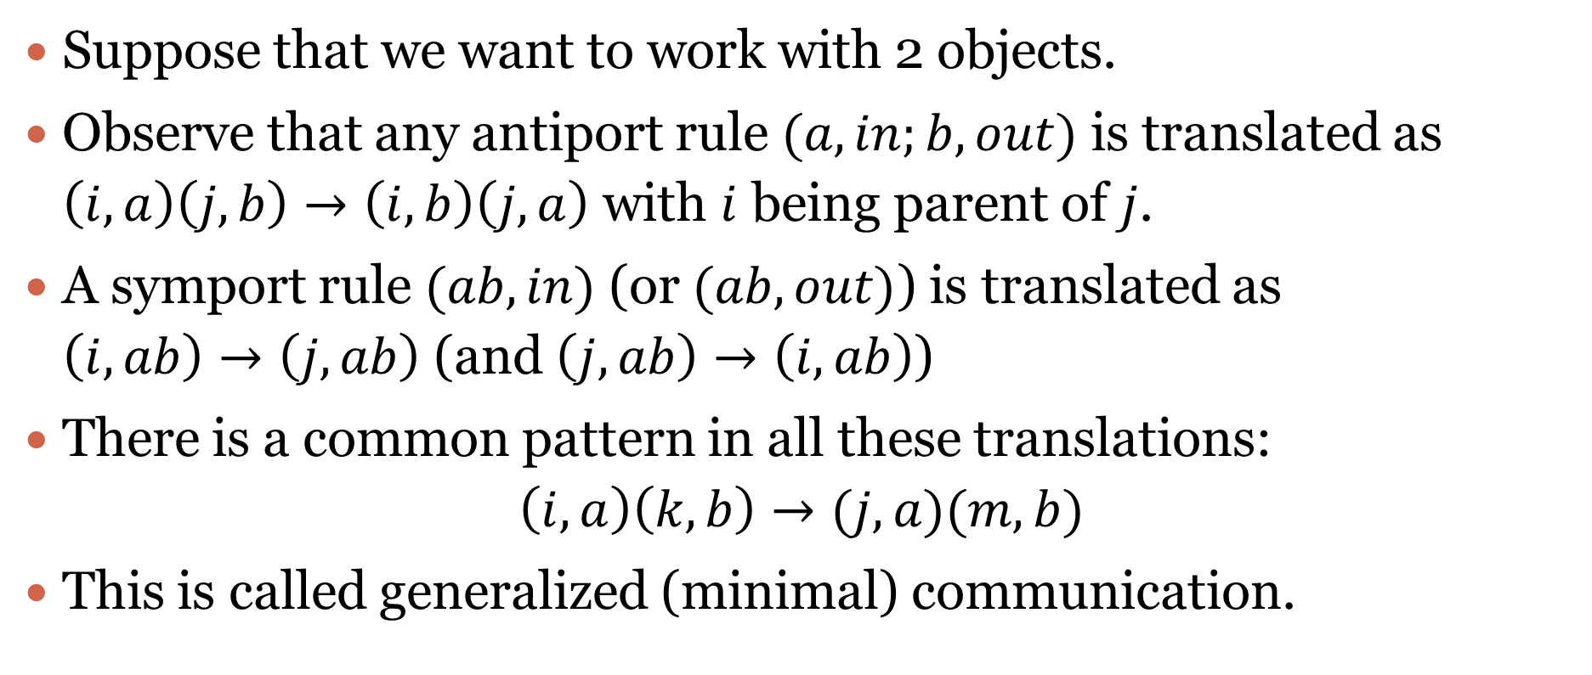
Generalized communication
Suppose that we want to work with 2 objects.
Observe that any antiport rule $(a,in;b,out)$ is translated as $\left(i,a\right)\left(j,b\right)→\left(i,b\right)\left(j,a\right)$ with $i$ being parent of $j$.
A symport rule $(ab,in)$ (or $(ab,out)$) is translated as $\left(i,ab\right)→\left(j,ab\right)$ (and $\left(j,ab\right)→\left(i,ab\right)$)
There is a common pattern in all these translations: $\left(i,a\right)\left(k,b\right)→(j,a)(m,b)$
This is called generalized (minimal) communication.

Slide 18
Generalized minimal communication
Restrictions: what if some of i,j,k,m coincide? 9 variants
A
A
B
Semantics (local):
1:1
1:*
*:*
k:m
A
i
m
So, FF allows to raise new questions
B
B
B
k
j
Semantics (global):
Max ||
Sequential
Asynchronous
Locally ||
Probabilistic
…
(i,A)(k,B)->(j,A)(m,B)

Slide 19
Example: Purely catalytical P systems
abc
aac
c
a
cb→caa
a
0
1
2
3
4
ca→cbb
3
aac
c
4
2
ca→cb_{in}d_{in4}b_{out}e_{out}e_{here}
(1,ca)→(0,be)(1,ce)(4,bd)
(1,ca)→(0,be)(1,ce)(3,b)(4,d)
1
abc
(0,cb)→(0,c)(2,a)
cb→ca_{in2}
(3,ca)→(3,cbb)
Use at most one rule from each membrane in maximal (non-extendable) set mode.
0
(3,cb)→(3,caa)
P1:
(1,a)→(0,be)(1,e)(4,bd)
(1,a)→(0,be)(1,e)(3,b)(4,d)
P3:
(3,a)→(3,bb)
min₁
(3,b)→(3,aa)
P2:
(0,b)→(2,a)
Notes:
Tree structure, maximal parallelism, total halting, the result is the number of objects in the skin/output membrane modulo the number of catalysts.
Hypergraph structure…

Slide 20
Relate
Also a link between the descriptional complexity parameters
P colonies
Multistable catalytic P systems
Formal framework for P systems

Slide 21
Extend

Slide 22
Implementing different features
We showed how to implement in FF the following features:
Membrane thickness.
Membrane polarization/labels.
Rule priorities.
Dissolution.
Flattening.
New derivation modes.
Probabilities.
This can be immediately used for any P systems model.

Slide 23
Extending with probabilities
Applicable(Π,C,δ)={R₁,…,R_{s}}
If s>1, then non-deterministic choice
Semantically, this is equivalent to choosing R_{i} equiprobably!
We can use a different distribution.
Main idea: chose R_{i} based on some probabilities/constants associated to each individual rule.
This permits to add probabilistic evolution to any P system.
Moreover, in classical case δ=seq, but we can play with more complex strategies.

Slide 24
Some interesting modes
Set-conditional (or flat) mode: maximally parallel, but at most one copy of each rule can be used. Firstly defined to speed-up the FPGA-based hardware simulation.
Look-ahead mode: disallow multisets of rules containing forbidden (trap) rules. Allow to reduce the non-determinism (in many cases deterministic evolution is obtained).
Bounded parallel modes (maximal and minimal). Particularly useful for computer simulations.

Slide 25
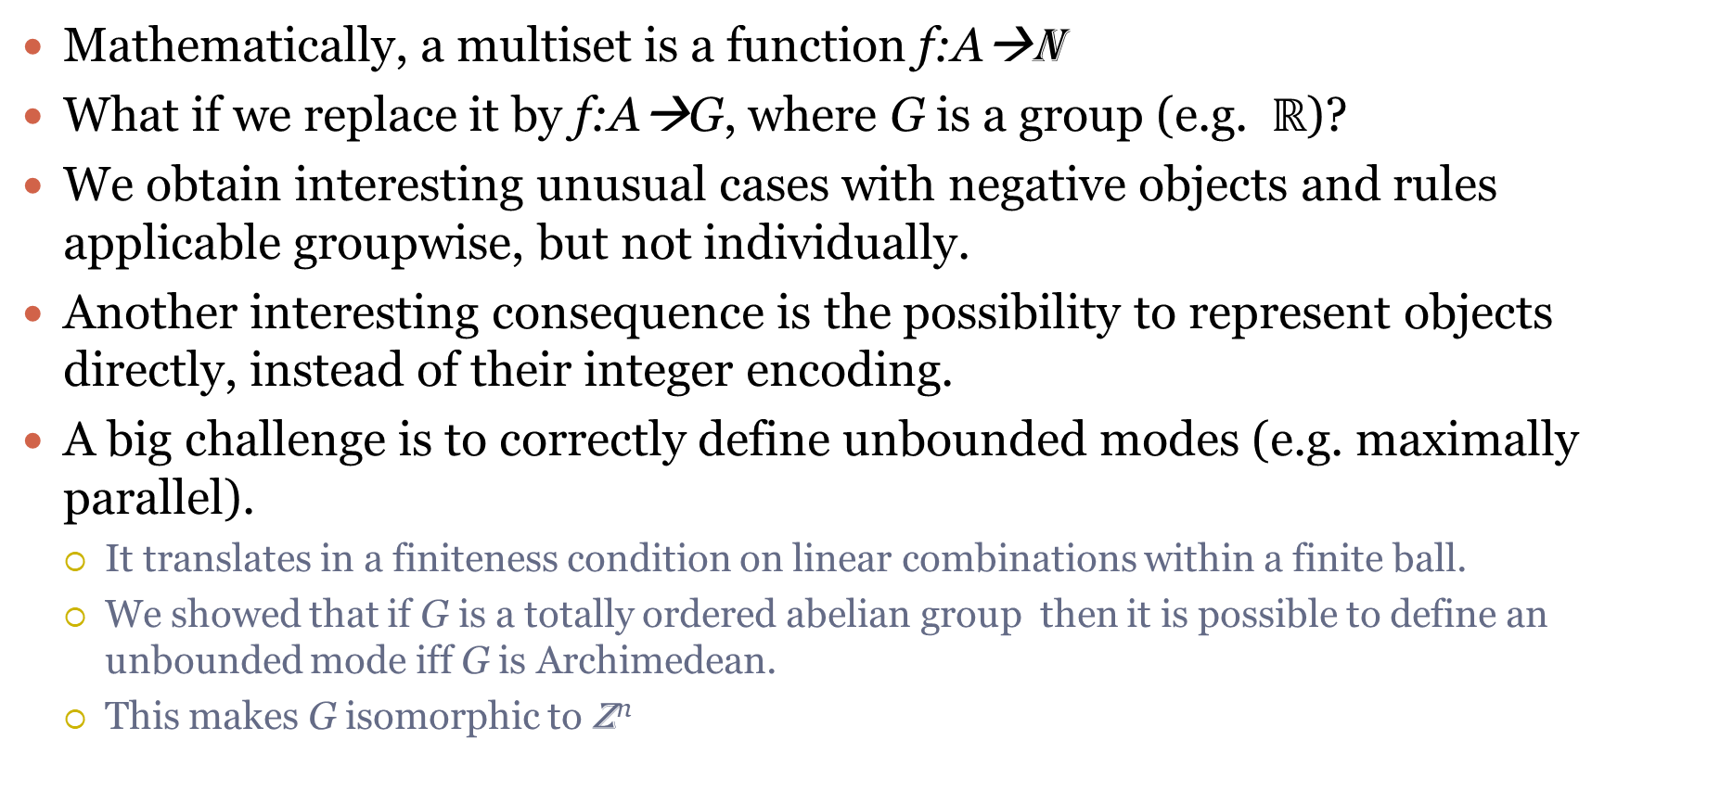
Going beyond integers
Mathematically, a multiset is a function f:A→N
What if we replace it by f:A→G, where G is a group (e.g. $ℝ$)?
We obtain interesting unusual cases with negative objects and rules applicable groupwise, but not individually.
Another interesting consequence is the possibility to represent objects directly, instead of their integer encoding.
A big challenge is to correctly define unbounded modes (e.g. maximally parallel).
It translates in a finiteness condition on linear combinations within a finite ball.
We showed that if G is a totally ordered abelian group then it is possible to define an unbounded mode iff G is Archimedean.
This makes G isomorphic to Z^{n}
Notes:
Easier transformation Diff. Eq. => membrane systems

Slide 26
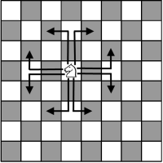

Example: chess knight as object
Moving chess knight on an infinite board.
Represent a knight by an object a = (x,y)
Rules like $\left(x,y\right)→(x+2,y+1)$

Slide 27
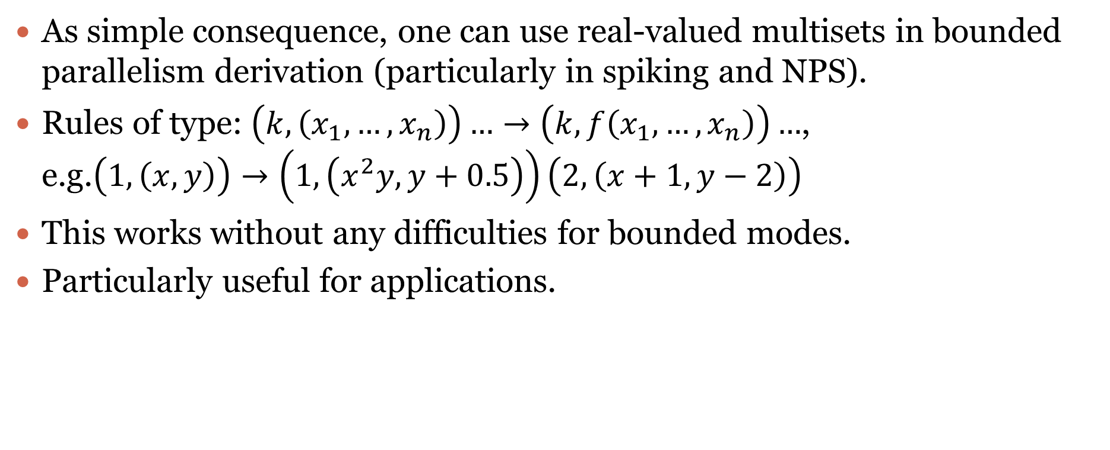

Using rational/real numbers
As simple consequence, one can use real-valued multisets in bounded parallelism derivation (particularly in spiking and NPS).
Rules of type: $\left(k,\left(x_{1},…,x_{n}\right)\right)…→\left(k, f\left(x_{1},…,x_{n}\right)\right)…$, e.g.$\left(1,\left(x,y\right)\right)→\left(1,\left(x^{2}y,y+0.5\right)\right)\left(2,\left(x+1,y−2\right)\right)$
This works without any difficulties for bounded modes.
Particularly useful for applications.
(x,y)
(x,y)
2
$$\left(1,\left(x,y\right)\right)→\left(1,\left(x^{2}y,y+0.5\right)\right)\left(2,\left(x+1,y−2\right)\right)$$
1
Notes:
Spiking & NPS

Slide 28

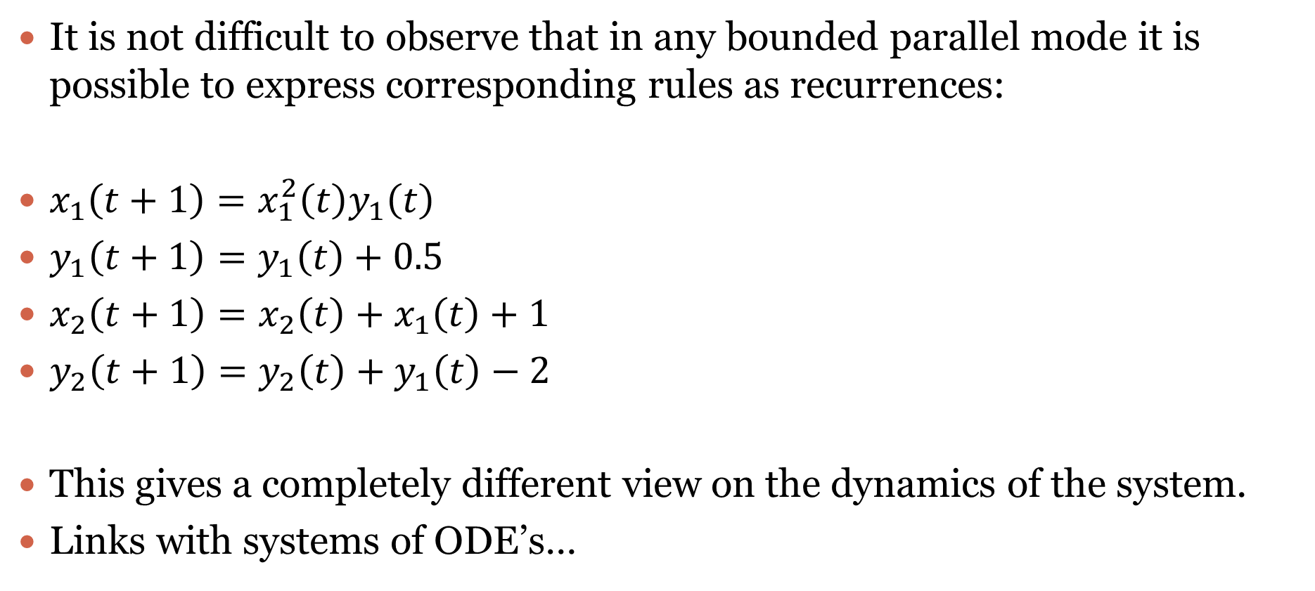
Recurrences
It is not difficult to observe that in any bounded parallel mode it is possible to express corresponding rules as recurrences:
$x_{1}\left(t+1\right)=x_{1}^{2}\left(t\right)y_{1}\left(t\right)$
$y_{1}\left(t+1\right)=y_{1}\left(t\right)+0.5$
$x_{2}\left(t+1\right)=x_{2}\left(t\right)+x_{1}\left(t\right)+1$
$y_{2}\left(t+1\right)=y_{2}\left(t\right)+y_{1}\left(t\right)−2$
This gives a completely different view on the dynamics of the system.
Links with systems of ODE’s…
(x,y)
(x,y)
2
$$\left(1,\left(x,y\right)\right)→\left(1,\left(x^{2}y,y+0.5\right)\right)\left(2,\left(x+1,y−2\right)\right)$$
1

Slide 29
Other models

Slide 30
Models
Formal framework can be applied for many other multiset-based models:
Static P systems
Multiset rewriting
Petri nets
Vector addition systems
Register machines
Counter automata
Population protocols
Systems of recurrences
This shows that essentially these models are the same.

Slide 31
Why use so many formalisms?
Multiset rewriting: chemical and biological modelling
Petri nets: modeling
Vector addition systems: decidability properties
P systems: spatial aspects, semantics, restrictions, computational completeness
Population protocols: distributed algorithms
Register machines: universality

Slide 32
Example: population protocols
Model of sensor networks used to study the population dynamics in the context of distributed algorithmics
Agents with limited capabilities: pq->p’q’
Fairness condition: for all configurations C that appear infinitely often in the execution, if C is predecessor of a configuration C’, then C’ appears infinitely often in the execution.
The result: the consensus value of the configuration (after stabilization)
A predicate is computable by PP iff it is semilinear (= predicates on counts of input agents definable in 1st-order Presburger arithmetic).
C
C'

Slide 33
Translation to the formal framework
The structure is the same, so a rule pq->p’q’ becomes (p,●)(q,●)->(p’,●)(q’,●)
The derivation mode fulfilling the fairness condition is a probabilistic evolution according to Gillespie SSA algorithm (used to simulate biochemical reactions).
As a consequence the evolution of the system can be described by a set of ODE’s simulating a set of chemical reactions under the mass action law.
Reverse problem can be also considered: for a given set of ODE’s construct a system that approximates it when the population size goes to infinity.
Notes:
SSA: gives a way to simulate a continuous-time Markov chain with the states corresponding to the configurations of and with transitions between states corresponding to a single application of a rule
The environment add more power

Slide 34
Past challenges
Biological modelling
Used groupwise probabilistic evolution.
Described and compared existing strategies.
Dynamically evolving structures
Solved using pattern matching and graph rewriting.
Still many results to come.
Spiking
The biggest challenge was to properly define the input and the output.
NPS and real-valued models
The challenge was the update scheme.
Solved using equation-based approach.

Slide 35
Future challenges
Deep learning.
Fuzzy reasoning.
Adapted models for applications.

Slide 36
Conclusion
FF is a useful tool to understand, review and extend others work on P systems and other multiset-rewriting based models.
It allows to situate a newly developed model with respect to existing ones.
It permits to ask, answer and raise questions related to the semantics of some model.
It allows to quickly enhance a model with a different derivation mode or halting condition.
Permits to relate (apparently) different models of P systems and also multiset-rewriting based models.

Slide 37
Milestones
2006-2007: Hypergraph structure (Generalized communicating P systems).
2007: Introduction of FF (with R. Freund) in order to correctly define the minimal parallelism.
By 2009: Systemized existing features in P systems and also proposed many new ideas.
2010: Parts of Handbook on MC are written using it.
2011-2013: Formalized the dynamical structure P systems (with R. Freund, I. Pérez-Hurtado and A. Riscos-Núñez).
2012: Introduced smax (flat mode).
2012: Used for the construction of fast hardware implementations.
By 2013: Considered probabilities, explained many variants of P systems, have shown links to other multiset-based models & PN, etc
2015: Generalization for abelian groups.
2016-2017: Several results on bi-simulations.
2019: Spiking

