Slide 1
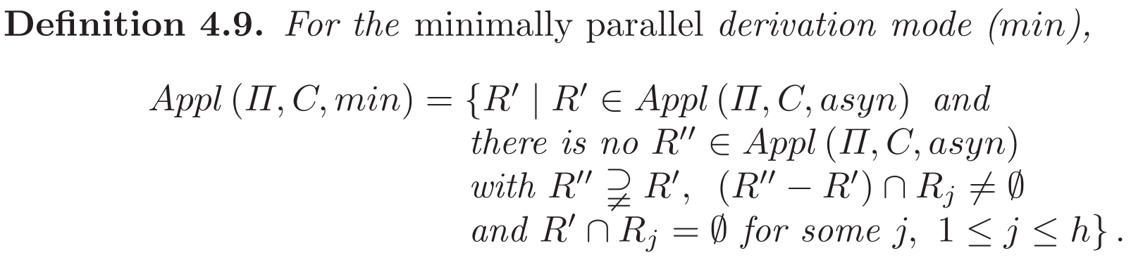
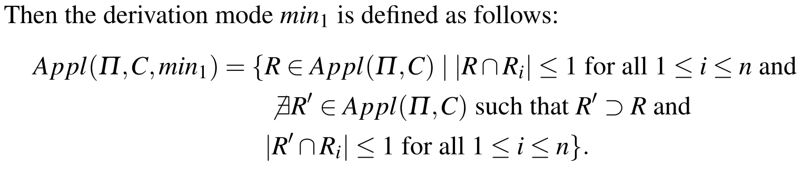
R ← R’
R’← R’’

Slide 2
R =
R₁
∪
R₂
∪
R₃
∪
R₄
∪
R₅
∪
R₆
∪
….
∪
R_{h}
….
R’
R’’
R’ is applicable.
R’’ is applicable.
|R’ ∩ R_{i} |≤ 1, for all i = 1,….,h
|R’’∩ R_{i} |≤ 1, for all i = 1,….,h
R’ ⊂ R’’

Slide 3
R =
R₁
∪
R₂
∪
R₃
∪
R₄
∪
R₅
∪
R₆
∪
….
∪
R_{h}
….
R’
R’’
R’ is applicable.
R’’ is applicable.
|R’ ∩ R_{i} |≤ 1, for all i = 1,….,h
|R’’∩ R_{i} |≤ 1, for all i = 1,….,h
R’ ⊂ R’’

Slide 4
Homogeneous SN P Systems
State – (Regular) Set of numbers of spikes
a¹
1
S₁ = {1}
r₁: a¹ / a^{c} → a^{p}; d
a²
a³
a⁴
1
2
3
S_{A} = {2k}_{k≥0}
S_{B} = {2k+1}_{k≥0}
r₁: (a²)* / a^{c1} → a^{p1}; d₁
r₂: a(a²)* / a^{c2} → a^{p2}; d₂

Slide 5
Homogeneous SN P Systems
State – (Regular) Set of numbers of spikes
+2
-2/0, +2
S_{A}
a¹⁰
r₁: (a²)* / a² → λ
r₂: a(a²)* / a² → a
+1, -2/0
+1, -2/1
1
S_{B}
+2
-2/1
S_{A} = {2k}_{k≥0}
S_{B} = {2k+1}_{k≥0}

