Slide 1
On String Languages Generated by
Spiking Neural P Systems with
Structural Plasticity
Algorithms and Complexity Laboratory
Department of Computer Science
University of the Philippines
Diliman, Quezon City, Philippines
2018 May 11
Master of Science Thesis by
Ren Tristan A. de la Cruz

Slide 2
Introduction

Slide 3
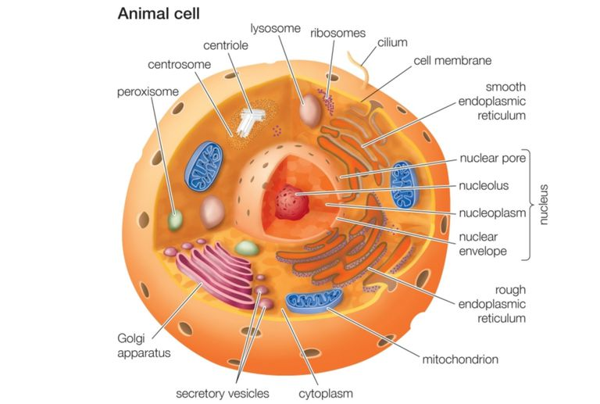
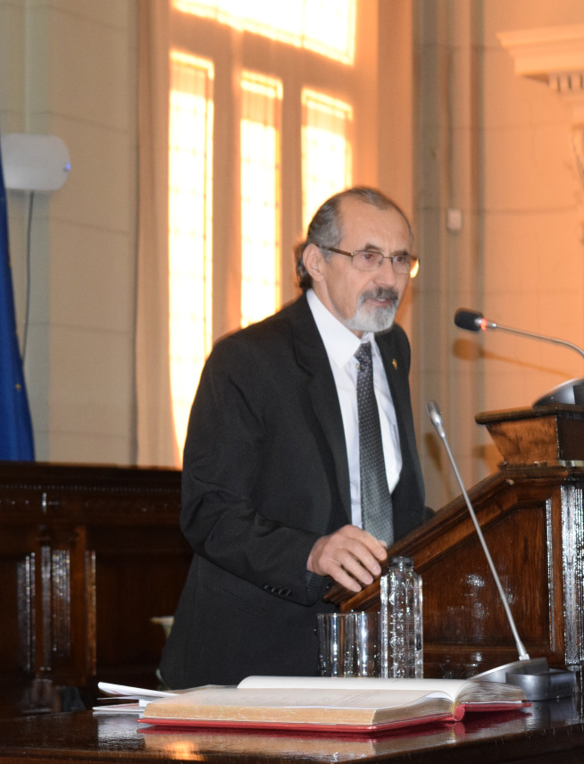
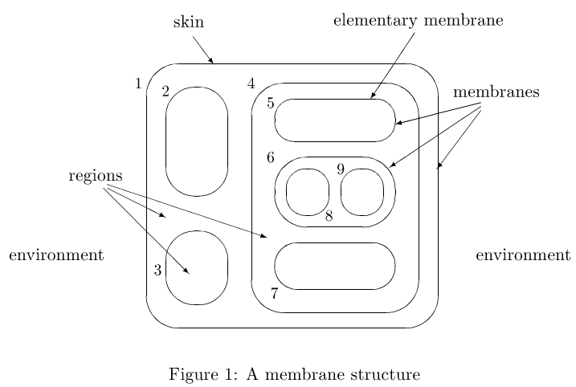
Introduction
Gheorghe Păun
1998: Computing with Membranes (P Systems)

Slide 4
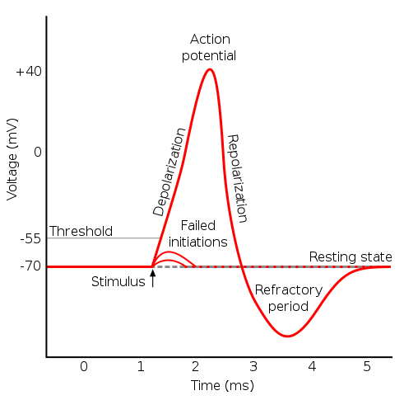
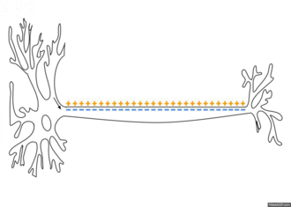
Introduction
2007: Spiking Neural P Systems

Slide 5
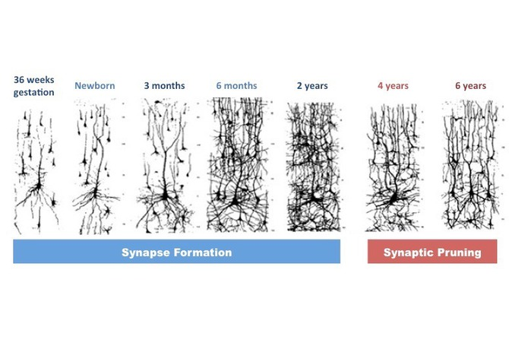
Introduction
2015: Spiking Neural P Systems with Structural Plasticity

Slide 6
Contributions

Slide 7
Contributions
Results:
1. Two procedures for constructing SNPSP systems that generate FIN languages
2. Two procedures for constructing SNPSP systems that generate REG languages
3. Two versions of a procedure for constructing SNPSP systems that generate RE languages
4. An implementation of an SNPSP module called Arithmetic-Memory module that performs arithmetic operations

Slide 8
Contributions
Results:
5. A procedure for constructing an SNPSP system that generates CF languages
6. A way for simulating SNP system’s forgetting rules in SNPSP systems
7. Ways for simulating the ‘delay’ aspect of an SNP system’s spiking rule in SNPSP systems
8. A way for simulating, in SNP systems, some aspects of SNPSP system’s plasticity rules

Slide 9
SNP & SNPSP Systems

Slide 10
SNP & SNPSP Systems (1/11)
SNP system Π of degree m:
Π = (O, σ₁, ... ,σ_{m}, syn, out)
Alphabet: O = {a}, a - spike
Synapses: syn ⊂ {1,...,m} × {1,...,m}
Neurons: σ₁, ... ,σ_{m}
σ_{i} = (n_{i}, R_{i})
n_{i} - initial number of spikes
R_{i} - set of rules of the neuron
Output Neuron (label): out∈{1,...,m}
SNPSP system Π of degree m:
Π = (O, σ₁, ... ,σ_{m}, syn, out)
Alphabet: O = {a}, a - spike
Initial Synapses: syn ⊂ {1,...,m} × {1,...,m}
Neurons: σ₁, ... ,σ_{m}
σ_{i} = (n_{i}, R_{i})
n_{i} - initial number of spikes
R_{i} - set of rules of the neuron
Output Neuron (label): out∈{1,...,m}

Slide 11
SNP & SNPSP Systems (2/11)
a²
a³
a⁵
1
2
3
a⁷
a¹¹
a¹³
4
5
6
SNP/SNPSP system Π of degree m: Π = (O, σ₁, ... ,σ₆, syn, 6)
Alphabet: O = {a}
Synapses: syn = {(1,2), (2,3), (3,5), (3,6), (4,1), (4,2), (5,4)}
Neurons: σ₁=(2,R₁), σ₂=(3,R₂), σ₃=(5,R₃), σ₄= (7,R₄),
σ₅=(11,R₅), σ₆=(13,R₆)
Output Neuron (label): 6

Slide 12
SNP & SNPSP Systems (3/11)
SNP system Rules:
Neurons: σ_{i} = (n_{i}, R_{i})
R_{i} - set of rules of the neuron
Rule: r_{j}∈R_{i}
r_{j} is a rule in R_{i}. It can have either of the following forms:
Spiking Rule (Form):
E / a^{c} → a:d
Forgetting Rule (Form):
a^{c} → λ
SNPSP system Rules:
Neurons: σ_{i} = (n_{i}, R_{i})
R_{i} - set of rules of the neuron
Rule: r_{j}∈R_{i}
r_{j} is a rule in R_{i}. It can have either of the following forms:
Spiking Rule (Form):
E / a^{c} → a
Plasticity Rule (Form):
E / a^{c} → αk(i, N)

Slide 13
SNP & SNPSP Systems (4/11)
Rule’s Activation Criteria: E / a^{c}
1) a^{c} – c is positive integer. a^{c} means that the neuron that contains the rule should have at least c spikes.
2) E – Regular Expression over O = {a}. The rule can only activate when the number of spikes (represented by a^{n}) in the neuron is ‘covered’ by the regular expression E.
a^{n} ∈ L(E).
Examples:
a^{n}=a⁷, E₁=a²(a⁵)* – a⁷∈L(E₁) – OK – L(E₁) ={a^{5x+2} | x ≥ 0}
a^{n}=a⁹, E₂=(a²)* – a⁹∉L(E₂) – Not OK – L(E₂) ={a^{2x} | x ≥ 0}
a^{n}=a¹⁰, E₃=(a²+a³)* – a¹⁰∈L(E₃) – OK –
L(E₃)={a^{2x+3y} | x ≥ 0, y ≥ 0}

Slide 14
SNP & SNPSP Systems (5/11)
Notes on: E / a^{c}
1) When the regular expression E = a^{c}, the rule criteria
“a^{c} / a^{c}” can simply be written as “a^{c}”.
2) For forgetting rule, the activation criteria are written as “a^{c}”. The regular expression E (of forgetting rules) is restricted and is always “a^{c}”. For any forgetting rule with criteria a^{c}, the string a^{c}∉L(E’) where E’ a regular expression of any of the spiking rule in the same neuron.
3) If rule r₁ has regular expression E₁ and rule r₂ has regular expression E₂, it is possible that L(E₁) ∩ L(E₂) ≠ ∅. The languages defined by the regular expressions can intersect. It is possible that multiple rules are applicable. If this is the case, then one rule in non-deterministically selected and appliced/activated.

Slide 15
SNP & SNPSP Systems (6/11)
Spiking Rule: E / a^{c} → a:d
d ≥ 0 is known as the delay. When a spiking rule is activated /applied at time t, c spikes are consumed and the neuron containing the rule will be ‘closed’ for d steps, then will open at time t+d and send a spike to connected neurons.
Example: r_{j}: (a²)* / a² → a:3, r_{j}∈R₁, n₁ = 8
σ₁ sends spikes
a²
2
a²
2
a²
2
a³
2
a³
3
a³
3
a³
3
a⁴
3
a⁶
a⁶
a⁶
a⁶
a⁵
4
a⁵
4
a⁵
4
a⁶
4
1
1
1
1
a⁷
5
a⁷
5
a⁷
5
a⁸
5
t+0
σ₁ closes
t+1
σ₁ is closed
t+2
σ₁ is closed
t+3
σ₁ opens

Slide 16
SNP & SNPSP Systems (7/11)
Notes on Spiking Rules: E / a^{c} → a:d
- When a neuron is ‘closed’, it can not receive spikes from other neurons and can not activate/applied other rules.
- After applying a spiking rule at time t, only at time t+d+1 can another rule be applied.
Forgetting Rule: a^{c} → λ
When a forgetting rule is applied/activated it will simply consume c spikes (all the spikes) from the neuron that contains the rule.

Slide 17
SNP & SNPSP Systems (8/11)
Plasticity Rules: E / a^{c} → αk(i, N)
1) i is the label of the neuron containing the rule.
2) α ∈ {+,-,±,∓} - action to be performed.
+ add synapses
- delete synapses
± add then (in the next step) delete synapses
∓ delete then (in the next step) add synapses.
3) N ⊆ {1,...,m}-{i} - the set of target neurons
4) 1 ≤ k ≤ |N| - number of synapses to be added or deleted.
5) When a synapse (i,j) is created, it will send one spike to neuron j.

Slide 18
SNP & SNPSP Systems (9/11)
Example: r_{j}: a(aa)* / a² → +2(1, {2,3,4}), r_{j}∈R₁, n₁ = 5
Case 1
a⁷
2
a⁸
Case 2
a⁷
2
a⁸
2
2
a¹¹
3
a¹²
3
a¹¹
3
a¹¹
3
a⁵
a³
a⁵
a³
a¹³
4
a¹³
4
a¹³
4
1
a¹³
4
1
1
1
a¹⁷
5
a¹⁷
5
a¹⁷
5
a¹⁷
5
Case 3
a⁷
2
a⁸
2
a⁸
2
a⁷
2
a¹¹
3
a¹²
3
a¹¹
3
a¹²
3
a⁵
a³
a³
a³
a¹³
4
a¹³
4
a¹⁴
4
a¹⁴
4
1
1
1
1
a¹⁷
5
a¹⁷
5
a¹⁷
5
a¹⁷
5

Slide 19
SNP & SNPSP Systems
Example: r_{j}: a(aa)* / a² → -2(1, {2,3,4}), r_{j}∈R₁, n₁ = 5
Case 1
a⁷
a⁷
Case 2
a⁷
a⁷
2
2
2
2
a¹¹
3
a¹¹
3
a¹¹
3
a¹¹
3
a⁵
a³
a⁵
a³
a¹³
4
a¹³
4
a¹³
4
a¹³
4
1
1
1
1
a¹⁷
5
a¹⁷
5
a¹⁷
5
a¹⁷
5
Case 3
a⁷
a⁷
a⁷
2
a⁷
2
2
2
a¹¹
a¹¹
3
a¹¹
3
a¹¹
3
3
a⁵
a³
a³
a³
a¹³
a¹³
4
a¹³
4
a¹³
4
1
4
1
1
1
a¹⁷
a¹⁷
5
a¹⁷
5
a¹⁷
5
5

Slide 20
SNP & SNPSP Systems (11/11)
Semantics:
1) There is a global clock. For every step, every (open) neuron will check if there are any rules that are applicable.
2) If there are applicable rules, the neuron will non-deterministically select and apply a rule.
3) The system will halt if there are no active rules and there are no rules in any neuron that can be activated.
Output of the System (Interpretations):
1) Take note of the times when the first two spikes were sent by the output neuron to the environment. If it halts, the time difference is the output (number generated) of the system.
2) If the output neuron sends a spike to the environment then symbol ‘1’ is generated, otherwise ‘0’ is generated. If the system halts, then the string of 0 and 1 symbols is the output of the system.

Slide 21
SNP & SNPSP System Features

Slide 22
SNP & SNPSP Features: Forgetting Rule
Example 1: r_{j}: E / a^{c} → -1(1, {0}), r_{j}∈R₁
1
a^{n}
a^{m}
0
Example 2: r_{j}: E / a^{c} → +1(1, {0}), r_{j}∈R₁
1
a^{n}
a^{m}
0
Notes:
1. SNP’s forgetting rule a^{c} → λ has a restriced regular expression E=a^{c}.
2. SNPSP’s “forgetting” rule E/a^{c} → λ cis more general that SNP’s.

Slide 23
SNP & SNPSP Features: Rules with Delay
SNP spiking rule at neuron a: E / a^{c} → a:d
b₁
....
a
b_{i}
....
b_{n}
SNPSP plasticity rule at neuron a: E / a^{c} → ±1(a, {c₁,c₂,...,c_{d}})
E / a^{c} → ±1(a, {c_{d}})
b₁
....
a
c_{d}
c_{d-1}
....
c₂
c₁
b_{i}
....
b_{n}

Slide 24
SNP & SNPSP Features: Selecting Neurons
Plasticity Rule:
E / a^{c} → +1(a,{b₁,...,b_{n}})
SNP: r₁:E₁/a^{c1}→a:0, r₂:E₂/a^{c2}→a:2
t+0: r₁ (‘1’)
t+1: r₂ (‘0’)
t+2: r₂ (‘0’)
t+3: r₂ (‘1’)
b₁
....
a
c₁
b’₁
b₁
a
b_{i}
....
c₂
b’₂
b₂
b_{n}
c₃
b’₃
b₃
c₄
....
....
....
b’_{n}
b_{n}
c_{n+1}

Slide 25
SNPSP Systems & FIN Languages 1

Slide 26
SNPSP Systems & FIN Languages 1
Theorem: If L∈FIN and L⊆{0,1}⁺ , then the SNPSP system Π generates words in L’ where L’ = {0}L.
L = {b₁,b₂,b₃,...,b_{n}}
L’ = {0}L = {0b₁,0b₂,0b₃,...,0b_{n}}
l_{max} = max{|b_{i}|}
l_{max} is the length of the longest word in L.
1
2
3
l_{max}
a→a
a→a
a→a
...
a→a
Π
a
r₁,...,r_{n}
0
a→a
a→a
a→a
...
a→a
0’
1’
2’
3’
l’_{max}

Slide 27
SNPSP Systems & FIN Languages 1
For each word b_{i}∈L, there will be plasticity rule r_{i} in neuron 0 with form r_{i}: a→+k_{i}(0, N_{i}∪{|b_{i}|’}) where
N_{i} = {p | p^{th} symbol of b_{i} is ‘1’} and k_{i}=|b_{i}|₁+1.
Example: L={b₁=10110}, N₁={1,3,4}, k₁=3+1= 4,
r₁: a→+4(0, {1,3,4}∪{5’})
1
2
3
4
5
a→a
a→a
a→a
a→a
a→a
Π
a
r₁
0
a→a
a→a
a→a
a→a
a→a
0’
1’
2’
3’
4’
5’

Slide 28
SNPSP Systems & FIN Languages 1
Example: L={b₁=10110}, r₁: a→+4(0, {1,3,4}∪{5’})
1
2
3
4
5
Time: t
0
a
a→a
a
a→a
a
a→a
a→a
a→a
0
r₁
a→a
a→a
a→a
a→a
a
a→a
0’
1’
2’
3’
5’
Time: t+5
1
2
3
4
5
010110
a→a
a→a
a→a
a→a
a→a
0
r₁
a
a→a
a→a
a→a
a→a
a→a
0’
1’
2’
3’
4’
5’

Slide 29
SNP System for FIN Languages
a
a→ a; i, i = 0,…,n-1
x = 0^{d1}1 | 0^{d2}1 | ... | 0^{di}1 | 0^{di+1}
Neuron W:
r₁: E₁/a→a:d₁ - 0^{d1}1
r₂: E₂/a→a:d₂ - 0^{d2}1
...
r_{i}: E_{i}/a→a:d_{i} - 0^{di}1
Neuron l_{n}:
r_{i}: a→a:|x|-1 - 0^{di+1}
z
c₁
c₂
c_{n}
a
a→a
a→a
….
a→a
c’₁
c’₂
c’_{n}
a²→a
a→ λ
a²→a
a→ λ
a²→a
a→ λ
….
m_{1,1}
m_{2,1}
m_{n,1}
a→a
a→a
a→a
m_{1,s1}
m_{2,s2}
m_{n,sn}
….
….
….
a→a
a→a
a→a
l₁
l₂
….
l_{n}
a→a;|x₁|-1
a→a;|x₂|-1
a→a;|x_{n}|-1
R₁
w₁
R₂
w₂
….
R_{n}
w_{n}
a→a
out

Slide 30
SNPSP Systems & FIN Languages 2

Slide 31
SNPSP Systems & FIN Languages 2
Theorem: If L∈FIN and L⊆{0,1}⁺, then the SNPSP system Π that generates words in L.
Let L = {b₁,b₂,b₃,...,b_{n}}.
Let l_{max} = max{|b_{i}|} is the length of the longest word in L.
a
r_{0,i} , r_{i,0} , r_{i,1}
(n+1)·l_{max}
Π
0
1
For each b_{i}, the 3 rules r_{0,i} , r_{i,0} , r_{i,1} are added in σ₀.
r_{0,i} - generates the initial symbol of b_{i}
r_{i,0} - generates the ‘0’ symbols of b_{i}
r_{i,1} - generates the ‘1’ symbol of b_{i}

Slide 32
SNPSP Systems & FIN Languages 2
Example: L = {b₁=101, b₂ =01001, b₃=1100}. l_{max}= 5.
(n+1)·l_{max} = (3+1)5 = 20.
r_{0,1}
r_{0,2}
r_{0,3}
r_{3,0} & r_{3,1}
r_{2,0} & r_{2,1}
r_{2,0} & r_{2,1}
20 19 18 17 16 15 14 13 12 11 10 9 8 7 6 5 4 3 2 1 0
1 19 18 17 16 1 0 0 12 11 1 0 0 1 6 0 1 3 2 1 0
.
.
.
1
0
0

Slide 33
SNPSP Systems & FIN Languages 2
Example: L = {b₁=101, b₂ =01001, b₃=1100}. l_{max}= 5.
(n+1)·l_{max} = (3+1)5 = 20.
r_{0,1}:a²⁰/a¹⁵→λ
r_{0,2}:a²⁰/a¹⁰→λ
r_{0,3}:a²⁰/a¹⁰→a
r_{3,0}:a¹³+a¹⁴→λ
r_{3,1}:a¹⁵→a
r_{2,0}:a⁸+a⁹→λ
r_{2,1}:a¹⁰+a⁷→a
r_{1,0}:a⁵→λ
r_{1,1}:a⁴→a
20 19 18 17 16 15 14 13 12 11 10 9 8 7 6 5 4 3 2 1 0
1 19 18 17 16 1 0 0 12 11 1 0 0 1 6 0 1 3 2 1 0
.
.
.
1
0
0

Slide 34
SNPSP Systems & FIN Languages 2
For each b_{i}, the 3 rules r_{0,i} , r_{i,0} , r_{i,1} are added in σ₀.
Rule Form: r_{0,i}: a / a →x
(Spiking) x = a if the first symbol of b_{i} is ‘1’.
(Forgetting) x = λ if the first symbol of b_{i} is ‘0’.
(n+1)·l_{max}
(n+1-i)·l_{max}
Rule Form: r_{i,0}: E_{i} / a→λ
E_{i} =
Q_{i} ={q | q^{th} symbol of b_{i} is ‘0’}
Q’_{i} =Q_{i}-{1}
Rule Form: r_{i,1}: E_{i} / a→a
E_{i} =
P_{i} ={p | p^{th} symbol of b_{i} is ‘1’}
P’_{i} =P_{i}-{1}
Σa
Σa
i·l_{max}-(q_{j}-2)
i·l_{max}-(p_{j}-2)
q_{j}∈Q’_{i}
p_{j}∈P’_{i}

Slide 35
SNPSP Systems & REG Languages 1

Slide 36
SNPSP Systems & REG Languages 1
Right-Linear Grammar: G=(N,B,S,P)
N={N₁,N₂,...,N_{m}} (non-terminal symbols)
B={0,1} (terminal symbols)
S=N_{m} (start symbol)
P is the set of k production rules of the forms:
R_{i}: N_{pi}→bN_{qi} , b∈B, 1 ≤ p_{i},q_{i} ≤ m, 1 ≤ i ≤ k
R_{i}: N_{pi}→b , b∈B, 1 ≤ p_{i} ≤ m, 1 ≤ i ≤ k

Slide 37
SNPSP Systems & REG Languages 1
Right-Linear Grammar: G=(N,B,S,P)
N={N₁,N₂} (non-terminal symbols)
B={0,1} (terminal symbols)
S=N₂ (start symbol)
P is the set of 3 production rules:
R₁: N₂→1N₁
R₂: N₁→0N₁
R₃: N₁→1
String Derivation Example:
N₂
1N₁
10N₁
100N₁
1001

Slide 38
SNPSP Systems & REG Languages 1
Theorem: If L⊆B⁺={0,1}⁺ and L∈REG , then there is an SNPSP system Π and a morphism h: B*→B* such that
L = h⁻¹(L(Π)).
If x∈L: x=s₁s₂s₃...s_{n}
then x’∈L(Π): x’=0s₁s₁0s₂s₂0s₃s₃...0s_{n}s_{n}
s_{i}∈B (1 ≤ i ≤ n)
Morphism: h(0)=000, h(1)=011
Example: If x=10100, then x’=h(10100)
x’=h(1)h(0)h(1)h(0)h(0)
x’=011 000 011 000 000
x’=011000011000000

Slide 39
SNPSP Systems & REG Languages 1
Theorem: If L⊆B⁺={0,1}⁺ and L ∈ REG , then there is an SNPSP system Π and a morphism h: B*→B* such that
L = h⁻¹(L(Π)).
c₁
a→a
a^{2m}
r₁,…,r_{k}
c₂
a→a
0
Π
….
c_{m}
a→a
1
2
3
a→a
a→a
a→a

Slide 40
SNPSP Systems & REG Languages 1
Production Rule: R_{i}: N_{pi}→1N_{qi}
c₁
c₁
a^{m+pi}
r_{i}
c₂
a^{qi}
r_{i}
c₂
0
0
…
…
c_{m}
c_{m}
0
a
a
a
1
2
3
1
2
3
Time: t
c₁
c₁
a
a^{qi}
r_{i}
c₂
a^{m+qi}
r_{i}
c₂
0
a
0
…
…
c_{m}
a
c_{m}
01
a
011
1
2
3
1
2
3
Time: t+1
Time: t+2

Slide 41
SNPSP Systems & REG Languages 1
Production Rule: R_{i}: N_{pi}→0N_{qi}
c₁
c₁
a^{m+pi}
r_{i}
c₂
a^{qi}
r_{i}
c₂
0
0
…
…
c_{m}
c_{m}
0
a
1
2
3
1
2
3
Time: t
c₁
c₁
a
a^{qi}
r_{i}
c₂
a^{m+qi}
r_{i}
c₂
0
a
0
…
…
c_{m}
a
c_{m}
00
000
1
2
3
1
2
3
Time: t+1
Time: t+2

Slide 42
SNPSP Systems & REG Languages 1
Production Rule: R_{i}: N_{pi}→1
c₁
c₁
a^{m+pi}
r_{i}
c₂
r_{i}
c₂
0
0
…
…
c_{m}
c_{m}
0
a
a
a
1
2
3
1
2
3
Time: t
c₁
c₁
a
r_{i}
c₂
a^{m}
r_{i}
c₂
0
a
0
…
…
c_{m}
a
c_{m}
01
a
011
1
2
3
1
2
3
Time: t+1
Time: t+2

Slide 43
SNPSP Systems & REG Languages 1
Production Rule: R_{i}: N_{pi}→0
c₁
c₁
a^{m+pi}
r_{i}
c₂
r_{i}
c₂
0
0
…
…
c_{m}
c_{m}
0
a
1
2
3
1
2
3
Time: t
c₁
c₁
a
r_{i}
c₂
a^{m}
r_{i}
c₂
0
a
0
…
…
c_{m}
a
c_{m}
00
000
1
2
3
1
2
3
Time: t+1
Time: t+2

Slide 44
SNPSP Systems & REG Languages 1
Non-terminal Production rule: R_{i}: N_{pi}→bN_{qi}
Corresponding plasticity rule r_{i} in σ_{i}:
If b=1, r_{i}: a^{(m+pi)} /a^{(m+pi-qi)}→±3(0,{1,2,3})
If b=0, r_{i}: a^{(m+pi)} /a^{(m+pi-qi)}→±1(0,{3})
Requires: (m+p_{i}) spikes. Consumes: (m+p_{i}-q_{i}) spikes.
Terminal Production rule: R_{i}: N_{pi}→b
Corresponding plasticity rule r_{i} in σ_{i}:
If b=1, r_{i}: a^{(m+pi)} /a^{(m+pi)}→±3(0,{1,2,3})
If b=0, r_{i}: a^{(m+pi)} /a^{(m+pi)}→±1(0,{3})
Requires: (m+p_{i}) spikes. Consumes: (m+p_{i}) spikes.

Slide 45
SNP System for REG Languages
m+1
m+2
a²
a²/a→ a; 0
a²/a→ a; 1
a→ λ
a²
a²/a→ a; 0
a→ λ
V={a₁,...,a_{k}}
a_{s} - 0^{s}1
N_{i}→0^{s}1N_{j}
a^{m+i}/a^{m+i-j}→a;s
1
2
m
a→ a;0
a→ a;0
….
a→ a;0
a^{2m}
a^{m+i}/a^{m+i-j}→a;s
for N_{i}→0^{s}1N_{j} ∈P
a^{j}→a;k+2
for 1 ≤ j ≤ m
m+3

Slide 46
SNPSP Systems & REG Languages 2
c₁
c₂
a→a
a^{2m}
r₁,…,r_{|p|}
0
a→a
c_{m}
….
a→a
1
2
k
a→a
a→a
….
a→a

Slide 47
SNPSP Systems & RE Languages

Slide 48
SNPSP Systems & RE Languages 1: Encoding
Encoding Strings: val_{k}(x)
V={a₁,a₂,a₃,..., a_{k}} – Alphabet
x = a_{i1}a_{i2}a_{i3}...a_{im} – string over over V.
Symbol Encoding: val_{k}(a_{i})=i of symbol a_{i}.
val_{k}(a₁) = 1
val_{k}(a₂) = 2
....
val_{k}(a_{k}) = k

Slide 49
SNPSP Systems & RE Languages 1: Encoding
Example: V={a₁=p, a₂=q, a₃=r, a₄=s}, k+1 = 4+1 = 5
x = sqqrp
val₄(s) = 4₅
val₄(sq) = 10₅·val₄(s) + val₄(q) = 40₅ + 2₅ = 42₅
val₄(sqq) = 10₅·val₄(sq) + val₄(q) = 420₅ + 2₅ = 422₅
val₄(sqqr) = 10₅·val₄(sqq) + val₄(r) = 4220₅ + 3₅ = 4223₅
val₄(sqqrp) = 10₅·val₄(sqqr) + val₄(p) = 42230₅ + 1₅ = 42231₅

Slide 50
SNPSP Systems & RE Languages 1
Theorem: For every alphabet V={a₁,a₂,a₃,..., a_{k}}, there is a morphism h₁:(V∪{b,c})*→B* and a projection h₂:(V∪{b,c})*→ V* such that for each language L⊆V*, L∈RE, there is an SNPSP system Π such that L = h₂(h₁⁻¹(L(Π)))
x∈L, y∈L(Π)
x = a_{i1}a_{i2}a_{i3}...a_{im}
y = 10^{i1}1 | 0^{j1}1 | 10^{i2}1 | 0^{j2}1 | ... | 10^{im}1 | 0^{(jm+s)}1.
We define h₁ and h₂ as:
h₁(a_{i}) = 10^{i}1 for 1 ≤ i ≤ k, h₁(b)=0, h₁(c)=01
h₂(a_{i}) = a_{i} for 1 ≤ i ≤ k, h₂(b)=λ, h₂(c) = λ

Slide 51
SNPSP Systems & RE Languages 1
h₁:
h₁(a_{i}) = 10^{i}1
h₁(b) = 0
h₁(c) = 01
h₂:
h₂(a_{i}) = a_{i}
h₂(b) = λ
h₂(c) = λ
y = 10^{i1}1 | 0^{j1}1 | 10^{i2}1 | 0^{j2}1 | ... | 10^{im}1 | 0^{(jm+s)}1.
y’ = h₁⁻¹(y) = a_{i1} | b^{j1-1}c | a_{i2} | b^{j2-1}c | ... | a_{im} | b^{jm+s-1}c
x = h₂(y’) = a_{i1} | λ | a_{i2} | λ | ... | a_{im} | λ
x = h₂(h₁⁻¹(y)) = a_{i1}a_{i2}a_{i3}...a_{im}

Slide 52
SNPSP Systems & RE Languages 1: System
M₀
M
x = a_{i1}a_{i2}a_{i3}...a_{it}...a_{im}
Symbol (for x):
a_{it}
Symbol Encoding:
i_{t}
Substring (for y):
10^{it}1
val_{k}(x)
i
Generator
Continue-Stop
Choice
Output
y = 10^{i1}1 | 0^{j1}1 | 10^{i2}1 | 0^{j2}1 | ... | 10^{im}1 | 0^{(jm+s)}1.

Slide 53
SNPSP Systems for RE Languages (Version 1)
M₀
M
c₁
l_{h}
x
l₀
c₀
l_{0,0}
l_{h,0}
s₁
s₂
z
n
a
a→a
a²→λ
a
a→a
a²→λ
s₀
a→±1(z,{y,n})
a→a
a→a
y
a→a
d₁
y’
a→a
d₀
a→a
d₂
a→a
a
a→±1(d₀ ,{d_{i}})
i= 1,2,...,k-1
a→±4(d₀ ,{s₀,s₁,s₂,o})
Out
o
a
a→a
...
a→a
d_{k-1}
a→a

Slide 54
SNP System for RE Languages
M₀
M
c₁
l_{h}
l₀
c₀
l_{0,0}
l_{h,0}
11
1
a→a;0
a→a;0
2
4
12
9
a→a;0
a→a;0
3
a→a;0
5
a→a;0
a→a;1
10
a→a;0
a→a;0
a→a;0
14
15
6
7
a²→a;0
a→λ
a→a;0
a²→λ
a
a→a;0
a²→λ
a
a→a;0
a²→λ
13
16
a²→a;0
a→a;0
18
a
a→a; i-1
i=1,2,…,k
17
a
a→a;0
a→a;0
8

Slide 55
SNPSP System for RE Languages (Version 0)
M₀
M
c₁
l_{h}
x
l₀
c₀
l_{0,0}
l_{h,0}
s₁
s₂
a→±2(9,{14,15})
a→±1(9,{9’})
a
a→a
a²→λ
a
a→a
a²→λ
s₀
9
a→a
10
a→a
9’
a→a
a→λ
a²→a
15
a→a
a²→λ
14
d₁
16
13
a→a
a→a
a²→a
d₀
d₂
a→a
a
a→±1(d₀ ,{d_{i}})
i= 1,2,...,k-1
a→±4(d₀ ,{s₀,s₁,s₂,o})
Out
o
a
a→a
...
a→a
d_{k-1}
a→a

Slide 56
SNPSP Systems & CF Languages
String Generation Algorithm

Slide 57
SNPSP + CFL: Context-free Grammar (GNF)
Greibach Normal Form Grammar: G=(N,T,S,P)
N = {n₁,n₂,..., n_{x}}, (non-terminal symbols)
T={t₁,t₂,...,t_{y}} (terminal symbols)
S∈N (start symbol)
P is the set of production rules of the forms:
R_{j}: n_{rj}→t_{r’j}N_{j} where n_{rj}∈N, t_{r’j}∈T, N_{j} ∈N*, 1 ≤ r_{j} ≤ x, 1 ≤ r’_{j} ≤ y.

Slide 58
SNPSP + CFL: Context-free Grammar (GNF)
Example: G=(N={A,B,C},T={a,b,c},A,P)
R₁:A→aABB
R₂:A→bBBC
R₃:A→a
R₄:B→b
R₅:C→c
Derive: aabbbcb
A
aABB
aaBB
aabBBCB
aabbBCB
aabbbCB
aabbbcB
aabbbcb

Slide 59
SNPSP + CFL: String Generation Algorithm
Grammar: G=(N,T,S,P)
1. Place initial symbol S on top of stack.
2. Pop: Get the non-terminal symbol on top of the stack.
3. Compare: Check the top symbol and see which production rule R_{j}: n_{rj}→t_{r’j}N_{j} can be applied on the top symbol. Non-deterministically apply one of the applicable rule.
4. Output + Push: Output the terminal t_{r’j} symbol of the rule and push the non-terminal symbols N_{j} back to the stack.
5. Repeat steps 2-4 until stack is empty.

Slide 60
SNPSP + CFL: String Generation Algorithm
No | Stack | Rule | New Stack | Output
1 | A* | R₁:A→aABB | BBA* | a
2 | BBA* | R₃:A→a | BB* | a
3 | BB* | R₂:A→bBBC | BCBB* | b
4 | BCBB* | R₄:B→b | BCB* | b
5 | BCB* | R₄:B→b | BC* | b
6 | BC* | R₅:C→c | B* | c
7 | B* | R₄:B→b | * | b

Slide 61
SNPSP + CFL: Encoding
Example: V={a₁=p, a₂=q, a₃=r, a₄=s}, k+1 = 4+1 = 5
x = sqqrp
val₄(s) = 4₅
val₄(sq) = 10₅·val₄(s) + val₄(q) = 40₅ + 2₅ = 42₅
val₄(sqq) = 10₅·val₄(sq) + val₄(q) = 420₅ + 2₅ = 422₅
val₄(sqqr) = 10₅·val₄(sqq) + val₄(r) = 4220₅ + 3₅ = 4223₅
val₄(sqqrp) = 10₅·val₄(sqqr) + val₄(p) = 42230₅ + 1₅ = 42231₅

Slide 62
SNPSP + CFL: Encoding
Example: V={a₁=p, a₂=q, a₃=r, a₄=s}, k+1 = 4+1 = 5
x = sqqrp, y=pqrs
val₄(sqqrp) = 42231₅
val₄(pqrs) = 1234₅
val₄(xy) = val₄(x)(10₅)^{|y|}+val₄(y)
= 42231₅(10₅)⁴+1234₅
= 42231₅(10000₅)+1234₅
= 422310000₅+1234₅
= 422311234₅
=val₄(sqqrppqrs)

Slide 63
SNPSP + CFL: Encoding
Example: V={a₁=p, a₂=q, a₃=r, a₄=s}, k+1 = 4+1 = 5
x = sqqrp
val₄(sqqrp) = 42231₅
val₄(sqqr) = val₄(sqqrp)/(10₅) = 4223₅
val₄(p) = val₄(sqqrp) % (10₅) = 1₅

Slide 64
SNPSP + CFL: String Generation Algorithm
No | Stack | Rule | New Stack | Output
1 | 1₄ | R₁:A→aABB | 221₄ | a
2 | 221₄ | R₃:A→a | 22₄ | a
3 | 22₄ | R₂:A→bBBC | 2322₄ | b
4 | 2322₄ | R₄:B→b | 232₄ | b
5 | 232₄ | R₄:B→b | 23₄ | b
6 | 23₄ | R₅:C→c | 2₄ | c
7 | 2₄ | R₄:B→b | 0₄ | b

Slide 65
SNPSP Systems & CF Languages
Arithmetic Memory Module

Slide 66
Arithmetic-Memory Module: Addition, Subtraction
Control
Control
m
n
m
n
Module A
Module C
Module B
Module D
O
E
E
O
E
E
1
1
1
1
z=0⁶(10)^{m+n}
z=0^{2x+6}(10)^{|m−n|}
Addition: |z|₁=m+n
Difference: |z|₁=|m-n|

Slide 67
Arithmetic-Memory Module: Multiplication, Division
i = 1 if (m% n) ≠ 0
i = 0 if (m% n) = 0
Control
Control
m
n
m
n
Module A
Module C
Module B
Module D
O
E
E
O
E
E
1
1
1
1
z=0¹¹((10)^{m}(0 8 ))^{n−1}(10)^{m}
z=0⁶((0⁵)^{n−1} (10⁴))^{q}(0⁵)^{i·n}
q=m/n
Multiplication: |z|₁=m·n
Division: |z|₁=m/n

Slide 68
Arithmetic-Memory Module
...
^{I1}
...
^{I9}
^{F1}
^{A1}
^{R1}
...
^{R15}
^{C1}
...
^{C15}
^{R’1}
...
^{R’15}
^{F2}
^{F3}
^{A’1}
^{V1}
^{G1}
...
^{G5}
^{V’1}
^{F4}
^{A2}
^{V2}
^{V’2}
^{F5}
^{V3}
^{V’0}
^{V’3}
^{F6}
^{A’2}
Addresing
^{W’1}
^{W1}
^{W’2}
^{W2}
Operations
(Spike Trains)
^{T’1}
^{F7}
^{A3}
…
^{S’}
^{F8}
^{S}
^{T1}
^{T’15}
…
^{F9}
^{A’3}
^{T15}
Data / Instruction
Lines
^{F10}
^{A4}
^{F11}
^{E’’}
^{F12}
^{A’4}
Storage and Control
^{X’1}
^{X’2}
^{X’3}
^{M1}
^{M2}
^{M3}
^{V0}
Output
^{X1}
^{X2}
^{X3}
^{E’}
^{E}
^{O}

Slide 69
SNPSP Systems & CF Languages
Stack Operation Subsystems

Slide 70
SNPSP + CFL: Compare Subsystem
o’_{A}
f
T
Module N₁
I₂
I₃
I₉
val_{x}(n₁)
Module T₁
I₃
E
E
….
n’₁
n₁
n’’₁
….
T
val_{x}(n₂)
I₂
I₃
I₉
I₃
Module T
Module N_{i}
Module T₂
Module N₂
E
E
….
T
val_{x}(n_{i})
n’₂
n₂
….
….
….
n’’₂
….
….
u₁
val_{x}(n_{i})
….
T
I₃
I₂
I₃
I₉
Module N_{i}
Module T_{i}
….
E
E
….
v_{j}
Non-deterministic
Rule Choice
n’_{i}
n_{i}
u_{j}
u’_{j}
n’’_{i}
….
v’_{j}
….
….
….
….
….
u_{|P|}
T
….
I₂
I₃
I₉
val_{x}(n_{x})
I₃
Module T_{x}
Module N_{x}
E
E
….
n’_{x}
n_{x}
n’’_{x}
….
g

Slide 71
SNPSP + CFL: Output Subsystem
t₁
r₁
T={t₁,...,t_{i},...,t_{x}}
t₂
r₂
t₃
r₃
z
01^{ti}0
….
….
u_{j}
t_{i}
r_{i+1}
u’₁
….
….
….
….
t_{y}
r_{y}
u’_{|P|}
r_{y+1}

Slide 72
SNPSP + CFL: Pop Subsystem
C
I₃
Module G
W
O
E
I₁
I₂
I₃
I₇
I₉
Module A
x+1
A₄
I₈
A’₄
Module C
k₁
O
E
E
e_{G}
d₄
k₂
d₃
o_{A}
e_{A}
e_{C}
d₂
Address AM Module
k₃
d₁
k₄
m₁
a₁
k₅
o’’_{A}
e’_{A}
e’’_{A}
m₂
Base AM Modules
a₂
k₆
o’_{A}
m₃
k₇
a₃
Stack AM Module
m₄
P’₂₃
a₄
m₅
Scratch AM Module
S
I₂
I₃
I₅
I₉
a₅
Module B
x+1
m₆
I₆
a₆
Control
E
Module D
m₇
O
a₇
q₁
E
m₈
q₂
e_{D}
d₇
q₃
o_{B}
d₆
d₅
q₄
e’_{D}
e’’_{D}
d_{x}
d_{y}
d_{z}
o’_{B}
o’’_{B}
e_{B}

Slide 73
SNPSP + CFL:
Push Subsystem
u’_{j}
(x+1)^{|Nj|}
val_{x}(ρ(N_{j}))
I₃
I₃
Module N’_{j}
Module L_{j}
O
E
O
E
W
I₁
I₂
I₃
I₇
I₉
Module A
B
D
E
A₄
I₂
I₆
I₉
I₂
I₃
I₉
I₃
Non-terminal String
AM Modules
A’₄
Module E
Module F
Module H
O
E
k₁
O
E
O
E
O
E
k₂
e_{E}
e_{F}
e_{H}
Length AM Modules
k₃
o_{A}
e_{A}
k₄
e’_{E}
e’’_{E}
d’₃
e’_{A}
e’’_{A}
d’₂
Address AM Module
k₅
o’’_{A}
d’₁
m’₁
k₆
o’’’_{A}
b₁
k₇
m’₂
Stack AM Module
b₂
m’₃
S
I₁
I₂
I₅
I₉
b₃
Scratch AM Module
Module B
m’₄
P’₁
O
E
b₄
m’₅
q₁
Control
q₂
b₅
o_{B}
m’₆
q₃
b₆
m’₇
q₄
d’₆
o’_{B}
o’’_{B}
e_{B}
d’₅
d’_{x}
d’_{y}
d’_{z}
d’₄

Slide 74
Summary + Future Work

Slide 75
Conclusion
Summary:
1. We were able to create procedures for constructing SNPSP systems that generate FIN, REG, RE languages These results were presented at 18th International Conference on Membrane Computing, 24-28 July 2017 - Bradford, UK.
2. We implemented an Arithmetic-Memory module that can perform arithmetic operations and store numbers. This result was presented at 6th Asian Conference on Membrane Computing, 21-25 September 2017, Chengdu (P.R. China)
3. We were able to create a procedure for constructing SNPSP systems that generate CF languages.
4. We we are able to simulate forgetting rules and rules with delay in SNPSP system and was able to show how, to some extent, SNP systems can simulate plasticity rules.

Slide 76
Conclusion
Possible Future Works:
1. Improve the design of the AM modules. Can it be made smaller with lost of functionality? Additional operators may be added.
2. Instead of language generation, compare the smallest know SNP to SNPSP systems. Does having plasticity rules decreases the size of the current smallest SNPSP system compared to the current smallest SNPSP systems?
3. Is it possible use only one type of plasticity rule action (i.e. ± only) and still have a Turing-complete model?

Slide 77
Thank you!
Acknowledgments
R.T.A. de la Cruz is grateful for the Department of Science and Technology (DOST)’s support through the Engineering Research and Development forTechnology (ERDT)’s graduate scholarship program.

