Slide 1
Techengers
Work until now
16-04-2021
Group 1B - Rei Balla, Nikaela Balla, Klejda Kumi, Xhois Shaholli, Xhesika Bicaku, Lidio Hoxha

Slide 2
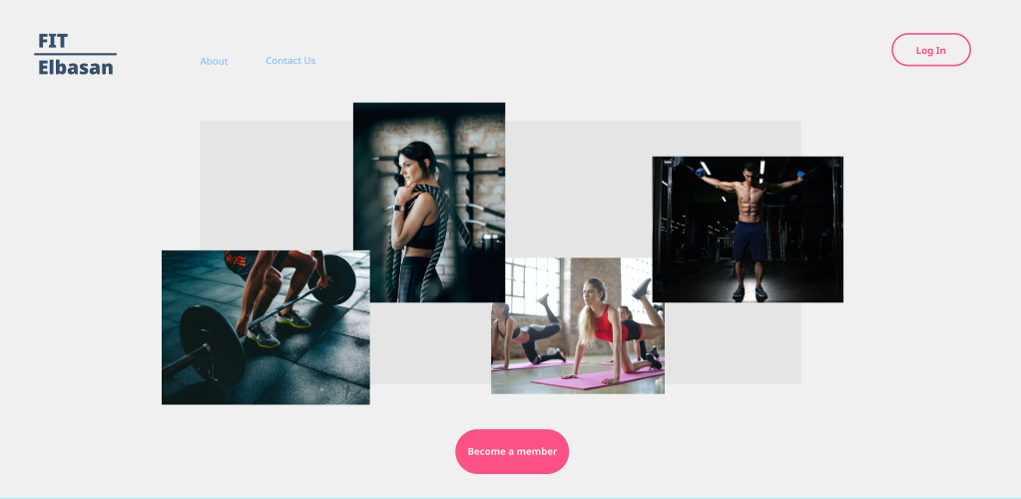
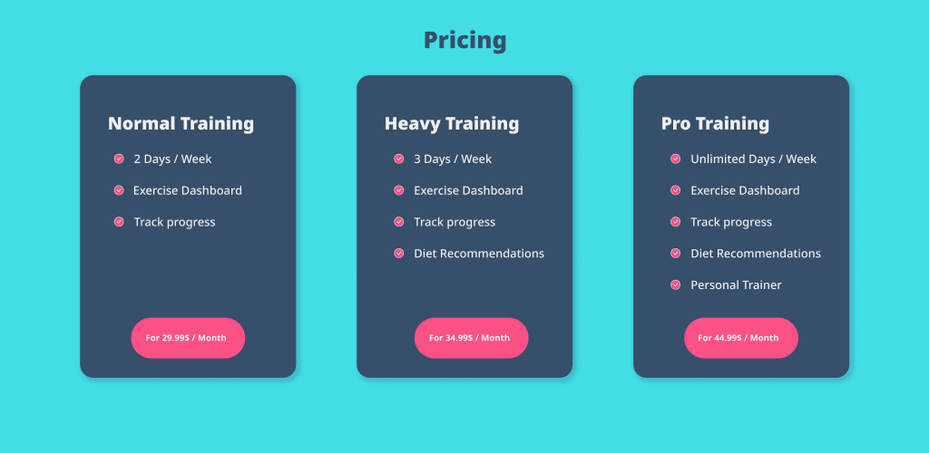
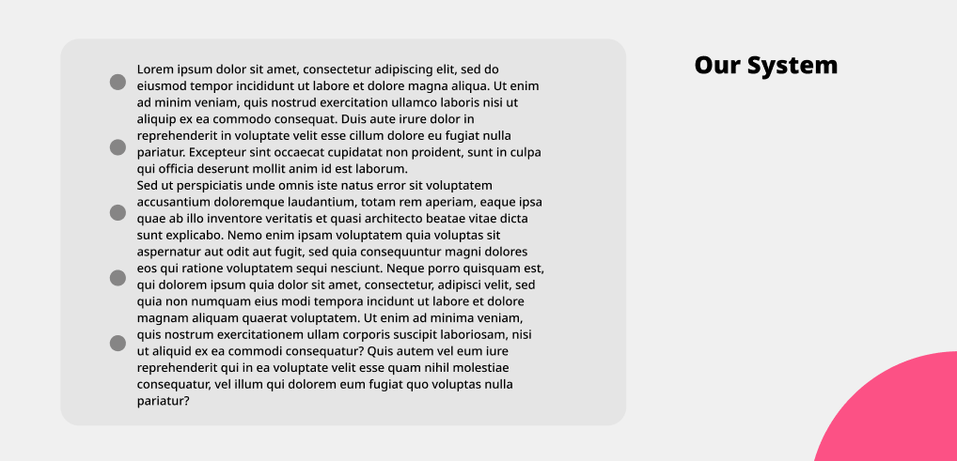
Figma Sketches
Week 1

Slide 3
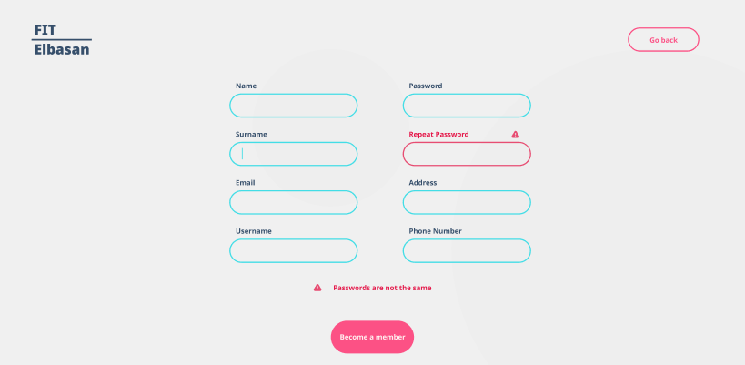

Slide 4
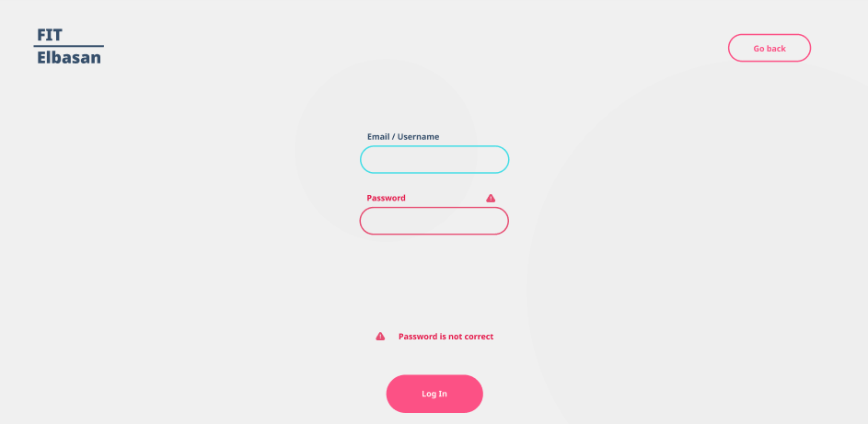

Slide 5
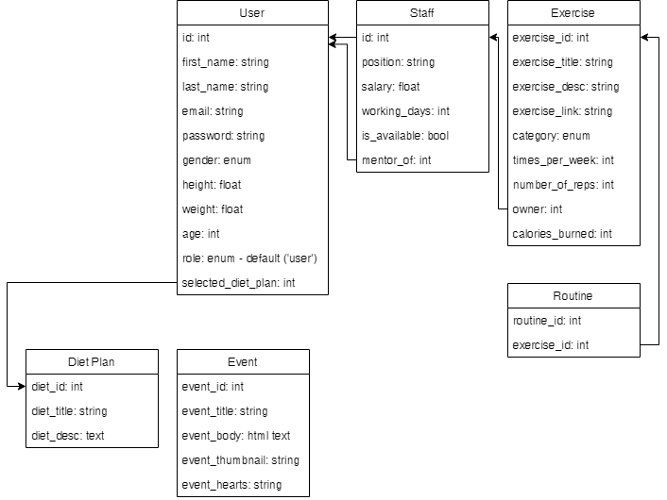
UML System Diagram
Week 2
(only class tables)

Slide 6
Rough Dashboard Sketches
Week 3

Slide 7
User Dashboard Menu
Actions
Other links
Exercises Timeline/Dashboard
Sticky div
W/ Overflow
Latest Events on the gym / business
Diet plans on the bottom
Sticky div w/ overflow
pic
Search box
Options
…
Log out

Slide 8
Exercises Timeline/Dashboard
Sticky div
W/ Overflow
Latest Events on the gym / business
Diet plans on the bottom
Sticky div w/ overflow
pic

Slide 9
Admin Dashboard Menu
Admin Actions (like add new user, view users/exercises/events, add new event etc.)
Other links
Dashboard useful data graphs and other views
Sticky div
W/ Overflow
Search box
pic
Log out

Slide 10
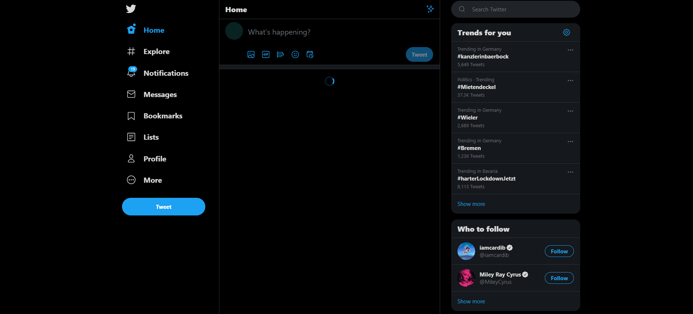
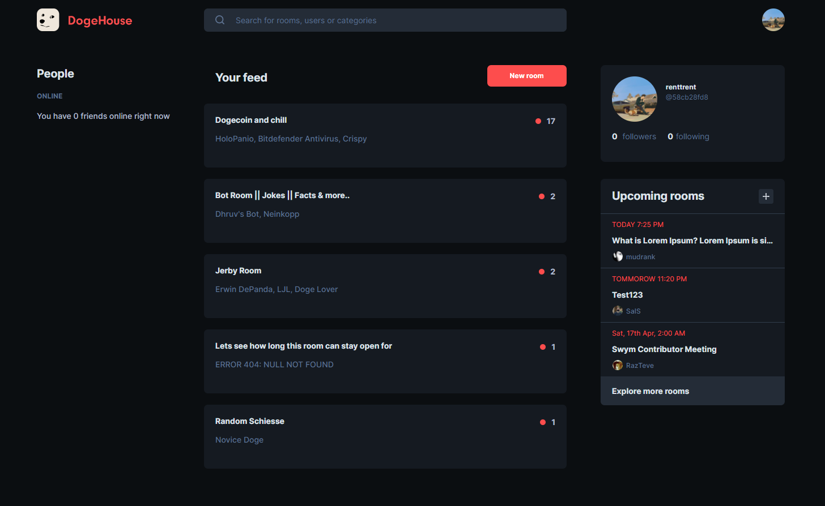
User dashboard inspirations / ideas
3 columns
Left -> actions
Mid -> current activity
Right -> events / what’s going on
This will be easier for mobile view too

Slide 11
Some Use Cases
Week 3

Slide 12
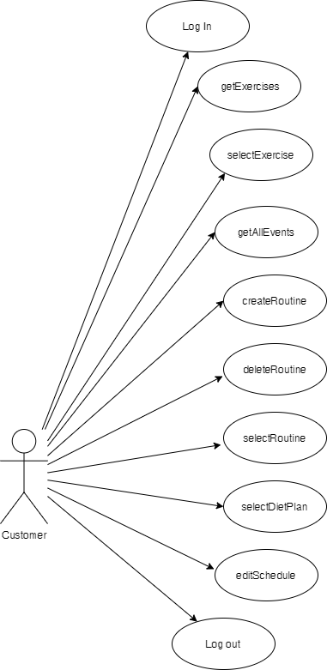
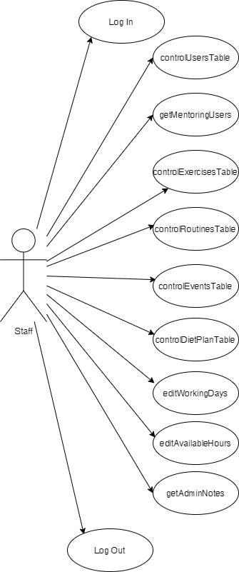
Eventually Staff roles will be separated and new use cases will be made for each role. (ex. Trainers can add exercises/routines but can’t delete users. Etc.)

Slide 13
