Slide 1
Linear Discriminant Analysis (LDA)
Prof. G. Panda
Professorial fellow
IIT, Bhubaneswar, India
1/18/2019

Slide 2
LDA Objective
The objective of LDA is to perform dimensionality reduction.
So what, PCA does this….
However, we want to preserve as much of the class discriminatory information as possible.

Slide 3
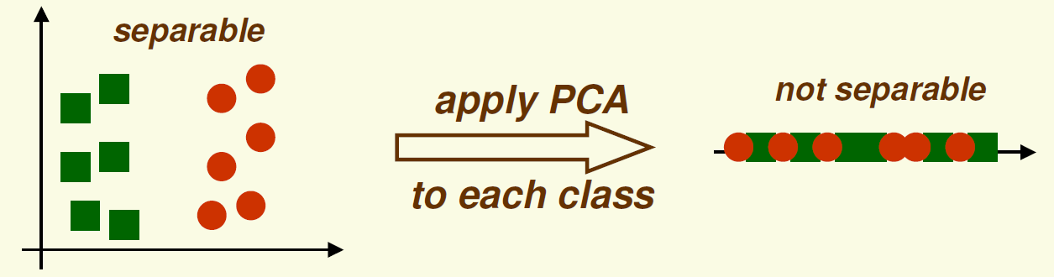
Recall PCA
PCA finds the most accurate data representation in a lower dimensional space
Project data in the directions of maximum variance

Slide 4
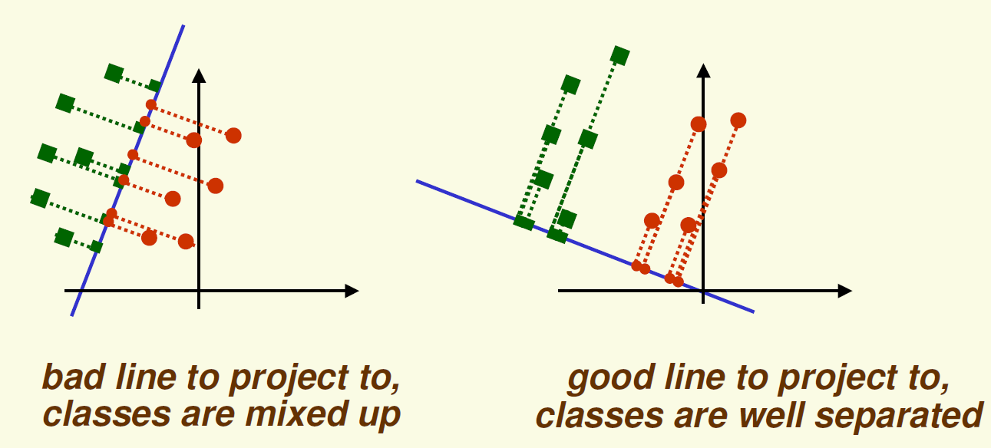
LDA Motivations
Main Idea: find projection to a line such that samples from different classes are well separated
Example in 2D

Slide 5
PCA vs LDA
PCA | LDA
Unsupervised | Supervised
Best represents the data | Best discriminates the data
Project the data in the directions of maximum variance | Project the data that maximizes the class separability
May not be good for classification | Good for classification

Slide 6
Linear Discriminant Analysis (LDA) for two classes
Suppose we have 2 classes and p-dimensional samples
n1 samples come from the first class
n2 samples come from the second class
We seek to obtain a scalar z by projecting the samples onto a line (c-1 space, c=2)
Of all the possible lines we would like to select the one that maximizes the separability of the scalars.

Slide 7
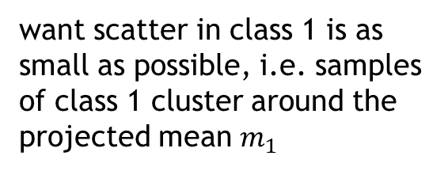
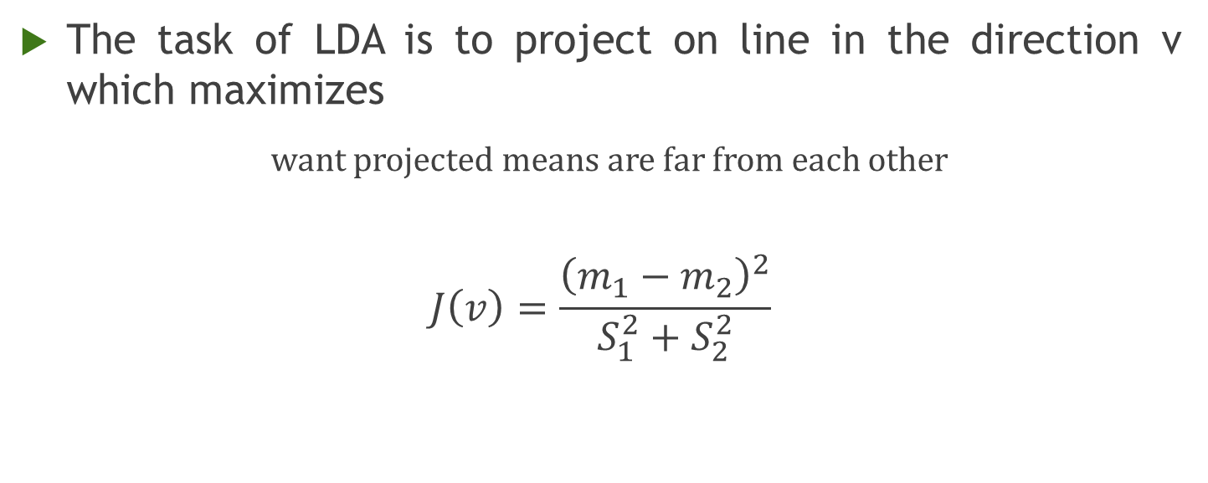
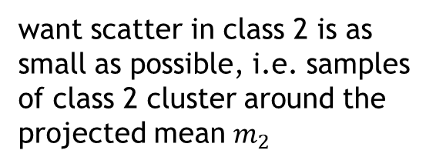
Linear Discriminant Analysis (LDA) for Two Classes
The task of LDA is to project on line in the direction v which maximizes
want projected means are far from each other
$$J\left(v\right)=\frac{{\left(m_{1}−m_{2}\right)}^{2}}{S_{1}^{2}+S_{2}^{2}}$$
want scatter in class 1 is as small as possible, i.e. samples of class 1 cluster around the projected mean $m_{1}$
want scatter in class 2 is as small as possible, i.e. samples of class 2 cluster around the projected mean $m_{2}$

Slide 8
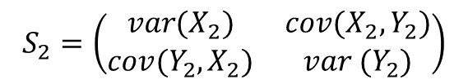
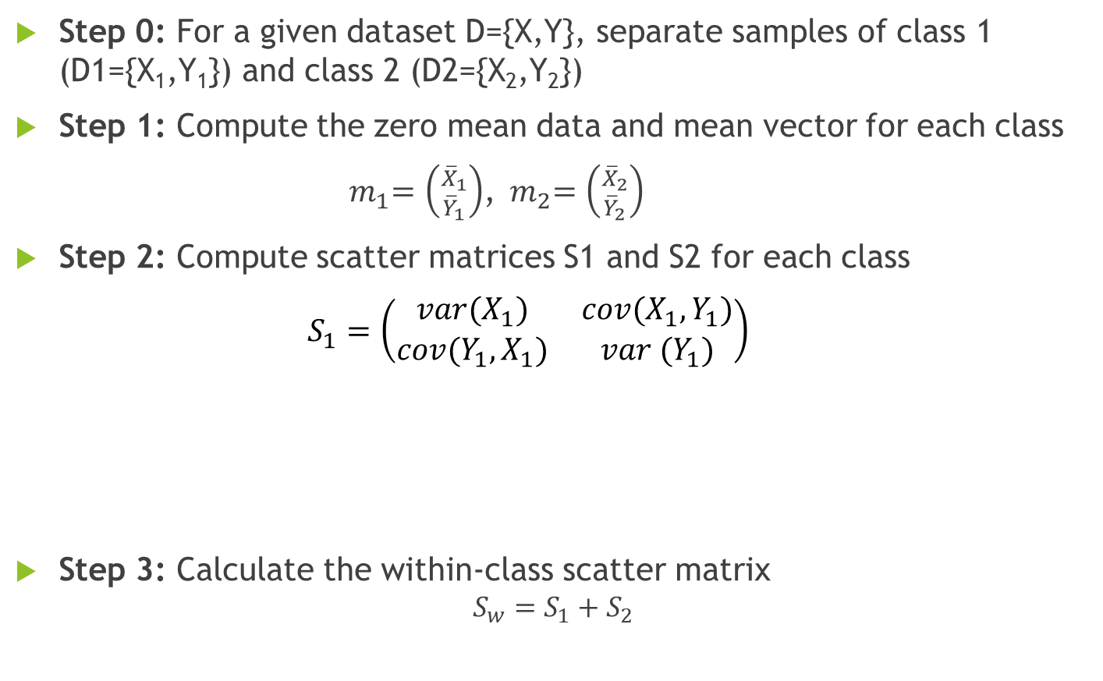
LDA Algorithm for Two Classes
Step 0: For a given dataset D={X,Y}, separate samples of class 1 (D1={X₁,Y₁}) and class 2 (D2={X₂,Y₂})
Step 1: Compute the zero mean data and mean vector for each class
${ m}_{1}=\left({{\overline{X}}_{1} \atop {\overline{Y}}_{1}}\right)$,${ m}_{2}=\left({{\overline{X}}_{2} \atop {\overline{Y}}_{2}}\right)$
Step 2: Compute scatter matrices S1 and S2 for each class
$S_{1}=\left(\begin{matrix}var(X_{1}) & cov(X_{1},Y_{1}) \\ cov(Y_{1},X_{1}) & var (Y_{1})\end{matrix}\right)$
Step 3: Calculate the within-class scatter matrix
$$S_{w}=S_{1}+S_{2}$$
$$S_{2}=\left(\begin{matrix}var(X_{2}) & cov(X_{2},Y_{2}) \\ cov(Y_{2},X_{2}) & var (Y_{2})\end{matrix}\right)$$

Slide 9
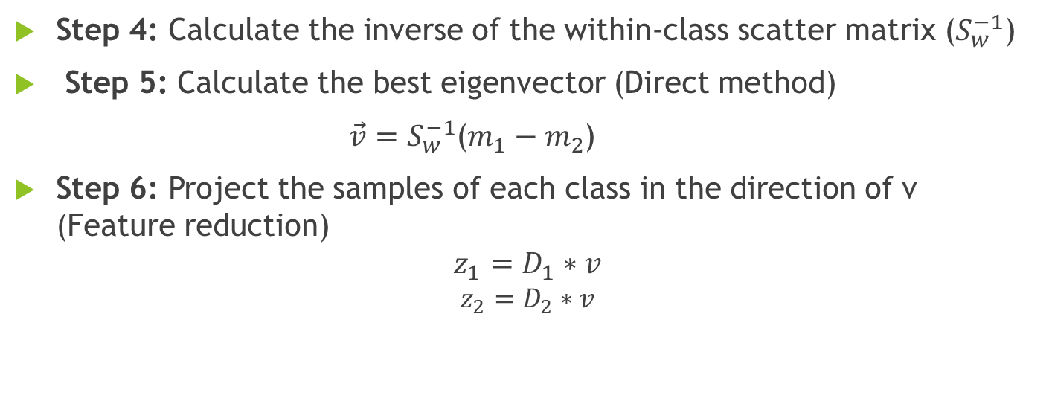
LDA Algorithm for Two Classes (Contd..)
Step 4: Calculate the inverse of the within-class scatter matrix ($S_{w}^{−1}$)
Step 5: Calculate the best eigenvector (Direct method)
$\vec{v}=S_{w}^{−1}$($m_{1}−m_{2}$)
Step 6: Project the samples of each class in the direction of v (Feature reduction)
$$z_{1}=D_{1}∗v$$
$$z_{2}=D_{2}∗v$$

Slide 10
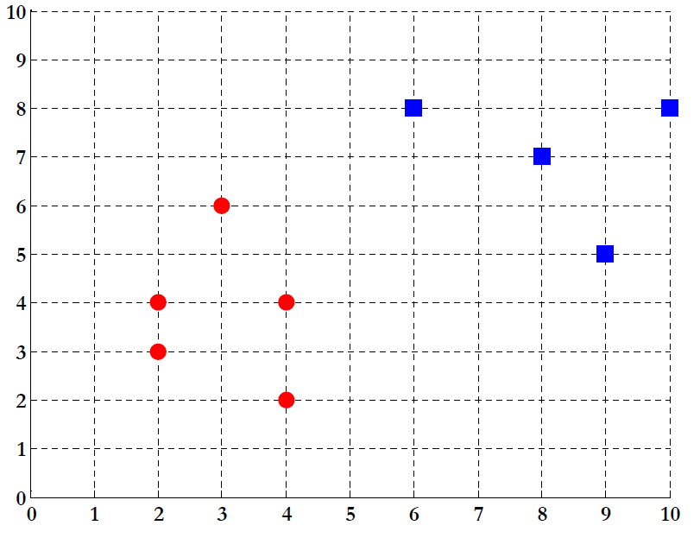
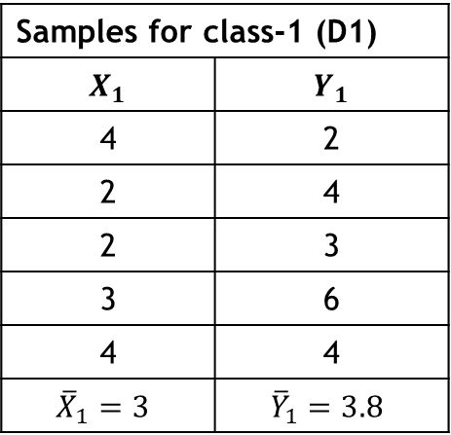
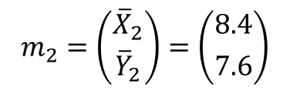
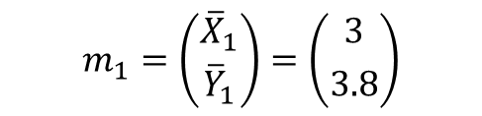
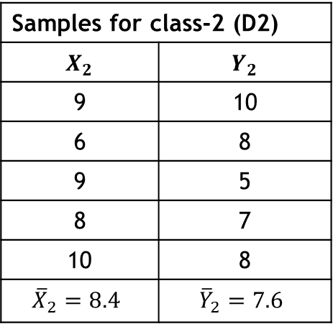
LDA Example –STEP 1
Samples for class-1 (D1)
$$X_{1}$$ | $$Y_{1}$$
4 | 2
2 | 4
2 | 3
3 | 6
4 | 4
$${\overline{X}}_{1}=3$$ | $${\overline{Y}}_{1}=3.8$$
Y
Samples for class-2 (D2)
$$X_{2}$$ | $$Y_{2}$$
9 | 10
6 | 8
9 | 5
8 | 7
10 | 8
$${\overline{X}}_{2}=8.4$$ | $${\overline{Y}}_{2}=7.6$$
X
$$m_{1}=\left({{\overline{X}}_{1} \atop {\overline{Y}}_{1}}\right)=\left({3 \atop 3.8}\right)$$
$$m_{2}=\left({{\overline{X}}_{2} \atop {\overline{Y}}_{2}}\right)=\left({8.4 \atop 7.6}\right)$$

Slide 11
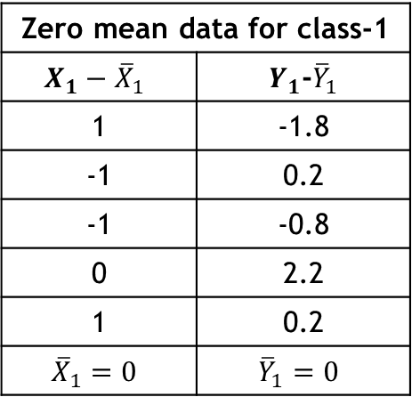
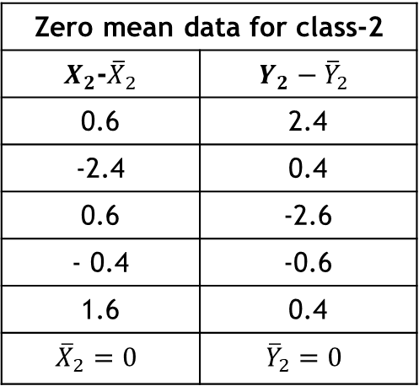
LDA Example –STEP 1
Zero mean data for class-1
$$X_{1}−{\overline{X}}_{1}$$ | $Y_{1}$-${\overline{Y}}_{1}$
1 | -1.8
-1 | 0.2
-1 | -0.8
0 | 2.2
1 | 0.2
$${\overline{X}}_{1}=0$$ | $${\overline{Y}}_{1}=0$$
Zero mean data for class-2
$X_{2}$-${\overline{X}}_{2}$ | $$Y_{2}−{\overline{Y}}_{2}$$
0.6 | 2.4
-2.4 | 0.4
0.6 | -2.6
- 0.4 | -0.6
1.6 | 0.4
$${\overline{X}}_{2}=0$$ | $${\overline{Y}}_{2}=0$$

Slide 12
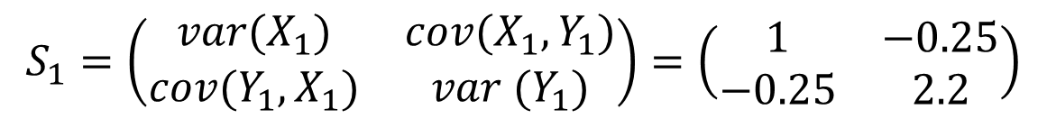
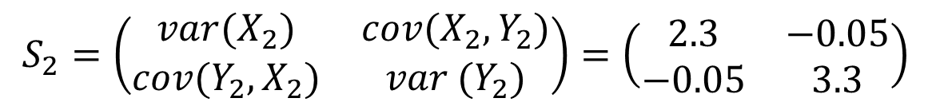
LDA Example –STEP 2
Calculate the scatter matrices
$$S_{1}=\left(\begin{matrix}var(X_{1}) & cov(X_{1},Y_{1}) \\ cov(Y_{1},X_{1}) & var (Y_{1})\end{matrix}\right)=\left(\begin{matrix}1 & −0.25 \\ −0.25 & 2.2\end{matrix}\right)$$
$$S_{2}=\left(\begin{matrix}var(X_{2}) & cov(X_{2},Y_{2}) \\ cov(Y_{2},X_{2}) & var (Y_{2})\end{matrix}\right)=\left(\begin{matrix}2.3 & −0.05 \\ −0.05 & 3.3\end{matrix}\right)$$

Slide 13

LDA Example –STEP 3
Calculate the within-class scatter matrix
$$S_{w}=S_{1}+S_{2}$$
$$=\left(\begin{matrix}1 & −0.25 \\ −0.25 & 2.2\end{matrix}\right)+\left(\begin{matrix}2.3 & −0.05 \\ −0.05 & 3.3\end{matrix}\right)$$
$=\left(\begin{matrix}3.3 & −0.3 \\ −0.3 & 5.5\end{matrix}\right)$

Slide 14

LDA Example –STEP 4
Compute the inverse of within-class scatter matrix
$S_{w}^{−1}=$ ${\left(\begin{matrix}3.3 & −0.3 \\ −0.3 & 5.5\end{matrix}\right)}^{−1}$
$$=\left(\begin{matrix}0.3045 & 0.0166 \\ 0.0166 & 0.1827\end{matrix}\right)$$

Slide 15

LDA Example –STEP 5
Calculate the best eigenvector (Direct method)
$$\vec{v}=S_{w}^{−1}\left(m_{1}−m_{2}\right)$$
$$=\left(\begin{matrix}0.3045 & 0.0166 \\ 0.0166 & 0.1827\end{matrix}\right)\left[\left({3 \atop 3.8}\right)−\left({8.4 \atop 7.6}\right)\right]$$
$=\left(\begin{matrix}0.3045 & 0.0166 \\ 0.0166 & 0.1827\end{matrix}\right)\left(\begin{matrix}−5.4 \\ −3.8\end{matrix}\right)$
$=\left(\begin{matrix}0.9088 \\ 0.4173\end{matrix}\right)$

Slide 16

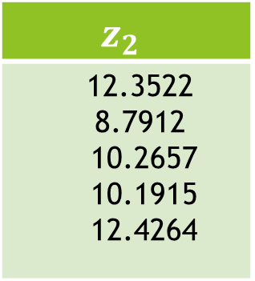

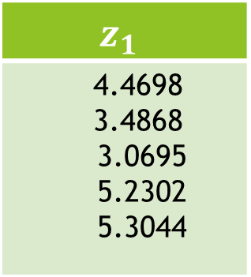
LDA Example –STEP 6
Reduce dimensionality and form feature vector
Size of feature vector of class-1: 5×2
Size of v: 2×1
Resulted feature vector will be of size 5×1
$$z_{1}=D_{1}∗v$$
$$z_{2}=D_{2}∗v$$
$$z_{1}$$
4.4698 3.4868 3.0695 5.2302 5.3044
$$z_{2}$$
12.3522 8.7912 10.2657 10.1915 12.4264

Slide 17
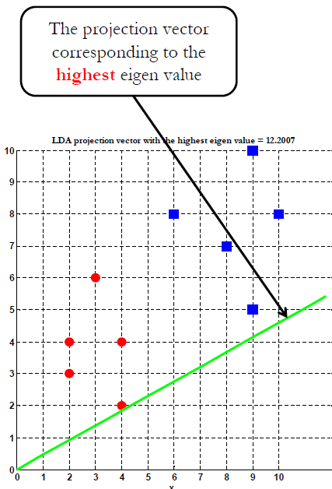
LDA Projection

Slide 18
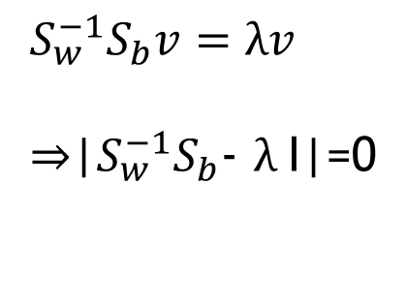

LDA Example STEP 5 (Another method)
Calculate the eigenvalues and eigenvector (Another method)
$$S_{w}^{−1}S_{b}v=λv$$
⇒|$S_{w}^{−1}S_{b}$- $λ$I|=0
Where, $S_{b}=\left(m_{1}−m_{2}\right){\left(m_{1}−m_{2}\right)}^{T}$

Slide 19
Thank You

