Slide 1

Project introduction
Project Title : Uncovering the gaming industry’s hidden gems : A comprehensive analysis of video game sales
This project is based on gaming industry sales in all over country gaming industry is one of the most exciting industries in tech because of its importance to culture, entertainment and technological advancement. PC, console and mobile gaming companies are using the latest in tech to bring their games to the screens of more than three billion people.

Slide 2
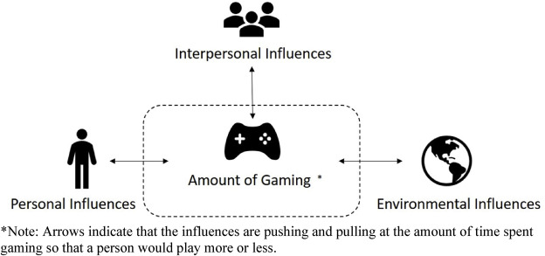
Purpose of gaming industry
The main 5 purpose of gaming industry
Improved Cognitive abilities
Greater multi – tasking abilities
Increased hand to eye coordination
Better Eyesight
Improved problem solving skill and logic

Slide 3
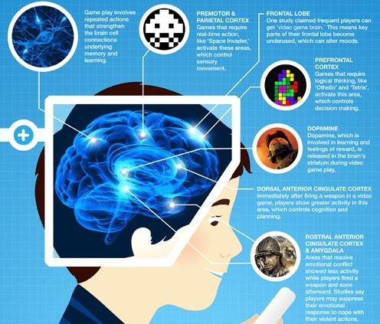
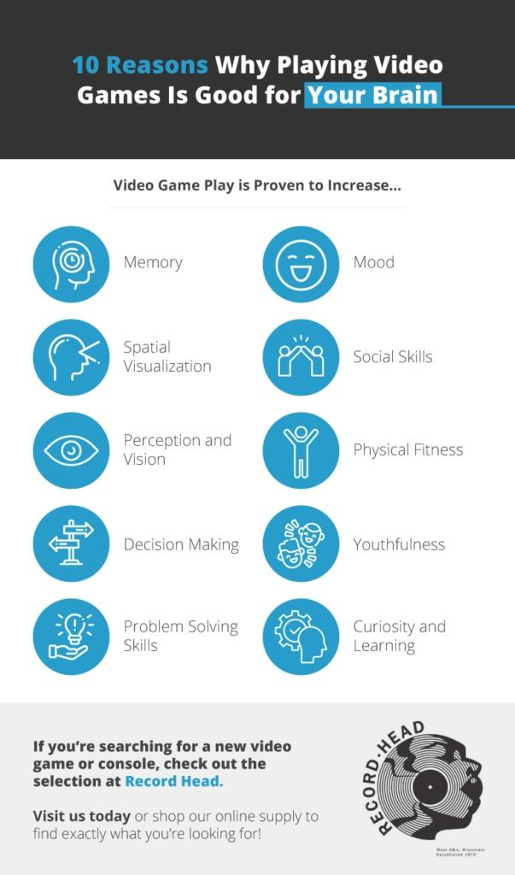
Uses of gaming

Slide 4
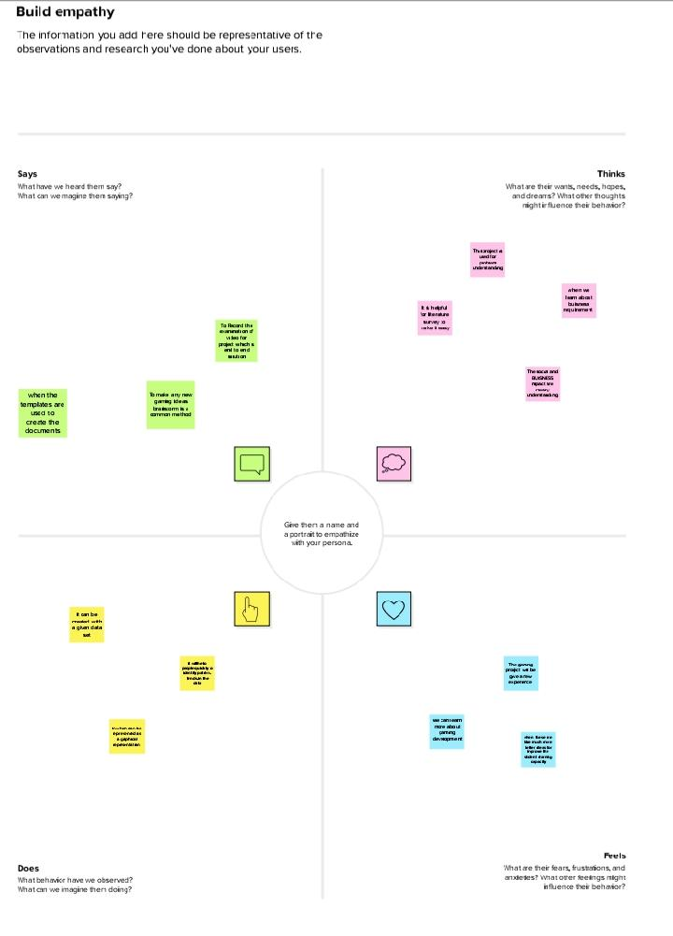
Empathy map

Slide 5
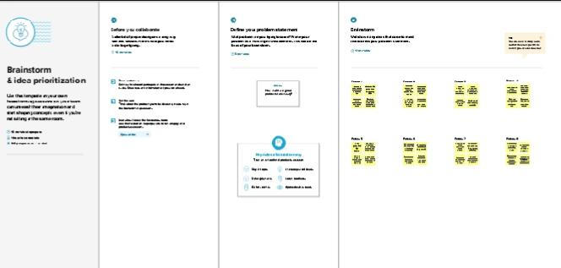
Brainstrom
Brainstrom is used to improve the project content
It will give the information about the data set
The main purpose of these brainstrom to give better solution of learning environment
The dataset visualization and story will be imroved

Slide 6
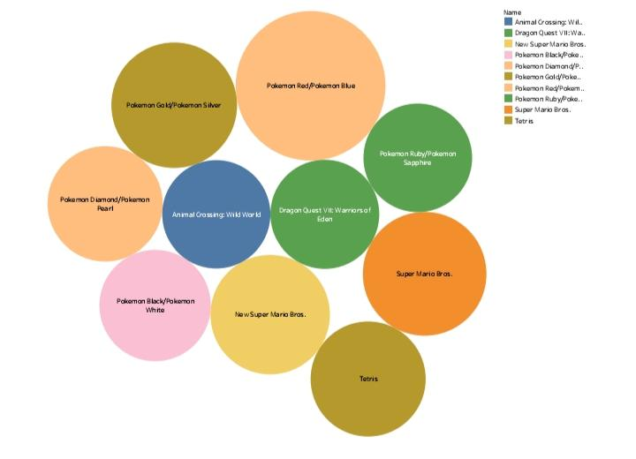
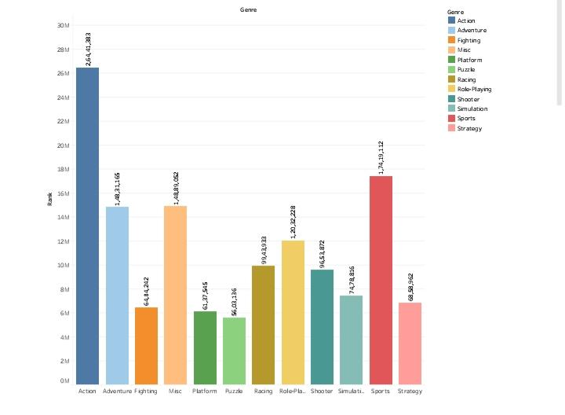
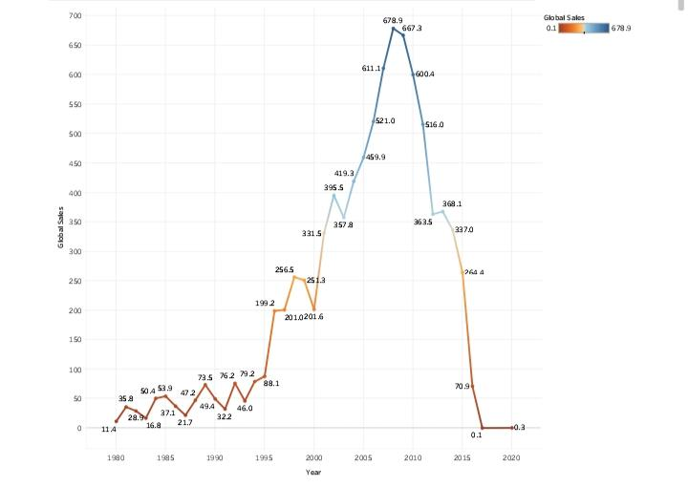
Result (final finding output)

Slide 7
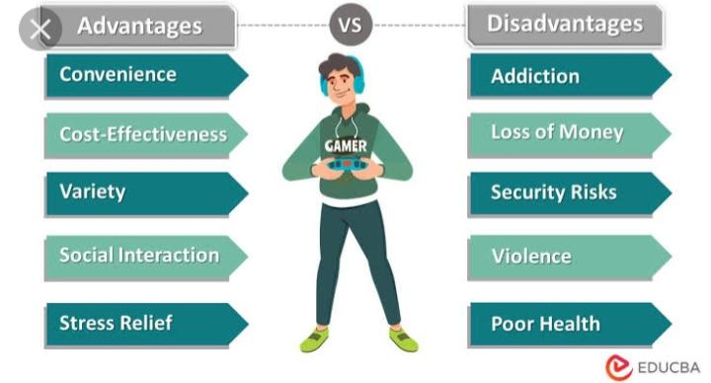
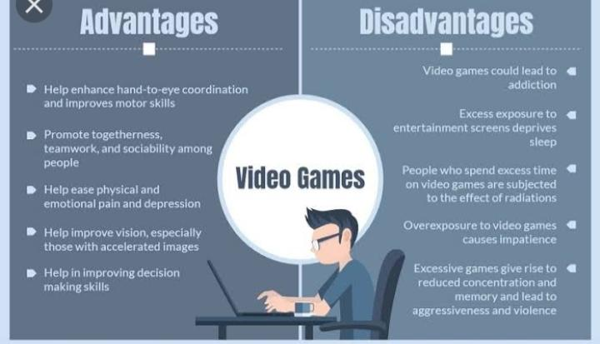
Advantages & disadvantages

Slide 8
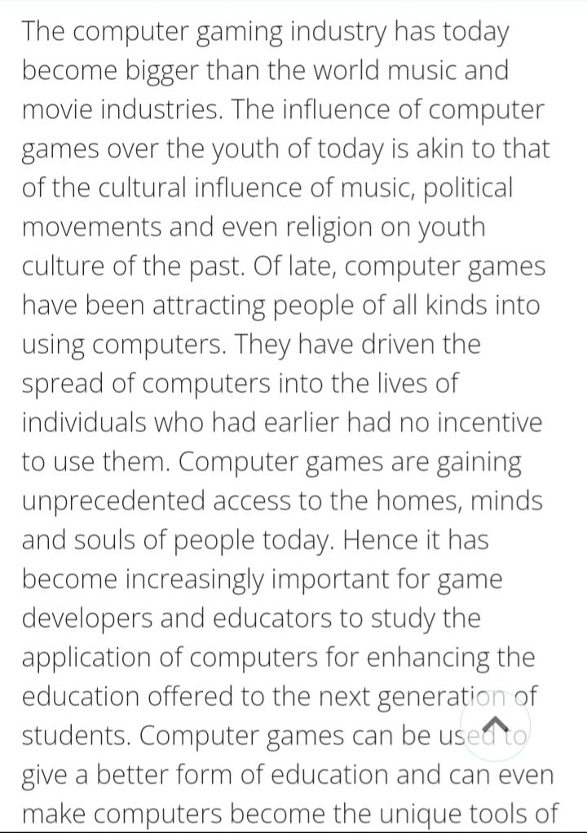

Apllication

Slide 9
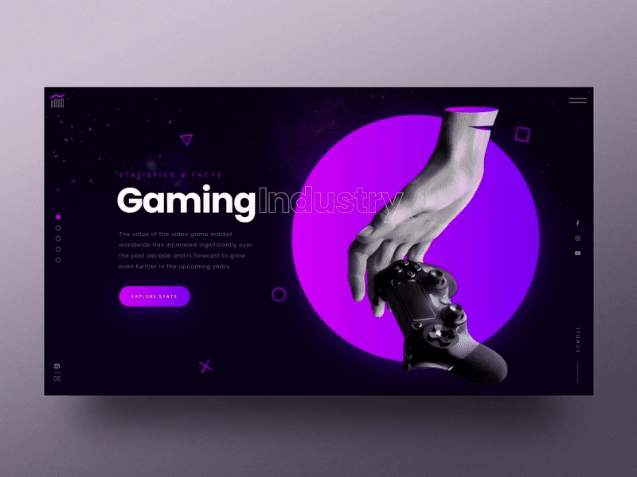
Conclusion(summarizing the work and finding)
The coclusion of the project is based on our work
The entire project is based on the gaming industry and sales in different regions
The main learning purpose is to know about data analytics in gaming industry

Slide 10
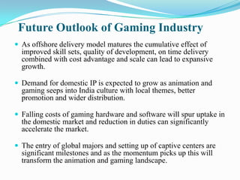

Future scope in gaming

