Slide 1
STUDENT NAME: V. Renugadevi
REGISTER NO AND NMID: autanm11111124uaic019
DEPARTMENT: B. Sc-Aritficial Intelligence
COLLEGE:Krishnasamy college of science, Arts and Management for women

Slide 2
PROJECT TITLE
DIGITAL PORTFOLIO

Slide 3


AGENDA
Problem Statement
Project Overview
End Users
Tools and Technologies
Portfolio design and Layout
Features and Functionality
Results and Screenshots
Conclusion
Github Link
3/21/2024 Annual Review

Slide 4

PROBLEM STATEMENT
In today’s digitally-driven world, individuals and professionals need an effective way to showcase their skills, achievements, and experiences but in the current academic and professional landscape, college students face increasing competition when applying for internships, scholarships, higher education, or jobs. Resumes and printed documents are no longer sufficient to fully represent a student’s capabilities, experiences, and creativity. The problem of the statement is many students lacking in centralized, professional platform to showcase their work. Existing solutions often require technical expertise or are limited in customization and interactivity. .

Slide 5

PROJECT OVERVIEW
A digital portfolio serves as a modern, interactive platform where students can showcase their skills, academic achievements, projects, certifications, extracurricular activities, and personal interests in a visually appealing and accessible manner. This project aims to design and develop a responsive, easy-to-use digital portfolio platform specifically tailored for college students. The platform will allow users to create personalized portfolio websites without requiring advanced technical skills. Students can include various sections such as: About Me / Bio Educational Background Skills and Technologies Academic and Personal Projects Certifications and Courses Extracurricular Activities Resume Download Contact Information and Social Media Links

Slide 6

END USERS
The End users of a digital portfolio for ollege students can be grouped into primary and secondary users, based on how they interact with the portfolio.
1.Primary End Users.
2.Secondary End Users .
1 Primary End Users: *College Students (Portfolio Owners)
2.Secondary End Users:
*Recruiters & Employers
*Professors & Academic Advisors
*Graduate School Admission Committees
*Peers and Collaborators

Slide 7

TOOLS AND TECHNOLOGIES
These are the list of Tools & Techniques commonly used in the development of a Digital Portfolio for College Students;
Tools : 1. Front-End Development
2. Back-End Development
3. Database
4. Design Tools
5. Version Control
6. Hosting & Deployment
7. Content Management
8. Responsive Design & Testing
Technologies:
1.Responsive Web Design
2.User-Centered Design (UCD)
3.SEO Optimization
4.Accessibility Compliance
. 5.Performance Optimization

Slide 8
PORTFOLIO DESIGN AND LAYOUT
* A Portfolio design and layout specifically for a digital portfolio, which is typically online and meant to showcase creative or professional work. (e.g., design, UX, development, writing, etc.)
Digital Portfolio Design & Layout.
1. Essential Structure (Page Layout) *Landing Page / Home
*About Me
*Portfolio / Work
*Project Case Study pages
* Contact Page
2. Visual & UI Design
. 3. Navigation & UX
4. Tools & Platforms to Build It
8

Slide 9
FEATURES AND FUNCTIONALITY
A Digital portfolio includes your best work samples, a professional “About Me” section, detailed project descriptions, relevant skills and achievements, and clear contact information. Essential features for effectiveness are intuitive navigation, a clean and professional design, mobile-friendliness, and options to include testimonials from clients or employers.
Digital portfolio’s core functionality is to showcase an individual’s skills, work samples, and accomplishments to potential employers or clients in a compelling, multimedia-rich format, serving as a persuasive marketing tool that highlights professionalism, technical prowess, and personality through visually appealing content like images, videos, and presentations. Key features include an “About Me” section, contact information, detailed work samples with context, an optional resume or CV, and a clear, easy-to-navigate structure that tells a narrative of the user’s journey and expertise.

Slide 10

RESULTS AND SCREENSHOTS
✅ Improved Job and Internship Opportunities
✅ Professional Branding and Online Presence
✅ Skills Demonstration
✅ Academic and Project Recognition
✅ Confidence & Clarity
3/21/2024 Annual Review
10

Slide 11
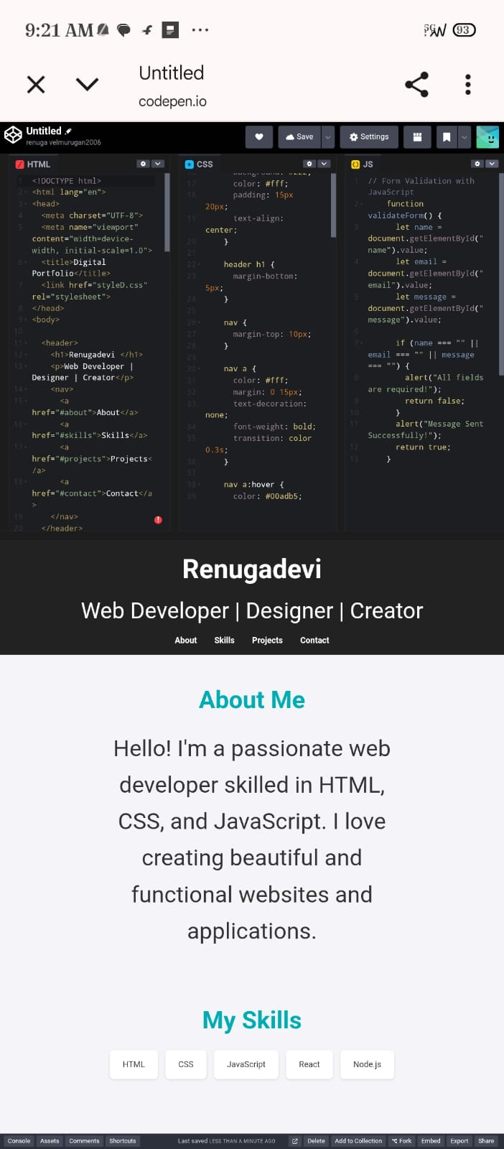
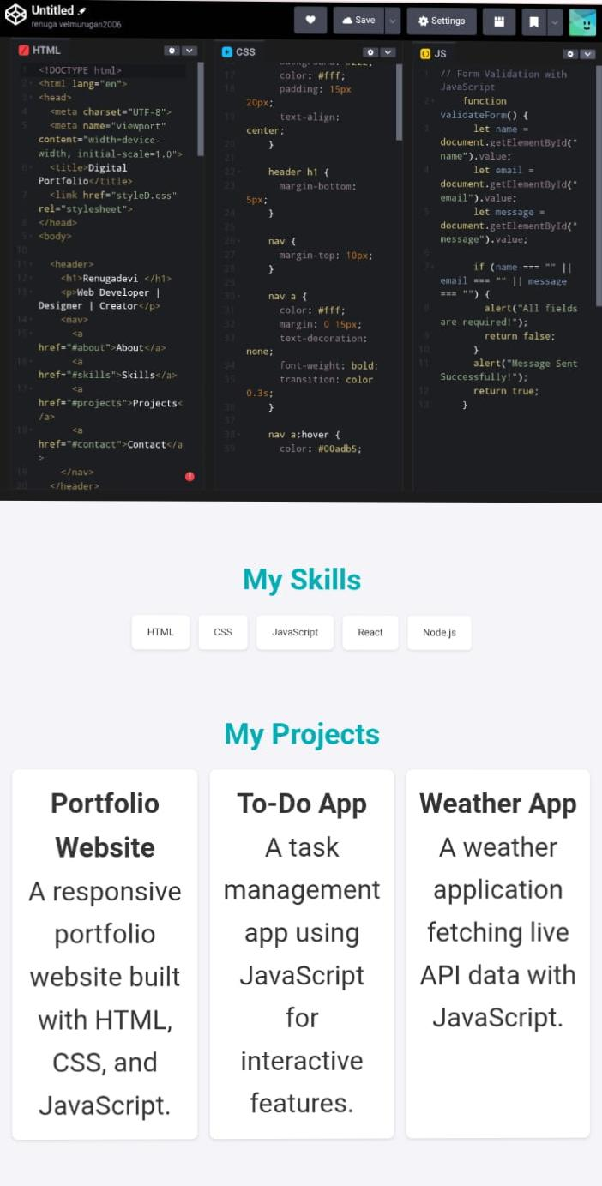
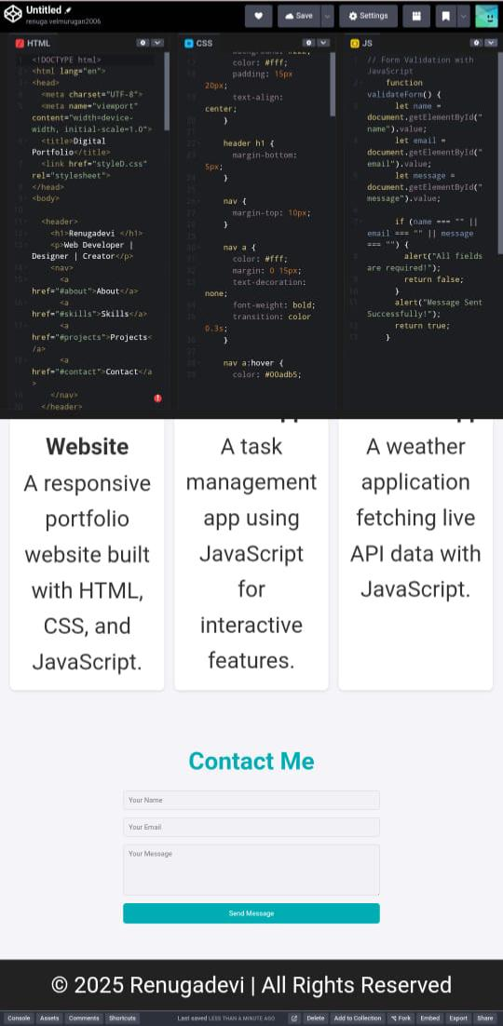

Slide 12
CONCLUSION
* A well-organized digital portfolio helps communicate your abilities clearly to potential employers, internship coordinators, and academic mentors. It reflects your initiative, technical proficiency, and readiness to transition from student to professional In today’s digital world, standing out means more than just having a resume—your portfolio tells your story, highlights your strengths, and demonstrates your potential. For college students, it’s not just a showcase of past work—it’s a launchpad for future opportunities.
12

