Slide 1
Concepts of Dimensional Modeling
(Hierarchy of the dimensions)

Slide 2
What is Dimensional Modeling?
A dimension hierarchy is a logical structure that uses ordered levels of granularity to organize data. It allows users to navigate data from a summary level to a detailed level.
Example (Time): Year → Quarter → Month → Day. This allows analysis by month, which can be rolled up to the quarter or year.
Example (Geography): Country → State → City → Store. This enables viewing sales by city, which can be aggregated up to the state or country level.
It organizes data into Facts and Dimensions.
Fact Table:
  Contains measurable, numerical data about a business event (the "what").
  Examples: Sales Amount, Units Sold, Profit Margin.
  Keys in this table connect to the dimension tables.
Dimension Tables:
  Contain the descriptive context for the facts (the "who, what, where, when").
  They provide the context for analysis.
  Examples: Customer details, Product information, Store locations, Dates.

Slide 3
Understanding Hierarchies in Dimensions
A dimension hierarchy is a logical structure that uses ordered levels to organize data. It allows users to navigate data at different levels of granularity.
This is the foundation for drill-down and roll-up analysis.
Drill-Down:
Drill-down means navigating from summarized data to more detailed data.
It helps analysts identify root causes or fine-grained insights.
Roll-Up:
Aggregating detailed data into a summary level.
Roll-up is the reverse of drill-down — it means aggregating detailed data into higher-level summaries.

Slide 4
Types of Dimension Hierarchies:
Hierarchies can be structured in several ways, depending on the nature of the data.
Balanced Hierarchy:
  Every branch of the hierarchy descends to the same level, and each member's parent is at the level immediately above it.
  Example: Time (Year → Quarter → Month → Day).
Unbalanced Hierarchy:
  Branches of the hierarchy have different depths.
  Example: An organizational chart where some managers have reports who are also managers, creating uneven levels.
Ragged Hierarchy:
  A hierarchy where some members skip at least one level in the logical path.
  Example: A geography hierarchy where a city like Washington D.C. reports directly to the country (USA), skipping the state level.

Slide 5
Date Dimensions

Slide 6
What is a Date Dimension?
A Date Dimension (Dim_Date) is a specialized table in a data warehouse that stores one record per date along with descriptive attributes like day, week, month, quarter, and year.
  It helps in joining fact tables with time-based data efficiently.
  Acts as a conformed dimension used across multiple facts for consistency.
Key Characteristics
  A standard, required component in almost every data warehouse.
  Static and shared across different fact tables (a "conformed" dimension).
  Uses a simple integer "Date Key" (e.g., 20251031) to link to fact tables.
Why It’s Important
  Simplifies querying by avoiding repeated date calculations.
  Ensures consistent date logic across reports (fiscal year, week numbering, holidays).
  Enables time-intelligent analytics like roll-up (day → month → year), drill-down, and year-over-year comparisons.

Slide 7
Common Attributes & Hierarchy
A Date Dimension is enriched with many attributes to support analysis:
  DateKey, FullDate, DayOfWeek, WeekNumber, Month, Quarter, Year, Flags (e.g, IsHoliday), FiscalMonth, FiscalQuarter.
Typical hierarchy: Year → Quarter → Month → Day
  Example: 2024-03-15 → Year = 2024, Quarter = Q1, Month = March, Day = 15
Use in Reporting & Analysis
Joins with fact tables to enable slicing by week, month, quarter, or fiscal period.
Can serve multiple roles like Order Date, Ship Date, or Invoice Date.
Supports analytics such as “Sales by Quarter vs Last Year” or “Holiday vs Non-Holiday Sales.”

Slide 8
Hierarchy Example:
DateKey | FullDate | Day Of Week | Week Number | Month | Quarter | Year | IsHoliday | Fiscal Month | Fiscal Quarter
20240315 | 2024-03-15 | Friday | 11 | March | Q1 | 2024 | N | 12 | FQ1
20240316 | 2024-03-16 | Saturday | 11 | March | Q1 | 2024 | N | 12 | FQ1
20240317 | 2024-03-17 | Sunday | 11 | March | Q1 | 2024 | Y (Festival) | 12 | FQ1
20240630 | 2024-06-30 | Sunday | 26 | June | Q2 | 2024 | N
The Date Dimension provides detailed information for each calendar date, such as day, month, quarter, and year.
It connects to fact tables using the DateKey, allowing time-based analysis like monthly or yearly trends.
This helps ensure consistent date logic across reports and supports drill-down and roll-up in analytics.

Slide 9
Slowly changing Dimensions

Slide 10
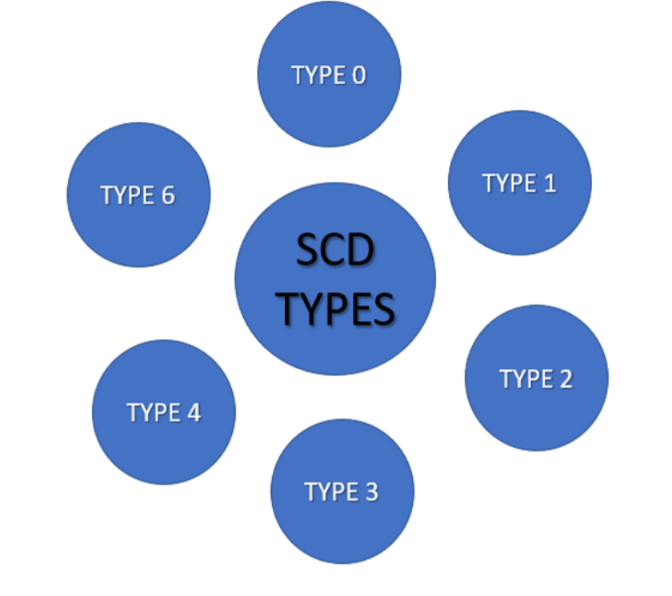
Introduction to SCD
In a data warehouse, a dimension may change slowly (e.g., a customer moves, product category changes). SCDs provide methods to handle these changes for analysis and historical tracking.
Choosing the right SCD type affects how you can track history and support reporting.
Why SCDs Matter
Without handling changes, reports may show incorrect historic context (e.g., a customer’s old region lost).
SCD methods help ensure facts are joined to the correct version of dimension attributes. They improve decision-making, analytics, and maintain data integrity over time.

Slide 11
SCD Type 0 – Fixed / No Change
Once the record is loaded into the dimension, it remains unchanged forever, regardless of source updates. Used for attributes that are constant ,or should remain as first recorded for historical reasons.
Example: Even if Riya changes her country later, the Country in this dimension will not be updated (fixed attribute).
When to Use:
  When values should never change (identity-defining attributes).
  For audit fields or reference data.
Examples of Fixed Attributes:
  DateOfBirth
  JoiningDate
  OriginalProductLaunchDate
  CustomerFirstSignupDate
CustomerID | Name | DOB | RegistrationDate | Country
101 | Riya Sharma | 1995-03-22 | 2021-07-10 | India

Slide 12
SCD Type 1 – Overwrite (No History)
Old data is overwritten with new data — history is not preserved.
Use Case: When only the latest value matters.
Example:
➡ If Priya moves to Pune:
ETL Logic: UPDATE dimension record with new value when source changes.
When to Use: For non-critical attributes like email, phone, last login city, etc.
Pros:
Simple implementation
Cons:
No historical tracking
CustomerID | Name | City
1001 | Priya | Mumbai
CustomerID | Name | City
1001 | Priya | Pune

Slide 13
SCD Type 2 – Add New Row (Full History)
Each time an attribute changes, a new row is inserted with a new surrogate key, and the old record is marked as expired.
Columns usually added: EffectiveStartDate, EffectiveEndDate, IsCurrent (or ActiveFlag).
Example:
ETL Logic: If a change is detected → expire old record (EndDate = today, IsCurrent = N), and insert a new record with new key.
When to Use: When historical analysis is needed (e.g., "Sales by customer region over time").
Pros:
  Complete history tracking
Cons:
  Larger table, more complex joins
CustomerKey | CustomerID | Name | City | StartDate | EndDate | IsCurrent
1001 | CUST001 | Priya | Mumbai | 2019-01-01 | 2020-12-31 | N
1002 | CUST001 | Priya | Pune | 2021-01-01 | 9999-12-31 | Y

Slide 14
SCD Type 3 – Add New Columns (Partial History)
Adds new columns to store limited history (usually only previous value).
Example:
ETL Logic: When change occurs → move old value to “PreviousCity”, update “CurrentCity”.
When to Use: When you only need to compare old vs new values, not full history.
Pros:
  Less storage
Cons:
  Limited to only one prior change
CustomerID | Name | CurrentCity | PreviousCity
1001 | Priya | Pune | Mumbai

Slide 15
SCD Type 4 – Separate History Table
Keeps the current data in the main dimension table and historical data in a separate “history” table.
Example:
Dim_Customer (Current):
Dim_Customer_History:
When to Use: When history exists but you want to keep the main dimension lightweight.
Pros:
  Fast for current lookups
Cons:
  Need join with another table for full history
CustomerID | Name | City
1001 | Priya | Pune
CustomerID | Name | City | StartDate | EndDate
1001 | Priya | Mumbai | 2019-01-01 | 2020-12-31

Slide 16
SCD Type 6 – Hybrid (Combination of 1 + 2 + 3)
Combines Type 1, 2, and 3 — stores current value in same row (Type 1), keeps full history via new rows (Type 2), and may include previous value (Type 3).
Example:
ETL Logic:
  Create new row when change happens (Type 2).
  Keep latest and previous values in columns (Type 3).
  Update current value directly (Type 1).
When to Use:
When both full history and comparison of last change are required.
CustKey | CustID | CurrentCity | PrevCity | StartDate | EndDate | IsCurrent
101 | C001 | Mumbai | NULL | 2019-01-01 | 2021-02-01 | N
102 | C001 | Pune | Mumbai | 2021-02-02 | 9999-12-31 | Y

Slide 17
Fast changing Dimensions

Slide 18
Introduction to Fast Changing Dimensions (FCD)
A Fast Changing Dimension (FCD) refers to a dimension where certain attributes change very frequently, even daily or hourly.
Applying standard Slowly Changing Dimension (SCD) techniques (like Type 2) can cause performance, storage, and maintenance issues because of too many versioned rows.
Purpose:
  To efficiently manage attributes that change rapidly without bloating the main dimension table.
  Example: Customer’s credit score, loyalty points, or social media preferences can change very frequently.
Problem with SCD Type 2:
Each attribute change creates a new record in the dimension.
For fast-changing data, this leads to:
  Huge table size.
  Longer ETL processing times.
  Slower query performance.
Impact Example: If a customer’s credit score changes every week, SCD Type 2 would insert a new record every week resulting in thousands of rows for the same customer over time.

Slide 19
Common Scenarios of Fast Changing Dimensions
In real-world systems, some attributes of dimension tables change very frequently. These are called fast-changing attributes, and handling them efficiently is important for maintaining accurate and optimized data models.
Typical examples:
Entity | Rapidly Changing Attribute | Description
Customer | Credit Score, Loyalty Points | These values are recalculated or updated frequently based on customer activity.
Product | Price, Discount Rate | Prices or discounts may change daily or even hourly in e-commerce platforms.
Employee | Performance Rating | HR systems often update ratings or metrics regularly based on performance data.
IoT Sensor | Status, Reading Level | IoT devices send continuous updates that can change multiple times per minute.
Key Insight:
All attributes within a dimension do not change at the same rate.
Only a few specific attributes tend to change rapidly these are the ones that need special handling techniques in data modeling.

Slide 20
Solutions for Handling Fast Changing Dimensions
Split into Mini-Dimensions
  Move rapidly changing attributes into a separate table called a Mini-Dimension.
  The main dimension (e.g., Dim_Customer) stores stable attributes, while the mini-dimension stores fast-changing ones (e.g., Dim_Customer_Status).
Use Surrogate Keys for Linking
  Fact tables link to both main and mini dimensions using surrogate keys.
  Example: 1. Fact_Sales → Customer_Key (main)
  2. Customer_Status_Key (mini)
Aggregate or Snapshot Facts
  For high-frequency changes, maintain snapshot fact tables (e.g., daily or hourly snapshots) to record current state efficiently.

Slide 21
Example Architecture (Mini-Dimension Approach)
Main Dimension (Dim_Customer):
Mini-Dimension (Dim_Customer_Status):
Fact Table (Fact_Transaction):
Result:
The main dimension stays small and stable.
Rapidly changing attributes are isolated in a mini-dimension.
Customer_Key | Customer_ID | Name | Gender | DOB
1001 | C001 | Riya | F | 1990-03-10
Status_Key | CreditScore | RiskRating | LoyaltyPoints | EffectiveDate
5001 | 720 | Low | 230 | 2024-01-01
5002 | 650 | Medium | 220 | 2024-02-01
Fact_ID | Customer_Key | Status_Key | Transaction_Amount
9001 | 1001 | 5001 | 1200
9002 | 1001 | 5002 | 1500

Slide 22
Advantages And Limitations / Considerations Of FCD Design
Advantages:
  Performance Benefits:
    Smaller main dimension size.
    Faster ETL load and query times.
  Design Flexibility:
    Easy to track changes for only relevant attributes.
    Maintain historical accuracy via mini-dimension keys.
  Data Integrity:
    Avoids duplication and unnecessary versioning.
    Keeps consistent joins with fact tables.
Challenges:
  Slightly more complex joins (main + mini dimension).
  Additional ETL logic to manage mini-dim insertions.
  Need consistent surrogate key mapping to fact tables.
Best Practice:
  Identify high-change attributes carefully.
  Use FCD design only where change frequency is significantly higher than normal.

Slide 23
Business Process Modeling for DW

Slide 24
Introduction to Business Process Modeling (BPM) in Data Warehousing
Definition:
  Business Process Modeling (BPM) in Data Warehousing is the activity of identifying, analyzing, and documenting key business processes that generate measurable events (facts).
  These processes define what data to collect, how it flows, and how it supports analytics.
Purpose:
  Helps convert real-world business operations into a structured data model.
  Ensures alignment between business goals and data warehouse design.
Example:
  Business Process: “Order to Cash”
    Involves orders, shipments, and payments.
    Becomes fact tables like: Fact_Sales, Fact_Shipment, and Fact_Payment.

Slide 25
Importance of Business Process Modeling in DW
Aspect | Why It Matters
Process Understanding | Helps identify what events need to be measured (e.g., sales, returns, claims).
Data Source Mapping | Defines where data originates from (ERP, CRM, external APIs).
Fact Table Design | Guides creation of fact tables for each business event.
Dimension Identification | Helps define who, what, when, where, how for every fact.
Data Consistency | Ensures consistent logic across reports and departments.
BPM provides the blueprint of how the business runs, which becomes the foundation of the data warehouse.

Slide 26
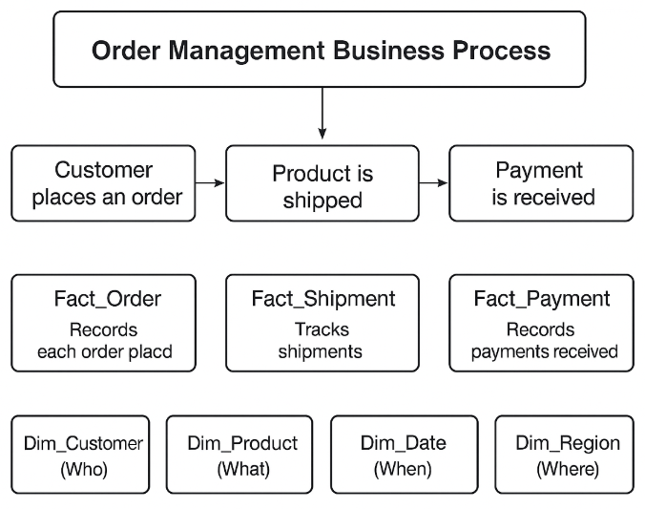
Steps in Business Process Modeling for Data Warehouse
Step 1: Identify Core Business Processes
Examples: Sales, Inventory, Procurement, Claims, HR Operations.
Step 2: Define the Business Events (Facts)
Events like “Order Placed”, “Shipment Sent”, “Payment Received”.
Step 3: Determine the Grain (Level of Detail)
Define what each record in the fact table represents.
  Example: One row per order, or one row per product per order.
Step 4: Identify Dimensions
Dimensions provide descriptive context: Customer, Product, Date, Region, etc.
Step 5: Map Source Systems
Connect each process to its data sources (e.g., ERP tables, CRM exports).
Step 6: Validate with Stakeholders
Review process flows and measures with business users to ensure accuracy.

Slide 27
Example – Order Management Process
Business Process: Customer places an order → Product is shipped → Payment is received.
Fact Tables:
Dimension Tables:
  Dim_Customer (Who)
  Dim_Product (What)
  Dim_Date (When)
  Dim_Region (Where)
Grain Example:
  Fact_Order → One row per order line item.
Fact Table | Description | Example Measures
Fact_Order | Records each order placed | Order Amount, Quantity
Fact_Shipment | Tracks shipments | Shipped Quantity, Delivery Days
Fact_Payment | Records payments received | Payment Amount, Discount

Slide 28
Data Modeling Levels
(Conceptual, Logical, Physical)

Slide 29
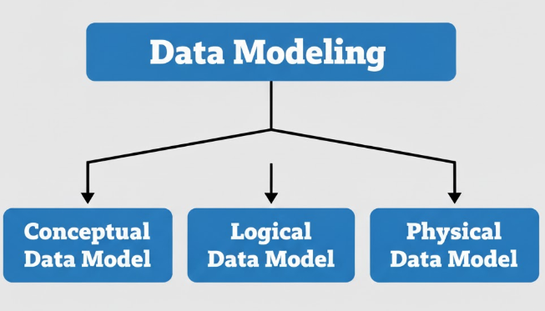
Data Modeling & Levels in Data Warehousing
What is Data Modeling?
Data modeling is the process of visually representing how data is stored, connected, and processed within a system.
Purpose:
  Provides a blueprint for designing databases.
  Helps bridge business understanding and technical implementation.
  Ensures data consistency, accuracy, and reusability.
Objective:
To understand how data models evolve from high-level business
understanding to actual database implementation.
Main Levels:
  Conceptual Data Model
  Logical Data Model
  Physical Data Model

Slide 30
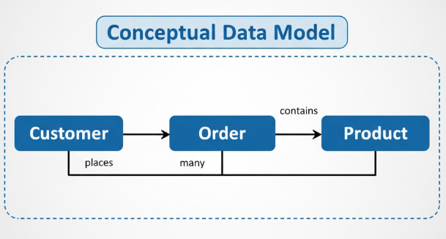
Conceptual Data Model (Business View)
High-level business understanding of data — “What data do we need?”
Key Points:
Represents main entities (Customer, Product, Order, etc.) and their relationships.
No technical details — purely business-oriented.
Used for discussions between business users and analysts.
Example:
Entities: Customer, Order, Product
Relationships:
  A Customer places many Orders.
  Each Order contains multiple Products.

Slide 31
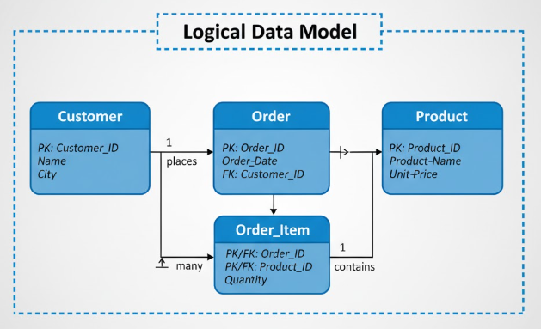
Logical Data Model (Detailed Design View)
Adds more detail to conceptual model — “How is data logically organized?”
Key Points:
Defines attributes for each entity (e.g., Customer → Name, Email, City).
Specifies primary keys (PK) and foreign keys (FK).
Still independent of any specific database system (e.g., SQL Server, Oracle).
Ensures data normalization and data integrity.
Example:
Table: Customer
  PK: Customer_ID
  Attributes: Name, Email, City

Slide 32
Physical Data Model (Implementation View)
Focus: Actual database implementation — “How is data stored physically?”
Key Points:
  Converts logical model into database tables, columns, indexes, and constraints.
  Includes data types (VARCHAR, INT, DATE, etc.).
  Optimized for performance, storage, and query efficiency.
  Reflects naming conventions, partitioning, and indexing strategies.
Example:
  Table: dim_customer
    customer_id INT PRIMARY KEY
    name VARCHAR(100)
  city VARCHAR(50)

Slide 33
Comparison of Conceptual, Logical, and Physical Data Models
Aspect | Conceptual | Logical | Physical
Purpose | Define business concepts | Define data structure | Implement database
Audience | Business users | Data architects | DBAs & developers
Detail Level | High-level | Medium | Low-level / technical
Focus | Entities & relationships | Attributes, keys | Columns, data types
Tool Example | ERD tools (Lucidchart) | ERWin, Draw.io | SQL DDL, ERStudio
Example:
Flow From Concept to Implementation Business Requirement —Track customer orders and payments.
Conceptual Model: Customer — Order — Payment
Logical Model: Add details:
  Customer (ID, Name, Email)
  Order (OrderID, Date, Amount, CustomerID)
  Payment (PaymentID, OrderID, Mode, Amount)
Physical Model: Convert into actual SQL tables with data types, constraints, and indexes.

Slide 34
Fact Table Design Process
(Steps to define the measure grain)

Slide 35
Fact Table Design Process
What is a Fact Table?
  Central table in a star schema that stores quantitative business measures.
  Represents events or transactions occurring in the business.
  Each fact is associated with multiple dimension keys for context.
Example:
  Sales Fact Table → captures revenue, quantity, and discount per transaction.
Key Purpose: To store measurable, numeric data for analysis and reporting.
What is “Grain”?
  Grain defines the level of detail for each record in a fact table.
  It answers: “What does one row in this fact table represent?”
Examples:
  One row per sales transaction.
  One row per customer per month.
  One row per product per store per day.
Why it’s Important:
  Ensures consistency between facts and dimensions.
  Prevents aggregation or duplication errors.
  Determines data volume and performance.

Slide 36
Fact Table Design Process – Step-by-Step
To design a consistent, efficient fact table that accurately represents business events.
Step 1: Identify the Business Process
Understand what business activity you are measuring.
(Example: Sales, Payments, Shipments, Claims, Orders)
Step 2: Declare the Grain (Level of Detail)
Define exactly what one row represents.
(Example: One row per product per order per day)
Step 3: Choose the Dimensions
Identify who, what, where, when, and how aspects of the event.
(Customer, Product, Store, Time, Channel, etc.)
Step 4: Identify the Facts (Measures)
Determine numeric or quantitative values that are measured.
(Sales Amount, Quantity Sold, Revenue, Discount, etc.)
Step 5: Validate Grain Consistency
Ensure every dimension and fact aligns with the declared grain.
Avoid mixing data of different granularities.
Step 6: Add Degenerate Dimensions (if needed)
Add transactional identifiers like Invoice ID or Order Number directly to the fact table.
Step 7: Review Aggregation & Summarization Needs
Consider how data will roll up
(daily → monthly → yearly).
Plan for aggregate fact tables if performance requires.

Slide 37
Example & Considerations in Fact Table Design
Example – Defining the Grain
Business Process: Sales Transactions
All facts and dimensions match the defined grain
Enables accurate aggregation and time-based reporting
Aspect | Example
Declared Grain | One row per Product per Customer per Day
Dimensions | Product, Customer, Store, Date, Salesperson
Facts | Quantity Sold, Total Amount, Discount, Tax
Degenerate Dim. | Invoice Number, Order ID
Key Considerations in Fact Table Design:
  Keep fact tables narrow and numeric — focus on measurable data.
  Dimensions hold descriptive text; facts hold numeric values.
  Ensure additive, semi-additive, or non-additive nature of facts is clear.
  Define surrogate keys for all dimensions for easy joins.
  Avoid nulls use defaults for missing facts.
  Plan data retention and archiving for large fact tables.

Slide 38
Common Pitfalls & Key Takeaways in Fact Table Design
Pitfalls to Avoid
  Mixing multiple grains in a single fact table.
  Storing descriptive attributes inside the fact table.
  Missing or inconsistent dimension references.
  Not validating facts after ETL transformations.
  Ignoring the volume impact of fine-grained facts.
Key Takeaways
  The grain defines the foundation of your fact table.
  All facts and dimensions must match that grain.
  Start design with business process → grain → dimensions → facts.
  Consistent grain ensures reliable analytics, performance, and scalability.
“Define the grain first. Everything else in your fact table design follows from it.”

Slide 39
Dimension Table Design Process
(attributes, keys, history)

Slide 40
The Dimension Table Design Process
A dimension table contains the descriptive, textual, and categorical details that describe the business entities giving meaning to facts.
Key Features of Dimension Tables
  Contain textual attributes (not numeric measures).
  Usually denormalized for faster analytical queries.
  Use surrogate keys as primary identifiers.
  Support hierarchies (e.g., Product → Category → Brand).
  Usually smaller than fact tables.
  Designed for read performance, not frequent updates.
6 Major Steps Of Dimension Table Design Process :
  Identify the Business Entity
  Define Attributes
  Define Keys
  Handle Historical Changes
  Establish Relationships with Facts
  Optimize for Query Performance

Slide 41
Step 1 – Identify the Business Entity
Determine what real-world entity the dimension represents.
Examples:
  Customer Dimension → Describes each customer.
  Product Dimension → Describes each product.
  Time Dimension → Describes each date or period.
Key Questions:
  What business process uses this entity?
  Which facts depend on it?
  What data sources provide it?
Note:
Always align your entity with a business process, not just a data source.
Example: “Customer” in sales, not “User” from CRM.

Slide 42
Step 2 – Define Attributes
List all descriptive details that help in analysis and reporting.
Types of Attributes:
  Descriptive: Name, Brand, Category, City
  Hierarchical: Country → State → City
  Derived: Age Group, Price Range
Example (Customer Dimension):
Design Tips:
  Use clear business names.
  Avoid unnecessary technical fields.
  Include hierarchies to support drill-down reports.
Note :
Choose attributes that add analytical value, not just raw data.
Attribute | Description
Name | Customer Full Name
Gender | Male/Female
City | Customer City
Loyalty_Status | Gold / Silver / Platinum

Slide 43
Step 3 – Define Keys
Two Key Types in Dimensions:
1. Surrogate Key (Primary Key)
  System-generated (e.g., Customer_Key, Product_Key).
  Used in fact tables as foreign keys.
  Independent of operational source changes.
2. Natural Key (Business Key)
  Comes from source (e.g., Customer_ID, SKU).
  Used to track updates and handle history.
Example:
Note:
Always use surrogate keys as the dimension’s primary key they ensure stability and consistency across systems.
Surrogate Key | Natural Key | Customer Name
1001 | C001 | John Smith

Slide 44
Step 4 – Handle Historical Changes (SCDs)
Why?
Because business attributes change — and analytics often need historical context.
Use Slowly Changing Dimensions (SCDs):
Example (SCD Type 2):
When customer moves city →
Insert a new record with updated city and mark previous record as inactive.
Note:
Always define an Effective_Date, End_Date, and Current_Flag to track SCD changes.
Type | Description | Example
SCD Type 0 | No history tracking | Customer DOB
SCD Type 1 | Overwrite old value | Correct name spelling
SCD Type 2 | Preserve full history | Address changes
SCD Type 3 | Keep limited history | Previous vs. Current Region

Slide 45
Step 5 – Establish Relationships with Fact Tables
To connect descriptive dimensions to numeric facts for analysis.
How it Works:
  The Fact Table stores foreign keys from each dimension.
  The Dimension Table provides detailed descriptive info.
Example: Sales_Fact Table
These keys link to:
Customer_Dim
Product_Dim
Date_Dim
Note:
Always verify grain compatibility between fact and dimensions.
Customer_Key | Product_Key | Date_Key | Amount_Sold

Slide 46
Step 6 – Optimize for Performance
Why Optimization Matters:
Large data volumes → slower queries → frustrated analysts.
Optimization Techniques:
  Denormalize dimensions (flatten hierarchies).
  Add indexes on surrogate keys & common filters.
  Create mini-dimensions for fast-changing attributes.
  Use data quality checks to remove duplicates or nulls.
  Periodically archive inactive records.
Example:
A “Product Mini Dimension” can store daily price or promotion details
to avoid overloading the main Product Dimension.
Note:
Balance between performance and maintainability — don’t overcomplicate design.

Slide 47
SCD Example with Common Pitfalls and Key Takeaways
Example – Customer Dimension Table (SCD Type 2)
Tracks full history of customer’s location using SCD Type 2.
Customer_Key | Customer_ID | Customer_Name | City | Loyalty_Status | Effective_Date | End_Date | Current_Flag
1001 | C001 | John Smith | New York | Gold | 2024-01-01 | 2024-08-15 | N
1002 | C001 | John Smith | Boston | Gold | 2024-08-16 | NULL | Y
Common Pitfalls to Avoid
  Using natural keys as the primary key.
  Ignoring SCD changes for evolving attributes.
  Over-normalizing (hurts performance).
  Missing foreign key links to fact tables.
  Using unclear or duplicate attribute names
Quick Fix:
  Use surrogate keys.
  Audit history columns regularly.
  Keep design simple and business-focused.
Key Takeaways
  Dimension = Context of facts
  Start design with: Entity → Attributes → Keys → History → Relationships → Optimization
  Always use surrogate keys
  Handle historical changes with proper SCD type
  Design for performance & business readability

