Slide 1


Slide 2



Vs
University of Moratuwa
Uva Wellassa University of Sri Lanka

Slide 3



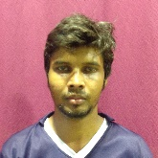
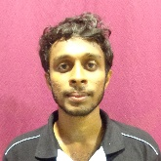
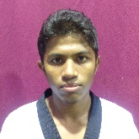
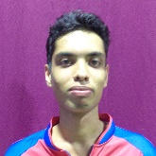
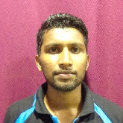
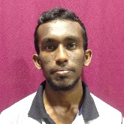
University of Moratuwa
Weigh Class : 54 - 67 Kg
M.C.J. Peiris
A.J. Munasinghe
D.L.T.S. Jaliya
J.K.B. Dassanayake
K.M.C.L. Amarathunga
M.D.M. Udayanga

Slide 4

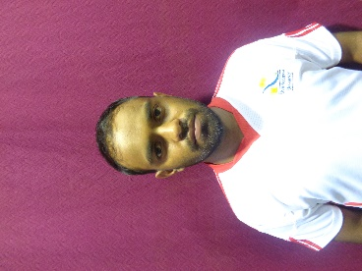
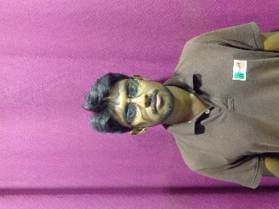
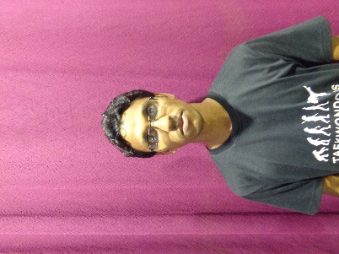
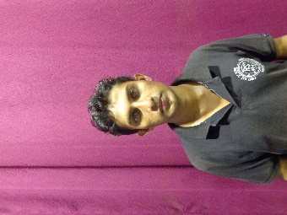
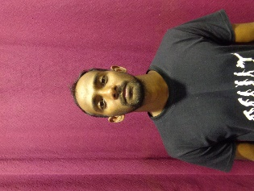
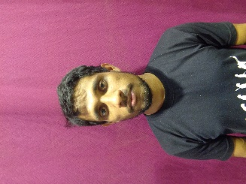
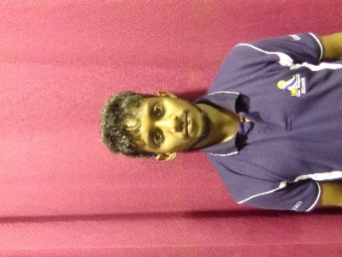
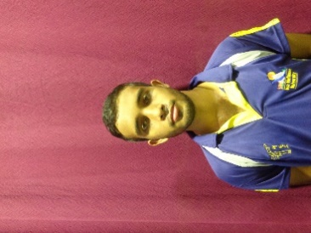
Uva Wellassa university of Sri Lanka
Weigh Class : 54 - 67 Kg
W.N.K.M.S. Danawardana
W.G.T.T.K. Dewasurendara
A.M.N. Jayantha
W.B.M.W.P.K. Weerasekara
T.P.S. Madusanka
A.C.S. Chandrasena
W.H.T.P. Weerapura
M.W.D. Jayasanka

Slide 6
Vs
University of Moratuwa
Uva Wellassa University of Sri Lanka

