Slide 1


Slide 2



Vs
University of Kelaniya
University Of Colombo

Slide 3


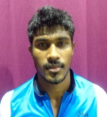
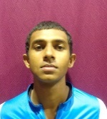
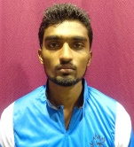
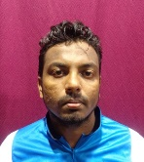
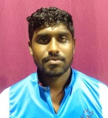
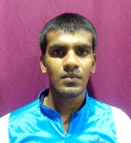
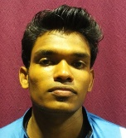
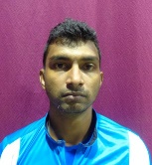
University of Kelaniya
Weigh Class : 72 - 86 Kg
R.M.C.K Bandara
G.L.P. Gunasinghe
D.M.S.P. Dassanayake
R.D.S.K. Jayasinghe
S.R.N.T Jayarathne
A.S.K. De Silva
V.H. Gunasekara
M.N.A. Prasanna

Slide 4

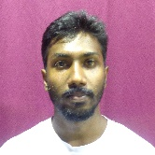
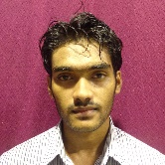
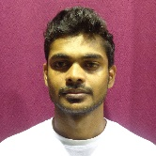
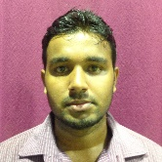
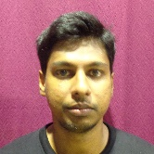
University of Colombo
Weigh Class : 72 - 86 Kg
J.A.D.S Perera
V. Ajeak
K.S.C De Silva
R.M.S.T. Siriwardana
D.G.P.M. Premathilake

Slide 6
Vs
University of Kelaniya
University Of Colombo

