Slide 1


Slide 2



Vs
University of Sri Jayawardana
Uva Wellassa University of Sri Lanka

Slide 3


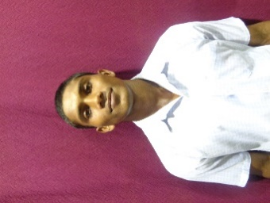
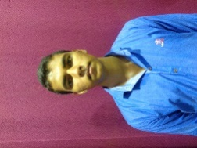
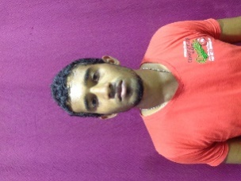
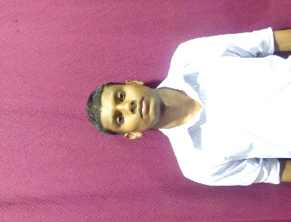
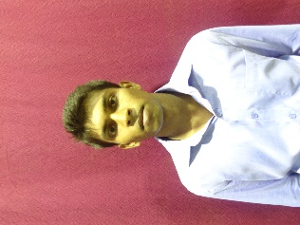
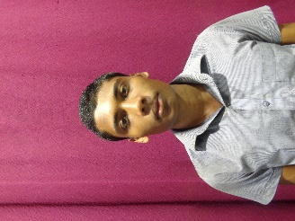
University of Sri Jayawardanapura
Weigh Class : 54 - 67 Kg
K.L.A.Y.I. Pushpakumara
P.M.D. Chathuranga
D.T.D. Gunasekara
B.L.D.M. De Silva
P.B. Wijebandara
H.M.U.M. Herath

Slide 4

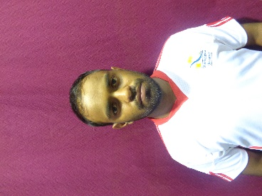
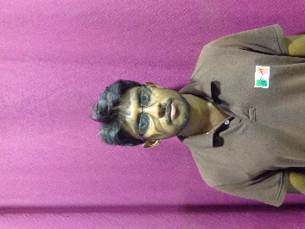
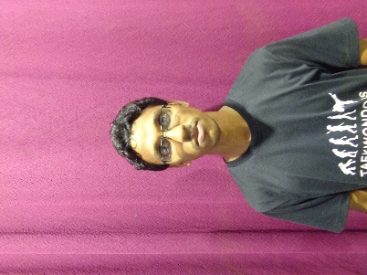
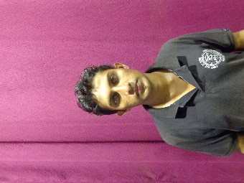
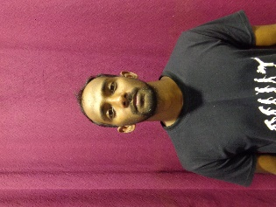
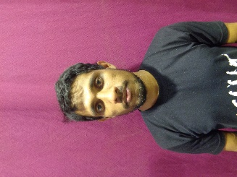
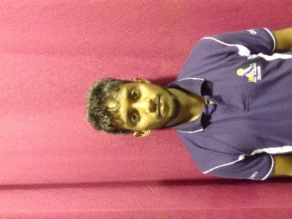
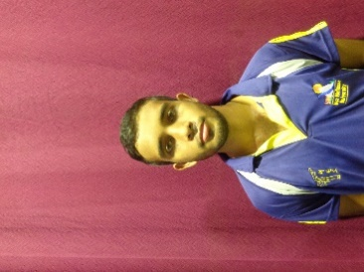
Uva Wellassa university of Sri Lanka
Weigh Class : 54 - 67 Kg
W.N.K.M.S. Danawardana
W.G.T.T.K. Dewasurendara
A.M.N. Jayantha
W.B.M.W.P.K. Weerasekara
T.P.S. Madusanka
A.C.S. Chandrasena
W.H.T.P. Weerapura
M.W.D. Jayasanka

Slide 6
Vs
University of Sri Jayawardana
Uva Wellassa University of Sri Lanka

