Slide 1


Slide 2



Vs
University of Ruhuna
Uva Wellassa University of Sri Lanka

Slide 3


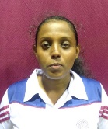
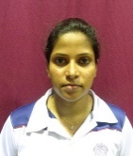
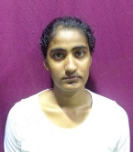
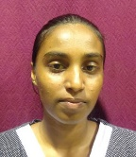
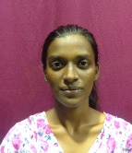
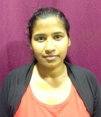
University of Ruhuna
Weigh Class : 46 - 58 Kg
H.N.T. Anuruddika
T.R.D. Fernando
S.M.N.M. Sandanayake
R.M.C. Shamali
A.P.I. Mendis
M.K.J.C. Rajatheja

Slide 4

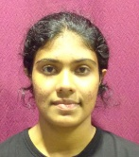
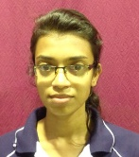
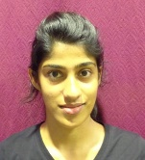
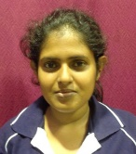
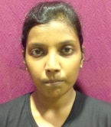
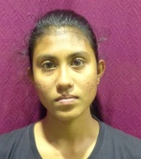
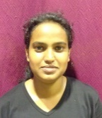
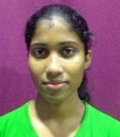
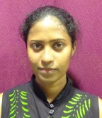
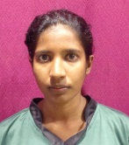
Uva Wellassa University of Sri Lanka
Weigh Class : 46 - 58 Kg
R.M.S.L. Rathnayake
A.P. Weerakoon
S.K.C. De Silva
R.M.S.D. Rathnayaka
G.A.D.T.B. Devindi
R.M.S.N. Rathnakaya
S.I.W. Abeywardana
D.H.I.S. Ranaweera
M.H.J. Chamani
P.K.T. Malshani

Slide 6
Vs
University of Ruhuna
Uva Wellassa University of Sri Lanka

