Slide 1


Slide 2



Vs
University of Kelaniya
University of Ruhuna

Slide 3


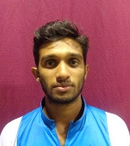
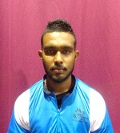
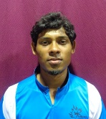
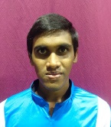

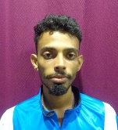
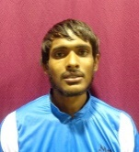
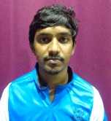
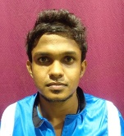
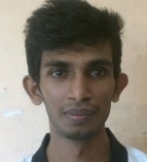
University of Kelaniya
Weigh Class : 54 - 67 Kg
D.T.M.N. Tharanga
H.M.U.A. bandara
I.B.C.S.B. Weerapokuna
H.D. Abesinghe
J.L.B. Jayaweera
A.K.V.H. Abeyrathne
M.L.M. Silva
P.L.N.U. Corray
H.M.P.K. Ekanayake
K.R.I. Maduranga

Slide 4
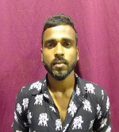

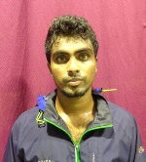
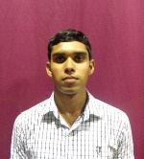


University of Ruhuna
Weigh Class : 54 - 67 Kg
B.M.A.C.Premarathne
M.Edison
K.K.P.S.Kumara
K.G.S.Divanjana
A.V.P.M.Prasad
W.V.T.S.Fernando

Slide 6
Vs
University of Kelaniya
University of Ruhuna

