Slide 1


Slide 2



Vs
University of Kelaniya
University of Colombo

Slide 3


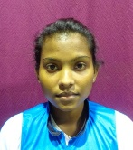
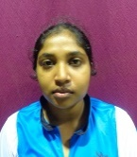
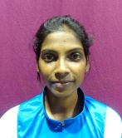
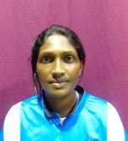
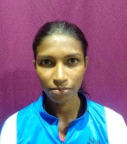
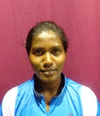
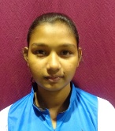
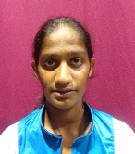
University of Kelaniya
Weigh Class : 46 - 58 Kg
W.P.P. Pathirana
P.A.A.D. Munasinghe
H.M.T.K. Hettiarachchi
M.I. Pushpakumari
S.A.T.A. Senevirathne
A.A.D. Sandamali
D.U.S. Jayasinghe
W.V.S.S. Wijekoon

Slide 4

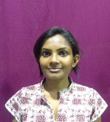
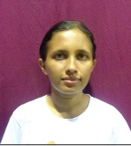
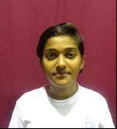
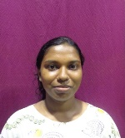
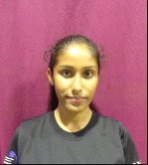
University of Colombo
Weigh Class : 46 – 58 Kg
K.P.S.H.De Silva
R.I.Jayathilaka
D.P.Wickramage
W.L.T.Pabasara
F.I.Moulana

Slide 6
Vs
University of Kelaniya
University of Colombo

