Slide 1


Slide 2



Vs
University of Kelaniya
Uva Wellassa University of Sri Lanka

Slide 3



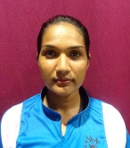
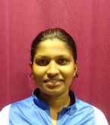
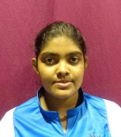
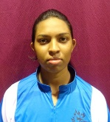
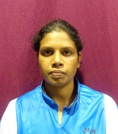
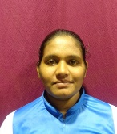
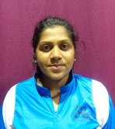
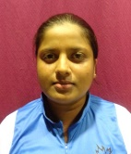
University of Kelaniya
Weigh Class : 72 - 86 Kg
N.P.S.S. Nuwarage
W.G.D.S. Wehigaldeniya
W.R.W. Wickramasinghe
N.H.A.C. Madhubashini
K.M.R.C.K. Samarakoon
W.M.K.S. Costha
W.C. Premarathne
U.D.P.T. Karunarathne

Slide 4

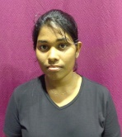
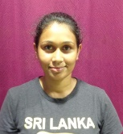
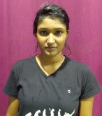
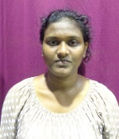
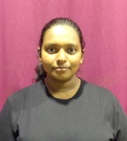
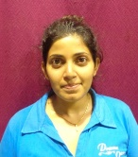
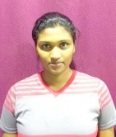
Uva Wellassa University of Sri Lanka
Weigh Class : 72 - 86 Kg
T.P.M.U. De Silva
G.D.B. Gayanjani
A.S. Amarasinghe
M.P.N.N. Vijangani
K.K.Y.S. Jayasuriya
R.W.M.K. Kanchanamala
S.S. Induruwage

Slide 6
Vs
University of Kelaniya
Uva Wellassa University of Sri Lanka

