Slide 1


Slide 2



Vs
University of Kelaniya
Uva Wellassa University of Sri Lanka

Slide 3



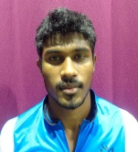
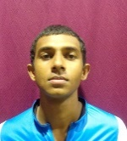
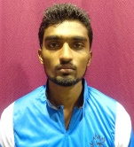
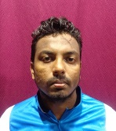
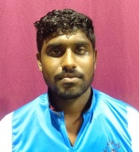
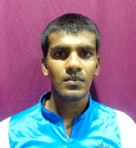
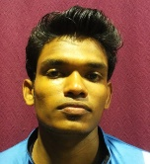
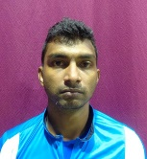
University of Kelaniya
Weigh Class : 72 - 86Kg
R.M.C.K Bandara
G.L.P. Gunasinghe
D.M.S.P. Dassanayake
R.D.S.K. Jayasinghe
S.R.N.T Jayarathne
A.S.K. De Silva
V.H. Gunasekara
M.N.A. Prasanna

Slide 4

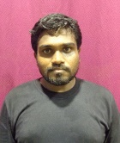
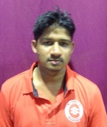
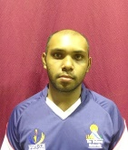
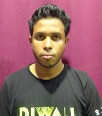
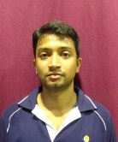
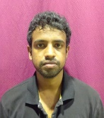
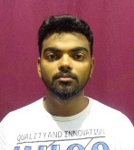
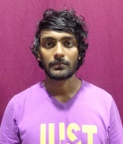
Uva Wellassa University of Sri Lanka
Weigh Class : 72 - 86 Kg
K.R. Madhusanka
A.A.L.A.C. Perera
H.A.T. Hewagamage
G.G.S. Udara
W.M.L. Iroshana
U.B. Kahawatta
A.L.M. Rifnas
K.H.D. Sandaruwan

Slide 6
Vs
University of Kelaniya
Uva Wellassa University of Sri Lanka

