Slide 1


Slide 2



Vs
Sabaragamuwa University of Sri Lanka
University of Sri Jayawardanapura

Slide 3



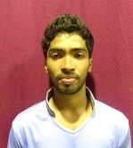
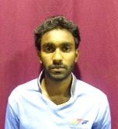
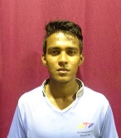
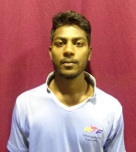
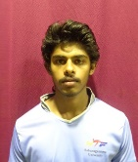
Sabaragamuwa University of Sri Lanka
Weigh Class : 54 - 67 Kg
W.P.N.T. Lakmal
W.N.K.S.I. Dhanawardana
S.M.D.P. Dasanayake
A.M. Darshana
R.V.A.J.Sampath

Slide 4
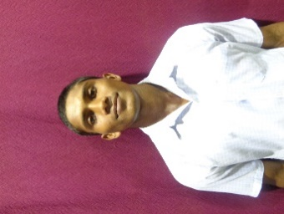
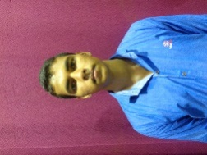
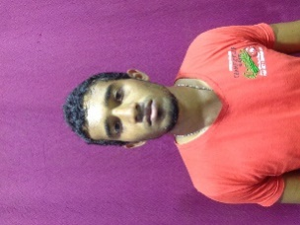
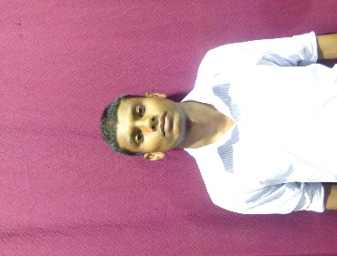
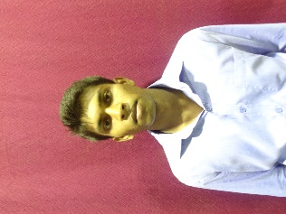
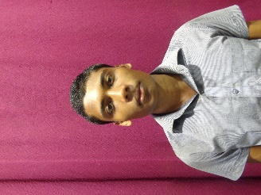
University of Sri Jayawardanapura
Weigh Class : 54 - 67 Kg
K.L.A.Y.I. Pushpakumara
P.M.D. Chathuranga
D.T.D. Gunasekara
B.L.D.M. De Silva
P.B. Wijebandara
H.M.U.M. Herath

Slide 6
Vs
Sabaragamuwa University of Sri Lanka
University of Sri Jayawardanapura

