Slide 1


Slide 2



Vs
University of Kelaniya
University of Moratuwa

Slide 3



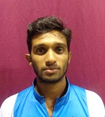
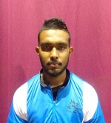
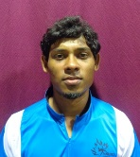
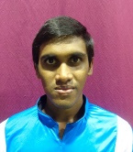
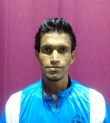
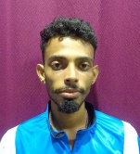
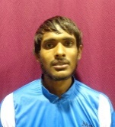
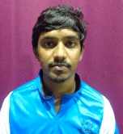
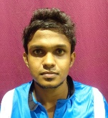
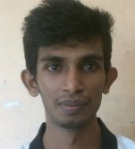
University of Kelaniya
Weigh Class : 54 - 67 Kg
D.T.M.N. Tharanga
H.M.U.A. bandara
I.B.C.S.B. Weerapokuna
H.D. Abesinghe
J.L.B. Jayaweera
A.K.V.H. Abeyrathne
M.L.M. Silva
P.L.N.U. Corray
H.M.P.K. Ekanayake
K.R.I. Maduranga

Slide 4

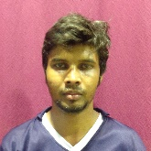
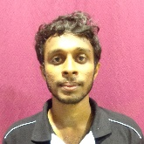
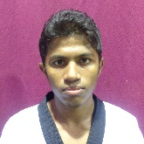
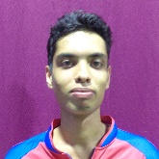
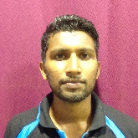
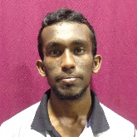
University of Moratuwa
Weigh Class : 54 - 67 Kg
M.C.J. Peiris
A.J. Munasinghe
D.L.T.S. Jaliya
J.K.B. Dassanayake
K.M.C.L. Amarathunga
M.D.M. Udayanga

Slide 6
Vs
University of Kelaniya
University of Moratuwa

