Slide 1


Slide 2



Vs
University of Ruhuna
Uva Wellassa University of Sri Lanka

Slide 3


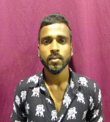
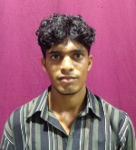
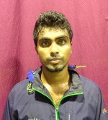
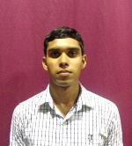

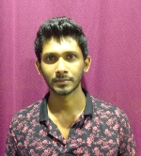
University of Ruhuna
Weigh Class : 54 - 67 Kg
B.M.A.C.Premarathne
M.Edison
K.K.P.S.Kumara
K.G.S.Divanjana
A.V.P.M.Prasad
W.V.T.S.Fernando

Slide 4

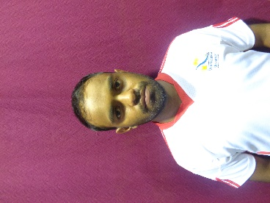
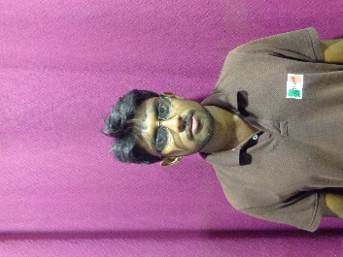
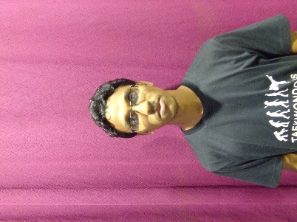
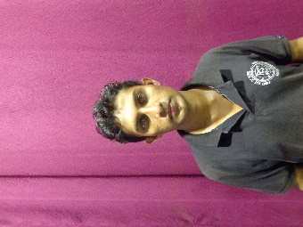
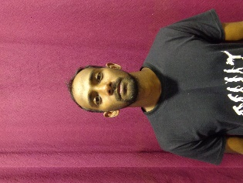
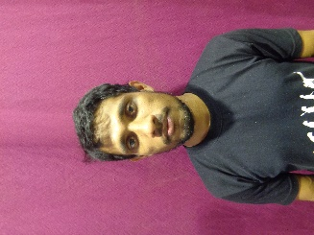
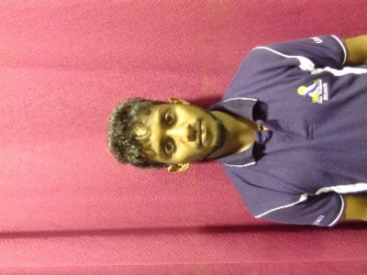
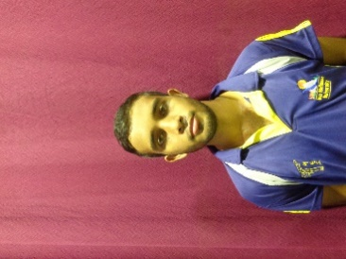
Uva Wellassa university of Sri Lanka
Weigh Class : 54 - 67 Kg
W.N.K.M.S. Danawardana
W.G.T.T.K. Dewasurendara
A.M.N. Jayantha
W.B.M.W.P.K. Weerasekara
T.P.S. Madusanka
A.C.S. Chandrasena
W.H.T.P. Weerapura
M.W.D. Jayasanka

Slide 6
Vs
University of Ruhuna
Uva Wellassa University of Sri Lanka

