Slide 1


Slide 2



Vs
University of Kelaniya
University of Ruhuna

Slide 3



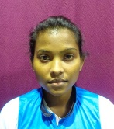
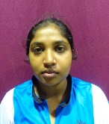
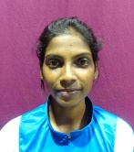
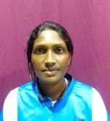
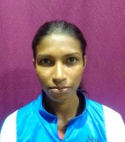
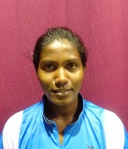
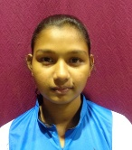
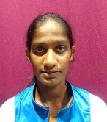
University of Kelaniya
Weigh Class : 46 - 58 Kg
W.P.P. Pathirana
P.A.A.D. Munasinghe
H.M.T.K. Hettiarachchi
M.I. Pushpakumari
S.A.T.A. Senevirathne
A.A.D. Sandamali
D.U.S. Jayasinghe
W.V.S.S. Wijekoon

Slide 4
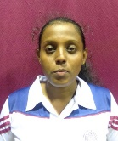
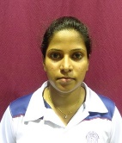
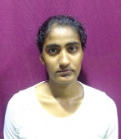
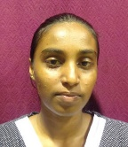
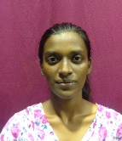
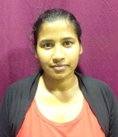
University of Ruhuna
Weigh Class : 46 - 58 Kg
H.N.T. Anuruddika
T.R.D. Fernando
S.M.N.M. Sandanayake
R.M.C. Shamali
A.P.I. Mendis
M.K.J.C. Rajatheja

Slide 6
Vs
University of Kelaniya
University of Ruhuna

