Slide 1


Slide 2



Vs
University of Colombo
Uva Wellassa University of Sri Lanka

Slide 3




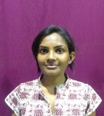
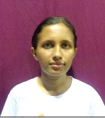
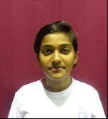
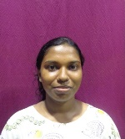
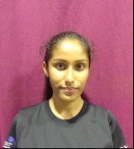
University of Colombo
Weigh Class : 46 - 58Kg
K.P.S.H.De Silva
R.I.Jayathilaka
D.P.Wickramage
W.L.T.Pabasara
F.I.Moulana

Slide 4

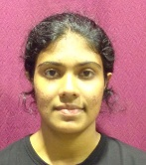
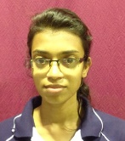
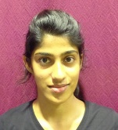
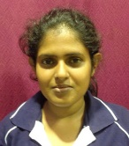
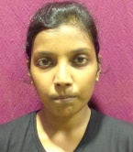
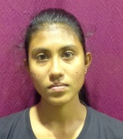
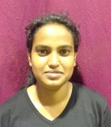
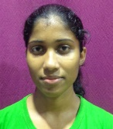
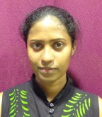
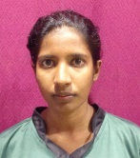
Uva Wellassa University of Sri Lanka
Weigh Class : 46 - 58 Kg
R.M.S.L. Rathnayake
A.P. Weerakoon
S.K.C. De Silva
R.M.S.D. Rathnayaka
G.A.D.T.B. Devindi
R.M.S.N. Rathnakaya
S.I.W. Abeywardana
D.H.I.S. Ranaweera
M.H.J. Chamani
P.K.T. Malshani

Slide 6
Vs
University of Colombo
Uva Wellassa University of Sri Lanka

