Slide 1


Slide 2



Mens 2nd Runner up
Weigh Class : 54 – 67 Kg
University of Sri Jayawardenapura

Slide 3
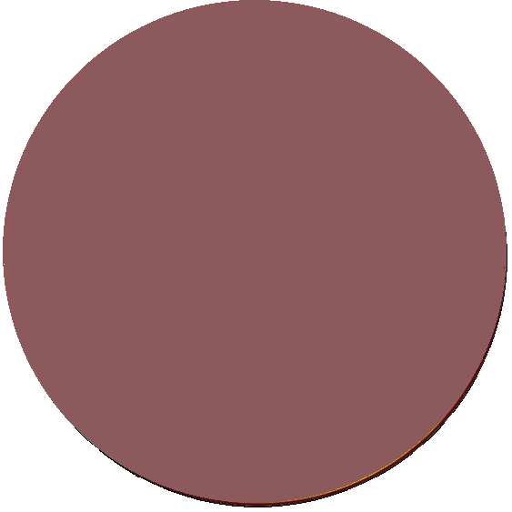
Mens 1st Runner up
Weigh Class : 54 – 67 Kg
University of Kelaniya

Slide 4
Mens Championship
Weigh Class : 54 – 67 Kg
University of Kelaniya

Slide 6

Mens 2nd Runner up
Weigh Class : 72 - 86 Kg
Uva Wellassa University of Sri Lanka

Slide 7

Mens 1st Runner up
Weigh Class : 72 - 86 Kg
University of Kelaniya

Slide 8

Mens Championship
Weigh Class : 72 - 86 Kg
University of Colombo

