Slide 1
Team name: H3xl4w
PharmaConnect
Team members:
Harshit Budhraja (team leader)
Kumari Renuka
Shailesh Mohta
Isha Pali
Rishabh Kumar Kandoi
Abhimanyu Sangitrao

Slide 2

PharmaConnect
An initiative proposed under Smart India Hackathon 2018
Problem Category: Government of Delhi
Problem Statement: Nationwide​ ​integration​ ​of​ ​all​ ​pharmaceutical​ ​groups​ ​(Education,​ ​Industries and​ ​all​ ​stakeholders)​ ​to​ ​share​ ​policies,​ ​updates,​ ​summits,​ ​seminars/expo
Problem Code: #GDL9
Team Name: H3xl4w
Team Leader: Harshit​ ​Budhraja
College Code (AISHE Code): U-0833​ ​(NIIT​ ​University,​ ​Neemrana,​ ​Alwar​ ​-​ ​301705)

Slide 3
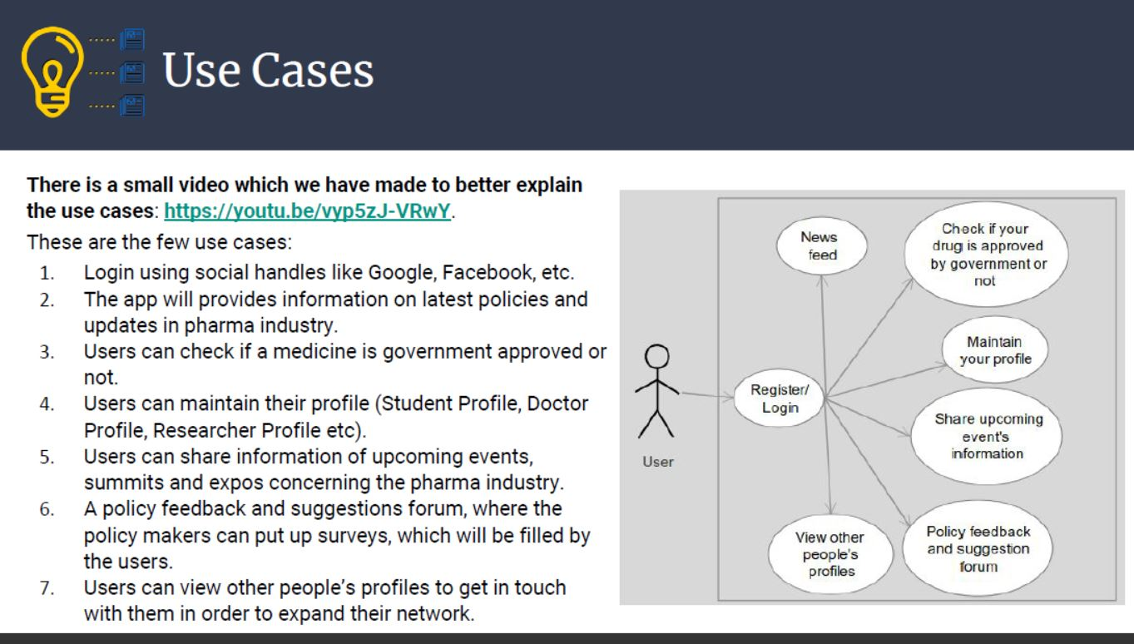

Slide 4
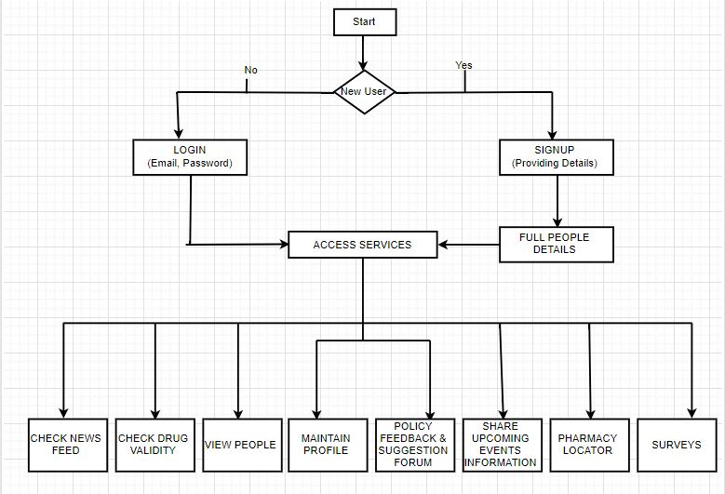
Flow Chart

Slide 5

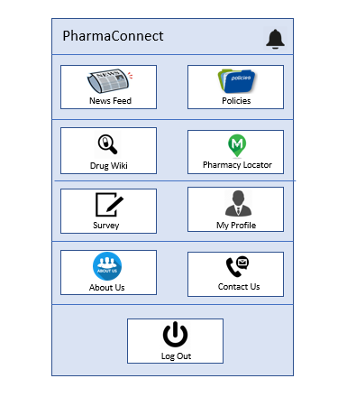
Proposed Solution

Slide 6

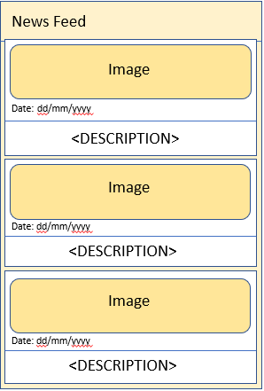
DESCRIPTION
Newsfeed
This (card-view) feature shows the current news and trends related to pharmaceutical sector with reference to:
PharmacyTimes.com

Slide 7
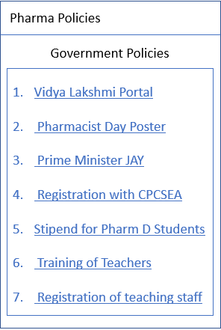
FEATURES
Policies
This section will show the information of latest policies and circulars released by the government

Slide 8
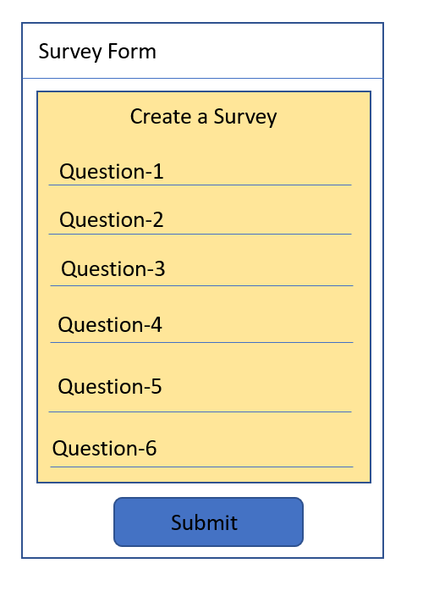
FEATURES
Survey
This can be used to create/fill surveys as
1) Suggestions
2) Feedback

Slide 9
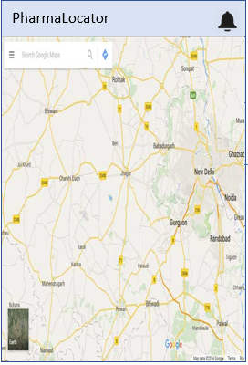
FEATURES
Pharmacy locator
This will let you know the location of pharmacies nearby.

Slide 10
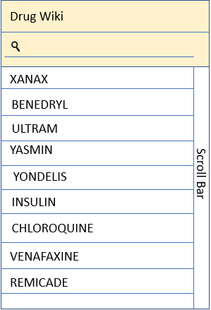
FEATURES
Drug Wiki
This will give some general information about a drug which can be searched by the user.

Slide 11
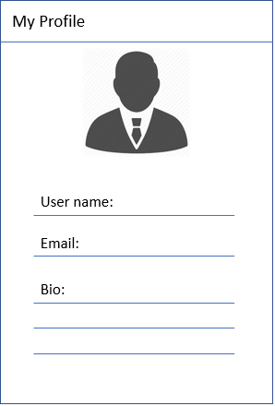
FEATURES
My Profile
This will give the user it’s profile information whatever he/she has entered during the signup.

Slide 12
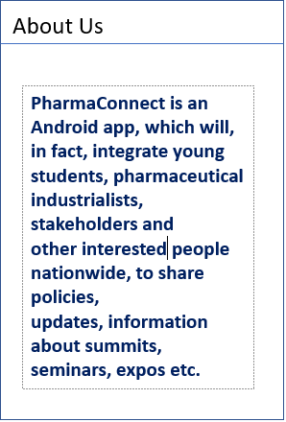
FEATURES
About Us
This will provide the information about the organisation/ministry who will work as a admin for the app.

Slide 13

FEATURES
Contact US
This will show some of the contact details of the admin.

Slide 14

Technology Stack and Approach
TECHNOLOGY STACK
Java in Android Studio IDE
MYSQL and NoSQL as the Database Models
PHP for Dedicated API
JSON for Data communication (using REST Technology)

Slide 15
Thank You

