Slide 1
An Energy-Efficient Approach Towards Network Intelligence In Cooperative communication In Vehicular Environment
R & D Mentor:
Jetendra Joshi
Project No - 25

Slide 2
TEAM DETAILS
ENROLLMENT NUMBER | STUDENT’S NAME | BRANCH
U101115FCS111 | KUMARI RENUKA | CSE
U101115FCS101 | ISHA PALI | CSE
U101115FCS283 | RISHABH KUMAR KANDOI | CSE
U101115FCS125 | SAI PRANEETH | CSE
U101115FCS305 | SHAILESH MOHTA | CSE

Slide 3




AGENDA
Rationale of work
Motivation
Objective
Literature Review
Methodology

Slide 4

RATIONALE OF WORK
VANET –Vehicular Ad Hoc Network
VANETs exchange info to support Intelligent Transportation System.
Primary Goal – Road Safety(minimizing traffic)
Secondary Goal – Real time traffic congestion and routing information, mobile information etc.

Slide 5
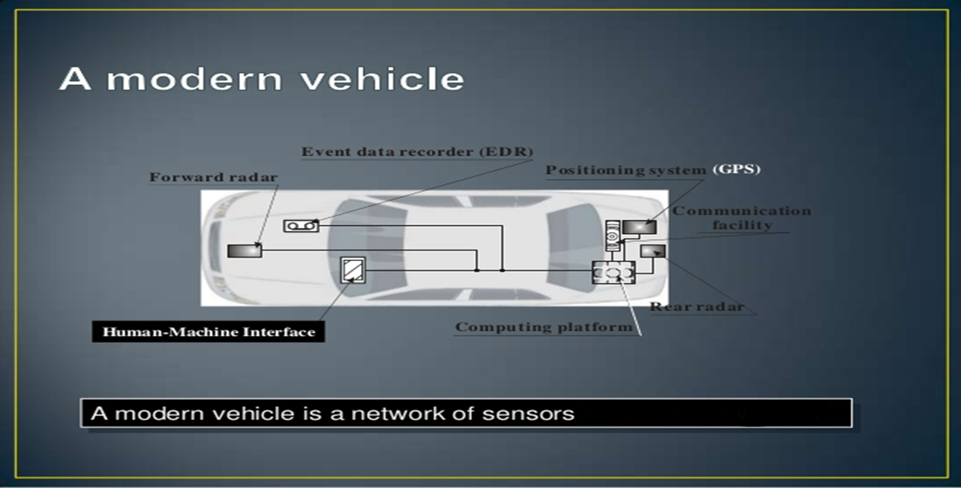
https://www.slideshare.net

Slide 6
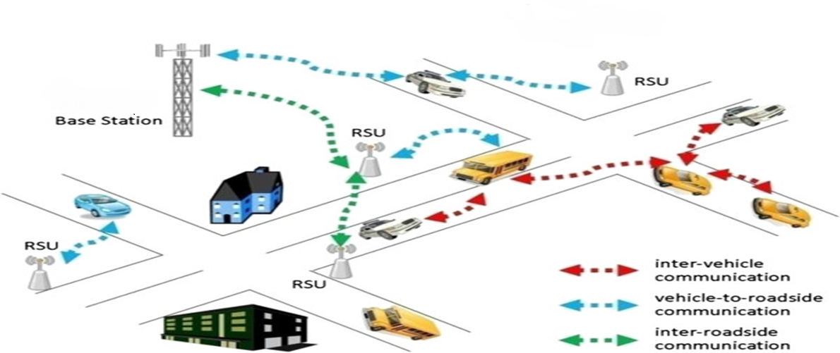
VEHICULAR COMMUNICATION SYSTEM
http://www.vanet.mdx.ac.uk

Slide 7
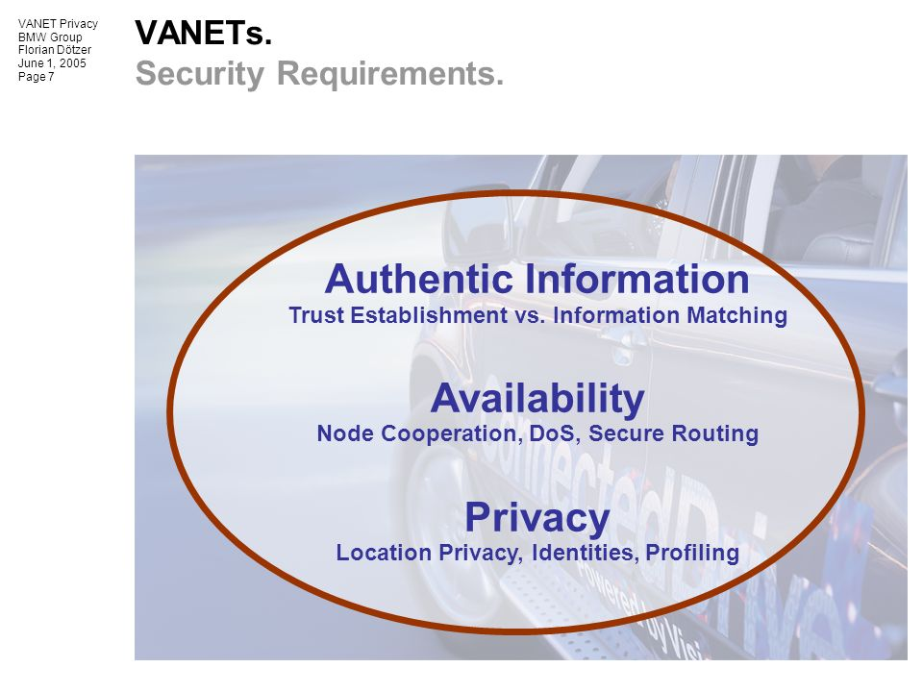
SECURITY REQUIREMENTS IN VANETS
Data Integrity
Data Verification
Non-repudiation
Authentication
Privacy
https://images.google.com/

Slide 8
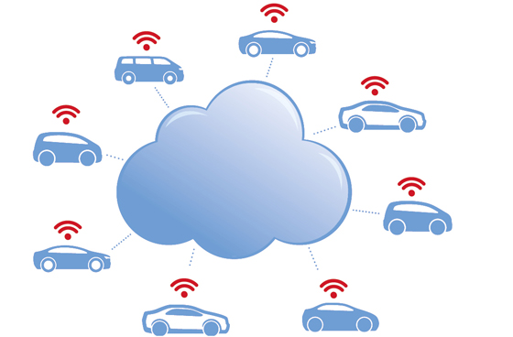
INTRODUCTION TO VCN
Huge amount of data exchange take place in VANETs.
VANETs change the computing and networking models, which leads to a future vehicular networking system.
VCN = VCC + ICN
Each vehicle has three categories of resources
- data storage, sensors, and computing

Slide 9
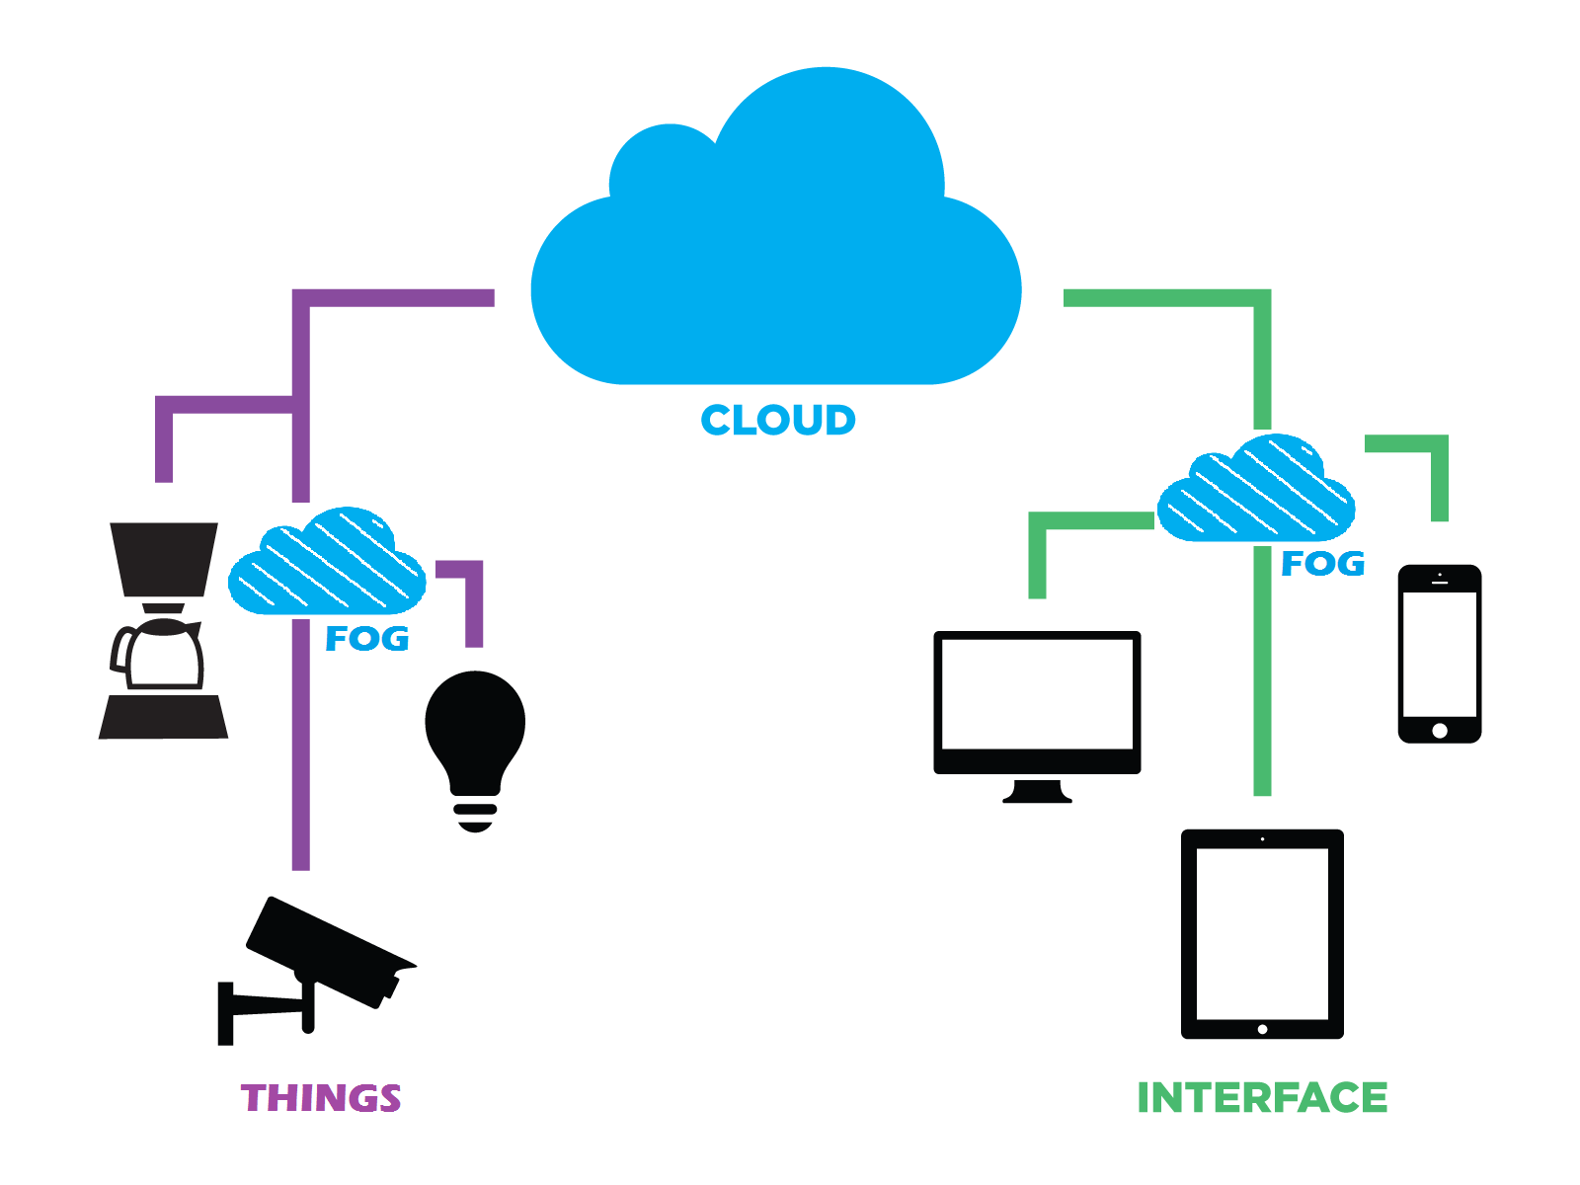
ADVANTAGES OF FOG COMPUTING IN VANETS
Disadvantage of cloud - computing cannot provide real-time services
Fog Computing provides real time services as
it extends cloud computing to the edge of an
enterprise's network
Advantage – Can be used in VANETs to
provide real time services without causing
much delay.
https://images.google.com/

Slide 10
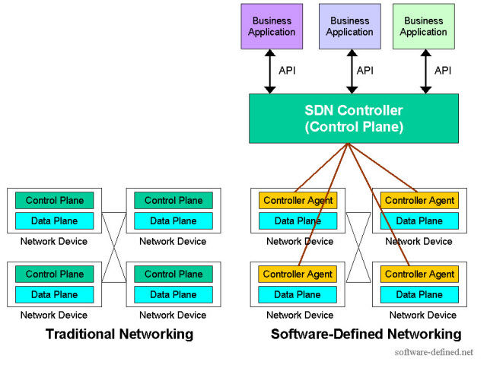
ADVANTAGE OF SDN IN VANETs

Slide 11
Motivation
In Connected Vehicle Environment, the communication channels are unstable and the topology changes frequently.
Efficient resource and energy management is essential but difficult because of the inflexibility of the current network structure.

Slide 12
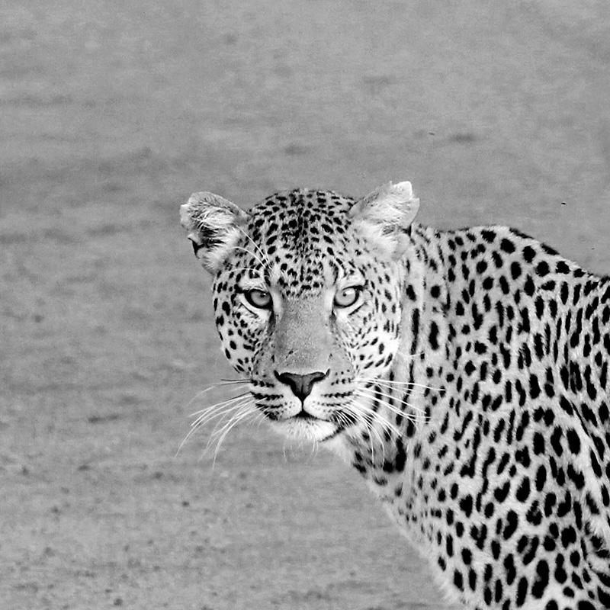
Objective
The main objective is to design an efficient network management strategy with guaranteed satisfaction of network traffic demand utilising SDN and fog computing in connected vehicular environment and to ensure secure communication in VANETs.

Slide 13
LITERATURE REVIEW
[1] SYousefi, M. Mousavi and M. Fathy, "Vehicular Ad Hoc Networks (VANETs): Challenges and Perspectives", 2006 6th International Conference on ITS Telecommunications, pp. 761-766, 2006.
[2]E. Lee, E. Lee, M. Gerla and S. Oh, "Vehicular cloud networking: architecture and design principles", IEEE Communications Magazine, vol. 52, no. 2, pp. 148-155, 2014.

Slide 14
[3] Truong, G. Lee and Y. Ghamri-Doudane, "Software defined networking-based vehicular Adhoc Network with Fog Computing", 2015 IFIP/IEEE International Symposium on Integrated Network Management (IM), pp. 1202-1207, 2015.
[4] Park and Y. Yoo, "Network Intelligence Based on Network State Information for Connected Vehicles Utilizing Fog Computing", Mobile Information Systems, vol. 2017, pp. 1-9, 2017.
[5]A. Luckshetty, S. Dontal, S. Tangade and S. Manvi, "A survey: Comparative study of applications, attacks, security and privacy in VANETs", 2016 International Conference on Communication and Signal Processing (ICCSP), 2016, pp.1594 - 1598, 2016.

Slide 15
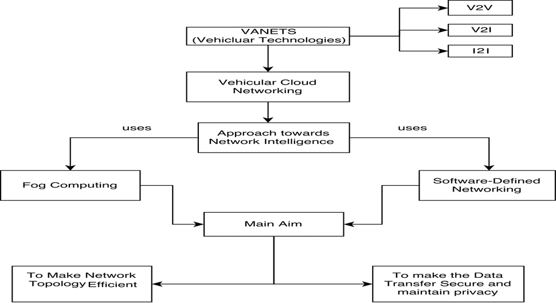
METHODOLOGY

Slide 16
APPROACH
To study the concept of fog computing and software-defined networking and their usage in VANETs.
The main aim is to focus on the networking layer part to design an efficient network management strategy in VANETS which will utilize two new emerging technologies – SDN and fog computing
To design an algorithm which will satisfy the network traffic demand and make efficient use of resources.
Various simulation would be conducted to evaluate the results.

Slide 17



SOFTWARES
TOOLS FOR SIMLUATION
Simulation in NS2/NS3
Mobility model generation by SUMO and Omnet++
OpenStreetMap
VSimRTI
IFogSim

Slide 18

THE SIMLUATION RESULT USING SUMO AND OPENSTREETMAP

Slide 19
Thanks!
Any questions?

