Slide 1
An Energy-Efficient Approach Towards Network Intelligence In Cooperative Communication In Vehicular Environment
R & D Mentor:
Prof Jetendra Joshi
Project No - 25

Slide 2
TEAM DETAILS
KUMARI RENUKA
ISHA PALI
SHAILESH MOHTA
SAI PRANEETH
RISHABH KUMAR KANDOI
U101115FCS111
U101115FCS101
U101115FCS305
U101115FCS125
U101115FCS283

Slide 3




AGENDA
Rationale of work
Objective
Methodology
Results

Slide 4
RATIONALE OF THE WORK
Cooperative communication
Network Intelligence
Algorithm – energy efficient and secure

Slide 5
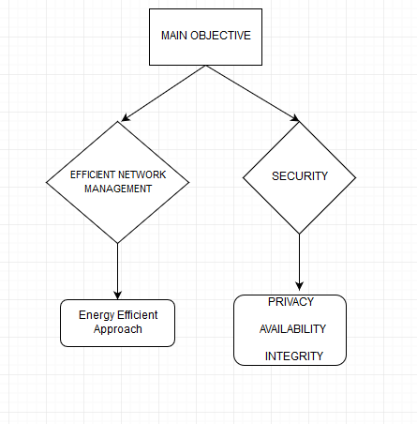
BREAKDOWN OF OBJECTIVE

Slide 6
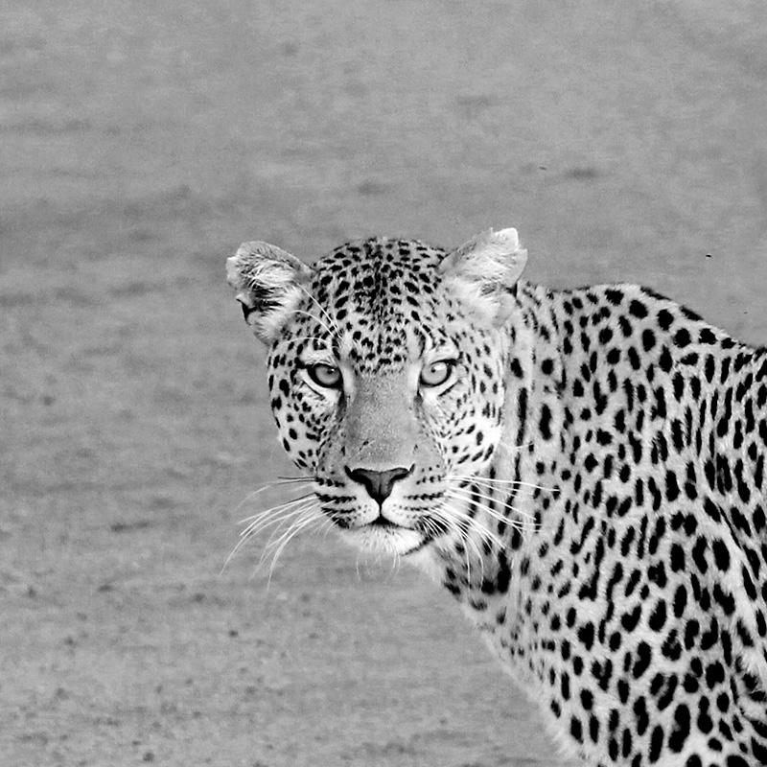
OBJECTIVE
Designing an energy efficient network management strategy in VANETs architecture utilizing fog computing and software-defined networking.
Ensuring secure data communication in VANETs.

Slide 7
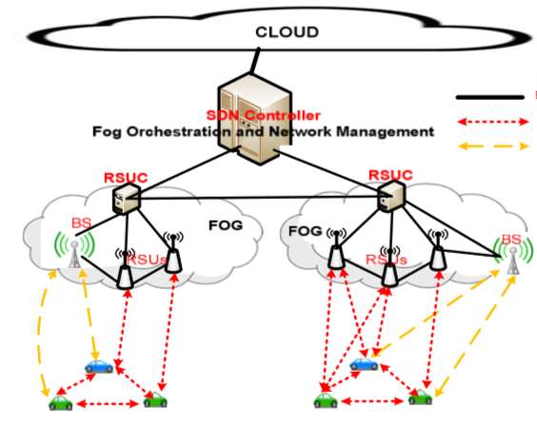
ENERGY-EFFICIENT APPROACH IN VANET

Slide 8
SIMULATION TOOLS FOR SDN VANET ARCHITECTURE
Mininet
Floodlight
The simple model is generated using mininet and floodlight to know the working of these tools. The demonstration of the simulation using the above tools is shown in the next slide.

Slide 9
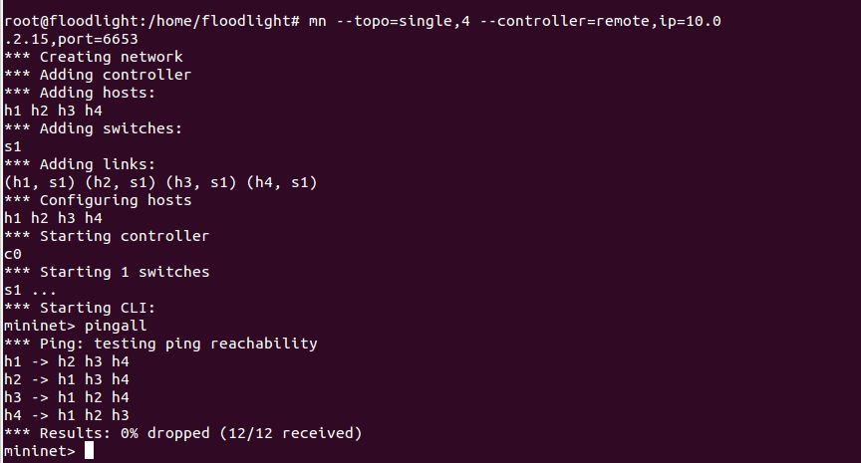
DEMONSTRATION OF THE SIMULATION

Slide 10
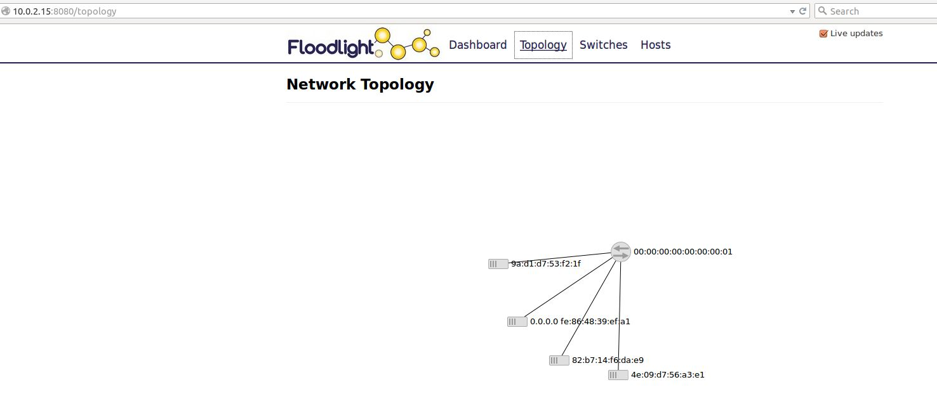

Slide 11
DIFFICULTIES
The suggested approach saves the amount of energy consumed in VANET architecture while satisfying the network traffic demand.
Hence, the scheme proposed by us must be implement in the shown topology in mininet and floodlight .
Hence, We would show the complete model with simulation results using mininet and floodlight in the next evaluation.

Slide 12
SECURITY IN VANETS
The following areas are covered in maintaining security in VANETS
Privacy
Data Integrity
Availability

Slide 13
CONCERNED ISSUE UNDER PRIVACY
Heartbeat messages in V2V Communication - Unsecured message
Use of Pseudonym instead of real identities
Securing the Heartbeat messages , Ensures location Privacy

Slide 14
OUR APPROACH : SILENCE AT LOW SPEEDS
Scheme:
Threshold speed vT
No broadcast of heartbeat message, or any other msg containing location or trajectory data
Then it changes pseudonyms
Ideal location to create mix-zones : Crowded place – traffic signal

Slide 15
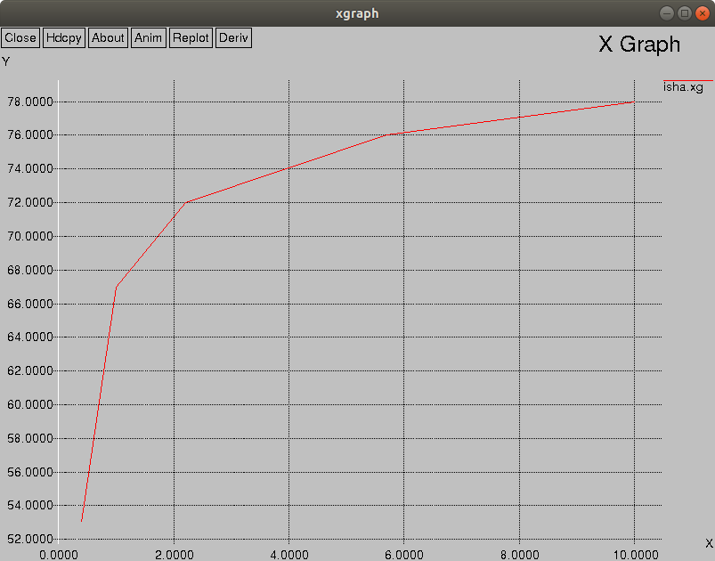
SIMULATION RESULT

Slide 16
DIFFICULTIES
1) Not a solution to avoid sending heartbeat.
2) Still the data is not secure even after stop sending the heartbeat
3) Need some technique to securely transmit the data

Slide 17
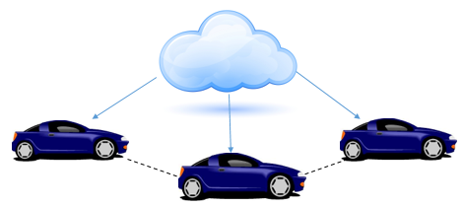
ALTERNATIVE SOLUTION
Securing the heartbeat messages while transmission.
Preparation
Request sent to cloud
Cloud broadcast message
Vehicle’s Response
Serving the request
Decryption of message

Slide 18
DATA INTEGRITY
Implementation of RSA algorithm to securely transmit the data in vehicular environment
Public/Private key concept
Three steps procedure-
Key generation
Encryption
Decryption

Slide 19
RSA ALGORITHM KEY GENERATION
Choose two distinct prime number p & q randomly with similar bit length.
Compute n (n=p*q).
Compute Euler’s totient function ∅(n)= ∅(p*q)= ∅(p) ∅(q)
=(p-1)(q-1)
Choose an integer ‘e’ such that 0≤e< ∅(n) and gcd(e, ∅(n))=1,
e is released as public key exponent
Determine private key exponent ‘d’ by using the formula
d*e(mod ∅(n))=1

Slide 20


ENCRYPTION
RSU want to transmits public key (n, e) to vehicles and keeps the private key d secret.
RSU uses reversible protocol known as the padding scheme to generate cypher text.
c=$m^{e}$ (mod n)
DECRYPTION
Vehicles can recover m from c by using private key exponent d via computing
m=$c^{d}$ (mod n)

Slide 21
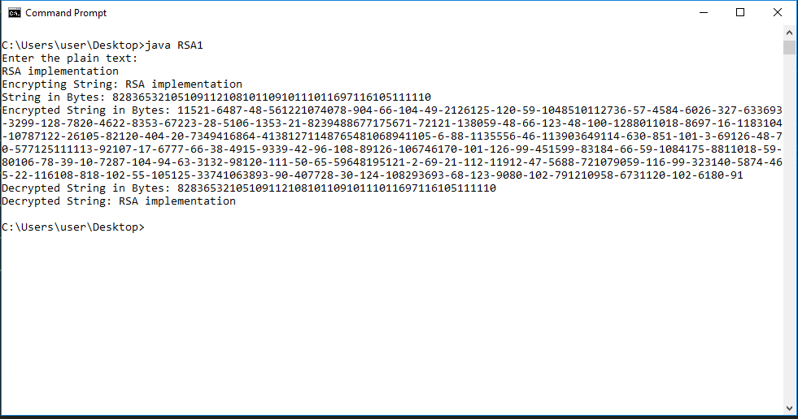
RSA ALGORITHM IMPLEMENTATION IN JAVA

Slide 22
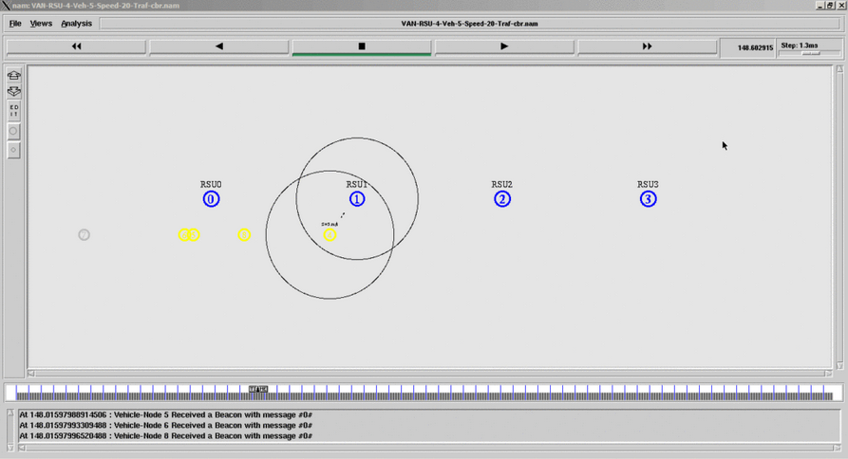
IMPLEMENTATION OF SECURITY IN VANET IN NS2

Slide 23
RESULTS OF DIFFERENT PARAMETERS BY GENERATING AWK FILES
NUMBER OF VEHICLES | DELAY | PDR | THROUGHPUT
5 | 39 | 50 | 3.5
10 | 41 | 51 | 3.6
15 | 42 | 53 | 3.7
20 | 45 | 56 | 3.9
25 | 47 | 58 | 3.9

Slide 24
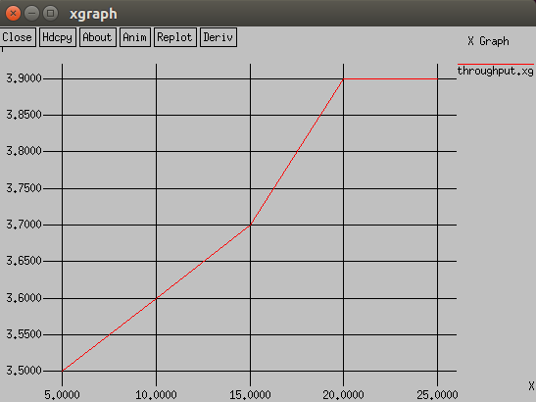
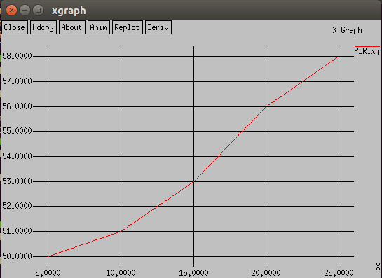
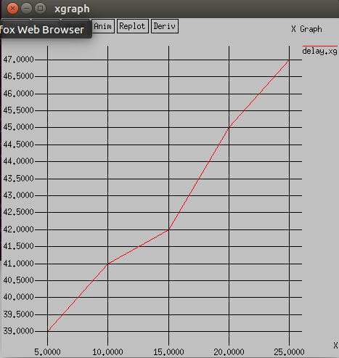
GRAPHICAL REPRESENTATION OF THE RESULTS
THROUGHPUT
PACKET DELIVERY RATIO
DELAY

Slide 25
BLACKHOLE ATTACK
Packet Drop attack
lossy network
Malicious Node
frequently deployed to attack

Slide 26
METHODOLOGY
Define a Blackhole attacker in Aodv.h File
Make a function which converts a node into a blackhole by giving a id to it Aodv.cc File
Make Clean in ns2 directory
Make
Add black hole Node in tcl Script
($ns at 0.0 &quot;[$n1 set ragent_] blackhole&quot;)

Slide 27
SIMULATION PARAMETER
No. of Nodes | 27
Simulation Time | 1000.0
Channel type | Wireless
Routing Protocols | AODV
Network interface type | Wireless Phy

Slide 28
MIGRATING BLACK HOLE ATTACK
Unique Sequence number
Redundant route method
Received and Sent Table method

Slide 29
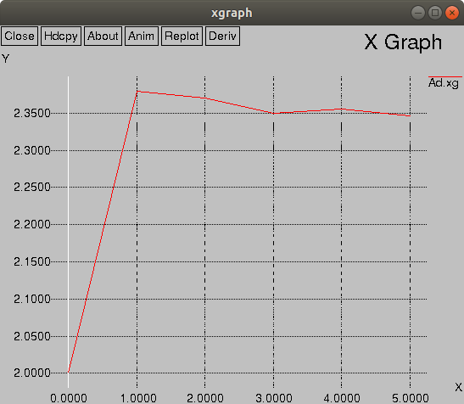
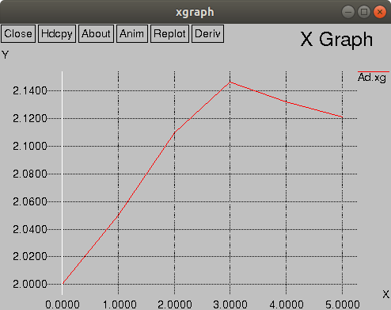
AVERAGE END-TO-END DELAY

Slide 30
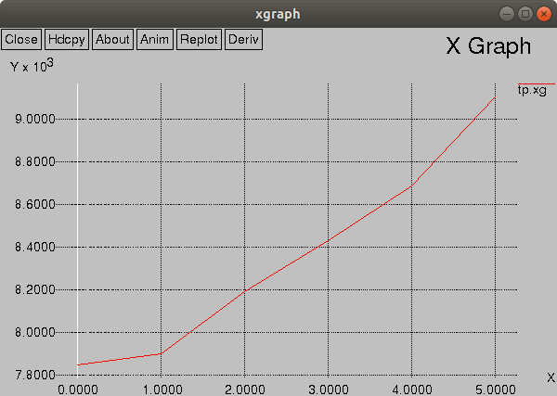
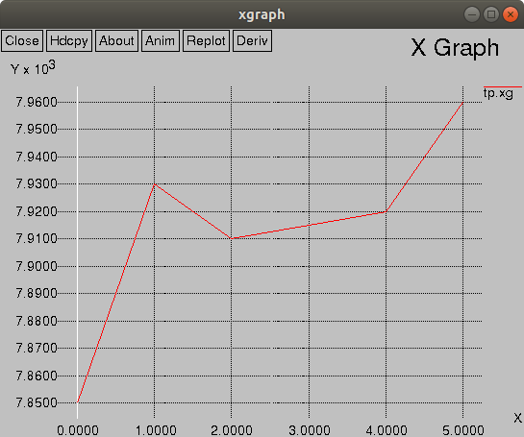
DROPPED-PACKETS

Slide 31
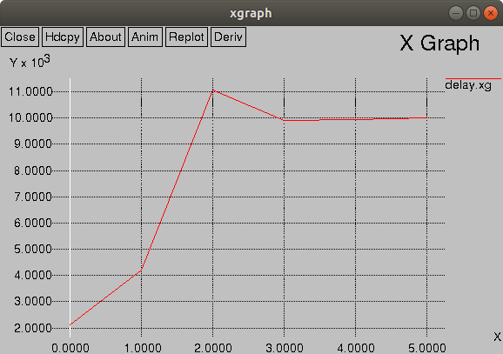
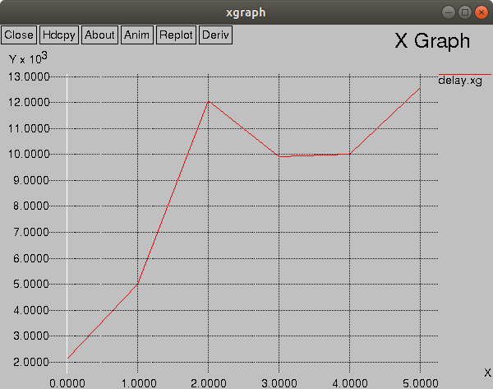
RECEIVED-PACKETS

Slide 32
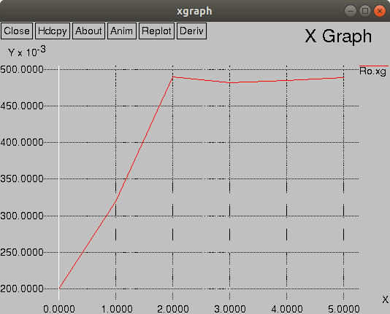
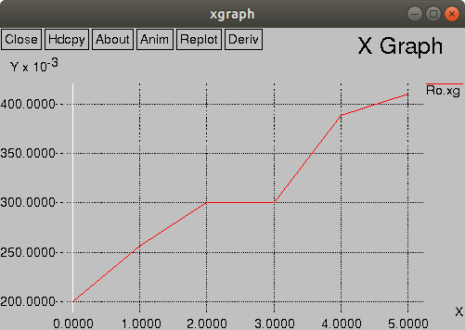
ROUTING-OVERHEAD

Slide 33
DATA INTEGRITY
Problem Statement :
To tackle fake messages sent in a VANET
environment

Slide 34
SOLUTION
Sending of application messages
Evaluation of Sender V_{s}
Evaluation of the intermediate V_{fi}
Evaluation of the message in Destination
Feedback reporting
Updating of the reputation level

Slide 35
Thanks!
Any questions?

