Slide 1
An Energy-Efficient Approach Towards Network Intelligence In Cooperative Communication In Vehicular Environment
R & D Mentor:
Prof Jetendra Joshi
Project No - 25

Slide 2
TEAM DETAILS
KUMARI RENUKA
ISHA PALI
SHAILESH MOHTA
SAI PRANEETH
RISHABH KUMAR KANDOI
U101115FCS111
U101115FCS101
U101115FCS305
U101115FCS125
U101115FCS283

Slide 3




AGENDA
Objective
Rationale of work
Milestones
Results of the work completed

Slide 4
RATIONALE OF THE WORK
Why SDN and fog computing ? Advantages of these technologies in VANETs?
Reasons for security issues in VANETs.
a) ARP Spoofing
b) DDOS attack – black hole
c) RSA +AES implementation

Slide 5
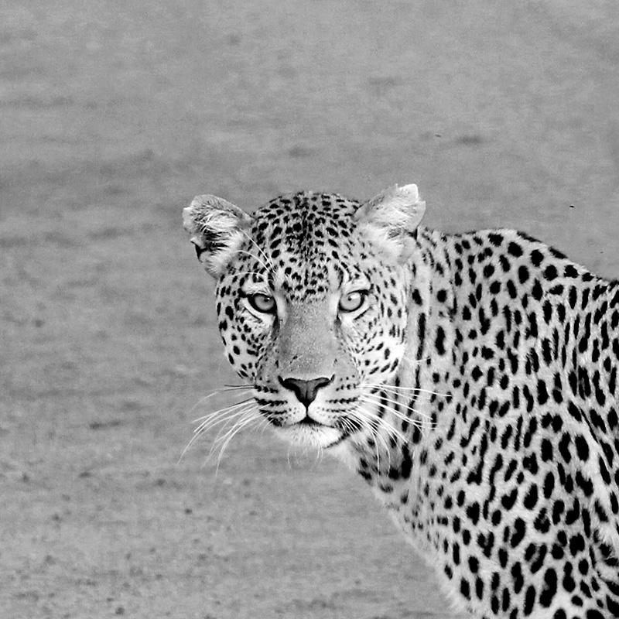
OBJECTIVE
Designing an energy efficient network management strategy in VANETs architecture utilizing fog computing and software-defined networking.
Ensuring secure data communication in VANETs.

Slide 6
MILESTONES
MID TERM 1
MID TERM 2
FINAL EVALUATION
Introduction to new technology
Defining objective and methodology
Details of the software used
Narrowing down the objective
Floodlight tool demo
Difficulties
Security in VANETS
RSA implementation
Energy efficient algorithm and model design
Floodlight implementation
Security- ARP spoofing and DDOS attack
RSA+AES implementation

Slide 7
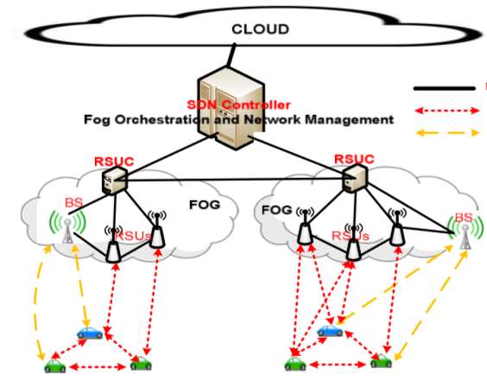
ENERGY-EFFICIENT APPROACH IN VANET

Slide 8
ALGORITHM DESIGN
1. Input = CurrentNetworkTopology(Graph), DataDemand
Output = ActivatedNetworkingDevices, DemandPath;
Initialization:
ActivatedNetworkingDevices=0, DemandPath=0;
4. Search all possible shortest path from source to destination vehicle
Select the shortest path with minimum newly activated networking devices
if CapacityOfPath=0 then remove the path from the given set of demand path
and go for another path from the given set of path
Update the status of each networking devices
In the end we check how many networking devices are activated.
Keep the track of the path used to accommodate the transfer of data.

Slide 9
SIMULATION TOOLS FOR SDN VANET ARCHITECTURE
Mininet
Floodlight
Floodlight and mininet is the tool used for SDN simulation. We generated a custom model using python in mininet and floodlight software. The shortest path algorithm have been implemented by modifying the controllers code. We followed the same topology with same configuration in both the energy-efficiency and secure approach in VANETs

Slide 10
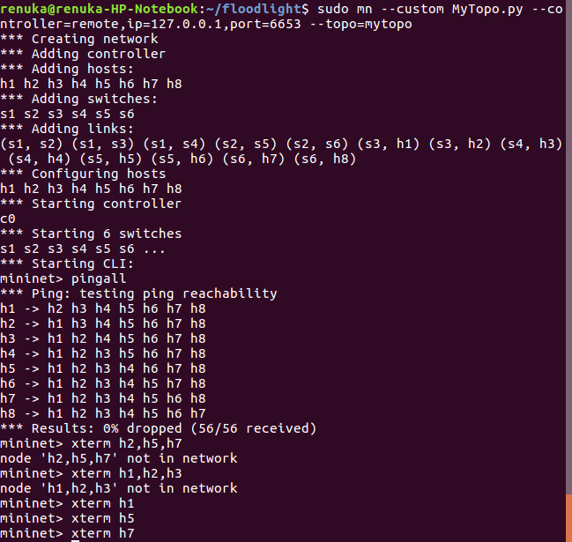
DEMONSTRATION OF THE SIMULATION

Slide 11
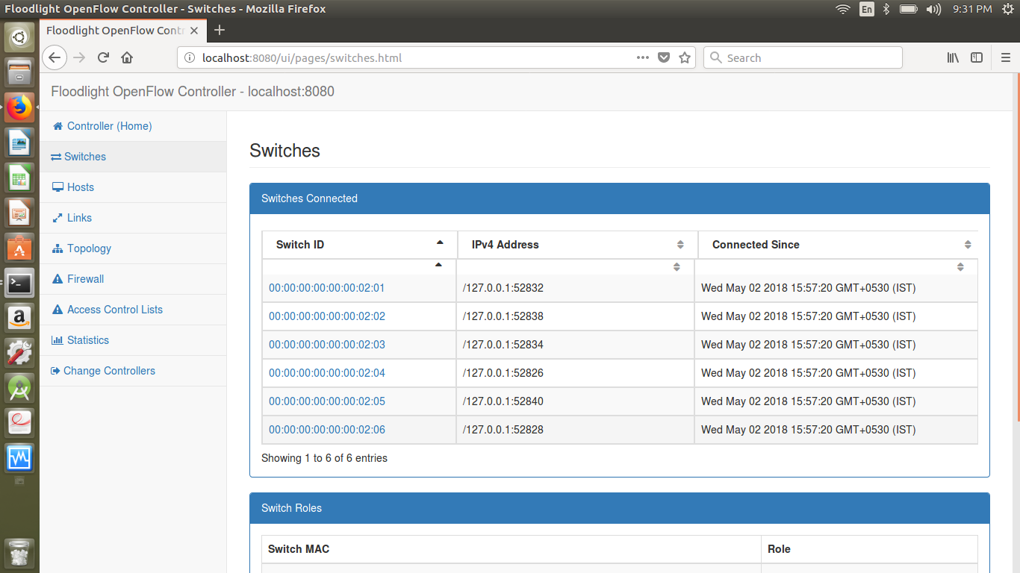
SWITCH CONFIGURATION

Slide 12
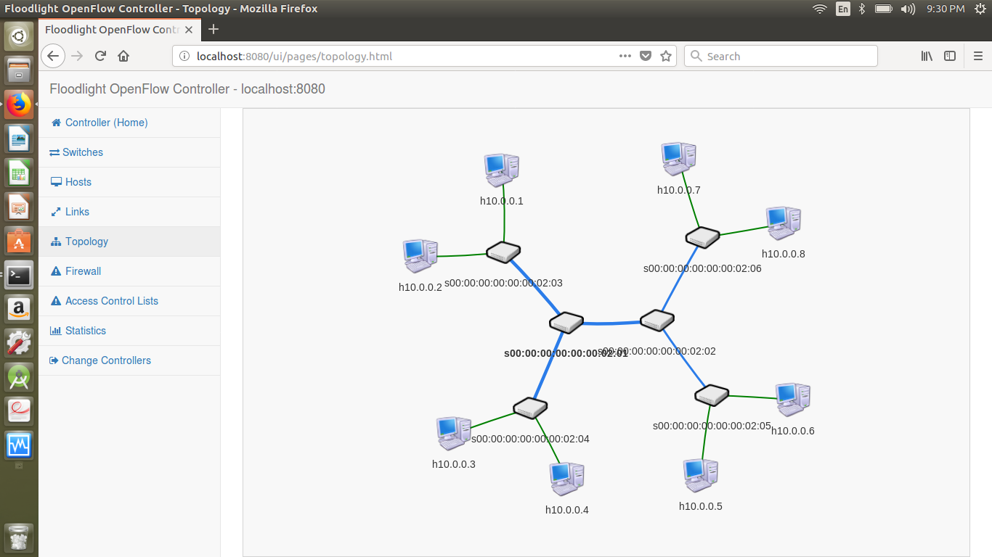
TOPOLOGY GENERATION

Slide 13
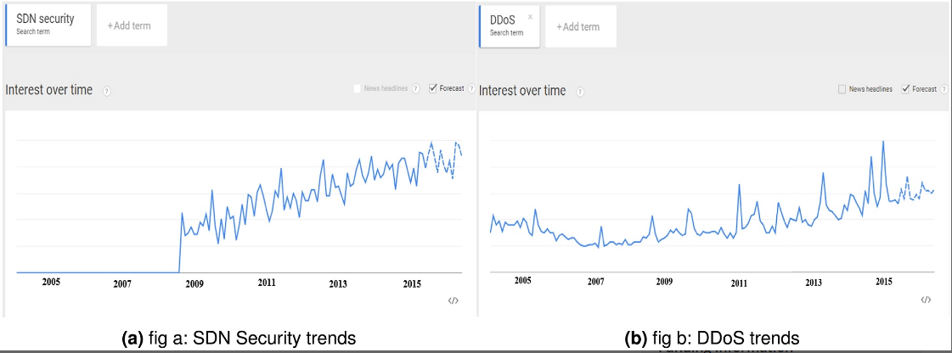
ANAYSIS OF SDN SECURITY AND DDOS TRENDS

Slide 14
SECURITY- ARP SPOOFING
ARP spoofing is a technique used by attackers to perform cache poisoning by inserting false IP to MAC address mappings in victim’s ARP cache.
Request Attack
An attacker broadcasts ARP request message with forged source IP-MAC in the ARP header. When victim receives this spoofed ARP message, it updates its ARP cache table with the attacker’s forged IP-MAC pair.
Response Attack
An attacker will either respond to normal ARP request with forged ARP replies that maps the next hop IP to the attacker MAC address or send spoofed

Slide 15
SECURITY- ARP SPOOFING
ARP spoofing may be used to launch either one of the following attacks -
DoS attacks: the attacker will prevent the two communicating hosts from getting connected to each other.
2. Host impersonation attack: the attacker will receive packets intended to the victim and can reply to these packets on behalf of the victim.
3. Man-In-The-Middle (MITM) attack: the attacker will be able to monitor all the traffic between two communicating hosts.

Slide 16
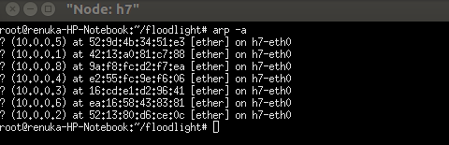
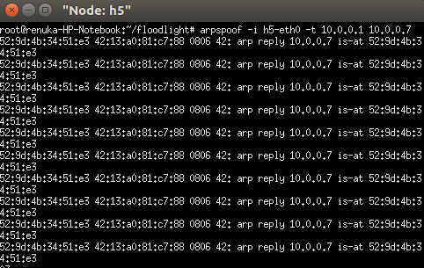
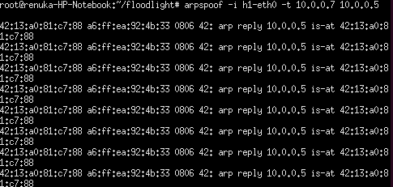
ARP SPOOFING SIMULATION

Slide 17
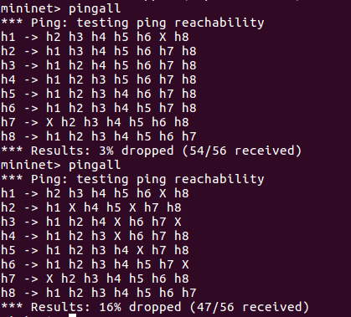
ARP SPOOFING SIMULATION RESULTS

Slide 18
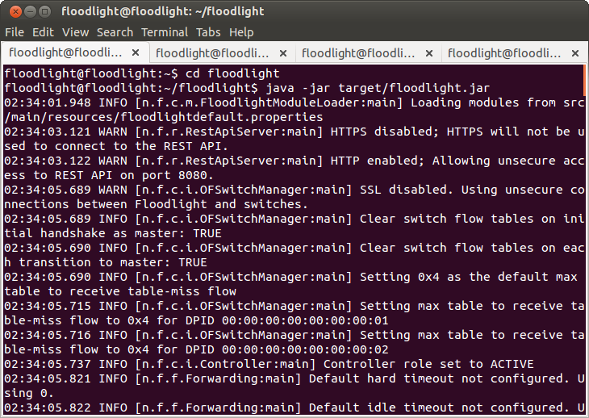
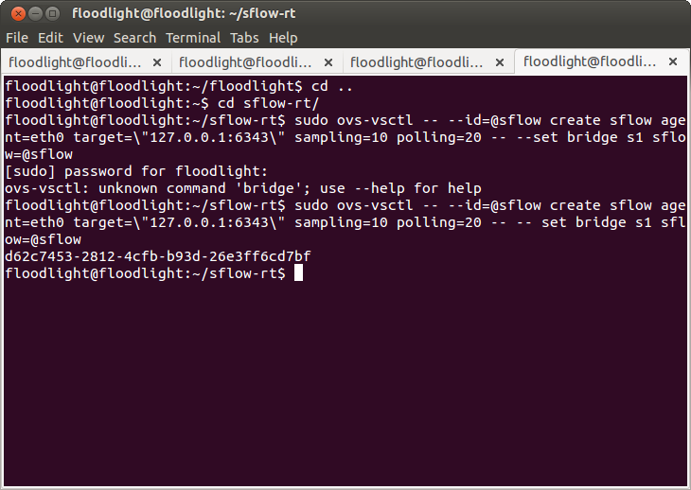
DDOS ATTACK IMPLEMENTATION IN FLOODLIGHT

Slide 19
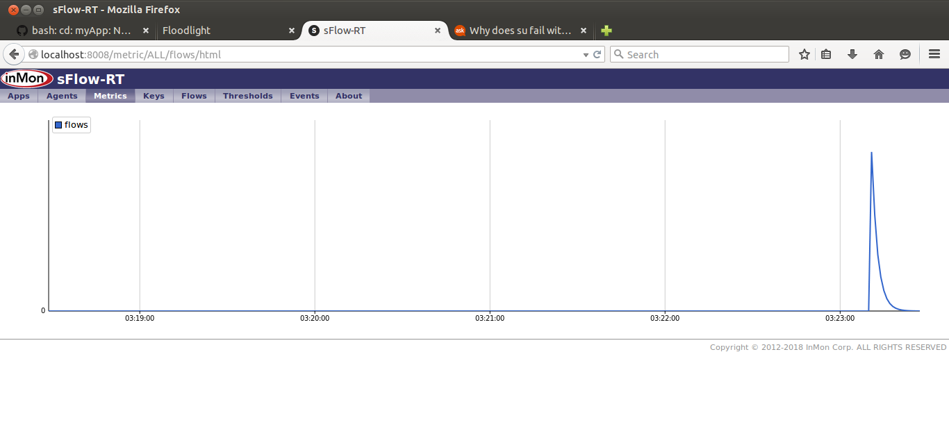
sFlow - RT
Running a basic ping to verify connectivity, Note the rate doesn’t exceed a few packets per second

Slide 20
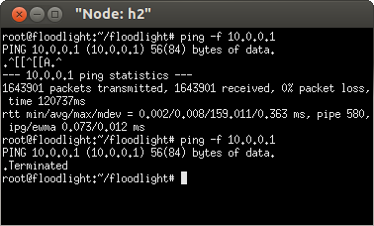
DDOS ATTACK FLOODING

Slide 21
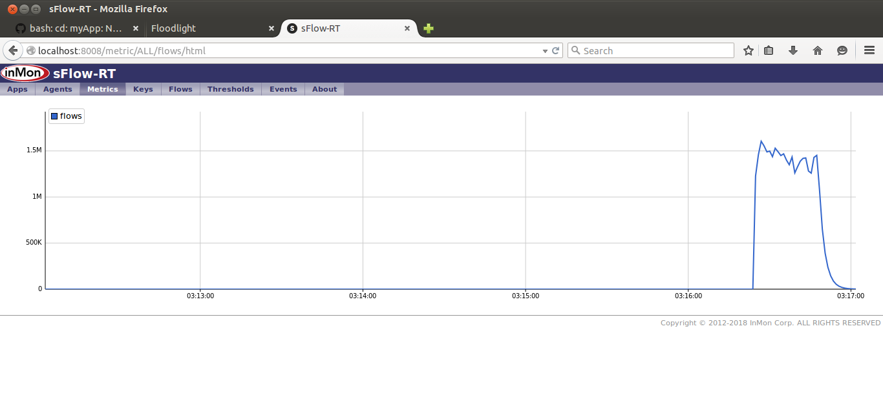
Starting a ping flood , the data rate soars to 1.5M pps.

Slide 22
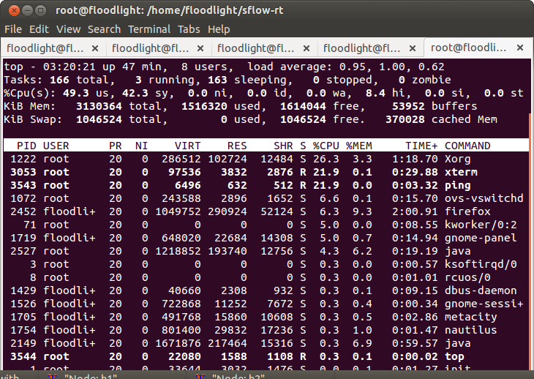
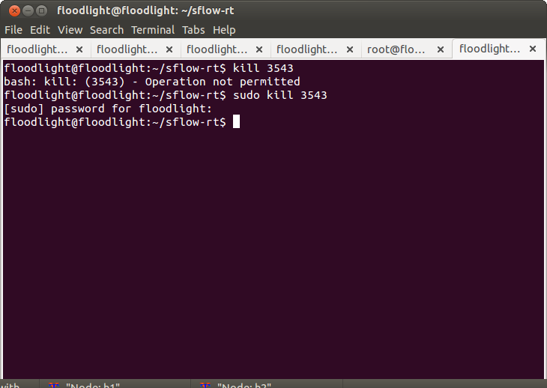
DDOS ATTACK MITIGATION

Slide 23
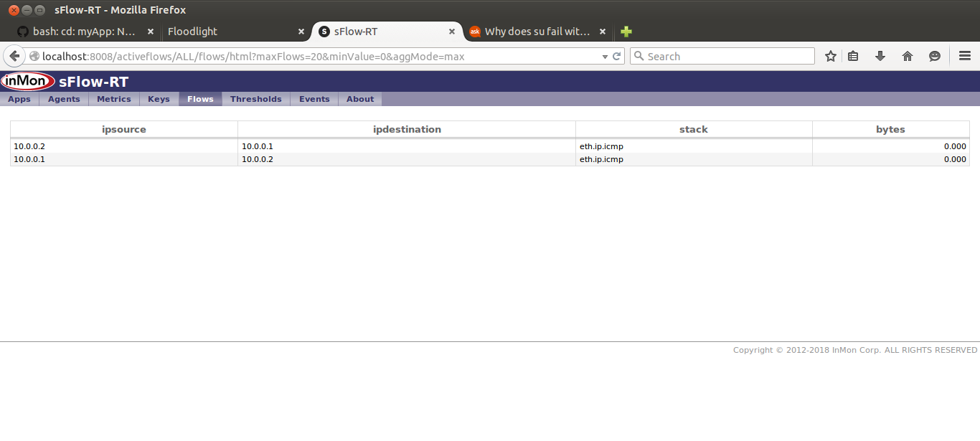
DDOS ATTACK MITIGATION

Slide 24
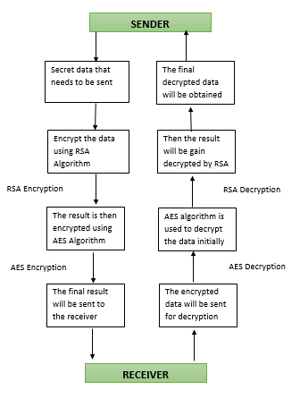
HYBRID CRYPTOGRAPHY IN VANET

Slide 25
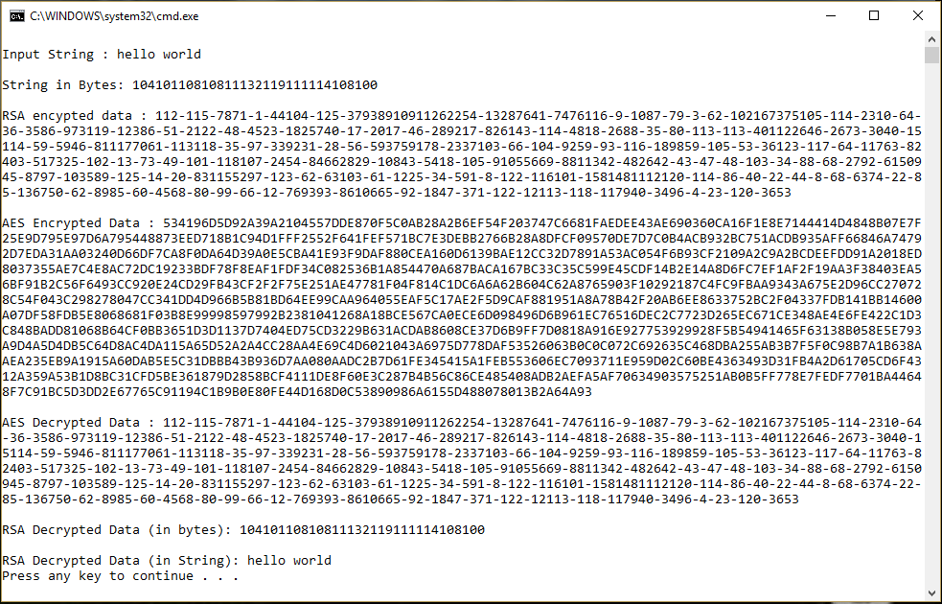
HYBRID CRYPTOGRAPHY IMPLEMENTATION IN JAVA

Slide 26
PERFORMANCE ANALYSIS IN NS2 USING VANET ARCHITECTURE
SIMULATION PARAMETERS | VALUES
Number of nodes | 100
Type of the nodes | Mobile nodes
Type of the packets | Data packets and control packets
Packet Size | 50 bytes
Type of the traffic | CBR traffic
Simulation Time | 300sec

Slide 27
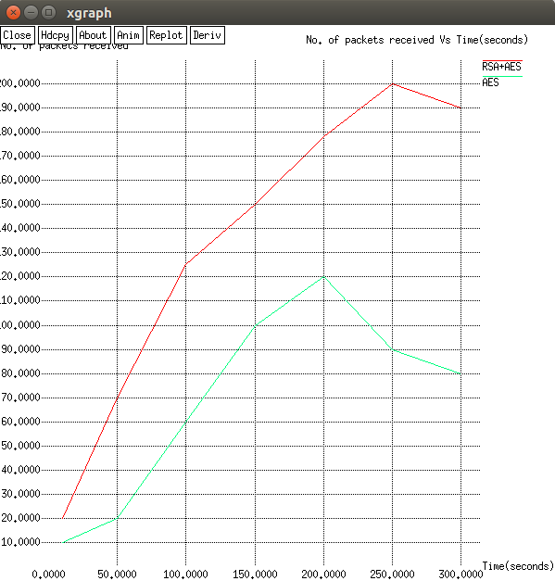
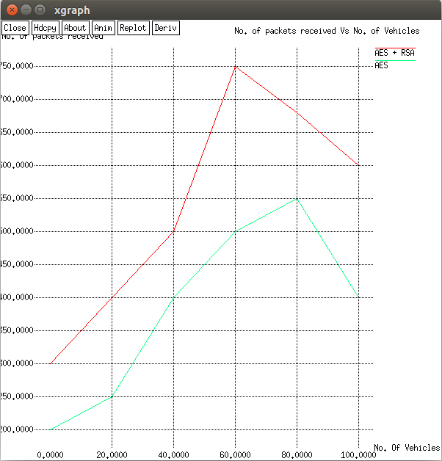
GRAPHICAL REPRESENTATION OF THE RESULTS
Performance of hybrid cryptography

Slide 28
DIFFICULTIES
Understanding and Implementation on the software mininet and floodlight.
Working with ns2 in terms of security implementation

Slide 29
Thanks!
Any questions?

