Slide 1
A Heuristic Approach Towards Energy-Efficient Software-Defined Data Centers
Under the guidance of:
Prof. R K Shial
Submitted by
Kumari Renuka

Slide 2
Agenda
Objective
Motivation
Introduction
Literature Review
System Model
Simulation Setup
Results
Limitations
References

Slide 3

Objective
The main objective is to design an energy-efficient network management strategy with guaranteed satisfaction of network traffic demands in Software-defined Data Center Networks.

Slide 4
Motivation
Due explosive demand on the cloud services, heavy burden is imposed on the modern data center, especially on the energy consumption. Hence energy optimization have become an emergent issue.

Slide 5
Introduction
The rapid development of cloud computing has raised big concern over the high energy consumption of modern data centers.
Operation cost(OPEX) has become dominant over capital expenditure(CAPEX).
Energy optimization has become emergent issue.

Slide 6
Literature Review
Title: Elastic tree: Saving energy in Data Center
Networks
B Heller, S Seetharaman, P Mahadevan, Y Yiakoumis…
AIM- to save energy in Data Center Networks.
In this paper, They present an ElasticTree.
A network wide power manager which dynamically adjusts the set of active network elements such as links and switches to satisfy changing data center traffic loads.

Slide 7
They implement and analyse Elastic Tree on a prototype testbed built with production OpenFlow switches from three network vendors
Elastic Tree can maintain the robustness and performance, while lowering the energy bill.

Slide 8
Title: Energy-aware routing in Data Center Networks
Y. Shang, D. Li, and M. Xu
In this paper, they discuss how to save energy consumption in high-density data center networks in a routing perspective.
The key idea is to use as few network devices to provide the routing service as possible, with no/little sacrifice on the network performance. Meanwhile, the idle network devices can be shut down or put into sleep mode for energy saving

Slide 9
They then formally establish the model of energy-aware routing problem, and prove that it is NP-Hard.
Then they proposed a heuristic routing algorithm to achieve their design goal.
Extensive simulations in typical data center networks is conducted to validate the effectiveness of the energy-aware routing algorithm

Slide 10

SYSTEM MODEL
Energy optimization problem is formulated as an integer linear programming problem.
While formulation the following constraints are kept into consideration.
Link capacity constraints

Slide 11


Forwarding rule placement constraints

Slide 12

AN ILP FORMULATION
Our main objective is to minimize the number of switch activated for energy saving, by keeping all constraints into consideration the problem can be formulated as an IPL problem.
ILP:

Slide 13
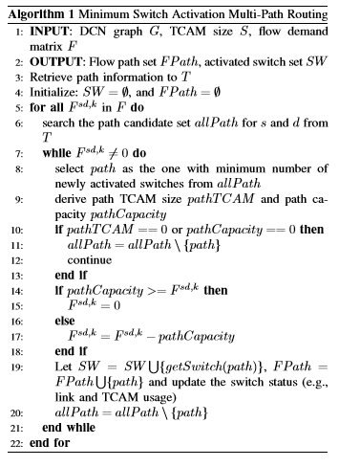
MINIMUM SWITCH ACTIVATION MULI-PATH ROUTING ALGORITHM

Slide 14
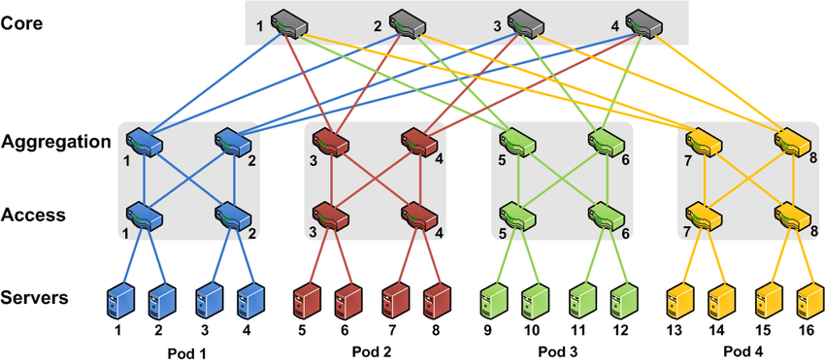
EXPERIMENTAL SETUP
Fat tree is used as the base data center topology throughout the experiment.

Slide 15
PARAMETERS
The following parameters are the user input-
DCN graph that is fat tree network topology is taken in the form of matrix.
Each switch consist of its own TCAM, so the TCAM size of all the switches are considered and the value ranges between [250,1250].
Flow demand is considered in the form of matrix whose each value lies between the range [100KB,100MB].

Slide 16
The main aim is to find the path for each flow with minimum number of activated switch from all path.
The output required are-
Flow path set Fpath
Activated switch set
The algorithm has been implemented in C++ programming language with the following above inputs to get the desire output

Slide 17
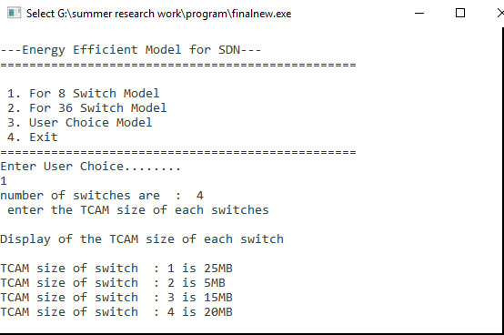
Screenshots:
Place your screenshot here

Slide 18
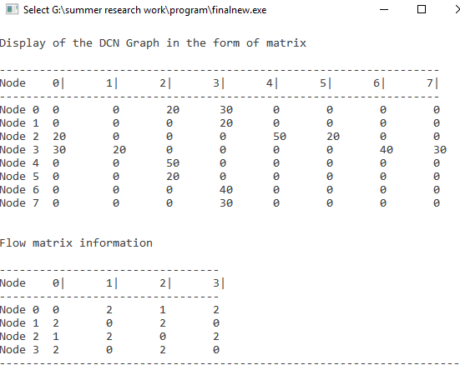

Slide 19
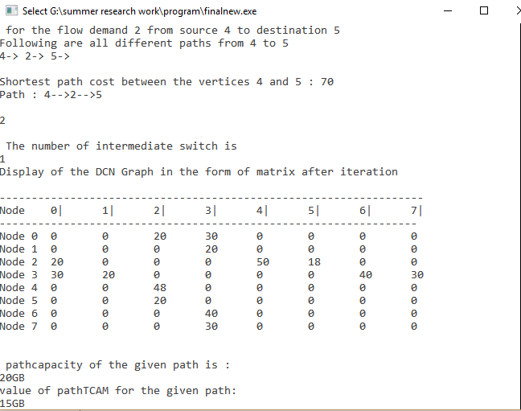

Slide 20
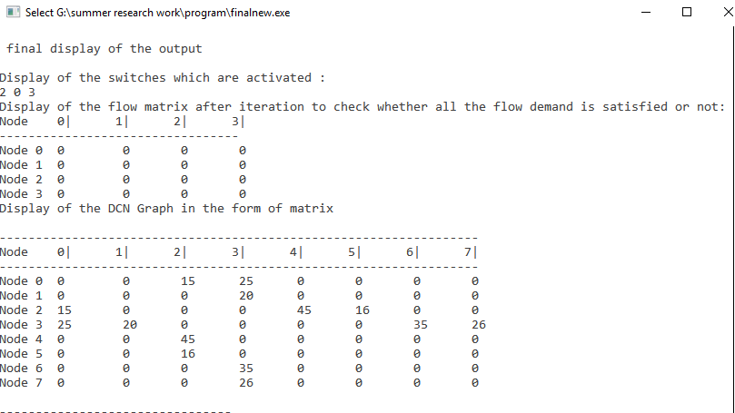
FINAL OUTPUT

Slide 21
RESULTS
Switch activation and multipath routing is jointly considered and the energy optimization problem is formulated as ILP problem.
Algorithm is defined to solve the ILP problem.
With the extensive simulation the high energy efficiency of the algorithm is proved.
Results shows that it can find near optimal solution while requiring substantially less scheduling time.

Slide 22
LIMITATIONS
This may the limitation that the path chosen is the longest path with minimum number of newly activated switches which will effect the Quality of Service(QOS).
As the number of flow increases the energy saving percentage may decrease as more switches must be activated to accommodate the huge traffic demand, leaving no optimization space.
Since in the given algorithm all path are found between two servers hence it is time consuming to search all these at runtime.

Slide 23
REFERENCES
[1] Y. Shang, D. Li, and M. Xu, “Energy-aware routing in data center network,” in Proceedings of the ﬁrst ACM SIGCOMM workshop on Green networking, pp. 1–8, ACM, 2010.
[2] D. Huang, D. Yang, and H. Zhang, “Energy-aware virtual machine placement in data centers,” GLOBECOM 2012, 2012.
[3] D. Li, Y. Shang, and C. Chen, “Software deﬁned green data center network with exclusive routing,” in INFOCOM, 2014 Proceedings IEEE, pp. 1743–1751, IEEE, 2014
[4] B. Heller, S. Seetharaman, P. Mahadevan, Y. Yiakoumis, P. Sharma, S. Banerjee, and N. McKeown, “Elastictree: Saving energy in data center networks.,” in NSDI, vol. 10, pp. 249–264, 2010

Slide 24
Thanks!
Any questions?

