Slide 1


Last-Mile Delivery Operations Analytics
MySQL Business Analytics Project
Presented By
Renuka Bamta

Slide 2
About Me
Hi, I'm Renuka Bamta, an aspiring Data Analyst with a background in B.Tech (CSE). I have developed skills in SQL, Python, Pandas, and NumPy. This presentation showcases my SQL project, Last Mile Delivery Analysis.
Work Experience : Fresher
LinkedIn : https://www.linkedin.com/in/renuka-bamta-06881224b/
GitHub : https://github.com/renukabamta01

Slide 3
Agenda
Project Overview
Project Objective
ER Diagram & Database Structure
SQL Analysis & Business Questions
Key Insights & Findings
. Challenges Faced in the Project
Conclusion & Recommendations

Slide 4
Project Overview
Last Mile Delivery Analysis focuses on analyzing the final stage of delivering orders from the delivery center to customers.
The project uses SQL to analyze customers, orders, drivers, vehicles, and delivery performance.
It helps identify delivery delays, multiple delivery attempts, driver/vehicle performance, and order patterns.
Business questions are answered using SQL queries, joins, aggregations, subqueries, CTEs, and window functions.
The analysis helps businesses improve delivery efficiency, reduce delays, and make better operational decisions.

Slide 5
Objective of the Project
Analyze delivery performance and identify factors affecting successful and timely deliveries.
Evaluate driver and vehicle performance based on delivery activity and efficiency.
Identify delivery delays and repeated delivery attempts to understand operational problems.
Analyze customer and order patterns to understand ordering behavior and service demand.
Generate actionable insights that can help improve delivery efficiency and customer satisfaction.

Slide 6
Database Structure
The project database consists of 5 main tables:
1.Customers
2.Orders
3.Drivers
4. Vehicles
5.Deliveries
Each table stores specific information related to the delivery process, avoiding unnecessary duplication.
Primary Keys uniquely identify each record, while Foreign Keys establish relationships between tables.
The Deliveries table acts as the central table, connecting orders with the assigned drivers and vehicles.
These relationships allow us to combine data from different tables and perform meaningful SQL analysis.

Slide 7
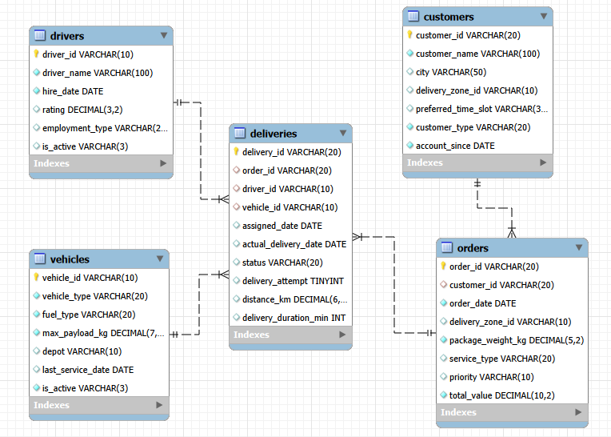
ER Diagram

Slide 8

Key Analysis Questions
What is the total number of customers?
Output
The COUNT(*) query successfully retrieves the total number of customers from the customers table.

Slide 9

What is the total number of orders?
Output
The COUNT(*) query successfully retrieves the total number of orders from the orders table.

Slide 10

What is the total number of deliveries?
Output
The COUNT(*) query successfully retrieves the total number of deliveries from the deliveries table.

Slide 11
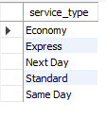
What are the different service types available?
Output
Distinct retrieves unique service types that means remove duplicates from the result.

Slide 12

How many drivers are currently active?
Output
COUNT(*) retrieves total number of drivers that are currently active from drivers table using is_active = “Yes”.

Slide 13
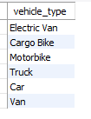
What are the different vehicle types?
Output
. Distinct retrieves unique vehicle types that means remove duplicate vehicle types from the result.

Slide 14

What is the total order value?
Output
. Sum(total_value) calculates the amount of all the orders present inside the orders table.

Slide 15

What is the average package weight?
Output
. Avg() it retrieve the overall average weight of the packages from orders table.

Slide 16
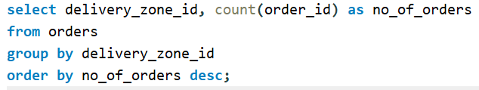
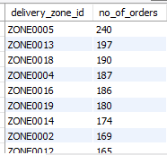
Objective-Based Analysis
Compare the number of orders across delivery zones.
Output
. Counts the total number of orders in each delivery zone using count and group by function. group by groups on the basis of delivery zone id and count() counts the total number of orders in each delivery zone

Slide 17
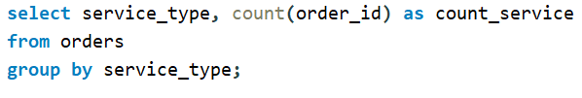
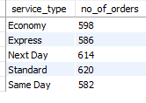
Compare orders across different service types.
Output
. It counts the number of orders on the basis of service type .This helps identify which service type is most commonly used by customers and which services have lower demand.

Slide 18

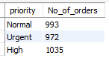
Compare orders based on priority.
Output
. This query counts the number of orders for each priority level.
It helps the business compare order volume across different priorities and understand demand patterns.

Slide 19
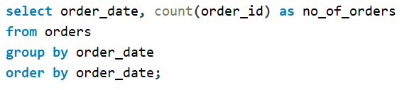
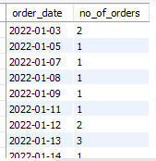
Examine how order volume changes over time.
Output
This query counts the number of orders placed on each order date.
It helps identify changes and trends in order volume over time.

Slide 20


Look at order value across different groups.
Output
This query calculates the total order value for each priority group.
It helps compare which priority group contributes the highest overall order value.

Slide 21

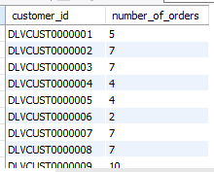
Compare customers based on the number of orders they place.
Output
This query counts the number of orders placed by each customer.
It helps compare customers and identify frequent or high-order customers.

Slide 22
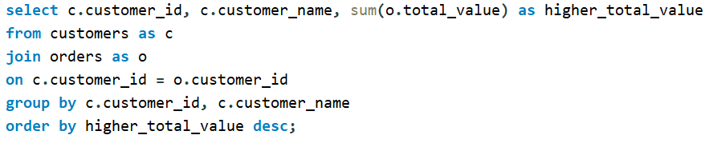
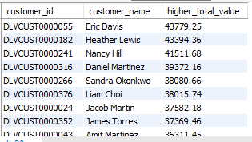
Identify customers with higher total order value.
Output
calculates the total order value for each customer.
It helps identify customers who contribute the highest revenue.

Slide 23

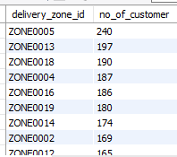
Compare customer activity across delivery zones.
Output
counts the number of customer orders in each delivery zone.
It helps identify which delivery zones have higher customer activity.

Slide 24


Look at differences between business and individual customers.
Output
counts customers based on their customer type, such as Business and Individual.
It helps compare the number of Business and Individual customers.

Slide 25
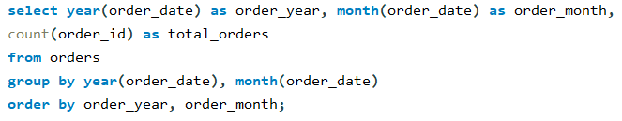
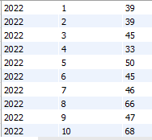
Examine customer ordering patterns over time.
Output :
counts the total orders for each month and year.
It helps identify customer ordering patterns and changes in order volume over time.

Slide 26
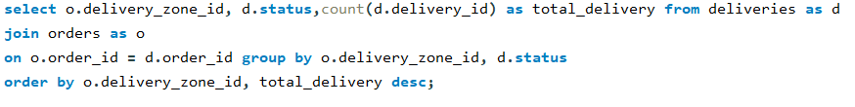
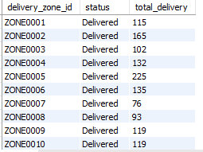
Compare delivery outcomes across different zones (zone information is on the orders table, so you will need to connect orders and deliveries).
Output
counts deliveries by status for each delivery zone.
It helps compare delivery outcomes across zones and identify zones with more successful or problematic deliveries.

Slide 27


Examine delivery duration.
Output
calculates the average, longest, and shortest delivery duration.
It helps evaluate overall delivery speed and identify slow or fast deliveries.

Slide 28

Compare delivery outcomes by status (Delivered, Failed, Pending, Rescheduled) — these are not a simple success/failure split, so consider what each status actually represents.
Output
counts deliveries for each status such as Delivered, Failed, Pending, and Rescheduled.
It helps understand the overall distribution of delivery outcomes, rather than treating them simply as success or failure.

Slide 29
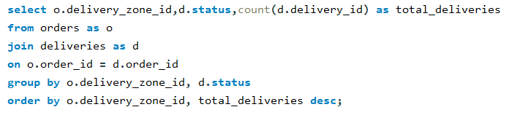
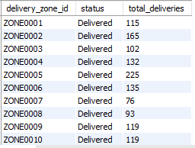
Identify areas with higher delivery activity or poorer outcomes.
Output
counts deliveries in each delivery zone.
It helps identify zones with higher delivery activity.

Slide 30
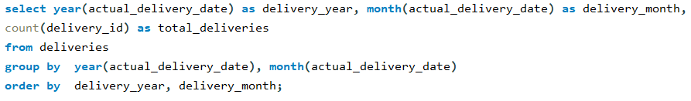
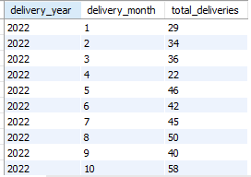
Compare delivery performance over time.
Output
counts deliveries for each month and year.
It helps compare delivery activity and performance trends over time.

Slide 31
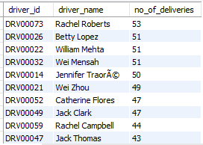
Compare the number of deliveries handled by drivers.
Output
counts the number of deliveries handled by each driver.
It helps compare driver workload and identify drivers handling more deliveries.

Slide 32
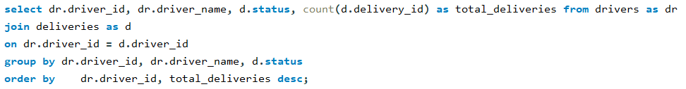
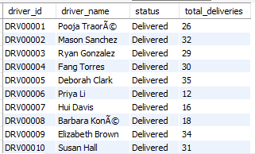
Compare driver performance across delivery outcomes.
Output
counts each driver's deliveries by outcome/status.
It helps compare driver performance across Delivered, Failed, Pending, and Rescheduled deliveries.

Slide 33
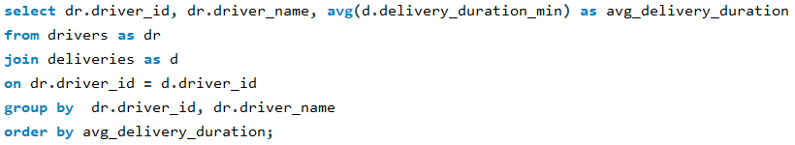
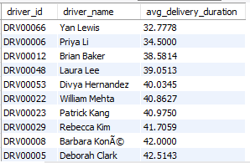
Examine delivery duration across drivers.
Output
calculates the average delivery duration for each driver.
It helps compare driver delivery speed and identify faster or slower drivers.

Slide 34

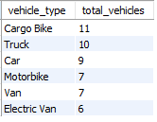
Compare vehicle usage across different vehicle types.
Output
counts the number of vehicles for each vehicle type.
It helps compare vehicle usage/availability across different vehicle types.

Slide 35
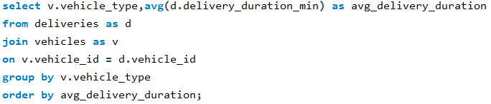
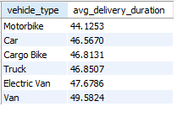
Look at delivery performance across different vehicles.
Output
calculates the average delivery time for each vehicle type.
It helps identify which vehicle types are faster or slower in completing deliveries.

Slide 36

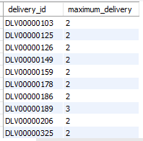
Examine which deliveries required multiple attempts before succeeding.
Output
identifies successfully delivered orders that required more than one attempt.
It helps find deliveries that faced initial failures or difficulties before succeeding.

Slide 37
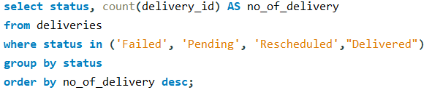

Identify common delivery statuses and problem patterns.
Output
. counts deliveries for each status and ranks them by frequency.
It helps identify common delivery outcomes and problem patterns, such as Failed, Pending, and Rescheduled deliveries.

Slide 38
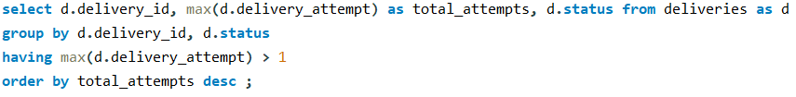
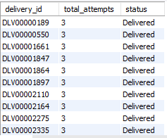
Compare delivery performance for orders with multiple attempts.
Output
This query identifies deliveries that required more than one attempt and shows their final status.
It helps compare delivery performance and identify deliveries with repeated attempts.

Slide 39
Key Insights & Findings
Identified customer ordering patterns and repeat customers.
Analyzed delivery performance and multiple delivery attempts.
Found problematic zones and delivery issues affecting operations.
Compared business vs. individual customers based on order activity.
Used SQL analysis to identify patterns that can support better business decisions.

Slide 40
Challenges Faced in the Project
Handling multiple related tables and understanding their relationships.
Writing complex SQL queries using JOIN, GROUP BY, HAVING, subqueries, and aggregate functions.
Analyzing delivery problems such as failed deliveries and multiple delivery attempts.
Converting raw data into meaningful business insights for better decision-making.
Ensuring data accuracy and consistency while performing analysis.

Slide 41
Conclusion & Recommendations
SQL analysis helped identify customer, order, and delivery performance patterns.
Optimize problematic delivery zones and reduce repeated delivery attempts.
Focus on high-value and repeat customers to improve customer retention.
Use data-driven insights to improve operational efficiency and business performance.

Slide 42
THANK YOU

