Slide 1
Herovired capstone project
Team 5: Renuka and Merry
January 28,2023

Slide 2
Requirements
Job portal creation
Refer attached requirement doc

Slide 3
Design agreements
Job portal front end- using react
Job portal back end using ruby on rails
Note: Figma design from requirement doc used for css

Slide 4
Frontend
Front end components
Signup – new user signup
Login - authenticate
Candidate profile- Upload candidate profile
Job portal –View job details, filter by location, job title, company ,posted date, apply for the job
View applied jobs/all jobs

Slide 5
Frontend continues…
Routes used:
login– new user signup
Sign up- authenticate
Candidate profile- Upload candidate profile
Job dashboard –View job details, filter by location, job title, company ,posted date, apply for the job
Applied job- view applied jobs

Slide 6
Frontend continues…
Note:Expected backend to run on 3002 port,local host.
(http://127.0.0.1:3002)

Slide 7
Back end
Postgres db used for this rails project.
Tables used:
Refer attached doc for the tables used

Slide 8
Backend apis
Pls refer attached api doc generated via command
rails routes –expanded

Slide 9
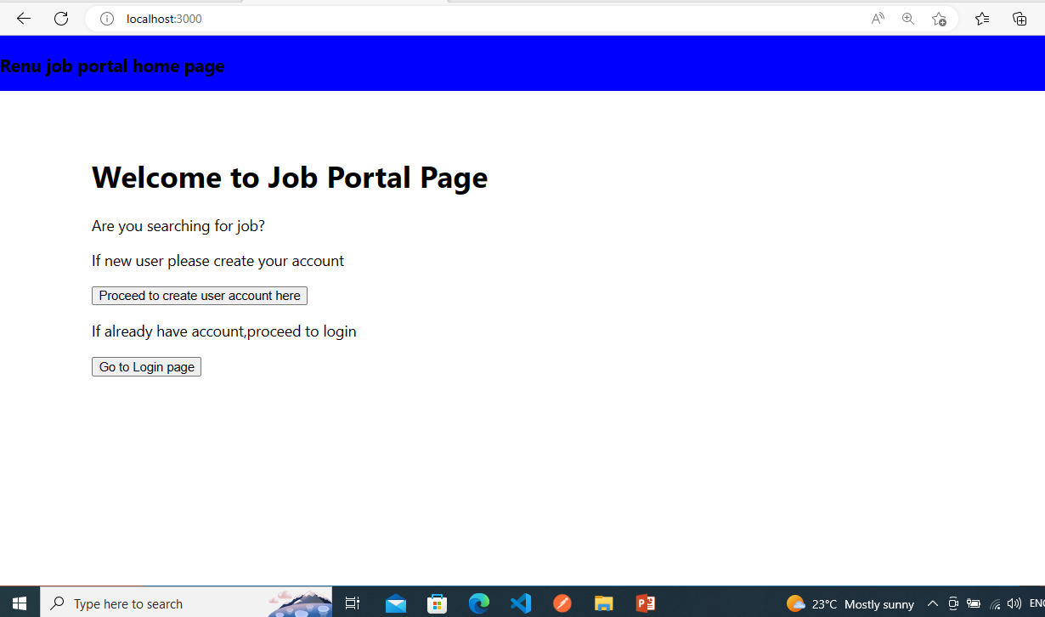
Output screens…home page

Slide 10
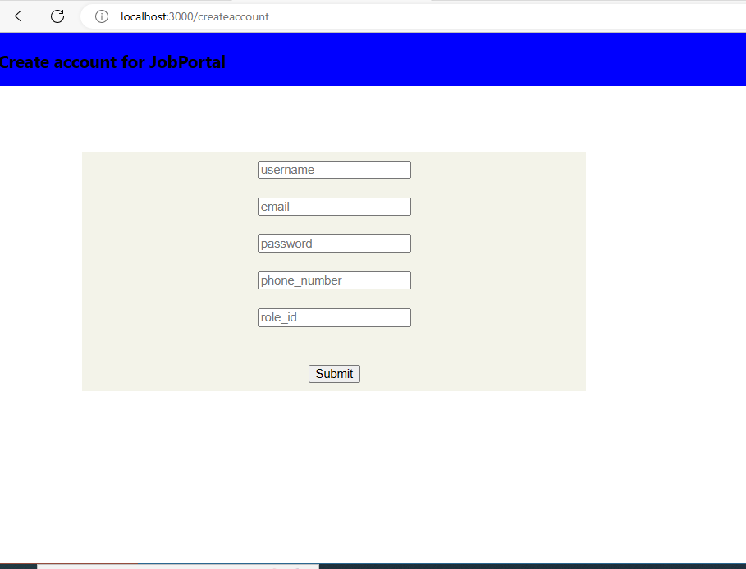
Output screens…sign up

Slide 11
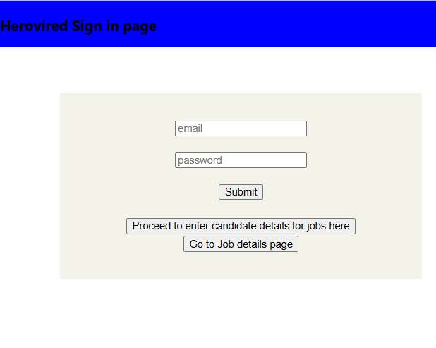
Output login page..

Slide 12
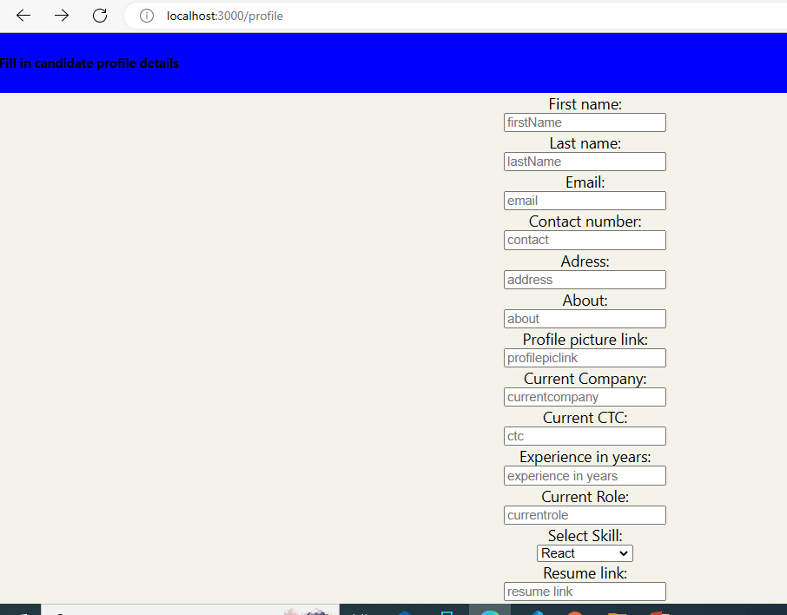
Output screens…candidate profile

Slide 13
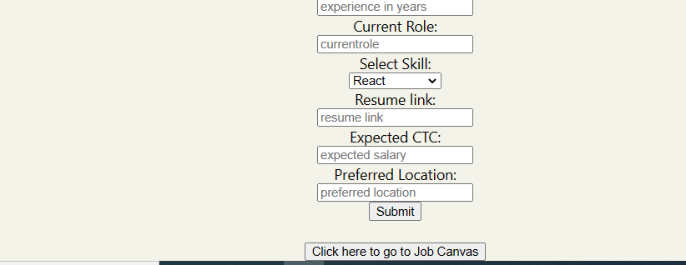
Output candidate profile continued…

Slide 14
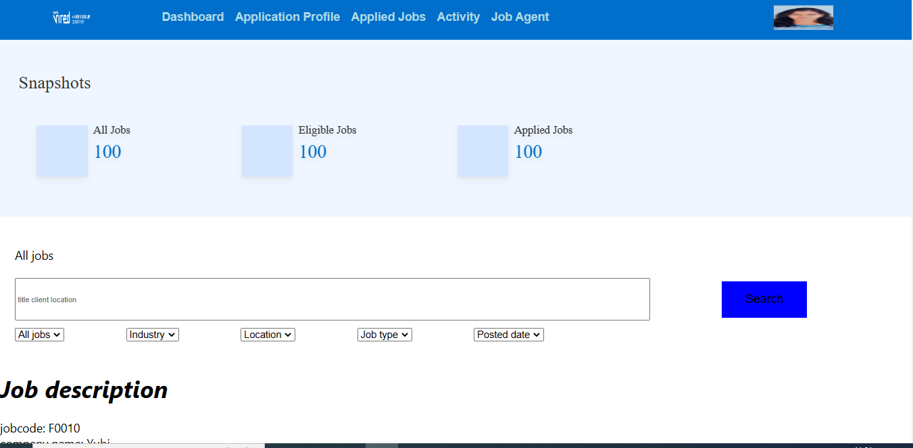
Output screens…dashboard

Slide 15
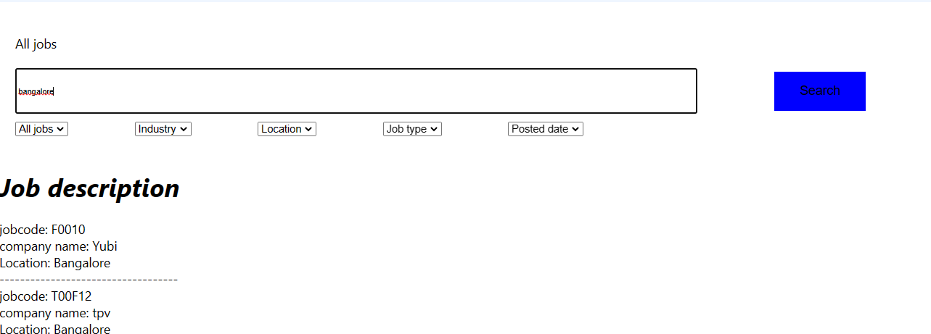
Output screens…dashboard filter job….

Slide 16
Thank you
Thanks to Pinky, Prashant,Shakul and Snehal.
Thanks to all my batch mates.

Slide 17
Questions???
Find out more at the PowerPoint Getting Started Center
(Click the arrow when in Slide Show mode)
Notes:
In Slide Show mode, click the arrow to enter the PowerPoint Getting Started Center.

