Slide 1

Deep Learning approach for Stress, Anxiety, Depression Detection by Real Time Facial Expressions using Image Processing
Project Guide : Prof. P. N. Jadhav
Sr. No. | Roll No. | Name
1 | 2110038 | Shraddha Irale
2 | 2110041 | Renuka Gour
3 | 2110057 | Sonali Suryavanshi
4 | 2110065 | Rutuja Kulkarni

Slide 2
INTRODUCTION
Mental health remains a global concern, with stress, anxiety, and depression affecting millions of lives.
As technology continues to advance, there is a growing opportunity to harness the power of deep learning and real-time image processing for proactive mental health monitoring.
Stress management is critical in today's world to keep stress levels low and health risks to a minimum, as stress is one of the leading causes of chronic illnesses.
This project endeavors to develop a cutting-edge system that leverages facial expression analysis to detect emotional distress in real-time, offering a non-intrusive and accessible solution for early identification.

Slide 3
LITERATURE REVIEW
SR NO | AUTHOR NAME | PAPER TITLE | YEAR | OBJECTIVE | METHODOLOGY | DATASET | ACCURACY | RESEARCH GAP
[1] | A. Phani Sridhar, R. Jahnavi Pramodhani, S. Padmini Priya, Ch Kanoj Kumar | Human stress detection using deep learning | 2023 | The objective of the project is to provide a system that analyze and predict the stress existence in a person by using deep learning algorithm techniques. | Deep learning algorithm named Convolution Neural Network(CNN) and even based on image processing using open-source as OpenCV | The dataset is known as fer2013 | The paper does not provide a specific accuracy figure for the algorithm implemented. However, it mentions that the project accurately identifies stress and records the user's feelings. | We can also improve the project by introducing the new future that can detect stress by audio processing techniques.
[2] | Adel Aref Ali Al-zanam, Omer Hussein Abdou Elsayed Hussein Alhomery , Choo Peng Tan Faculty of Information Science and Technology | Mental Health State Classification Using Facial Emotion Recognition and Detection Vol.13 | 2023 | This paper proposes an approach for determining mental health states by aggregating facial emotion scores over seven days. This innovative technique allows for a comprehensive and dynamic representation of an individual's emotional landscape, facilitating a more accurate classification of mental health status. | The methodology comprises several interconnected components,including preprocessing, feature extraction using Principal Component Analysis (PCA) and VGGNet, and classification using Support Vector Machines (SVM) and Multilayer Perceptron (MLP). | The dataset to be used for this project is the FER2013 facial emotion dataset, which has been previously used in studies such as the study by Sultana. | The accuracy of the algorithm implemented in the paper varies based on the different models and methods used. The best model, which combined VGGNet feature extraction with SVM classification, achieved an accuracy of 66%. | The training sample of the dataset is not evenly distributed, and the disgusted emotion sample has extraordinarily little compared to the other sample.This made classifying images disgustingly difficult for the model.

Slide 4
LITERATURE REVIEW
SR NO | AUTHOR NAME | PAPER TITLE | YEAR | OBJECTIVE | METHODOLOGY | DATASET | ACCURACY | RESEARCH GAP
[3] | Sabina Umirzakova, Shabir Ahmad , Sevara Mardieva, Shakhnoza Muksimova, Taeg Keun Whangbo | Deep learning-driven diagnosis: A multi-task approach for segmenting stroke and Bell’s palsy | 2023 | To propose a light deep-learning-based model that can analyze a patient’s facial asymmetry and parse six categories, namely, skin, eyebrow, eye, mouth, and stroke. | They investigated network by combining the convolution module and enhanced stroke category (ESC) blocks. | In this study, two datasets were employed: (1) a public dataset for Bell’s palsy patients and (2) a private Gil Hospital dataset for stroke patients and healthy individuals. | The accuracy of the algorithm implemented in the paper is not explicitly mentioned. However, the proposed method demonstrated an improvement of 9.69% on the Gil Medical Center database and achieved a mean IoU of 6.28% and 5.91% of mean AP higher than other state-of-the-art models trained using the same parameters. | Satisfactory results were obtained for asymmetrical face parsing using the proposed method. However, there was a slight degradation in the efficiency of some of the sampled faces. This is because our trained dataset does not have sufficient samples with bearded faces.
[4] | Vandana , Nikhil Marriwala , Deepti Chaudhary | A hybrid model for depression detection using deep learning | 2023 | The objective of this research paper is to propose a hybrid model for depression detection using deep learning algorithms, which combines textual and audio features of patients' responses. | Proposed Model is based on two algorithms i.e., one is CNN and second is LSTM. | DAIC-WOZ Depression Database is used for Automatic Depression Detection system. Meaning of DAIC-WOZ is Distress Analysis Interview Corpus-Wizard of Oz Interviews. | TEXT CNN – 92% AUDIO CNN – 98% HYBRID LSTM – 80% HYBRID Bi-LSTM -88% | A hybrid model which combines audio, video and text features will be designed in future work. This will increase accuracy of proposed model and give better results than the previous models. More audio features are needed for accurate results.

Slide 5
LITERATURE REVIEW
SR NO | AUTHOR NAME | PAPER TITLE | YEAR | OBJECTIVE | METHODOLOGY | DATASET | ACCURACY | RESEARCH GAP
[5] | Jing Zhang, Hang Yin, Jiayu Zhang, Gang Yang, Jing Qin and Ling He | Real-time mental stress detection using multimodality expressions with a deep learning framework | 2022 | The objective of this research paper is to propose a real-time deep learning framework for the detection of acute stress by fusing ECG, voice, and facial expressions. The study aims to address the growing concern of mental stress in modern society and to demonstrate the effectiveness of using objective indicators and multimodality fusion for stress detection. | The real-time deep learning framework proposed in this work used ECG, voice, and facial expressions for stress detection. Then the multidimensional features of each modality were extracted through the deep learning framework. The fully connected layers in the framework obtained the information about the stress state, and the framework fused them into a global matrix for stress detection. | The datasets presented in this article are not readily available because they contain identifiable information such as recognizable faces and must be approved by the Ethics Committee on Biomedical Research, West China Hospital of Sichuan University. Requests to access the datasets should be directed to LH, ling.he@scu.edu.cn | The accuracy of the algorithm implemented in this paper varies based on the modality used for stress detection. The method achieves 74.1%, 79.2%, and 83.0% detection accuracy using ECG, facial expressions, and voice,respectively. | The research gap in this paper is the lack of existing methods that effectively combine stress-related information from multiple modalities for acute stress detection. While previous studies have explored single-modality approaches using deep learning for stress detection
[6] | Rehmat Ullah ,Hassan Hayat, Afsah Abid Siddiqui, Uzma Abid Siddiqui, Jebran Khan, Farman Ullah, Shoaib Hassan, Laiq Hasan, Waleed Albattah , Muhammad Islam, and Ghulam Mohammad Karami | A Real-Time Framework for Human Face Detection and Recognition in CCTV Images | 2022 | To develop a machine learning and deep learning- based real-time framework for detecting and recognizing human faces in closed-circuit television (CCTV) images. | We use two feature extraction algorithms, principal component analysis (PCA) and convolutional neural network (CNN).Weuseandcomparetheperformance of the algorithms K-nearest neighbor (KNN), decision tree, random forest, and CNN. | A dataset of 40K images with different environ mental conditions, clutter backgrounds, and occlusion | recognized faces with a minimum computing time and an accuracy of more than 90% | We will enhance this System by making it a CompleteSecurity system.We recognize a single face from the image ; our next stepis to recognize multiple faces in a live-streaming video.

Slide 6
LITERATURE REVIEW
SR NO | AUTHOR NAME | PAPER TITLE | YEAR | OBJECTIVE | METHODOLOGY | DATASET | ACCURACY | RESEARCH GAP
[7] | Di Lu and Limin Yan Journal of Sensors | Face Detection and Recognition Algorithm in Digital Image Based on Computer Vision Sensor | 2021 | The objective of the research paper is to explore face detection and recognition algorithms in digital images based on computer vision sensors. | The methodology used in the research paper involves analyzing the accuracy of face detection and recognition by comparing different algorithms such as OpenCV, Seetaface, and YouTu. | this article does not cover data research. No data were used to support this study | The accuracy of the algorithm implemented in the paper is not explicitly stated. However, the document includes experimental results and comparisons of different algorithms for face detection and recognition, which can be used to assess the accuracy of the implemented algorithm. | The document does not explicitly mention a research gap. However, based on the content provided, a potential research gap could be the need for further exploration and comparison of face detection and recognition algorithms in challenging conditions, such as varying illumination, occlusion, and facial expressions..
[8] | Edeh Michael Onyema, Piyush Kumar Shukla, Surjeet Dalal, Mayuri Neeraj Mathur, Mohammed Zakariah, Basant Tiwari | Enhancement of Patient Facial Recognition through Deep Learning Algorithm: ConvNet | 2021 | use of machine learning algorithms for facial expression recognition and patient monitoring is a growing area of research interest. | design the convolutional neural network model by introducing a residual block in the existing ConvNet model. We have chosen different sets of parameters for optimizing the model and to improve the learning of the model. | FER2013 dataset - dataset | The accuracy of the algorithm implemented in the paper is 0.70, as shown in the confusion matrix and discussed in the document. | FER2013 dataset is a very complex dataset with a limited number of samples per class, in order to improve the accuracy, the number of samples in each class can be increased by an optimal amount.

Slide 7
LITERATURE REVIEW
SR NO | AUTHOR NAME | PAPER TITLE | YEAR | OBJECTIVE | METHODOLOGY | DATASET | ACCURACY | RESEARCH GAP
[9] | Russell Li and Zhandong Liu | Stress detection using deep neural networks | 2020 | 1. To detect and monitor human stress using physiological signals collected from sensors attached to the body 2. To compare the performance of deep neural networks with traditional machine learning algorithms for stress detection and emotion classification using physiological signals | The methodology involved the development of deep 1D convolutional neural networks and multilayer perceptron neural networks for stress detection and emotion classification. | The dataset used in the study is the WESAD (Wearable Stress and Affect Detection) dataset. This dataset contains physiological signals collected from sensors attached to the body, including chest-worn and wrist-worn devices. | The proposed deep 1D convolutional neural network achieved an accuracy rate of 99.80% and an F1 score of 99.67% for stress detection using all physiological signals, including signals from the ACC sensor. | The two neural networks must be trained and tested on much larger datasets with diverse human populations.
[10] | Dr.P.Kanagaraju, M. A. Ranjith, K. Vijayasarathy | Emotion detection from facial expression using image processing | 2022 | 1.To analyse emotions in real-time and provide solutions based on detected emotions. 2.To develop image-based face expression recognition system. | The methodology involves four phases: Emotional Database, Image Preprocessing, CNN Architecture, and Testing at Real Time. Image Preprocessing uses Haar-like features for face identification. The CNN Architecture is used for facial expression categorization. Testing at Real Time involves real-time emotion recognition using webcam to test the model. | Emotional Database uses the FER-2013 dataset | The proposed model achieved a validation accuracy of 64.52% during testing. The model was more accurate at predicting neutral, happy, sad, angry, and surprised emotions, but less accurate at predicting fear emotion states. | To increase accuracy of fear emotion prediction.

Slide 8
OBJECTIVE
To determine Depression, Anxiety, Stress levels by analyzing facial expressions using image processing.
To build a low-cost system that provides high accuracy and low prediction time that can be used by health practitioners for assessing and monitoring the severity of Depression Stress, Anxiety.
To evaluate the severity of the three emotional states and use them for a wide range of applications .
Act as a preventive measure for people who are likely to be get into mental health related issues.

Slide 9
FACIAL EXPRESSIONS
Facial Expressions are the key features of non-verbal communication and they play an essential role in human-computer interaction.
Face detection plays a vital role in emotion recognition.
Emotions are classified as happy, sad, disgust, angry, neutral, fear, and surprise. Other aspects such as speech, eye contact, frequency of the voice, and heartbeat are considered.

Slide 10
WHAT IS EMOTION ?
Emotion plays a crucial role to understand the feeling of each person figures clearly about a person’s personality.
Emotions are reflected in voice, hand and body gestures, and mainly through facial expressions.

Slide 11
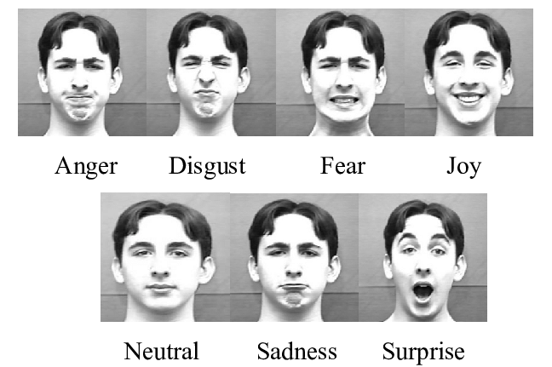
7 DIFFERENT TYPES OF EMOTIONS
Fig.1.Different kinds of emotions

Slide 12
FACIAL EXPRESSION AND EMOTION
Face Expression includes Smile, Sad, Anger, Disgust, Surprise, Neutral and Fear.
A Smile on a Human face shows their happiness and Eye brows are relaxed. The Mouth is open, and Mouth corners are upturned.
A Sad expression is the feeling of looseness which is normally expressed as Eyes are slightly closed. Eyebrows are bent upward, and Mouth is relaxed.
The Anger on human face is related to unpleasant conditions. Eyebrows are pulled downward and together. Eyes are wide open, and lips are tightly closed.

Slide 13
FACIAL EXPRESSION AND EMOTION
The Disgust expressions are expressed with Eyebrows and eyelids are relaxed. The Upper lip is raised and curled, often asymmetrically.
The Surprise or shock expression is expressed when some unpredicted happens. Eyebrows are raised. Eyes are wide open, and Mouth is open.
The expression of Fear is related with surprise expression which is expressed as Eyebrows are raised and pulled together. Eyes are open and tensed
The expression of Neutral is Eyebrows, Eyes and Mouth, are relaxed.

Slide 14
STRESS
Stress is a response to external pressures or demands, anxiety is a heightened state of worry or fear often without a specific cause, and depression is a persistent feeling of sadness or hopelessness.
Furrowed Brow: Tightening or furrowing of the forehead, often accompanied by vertical lines between the eyebrows.
Tensed Jaw: Clenching or grinding the teeth, which can be a sign of increased muscle tension.
Narrowed Eyes: Squinting or narrowing of the eyes, sometimes referred to as eye strain.
Facial Twitching: Involuntary facial movements or twitches, which can be a manifestation of stress-induced tension.
Tightened Lips: Pressed or pursed lips, indicating stress-related muscle tension in the face.
Increased Blinking: Rapid or increased blinking, sometimes associated with heightened arousal or stress.

Slide 15
ANXIETY
Anxiety is often associated with a combination of emotions, such as fear, worry, apprehension, and restlessness. Anxiety can be expressed through various facial expressions. Common facial cues associated with anxiety include:
Tense or Furrowed Brow: Wrinkles or a furrowed forehead can indicate stress and tension.
Wide Eyes or Pupil Dilation: Anxiety may lead to widened eyes or increased pupil size.
Facial Muscle Tension: Jaw clenching, lip biting, or facial muscles appearing tight can be signs of anxiety.
Restlessness or Fidgeting: Constantly shifting or moving facial muscles may indicate inner tension.
Nervous Smiling or Laughing: Anxious individuals may exhibit a smiling or laughing behavior that appears forced or uneasy.

Slide 16
DEPRESSION
Depression is often characterized by a persistent feeling of sadness, emptiness, or hopelessness.
Flat or Blank Expression: Reduced facial animation, where the person's face appears devoid of usual emotional responsiveness.
Sad or Downturned Mouth: A persistent downturned or frowning mouth can be indicative of the emotional state associated with depression.
Tearfulness: Frequent tearing or visible signs of crying may suggest emotional distress.
Fatigue: A tired or weary expression, often accompanied by drooping eyelids, may be evident.

Slide 17
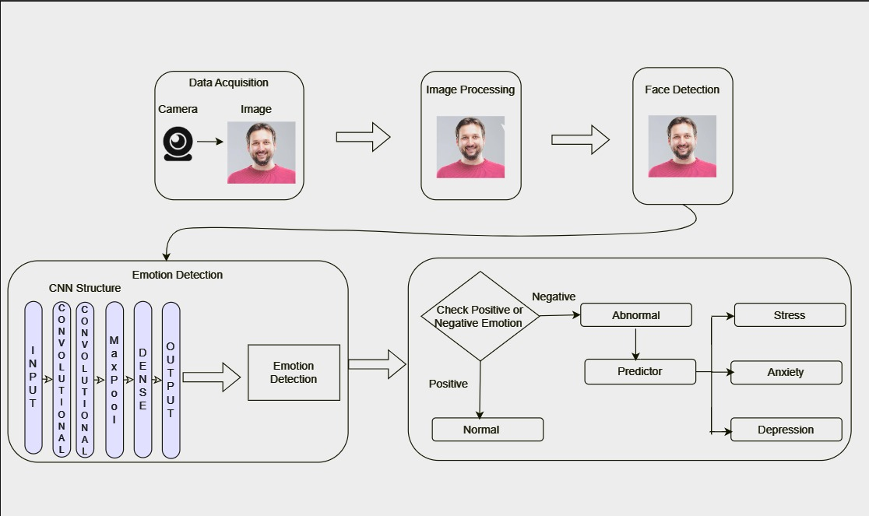
SYSTEM ARCHITECTURE
Fig.2.System Architecture

Slide 18
PROPOSED SYSTEM
The proposed system consists of:
1.Data Acquisition
2.Image Processing
3.Face Detection
4.Emotion Detection

Slide 19
CONCLUSION
In conclusion, the development and implementation of a Deep Learning approach for stress, anxiety, and depression detection through real-time facial expression analysis using image processing techniques represent a promising and impactful avenue in mental health research.
Leveraging the power of deep neural networks, this project aimed to provide a non-intrusive and accessible solution for early identification of emotional distress.
The project's significance lies in its potential to revolutionize mental health assessments by offering an objective and automated tool.

Slide 20
THANK YOU !!!

