Slide 1
COLLEGE NAME: Ashoka Women’s Engineering College
DEPARTMENT: Computer Science and Engineering
FINAL PROJECT REPORT
Title: Exploratory Analysis of Rainfall Data in India for Agriculture
Submitted by:
Renuka Madugundu
Under the Guidance of:
Mrs. HariPriya.
Academic Year: 2025–2026

Slide 2
🌧️ Exploratory Analysis of Rainfall Data in India for Agriculture
🇮🇳 Rainfall & Agriculture in India
India’s agriculture heavily depends on the monsoon system, especially the Southwest Monsoon (June–September). Around 50–60% of the country’s net sown area is rain-fed. Therefore, analyzing rainfall data is critical for improving crop productivity and reducing agricultural risks.
🎯 Project Objective
To perform Exploratory Data Analysis (EDA) on historical rainfall data in India to:
Identify rainfall trends and seasonal patterns
Detect drought and flood-prone regions
Understand rainfall variability across states
Support agriculture-related decision-making

Slide 3
📊 Key Components of Exploratory Analysis
1️⃣ Data Collection
Source: IMD (Indian Meteorological Department), Kaggle datasets, Government Open Data Portal
Data Fields:
Year
State/Region
Monthly Rainfall (Jan–Dec)
Annual Rainfall
Seasonal Rainfall
2️⃣ Data Preprocessing
Handling missing values
Removing duplicates
Converting rainfall values to numeric format
Aggregating yearly & seasonal data
3️⃣ Data Visualization Techniques
Line plots (Rainfall trend over years)
Heatmaps (Region-wise rainfall intensity)
Boxplots (Variability & outliers)
Bar charts (Seasonal comparison)

Slide 4
4️⃣ Statistical Analysis
Mean, Median, Standard Deviation
Coefficient of Variation (Rainfall stability)
Correlation between seasonal rainfall & crop yield
Trend analysis using moving averages
5️⃣ Machine Learning (Optional Advanced Step)
Linear Regression → Rainfall trend prediction
Time Series Forecasting (ARIMA)
Clustering (K-means) → Grouping states based on rainfall similarity
🌾 Real-World Applications (Scenarios Explained)
🌱 Scenario 1: Crop Planning
Using rainfall trends:
Identify high rainfall zones → Suitable for rice, sugarcane
Moderate rainfall zones → Suitable for maize, cotton
Low rainfall zones → Millets, pulses
📌 Farmers can:
Adjust sowing dates
Choose drought-resistant varieties
Plan crop rotation based on rainfall history

Slide 5
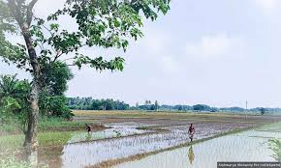
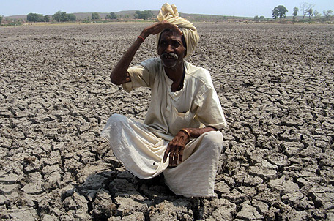
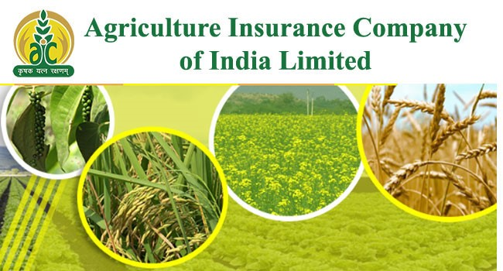
💧 Scenario 2: Irrigation Management
By analyzing rainfall variability:
Plan irrigation schedules efficiently
Avoid over-irrigation
Implement drip irrigation in low rainfall regions
Build rainwater harvesting structures
📌 Result:
Water conservation
Reduced crop loss
Sustainable farming
⚠️ Scenario 3: Agricultural Risk Assessment

Slide 6
Rainfall analysis helps to:
Identify drought-prone districts
Detect flood-frequency regions
Design crop insurance schemes
Develop disaster preparedness strategies
📌 Policymakers can:
Allocate subsidies efficiently
Plan relief funds
Improve climate resilience
🏗️ Technical Architecture
1️⃣ Data Layer
Historical rainfall dataset (CSV/Excel)
Crop yield dataset (Optional)
Stored in:
  Local system / Cloud storage (AWS S3, Azure Blob)
2️⃣ Processing Layer
Python (Pandas, NumPy)
Data Cleaning & Transformation
Statistical Analysis

Slide 7
3️⃣ Analysis & ML Layer
Scikit-learn
Statsmodels (Time Series)
Clustering & Regression Models
4️⃣ Visualization Layer
Matplotlib
Seaborn
Plotly (Interactive dashboards)
5️⃣ Deployment Layer (Optional)
Streamlit / Flask Web App
Power BI / Tableau Dashboard
Cloud Deployment (AWS / Azure)

Slide 8
🔄 Workflow Diagram (Conceptual)
Data Collection
↓
Data Cleaning
↓
Exploratory Data Analysis
↓
Statistical Insights
↓
Machine Learning Models
↓
Dashboard / Reports
↓
Agricultural Decision Making

Slide 9
📈 Expected Outcomes
Region-wise rainfall trend report
Identification of high-risk drought/flood areas
Seasonal rainfall comparison
Predictive rainfall model (optional)
Agriculture advisory dashboard
🌍 Impact
✔ Improved crop productivity
✔ Reduced agricultural losses
✔ Better water resource management
✔ Stronger climate adaptation strategies

