Slide 1

Practice Exam 2
Java Database Applications
Fall 2020
hlocklear@citytech.cuny.edu
OOP Basics
Simple oop
Professor HG Locklear

Slide 2
General
This is your Practice Exam 2
A correct solution is worth 6 Extra Credit Points on Exam 2.
Create a single Java Project which provides the solution to the problem specified in Slides 4 - 9 .
This program models the hierarchy of Imperial Troopers
Submit ONLY as a compressed NetBeans/Eclipse/IntelliJ project.

Slide 3

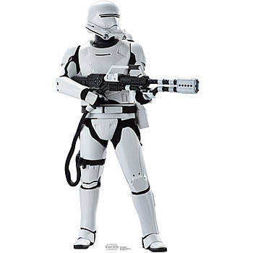

Class Structure of Program
[your last name]PE2
static main(String[ ] args): void
ImperialTrooper
See slide 4
<<Interface>> TrooperActions
See slide 8
Scouttrooper
See slide 5
Assaulttrooper
See slide 6
Stormtrooper
See slide 7

Slide 4
ImperialTrooper Class (SPECIFICATION)
ImperialTrooper
- trooperID: String - trooperType: String - height: int - weight: int - rank: String - yearsInService: int + static trooperCount: int
+ abstract communicates(String p): void + static showStatus(ImperialTrooper t): void
Method | Parameters | Output
communicates | String p | ABSTRACT
static showStatus | ImperialTrooper t | prints the trooperID and trooperType values to the console
Constructor Signature
public ImperialTrooper(String trooperType, int height, int weight, String rank, int yearsInService)
Constructor Specification
trooperID = ‘T’ + trooperType + ‘9’ + trooperCount
Increases trooperCount by 1

Slide 5
Scouttrooper Class (SPECIFICATION)
Scouttrooper
- scoutRole: String - weapon: String - scannerCarried: String + static scoutCount: int
+ communicates(String p): void + scoutsEnemy(String e): void + performsScan(String area): void
Method | Parameters | Output
communicates | String p | print ‘I am a scout [p]’ to the console
scoutsEnemy | String e | prints ‘[trooperID] is scouting the enemy’s [e]’ to the console
performsScan | String area | prints ‘[trooperID] is scanning the [area] with a [scannerCarried]’ to the console
Constructor Signature
public Scouttrooper(String rank, int yearsInService, String scoutRole, String weapon, String scannerCarried)
Constructor Specification
trooperType = “Scout”
height = 74
weight = 215
Increases scoutCount by 1
Must utilize superconstructor within constructor

Slide 6
Assaulttrooper Class (SPECIFICATION)
Assaulttrooper
- assaultRole: String - weapon: String - grenadesCarried: int + static assaultCount: int
+ communicates(String p): void + assaultsEnemy(String e) : void + throwGrenade(String tgt): void
Method | Parameters | Output
communicates | String p | print ‘I am an Assault’ to the console
assaultsEnemy | String e | prints ‘[trooperID] is assaulting the enemy’s [e]’ to the console
throwGrenade | String tgt | if grenadesCarried is greater than or equal to 1, prints ‘[trooperID] is throwing a grenade at [tgt] to the console…otherwise prints ‘No Grenades’ to the console. Decreases grenadesCarried by 1
Constructor Signature
public AssaultTrooper(String rank, int yearsInService, String assaultRole, String weapon, int grenadesCarried)
Constructor Specification
trooperType = “Assault”
height = 76
weight = 225
Increases assaultCount by 1
Must utilize superconstructor within constructor

Slide 7
Stormtrooper Class (SPECIFICATION)
Stormtrooper
- troopRole: String - weapon: String - radioCarried: String + static troopCount: int
+ communicates(String p): void + attacks(String e): void + useRadio(String rec): void
Method | Parameters | Output
communicates | String p | print ‘I am a Trooper’ to the console
attacks | String e | prints ‘[trooperID] is attacking the enemy’s [e]’ to the console
useRadio | String rec | prints ‘[rec] is being transmitted by [radioCarried]’ to the console’
Constructor Signature
public Stormtrooper(String rank, int yearsInService, String troopRole, String weapon, String radioCarried)
Constructor Specification
trooperType = “Standard”
height = 77
weight = 245
Increases troopCount by 1
Must utilize superconstructor within constructor

Slide 8
TrooperActions (SPECIFICATION)
<<Interface>> TrooperActions
+ abstract firesWeapon (String tgt): void
Method | Parameters | Output
firesWeapon | String tgt | IMPLEMENTATION BY CONCRETE SUBCLASSES ONLY …prints ‘[trooperID] is firing his [weapon] at the [tgt]’ to the console

Slide 9
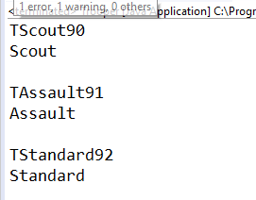
Object Creation and Testing
Create the following objects
Type | Identifier | Constructor Arguments
Scouttrooper | SCT1 | ”Cpl”,5,”Recon”,”Laser Rifle”,”SC-1”
AssaultTrooper | AST1 | ”Sgt”,7,”Demo”,”Thermite Launcher”,6
Stormtrooper | ST1 | ”Pvt”,2,”Security”,”Blaster”,”RX-1”
Use each of the objects created as an argument to the static method showStatus

