Slide 1
Video Frame text recognition system
Presented by :
Renuka R. Tamboli
Mayuri M. Videkar
Gayatri P. Suryawanshi

Slide 2
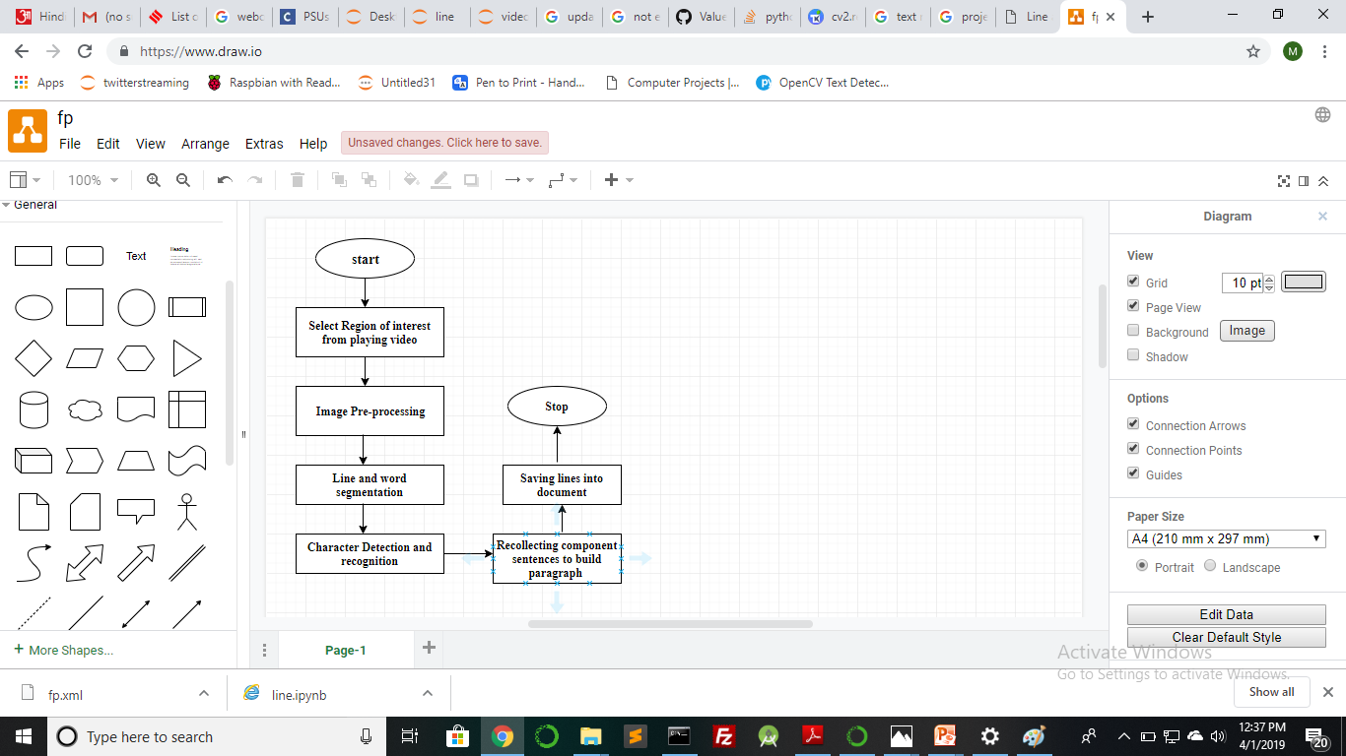
Flowchart :

Slide 3
Technology Stack
1
Front end:Django
2
Image preprocessing:
opencv(threshold,
binarization)
3
Segmentation:opencv
4
Text Recognition:
cnn(tensorflow)

Slide 4
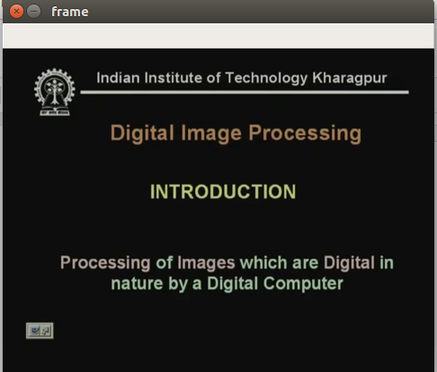
Steps :
Selecting region of interest from streaming video

Slide 5
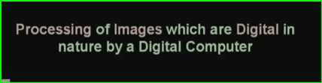
Steps :
Selected region of interest

Slide 6
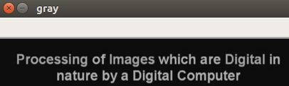
Steps :
Image preprocessing
BGR to Gray
cv2.cvtColor(img, cv2.COLOR_BGR2GRAY)

Slide 7
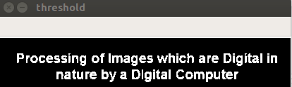
Steps :
Image preprocessing
Binarization
th, threshed = cv2.threshold(gray,100, 255, cv2.THRESH_BINARY|cv2.THRESH_OTSU)
Thresholding is used for separating the foreground text from its background.

Slide 8
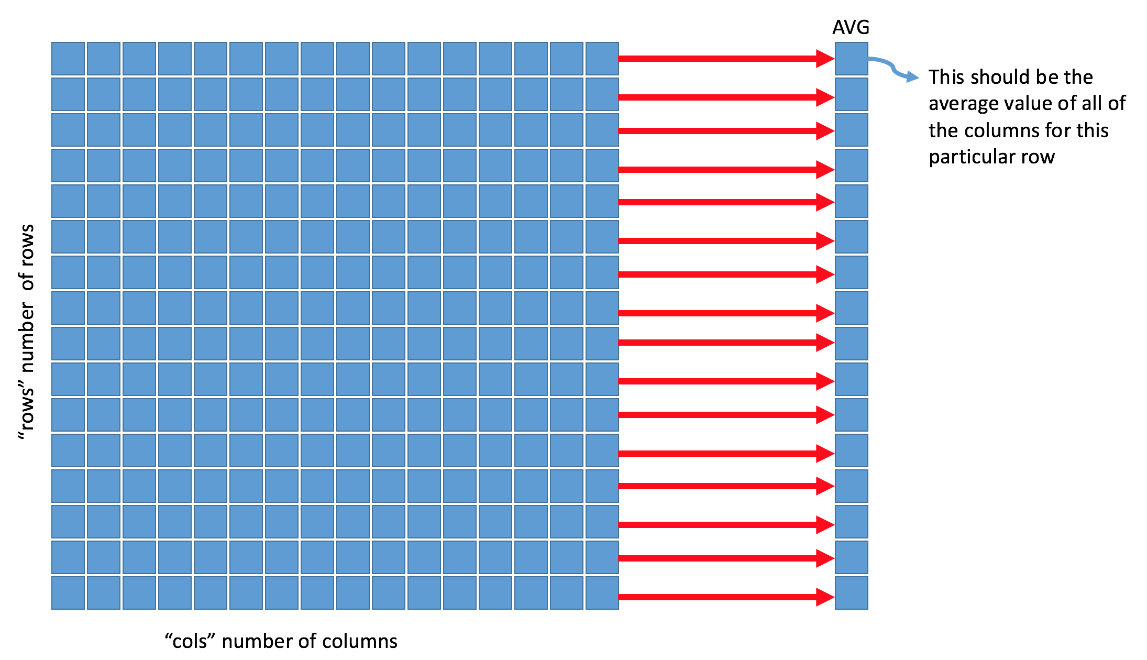
Steps :
Image Segmentation into lines
hist=cv2.reduce(threshed,1, cv2.REDUCE_AVG)
hist=[ 0 0 0 0 0 0 0 0 0
0 0 0 0 0 0 0 0 0
0 0 32 33 20 122 147 133
107 120 118 98 101 140 130
101 9 16 13 9 0 0 0 0
0 19 23 21 86 101 95 76 78
81 69 74 103 99 85 7 11
10 7 0 0 0 0 0 0 0 0
0 0 0 0 0 0 0 0 0 0]

Slide 9
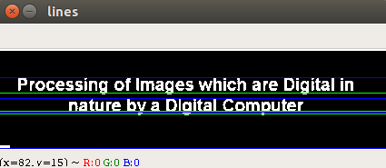
Steps :
Image Segmentation into lines

Slide 10
Steps :
Detect words from line image
Edge Detection
cv2.sobel(img,cv2.CV_8U,1,0)
Edge is detected in an image where pixels intensities changes distinctly.
Create kernel shape
element = cv2.getStructuringElement(cv2.MORPH_CROSS ,ele_size)
Perform Morphological operation like dilation followed by erosion to remove small black points on the line.
img_threshold=cv2.morphologyEx(img_threshold,
cv2.MORPH_CLOSE,element)

Slide 11
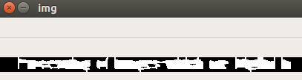
Steps :
words after morphological operation
find Contours
contours are defined as line joining all points along the boundary of image that have same intensity.
cv2.findContours(img_threshold,cv2.RETR_EXTERNAL,cv2.CHAIN_APPROX_SIMPLE)
Sort Contours and draw Rectangle
x,y,w,h=cv2.boundingRect(cnt)
From gray image retrieved this rectangular portion.

Slide 12
Steps :
Detect words from line image

Slide 13
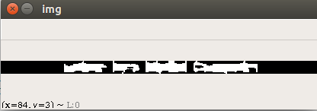
Steps :
Detect words from line image

Slide 14
Steps :
Detect characters from word image

Slide 15
Steps :
Detect characters from word image

Slide 16
Steps :
Detect characters from word image

Slide 17
Character Recognition
The detected character images are given as input to the Character recognition model built using convolutional neural network(CNN) implemented with tensorflow.
A Convolutional Neural Network is a Deep Learning algorithm which can take in an input image, assign importance/weights to various objects in the image and be able to differentiate one from the other.

Slide 18
Convolutional Neural Network
Computer understands an image using numbers at each pixels.
In CNN,input is given to neurons organized in square,whose values correspond to pixel intensities.
CNN has following layers:
Convolution Layer
ReLu Layer
Pooling
Fully Connected

Slide 19
Convolution Layer :
Uses filters to detect features at different locations from input image to produce feature maps.
Pooling Layer :
Takes feature maps and shrink it to create condensed feature maps.
ReLu Layer :
Activates the node if input is above zero.
Fully Connected layer :
This layer connects every neuron from pooling layer to every one of output neuron .

Slide 20
TensorFlow
TensorFlow is an open source library for machine learning and deep learning that allows developers to create dataflow graphs to build models.
It provides fast numerical computing and allows developers to create large-scale neural networks with many layers.

Slide 21
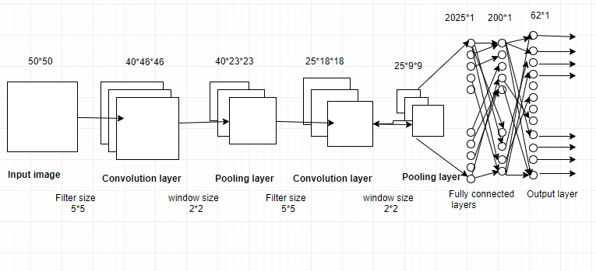
Convolutional Neural Network

Slide 22
Compiling Model
model.compile(loss='categorical_crossentropy', optimizer='adam', metrics=['accuracy'])
parameters:
loss function measures the performance of a classification model whose output is a probability value between 0 and 1.
Adam optimizer adapts learning rate with changing parameters during training model.
A metric is a function that is used to judge the performance of your model.

Slide 23
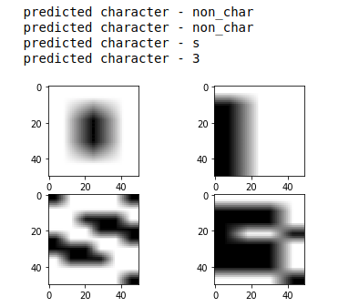
Result

Slide 24
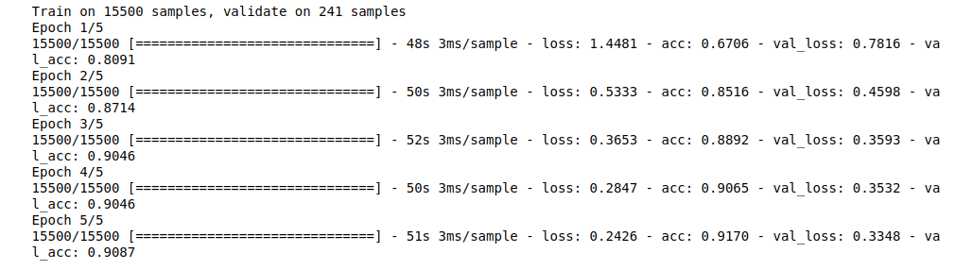
Accuracy

Slide 25
Thank You!

