Slide 1
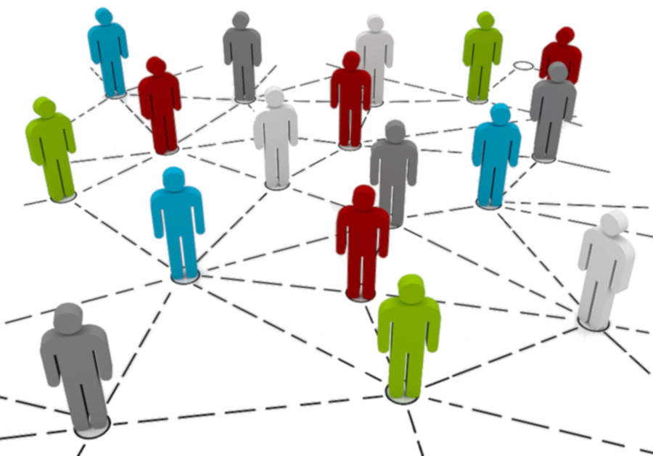

Census Data (Income) Analysis

Slide 2

Know My Customer and her Goals:
Ms. Reborn Victoria , an economist is starting a blog about USA economy and census data
My Plan and goal is to support her through our data mining efforts by delivering following :
Give her formatted , cleansed dataset in excel
Add different plots, graphs and histograms to our deliverables
Give her information about attributes and its values
Give her relevant findings and information about the data
Using demographic data like AGE, SEX, Education and Occupation predict whether an individual exists in lower or higher income group

Slide 3
Software Used :
Python and its libraries
Numpy
Pandas
Scipy
Sci-kit learn
2. Jupyter Notebook

Slide 4
Facts about the Data :
Database Address : Dataset URL :https://archive.ics.uci.edu/ml/datasets/Census-Income+(KDD)
Database Name : Adult
Owner Of Database : US Census Bureau
Extraction is done for native-country : United-States
Number of Attributes : 6 continuous, 8 nominal attributes
Attributes Dropped : FNLWGHT,Education-Num,Native-Country, Relationship
Data Instances : 27504, 15
Instances with unknown values are removed
Duplicate Data : Yes

Slide 5
Census Data Attributes and Values :
AGE | continuous
WORKCLASS | Private | Self-emp-not-inc | Self-emp-inc | Federal-gov | Local-gov
 | State-gov | Without-pay | Never-worked.
FNLWGT | continuous
EDUCATION | Bachelors | Some-college | 11th | HS-grad | Prof-school
 | Assoc-acdm | Assoc-voc | 9th | 7th-8th | 12th
 | Masters | 1st-4th | 10th | Doctorate | 5th-6th | Preschool
EDUCATION-NUM | continuous.
MARITAL-STATUS | Married-civ-spouse | Divorced | Never-married | Separated | Widowed
 | Married-spouse-absent | Married-AF-spouse.
OCCUPATION | Tech-support | Craft-repair | Other-service | Sales | Exec-managerial
 | Prof-specialty | Handlers-cleaners | Machine-op-inspct | Adm-clerical | Farming-fishing
 | Transport-moving | Priv-house-serv | Protective-serv | Armed-Forces.
RELATIONSHIP | Wife | Own-child | Husband | Not-in-family | Other-relative | Unmarried
RACE | White | Asian-Pac-Islander | Amer-Indian-Eskimo | Other | Black
SEX | Female | Male
CAPITAL-GAIN | continuous.
CAPITAL-LOSS | continuous.
HOURS-PER-WEEK | continuous.
NATIVE-COUNTRY | United-States
CLASS | >50K | <=50K

Slide 6
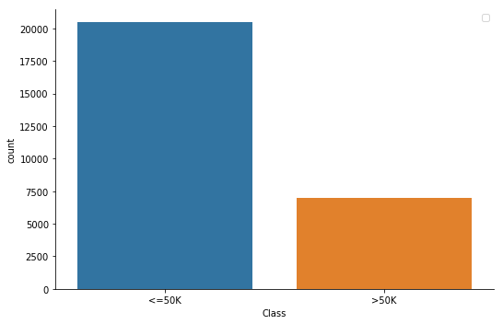
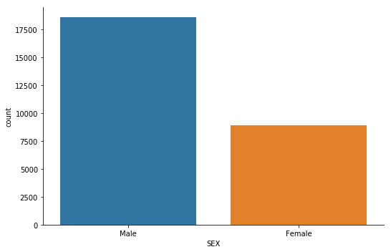
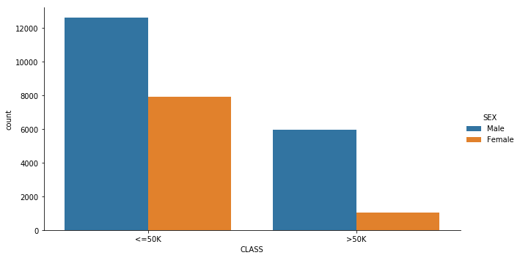
Analysis :
SEX R-CLASS
Female <=50K 7908
>50K 1024
Male <=50K 12601
>50K 5971
R-CLASS <=50K 20509
>50K 6995
SEX Female 8932
Male 18572
Census Data has more individuals whose income is less than or equal to 50K
Dataset has almost twice the number males than females
Female % in in higher income , is around 15%
More than half of males are in lower income group
Sex has high significance on Class

Slide 7
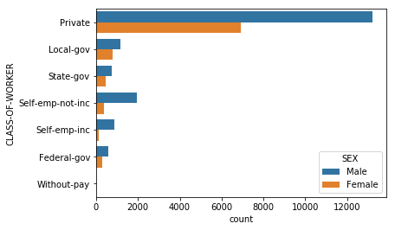
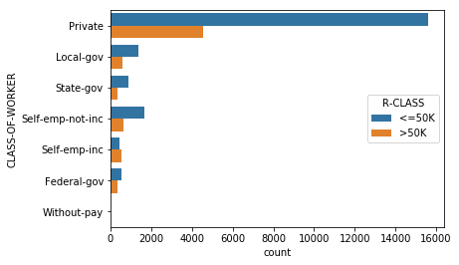
Analysis :
CLASS-OF-WORKER | R-CLASS | COUNT
Federal-gov | <=50K | 550
 | >50K | 336
Local-gov | <=50K | 1381
 | >50K | 575
Private | <=50K | 15594
 | >50K | 4541
Self-emp-inc | <=50K | 433
 | >50K | 558
Self-emp-not-inc | <=50K | 1654
 | >50K | 659
State-gov | <=50K | 884
 | >50K | 326
Without-pay | <=50K | 13
Most of the individuals are private workers and, in that male number are more
Self-emp-inc is the only category where females numbers are in less %
Self-emp-inc individuals are more in higher income
Local-gov and federal-gov females workers are more comparable to males worker’s number
Most of the individuals are in private jobs
Most of the males are in Private jobs having income <= 50 K
CLASS-OF-WORKER has significant effect on prediction

Slide 8
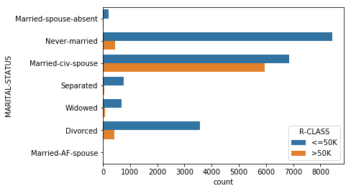
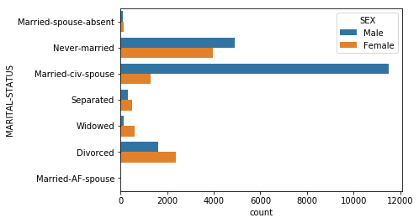
Analysis :
MARITAL-STATUS R-CLASS
Divorced <=50K 3564
>50K 429
Married-AF-spouse <=50K 11
>50K 10
Married-civ-spouse <=50K 6839
>50K 5959
Married-spouse-absent <=50K 208
>50K 25
Never-married <=50K 8435
>50K 441
Separated <=50K 765
>50K 60
Widowed <=50K 687
>50K 71
Married individuals with spouse are more in higher income group and most of them are males
Most of the never-married people are in lower income group
There are more divorced , separated and widowed females than males in the dataset
Most of the divorced , separated and widowed people are in lower income group
All the married people with spouse absent has lower income
Marital-Status has high significance on prediction

Slide 9
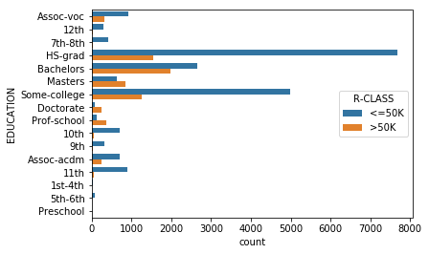
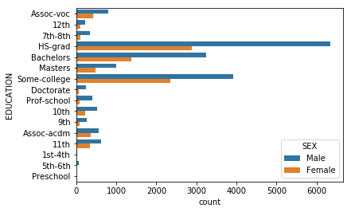
Analysis :
EDUCATION | R-CLASS
10th | <=50K 695
 | >50K 57
11th | <=50K 902
 | >50K 55
12th | <=50K 305
 | >50K 26
1st-4th | <=50K 38
 | >50K 1
5th-6th | <=50K 75
 | >50K 3
7th-8th | <=50K 408
 | >50K 29
9th | <=50K 328
 | >50K 22
Assoc-acdm | <=50K 698
 | >50K 241
Assoc-voc | <=50K 910
 | >50K 323
Bachelors | <=50K 2643
 | >50K 1975
Doctorate | <=50K 75
 | >50K 239
HS-grad | <=50K 7668
 | >50K 1541
Masters | <=50K 635
 | >50K 849
Preschool | <=50K 15
Prof-school | <=50K 121
 | >50K 367
Some-college | <=50K 4993
 | >50K 1267
33% of the total people are high school graduate
Most of the high School graduates make <=50K
74 % of Bachelors are in higher income group
Half of bachelors female makes less than males
Prof-school and Doctorate are less in number
Prof-school and doctors is the only class where more that 60% are in high income group
Higher the education , high impact it has on income group and prediction

Slide 10
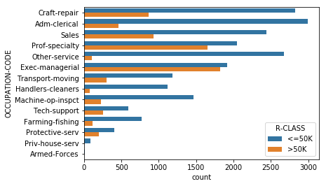
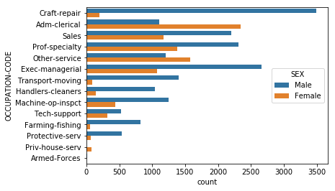
Analysis :
OCCUPATION-CODE | R-CLASS | CNT
Adm-clerical | <=50K | 2991
 | >50K | 458
Armed-Forces | <=50K | 8
 | >50K | 1
Craft-repair | <=50K | 2825
 | >50K | 860
Exec-managerial | <=50K | 1917
 | >50K | 1818
Farming-fishing | <=50K | 768
 | >50K | 111
Handlers-cleaners | <=50K | 1116
 | >50K | 73
Machine-op-inspct | <=50K | 1463
 | >50K | 224
Other-service | <=50K | 2671
 | >50K | 106
Priv-house-serv | <=50K | 89
 | >50K | 1
Prof-specialty | <=50K | 2043
 | >50K | 1650
Protective-serv | <=50K | 403
 | >50K | 203
Sales | <=50K | 2436
 | >50K | 928
Tech-support | <=50K | 593
 | >50K | 257
Transport-moving | <=50K | 1186
 | >50K | 305
Exec-managerial individuals are almost same in low and high income group
Admin-clerical and other services group has more females than males
Priv-house-serv has all the females
Prof-specialty and other services more 50% of higher income group
Occupation-code plays a great role in predicting earnings of an individual

Slide 11
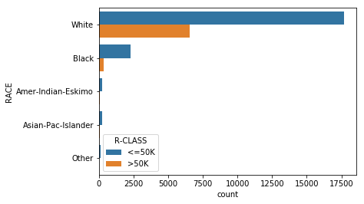
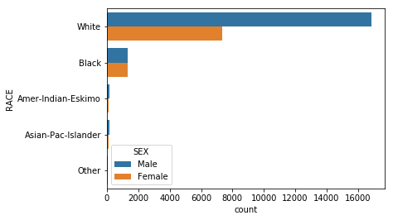
Analysis :
RACE | R-CLASS | COUNT
Amer-Indian-Eskimo | <=50K | 238
 | >50K | 33
Asian-Pac-Islander | <=50K | 206
 | >50K | 67
Black | <=50K | 2286
 | >50K | 343
Other | <=50K | 100
 | >50K | 13
White | <=50K | 17679
 | >50K | 6539
More than 85% are white individuals in this dataset
Most of the white individuals are male
More than 60% of white individuals makes less than 50K
Dataset has almost 50% males and 50% black females
More than 90% of black individuals are in lower income group

Slide 12
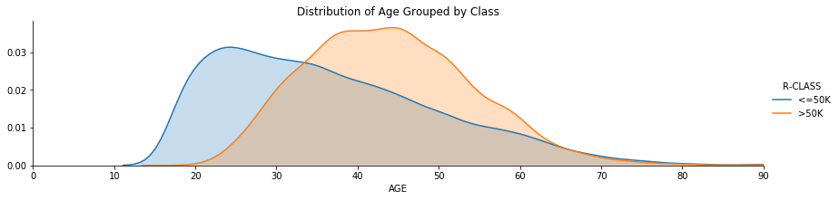
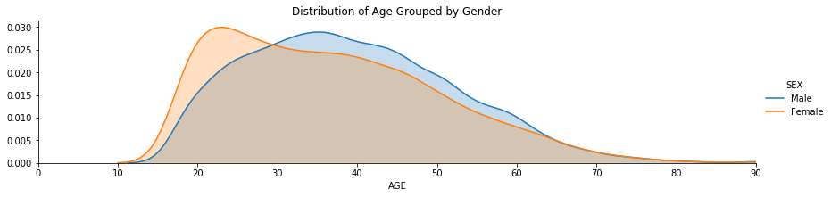
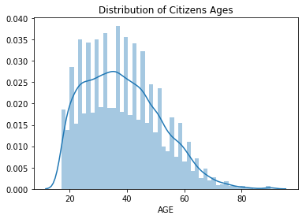
Analysis:
Average and median age of people are 39 and 37
Male has normal distribution
Female has skewed distribution between 20 and 30 years
Between 40 and 50 years of age people are more in higher income group

Slide 13
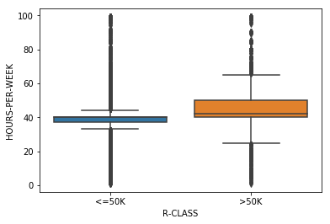
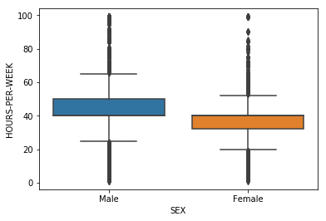
Analysis :
Hours-Per-Week has outliers in both side of the tails
Hours-Per-Week has range of attributes slightly higher in >50K
Hours-Per-Week has some significance on the prediction
HOURS-PER-WEEK
R-CLASS
<=50K 806841
>50K 320025
SEX
Female 329293
Male 797573

Slide 14
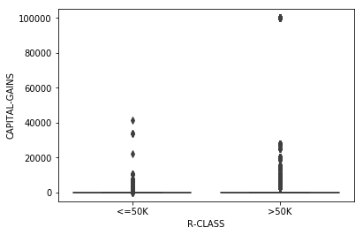
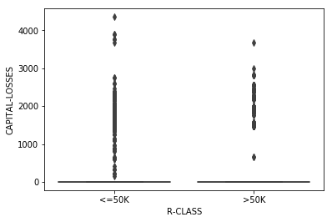
Analysis :
Both the boxplots has straight lines
,Capital Gain and Losses hasn’t got significant effect on prediction

Slide 15
 | Model Performance
Mode Name | Parameters | CROSS VALUE | Accuracy
KNeighborsClassifier1 | Neighbors =1 | 0.77366036 0.7736 0.76740464 | 0.77
KNeighborsClassifier3 | Neighbors =3 | 0.79658758 0.79733333 0.79781275 | 0.8096
KNeighborsClassifier5 | Neighbors =5 | 0.79712077 0.8064 0.79941318 | 0.8168
KNeighborsClassifier7 | Neighbors =7 | 0.80565183 0.80986667 0.80448119 | 0.8124
GaussianNB | default | 0.80191949 0.8136 0.80234729 | 0.8024
Random Forest3 | n_estimators=10, max_depth=1 | 0.71927486 0.7192 0.71939184 | 0.726933
Random Forest5 | n_estimators=100, max_depth=5 | 0.80831778 0.81626667 0.81355028 | 0.8192
Performance Matrix :
The above matrix shows clearly that best classifier , is random forest with max-depth 5 which should be used for predicting earning potential for an individual person

Slide 16
Summary :
Ms. Reborn Victoria would be able to use all the plots in her blog
For new census data I can use the same format and same plots
Ms. Reborn Victoria would be able to identify different individuals in the higher or lower income group dependent on same demographics

