Slide 1
Batch Analysis of Security Monitoring Data
SM and OST project
Renu Tiwari, Jiang Xing Kun, Kousa Mhyar, Gureva Olga

Slide 2
Datasets
Dec2019_00000_20191206100500.pcap
Exported .pcap data to network_security.csv using wireshark.
No
Time
Source
Destination
Protocol
Length
Info
150k rows

Slide 3
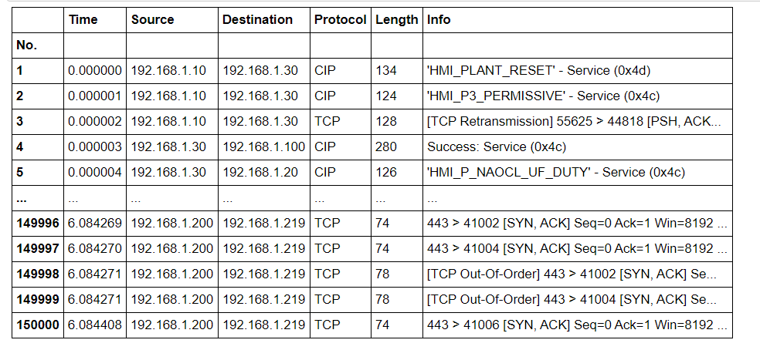
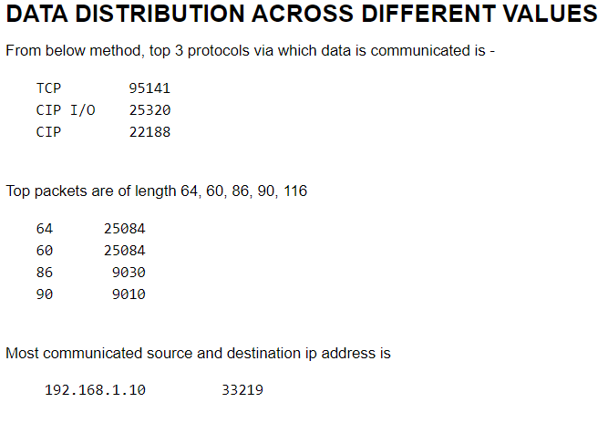
Datasets
network_security.csv

Slide 4
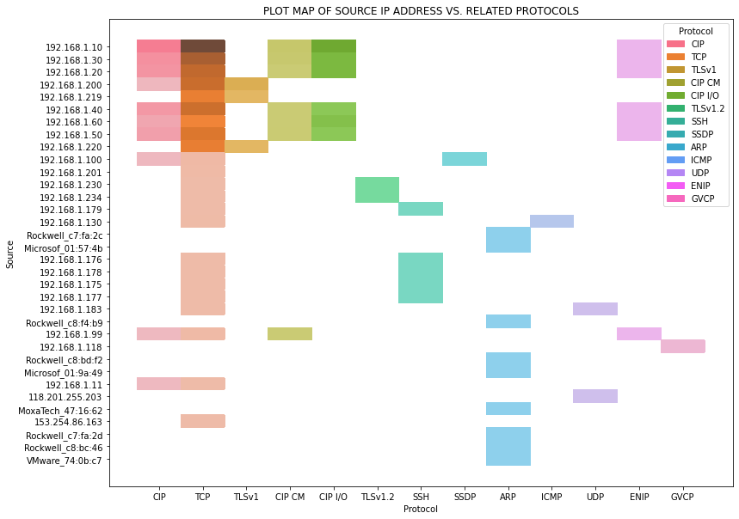
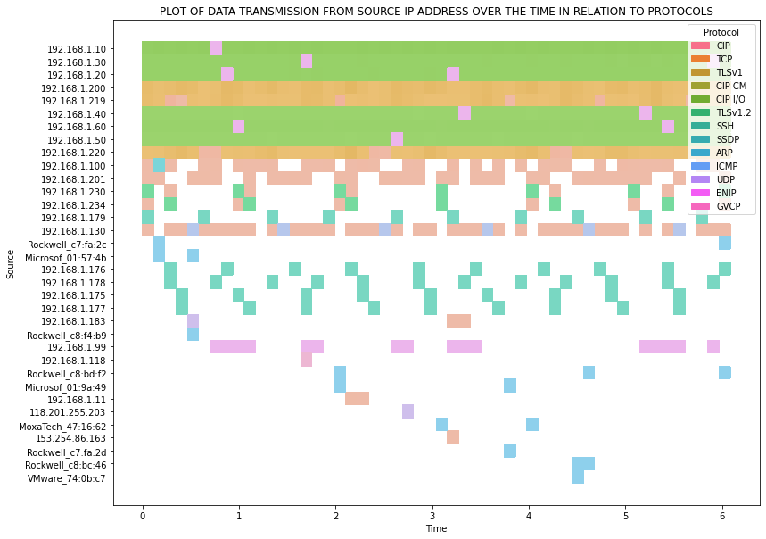
EDA – Visualization Plot

Slide 5
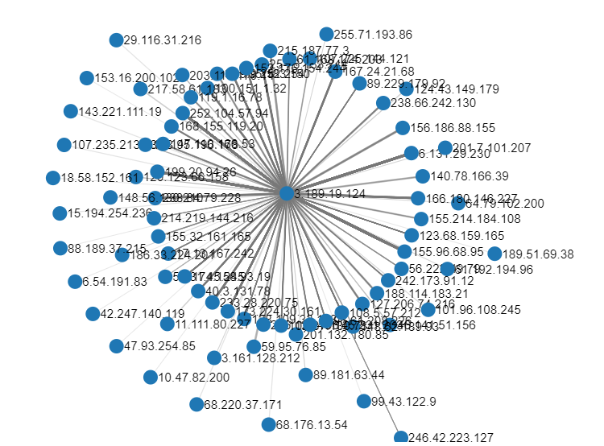
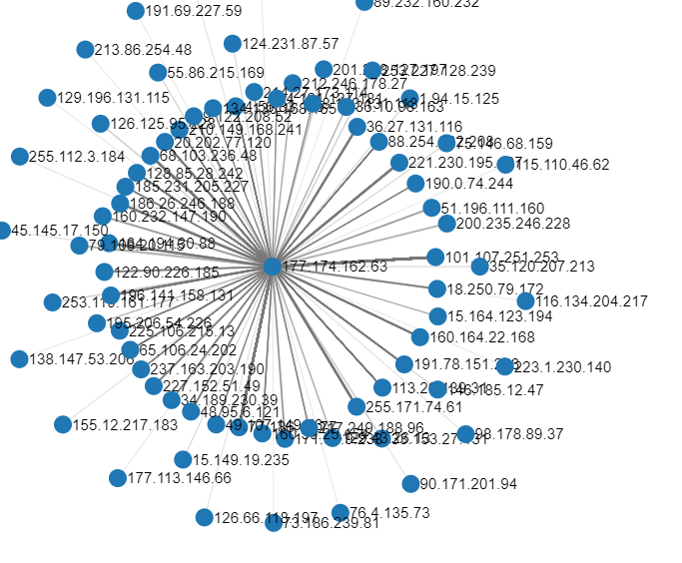
EDA – Visualization Graph

Slide 6
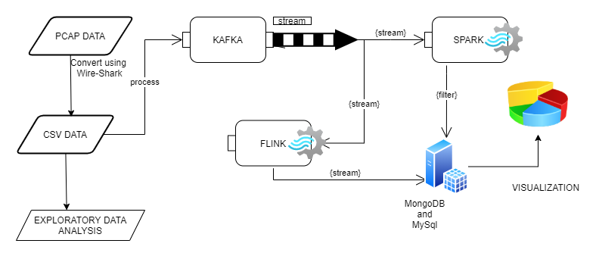
System Architecture
Jupyter Notebook
Kafka Streams as server
Spark as consumer
Flink (experiment)
MySQL
MongoDB
Echarts

Slide 7
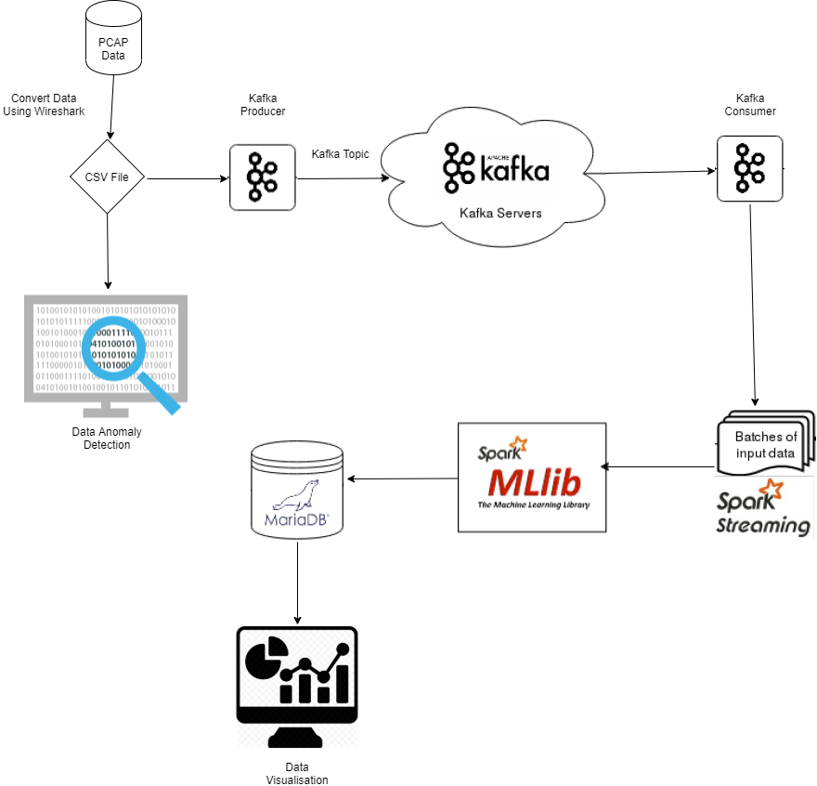
System Architecture
DataBricks For Anomaly
Detection.
Kafka Streams as server
Spark as consumer
Spark Mllib Pipeline
MariaDB SQL Server
Data Visualisation

Slide 8
Kafka Streams
Two Topics Created
topic1
streaming
.csv data streamed, api path “/streamData”
Create basic html to show data on localhost:8088/streamData

Slide 9
Spark Consumer
Filtering according to
Filter data on basis of length of data stream and must exist a protocol,
data_stream.length > 10 & data_stream[12]>0
Stream data from “topic1”, apply filtration and store on MySQL
Filter data on basis of protocol = “TCP”
Stream data from “streaming”, apply above filter and store on MongoDB.
Migrated MySQL to MongoDB

Slide 10
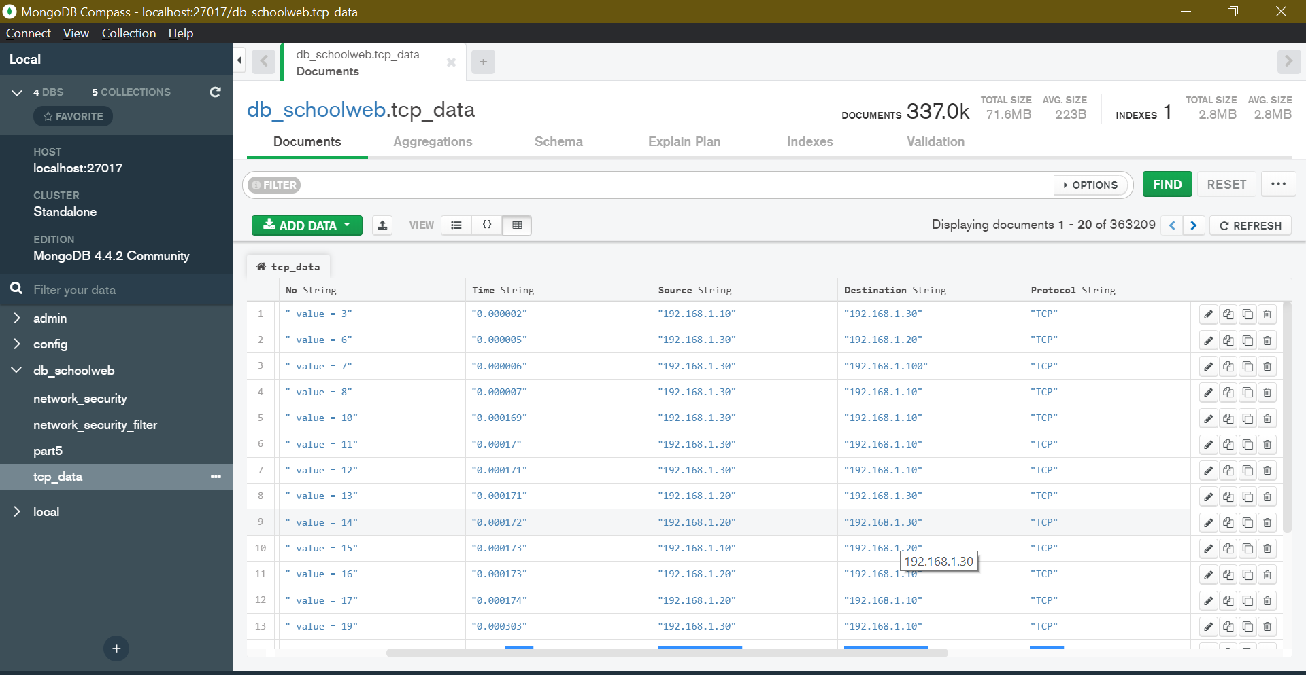

Slide 11
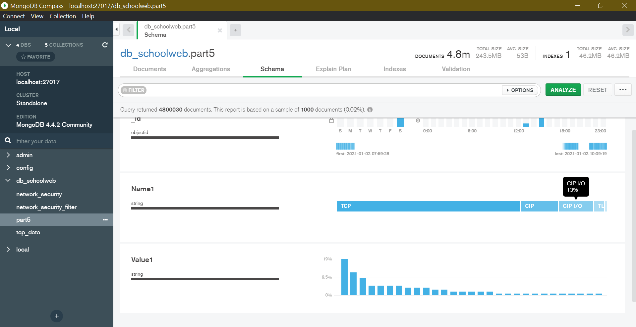
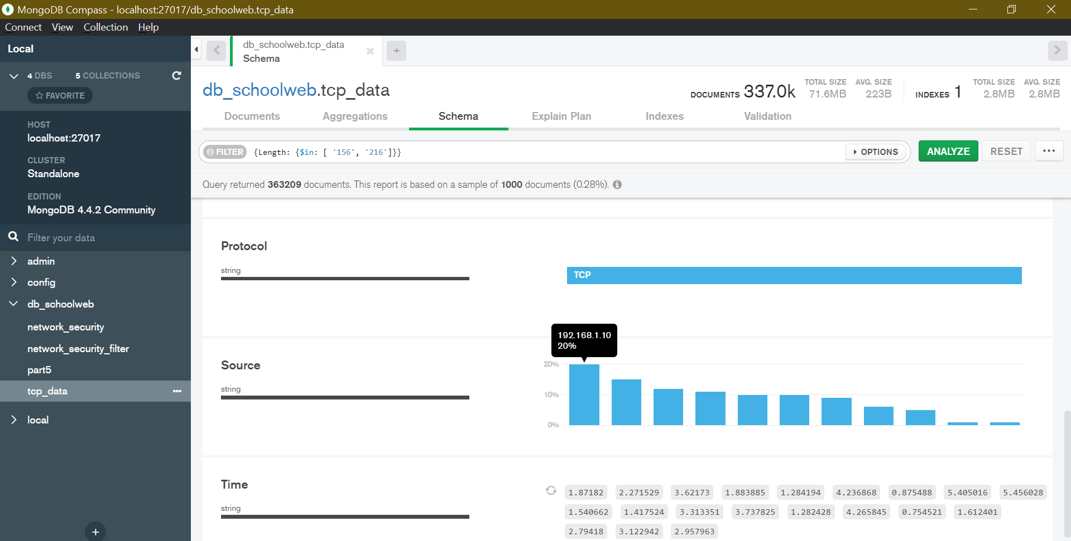
MongoDB Analysis

Slide 12
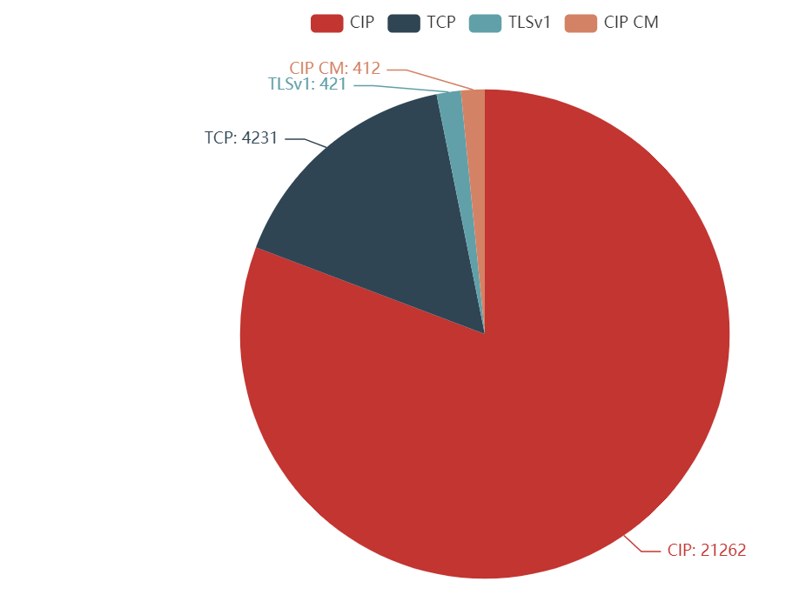
Visualization using eCharts library

