Slide 1

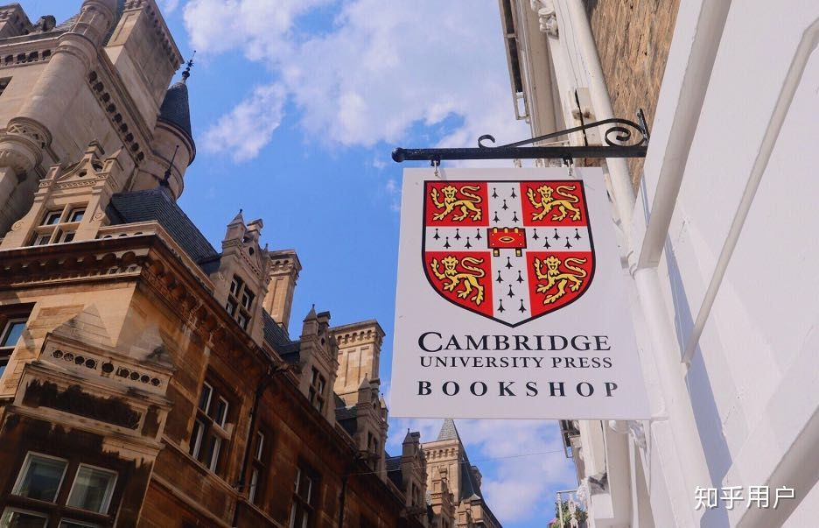
剑桥大学
By 伊凡 Evan & 王境庐 Ethan

Slide 2
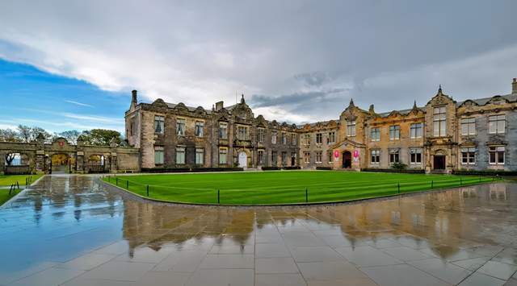
校园环境

Slide 3
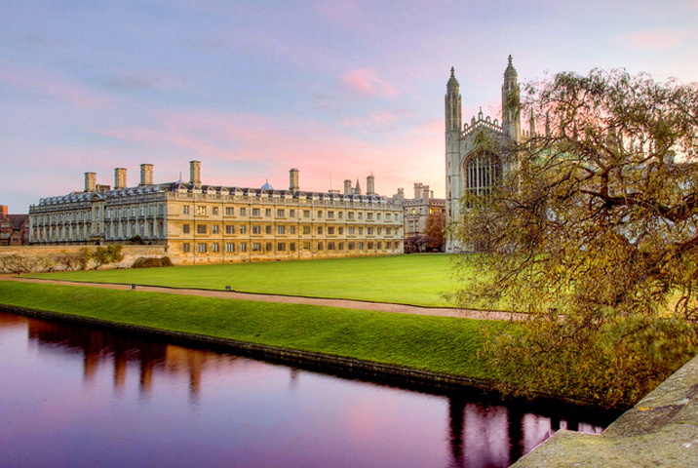

Slide 4
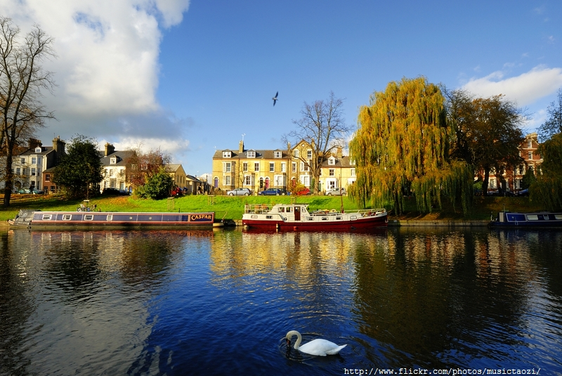

Slide 5
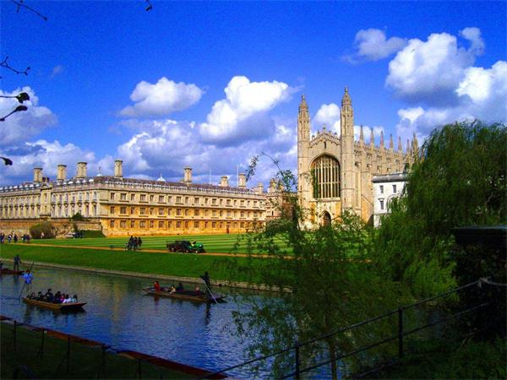

Slide 7
Archaeology
A Level: A*AA
Required by all Colleges: no specific subjects
Useful preparation: Classics, Geography, History, a language (ancient or modern), science subjects, social science subjects
All applicants for Archaeology are required to take a written assessment at interview, if interviewed.

Slide 8
Medicine
A Level: A*A*A
A Levels in Chemistry and one of Biology, Physics, Mathematics.
To develop understanding of what a career in Medicine involves and your suitability for your intended profession, you’re strongly advised (though not required) to undertake some relevant work experience (either paid or voluntary) in a health or social care organisation.

Slide 9
Veterinary Medicine
A Level: A*AA
‘Science/mathematics subjects’ refers to Biology, Chemistry, Physics and Mathematics. It does not include Psychology.
A Levels in Chemistry and one of Biology, Physics, Mathematics.
equired to take a pre-interview written assessment
Some experience are necessary

Slide 10
Natural Science
The flexibility of the course makes it possible to take purely biological sciences, purely physical sciences or a combination of both, according to your interests.
A Level: A*A*A
Most students have at least three science/mathematics A Levels.
required to take a pre-interview written assessment
taking other recognised qualifications to have a level of understanding in science and mathematics roughly equivalent to those applying with A Levels.

Slide 11
Natural Science course is optional for students interested in:
Anatomy, Astrophysics,
Biochemistry, Biological Sciences,
Biology, Biomedical Sciences, Botany,
Chemistry,
Earth Sciences,
Genetics, Geological Sciences,
Neuroscience,
Physics,
Zoology

Slide 12
Year 1 (Part IA)
You choose three science subjects from a wide range, covering:
Biology of Cells
Chemistry
Earth Sciences
Evolution and Behaviour
Materials Science
Physics
Physiology of Organisms
You will also study one mathematics option focusing on techniques in either the Physical or Biological Sciences.
Mathematics(focusing on Physical Sciences)
Mathematical Biology(focusing on Biological Sciences)

Slide 13
Year 2 (Part IB)
You choose a combination of three subjects, drawn from the following areas:
Biochemistry
Cell Biology
Chemistry A: Physical & Theoretical Chemistry
Chemistry B: Organic & Inorganic Chemistry
Materials Science
Mathematics
Microbiology
Molecular Biology
Neurobiology
Physics A: Waves, Quantum Mechanics, Condensed Matter Physics
Physics B: Dynamics, Electromagnetism, Thermodynamics
Plant Sciences
Psychology

Slide 14
Years 3 and 4 (Parts II and III)
You can opt to follow a broad spectrum Part II subject in Biological or Physical Sciences,
or you can choose to specialise in one of a wide range of areas, including:
Astrophysics¹
Biochemistry¹
Chemistry¹
Earth Sciences¹
Materials Science¹
Neuroscience
Pharmacology
Physics¹
Physiology, Development and Neuroscience
Plant Sciences
Psychology

Slide 15
Mathematics
A Level: A*A*A + STEP IB: 40-42 points, with 776 at Higher Level + STEP
All Colleges require: A Level/IB Higher Level Mathematics*, A Level Further Mathematics (A Level students only), STEP
Some Colleges Require: A Level/IB Higher Level in a science subject; A Level/IB Higher Level Physics (for Mathematics with Physics only)

Slide 16
Year 1 (Part IA)
In the first year, there are two options to choose from:
Pure and Applied Mathematics
Mathematics with Physics
Part IA introduces you to the fundamentals of higher mathematics, including:
the study of algebraic systems (such as groups)
analysis of calculus
probability
mathematical methods (such as vector calculus)
Newtonian dynamics and special relativity
You take eight subjects. Those taking Mathematics with Physics replace two Mathematics subjects with Part IA Physics from Natural Sciences, covering, for example, kinetic theory, electromagnetism, and practical work in a laboratory.

Slide 17
Year 2 (Part IB)
In Part IB, you choose from around 16 options available. In most, the topics of the first year are studied in much greater depth, but some new topics are offered, for example:
geometry
electromagnetism, quantum mechanics and fluid dynamics
numerical analysis
applicable mathematics, which includes statistics and optimisation (a rigorous treatment of topics from decision mathematics)
There are also optional computational projects.

Slide 18
Year 3 (Part II)
Year 3 gives you the opportunity to explore your mathematical interests in detail. There is a very wide choice, including papers on, for example:
cryptography
algebraic topology
number theory
cosmology
general relativity
stochastic financial models
waves
automata and formal languages
mathematical biology
the mathematics of machine learning
There are also optional computational projects.

Slide 19
Year 4 (Part III, optional integrated Masters)
Part III has a world-wide reputation for training the very best research mathematicians.
Progression to Part III, in which around 75 to 80 options are offered, normally requires a first in Part II or a very good performance in Parts IB and II, and successful completion leads to a BA with MMath.

Slide 20
https://www.cam.ac.uk/

