Slide 1
Remember: Implementation of search algorithms
Function General-Search(problem, Queuing-Fn) returns a solution, or failure
nodes ← make-queue(make-node(initial-state[problem]))
loop do
if nodes is empty then return failure
node ← Remove-Front(nodes)
if Goal-Test[problem] applied to State(node) succeeds then return node
nodes ← Queuing-Fn(nodes, Expand(node, Operators[problem]))
end
Queuing-Fn(queue, elements) is a queuing function that inserts a set of elements into the queue and determines the order of node expansion. Varieties of the queuing function produce varieties of the search algorithm.
From session02-04.pptx, slide 83

Slide 2
Remember: Implementation of search algorithms
Function General-Search(problem, Queuing-Fn) returns a solution, or failure
nodes ← make-queue(make-node(initial-state[problem]))
loop do
if nodes is empty then return failure
node ← Remove-Front(nodes)
if Goal-Test[problem] applied to State(node) succeeds then return node
nodes ← Queuing-Fn(nodes, Expand(node, Operators[problem]))
end
Queuing-Fn(queue, elements) is a queuing function that inserts a set of elements into the queue and determines the order of node expansion. Varieties of the queuing function produce varieties of the search algorithm.
From session02-04.pptx, slide 83

Slide 3
Adding tie-breaking
Function General-Search(problem, Queuing-Fn) returns a solution, or failure
nodes ← make-queue(make-node(initial-state[problem]))
loop do
if nodes is empty then return failure
node ← Remove-Front(nodes)
if Goal-Test[problem] applied to State(node) succeeds then return node
nodes ← Queuing-Fn(nodes, TieBreak(Expand(node, Operators[problem])))
end
TieBreak(nodeset) – homework 1 text says (p. 5):
“If all else is equal while searching routes (ties), you should explore (enqueue) multiple paths from the same intersection in the order in which they are listed in the live traffic inputs. “

Slide 4
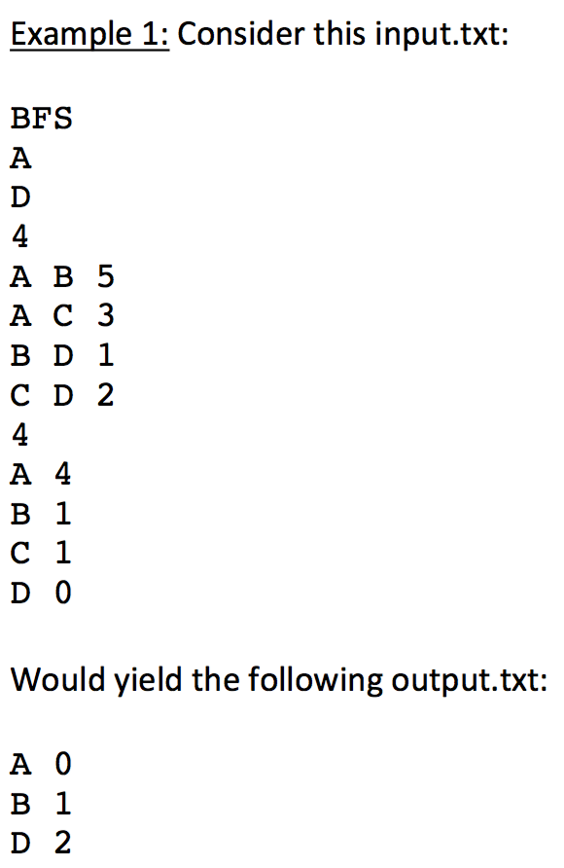
Order in which paths from each state are
Listed:
From A: A->B, A->C
From B: B->D
From C: C->D
This is why BFS returns ABD and not ACD.
Note: loop detection also contributed
Here by preventing the second encountered
Node with state D from being enqueued.

Slide 5
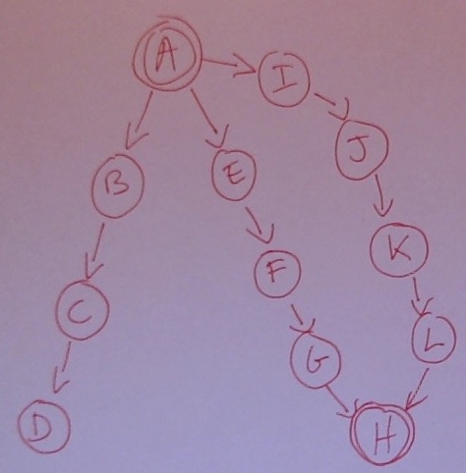
New hint: DFS example
Order in which paths from each state are listed:
From A: A->B, A->E, A->I
From B: B->C
From C: C->D
From E: E->F
From F: F->G
From G: G->H
From I: I->J
From J: J->K
From K: K->L
From L: L->H
DFS returns?
DFS
A
H
12
A B 1
B C 1
C D 1
A E 10
E F 2
F G 3
G H 3
A I 1
I J 1
J K 1
K L 1
L H 1
[…]

Slide 6
New hint: DFS example
Order in which paths from each state are listed:
From A: A->B, A->E, A->I
From B: B->C
From C: C->D
From E: E->F
From F: F->G
From G: G->H
From I: I->J
From J: J->K
From K: K->L
From L: L->H
DFS
A
H
12
A B 1
B C 1
C D 1
A E 10
E F 2
F G 3
G H 3
A I 1
I J 1
J K 1
K L 1
L H 1
[…]
Node State Parent
1 A NIL

Slide 7
New hint: DFS example
Order in which paths from each state are listed:
From A: A->B, A->E, A->I
From B: B->C
From C: C->D
From E: E->F
From F: F->G
From G: G->H
From I: I->J
From J: J->K
From K: K->L
From L: L->H
DFS
A
H
12
A B 1
B C 1
C D 1
A E 10
E F 2
F G 3
G H 3
A I 1
I J 1
J K 1
K L 1
L H 1
[…]
Node State Parent
2 B 1
3 E 1
4 I 1
1 A NIL

Slide 8
New hint: DFS example
Order in which paths from each state are listed:
From A: A->B, A->E, A->I
From B: B->C
From C: C->D
From E: E->F
From F: F->G
From G: G->H
From I: I->J
From J: J->K
From K: K->L
From L: L->H
DFS
A
H
12
A B 1
B C 1
C D 1
A E 10
E F 2
F G 3
G H 3
A I 1
I J 1
J K 1
K L 1
L H 1
[…]
Node State Parent
5 C 2
2 B 1
3 E 1
4 I 1
1 A NIL

Slide 9
New hint: DFS example
Order in which paths from each state are listed:
From A: A->B, A->E, A->I
From B: B->C
From C: C->D
From E: E->F
From F: F->G
From G: G->H
From I: I->J
From J: J->K
From K: K->L
From L: L->H
DFS
A
H
12
A B 1
B C 1
C D 1
A E 10
E F 2
F G 3
G H 3
A I 1
I J 1
J K 1
K L 1
L H 1
[…]
Node State Parent
6 D 5
5 C 2
2 B 1
3 E 1
4 I 1
1 A NIL

Slide 10
New hint: DFS example
Order in which paths from each state are listed:
From A: A->B, A->E, A->I
From B: B->C
From C: C->D
From E: E->F
From F: F->G
From G: G->H
From I: I->J
From J: J->K
From K: K->L
From L: L->H
DFS
A
H
12
A B 1
B C 1
C D 1
A E 10
E F 2
F G 3
G H 3
A I 1
I J 1
J K 1
K L 1
L H 1
[…]
Node State Parent
6 D 5
5 C 2
2 B 1
3 E 1
4 I 1
1 A NIL

Slide 11
New hint: DFS example
Order in which paths from each state are listed:
From A: A->B, A->E, A->I
From B: B->C
From C: C->D
From E: E->F
From F: F->G
From G: G->H
From I: I->J
From J: J->K
From K: K->L
From L: L->H
DFS
A
H
12
A B 1
B C 1
C D 1
A E 10
E F 2
F G 3
G H 3
A I 1
I J 1
J K 1
K L 1
L H 1
[…]
Node State Parent
7 F 3
6 D 5
5 C 2
2 B 1
3 E 1
4 I 1
1 A NIL

Slide 12
New hint: DFS example
Order in which paths from each state are listed:
From A: A->B, A->E, A->I
From B: B->C
From C: C->D
From E: E->F
From F: F->G
From G: G->H
From I: I->J
From J: J->K
From K: K->L
From L: L->H
DFS
A
H
12
A B 1
B C 1
C D 1
A E 10
E F 2
F G 3
G H 3
A I 1
I J 1
J K 1
K L 1
L H 1
[…]
Node State Parent
8 G 7
7 F 3
6 D 5
5 C 2
2 B 1
3 E 1
4 I 1
1 A NIL

Slide 13
New hint: DFS example
Order in which paths from each state are listed:
From A: A->B, A->E, A->I
From B: B->C
From C: C->D
From E: E->F
From F: F->G
From G: G->H
From I: I->J
From J: J->K
From K: K->L
From L: L->H
DFS
A
H
12
A B 1
B C 1
C D 1
A E 10
E F 2
F G 3
G H 3
A I 1
I J 1
J K 1
K L 1
L H 1
[…]
Node State Parent
9 H 8
8 G 7
7 F 3
6 D 5
5 C 2
2 B 1
3 E 1
4 I 1
1 A NIL

Slide 14
New hint: DFS example
Order in which paths from each state are listed:
From A: A->B, A->E, A->I
From B: B->C
From C: C->D
From E: E->F
From F: F->G
From G: G->H
From I: I->J
From J: J->K
From K: K->L
From L: L->H
DFS
A
H
12
A B 1
B C 1
C D 1
A E 10
E F 2
F G 3
G H 3
A I 1
I J 1
J K 1
K L 1
L H 1
[…]
Node State Parent
9 H 8
8 G 7
7 F 3
6 D 5
5 C 2
2 B 1
3 E 1
4 I 1
1 A NIL
Solution:
A 0
E 1
F 2
G 3
H 4

Slide 15
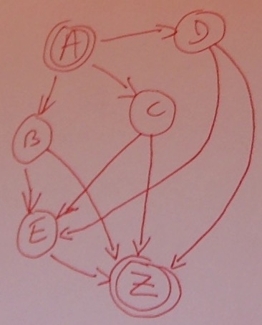
New hint:
another DFS example
Order in which paths from each state are listed:
From A: A->B, A->C, A->D
From B: B->E, B->Z
From C: C->E, C->Z
From D: D->E, D->Z
From E: E->Z
DFS returns?
DFS
Andy
Zoe
10
Andy Bill 4
Andy Claire 3
Andy Daniel 2
Bill Elaine 3
Bill Zoe 1
Claire Elaine 4
Claire Zoe 2
Daniel Elaine 2
Daniel Zoe 2
Elaine Zoe 2
[…]

Slide 16
New hint:
another DFS example
Order in which paths from each state are listed:
From A: A->B, A->C, A->D
From B: B->E, B->Z
From C: C->E, C->Z
From D: D->E, D->Z
From E: E->Z
DFS
Andy
Zoe
10
Andy Bill 4
Andy Claire 3
Andy Daniel 2
Bill Elaine 3
Bill Zoe 1
Claire Elaine 4
Claire Zoe 2
Daniel Elaine 2
Daniel Zoe 2
Elaine Zoe 2
[…]
Node State g Parent
1 A 0 NIL

Slide 17
New hint:
another DFS example
Order in which paths from each state are listed:
From A: A->B, A->C, A->D
From B: B->E, B->Z
From C: C->E, C->Z
From D: D->E, D->Z
From E: E->Z
DFS
Andy
Zoe
10
Andy Bill 4
Andy Claire 3
Andy Daniel 2
Bill Elaine 3
Bill Zoe 1
Claire Elaine 4
Claire Zoe 2
Daniel Elaine 2
Daniel Zoe 2
Elaine Zoe 2
[…]
Node State g Parent
2 B 1 1
3 C 1 1
4 D 1 1
1 A 0 NIL

Slide 18
New hint:
another DFS example
Order in which paths from each state are listed:
From A: A->B, A->C, A->D
From B: B->E, B->Z
From C: C->E, C->Z
From D: D->E, D->Z
From E: E->Z
DFS
Andy
Zoe
10
Andy Bill 4
Andy Claire 3
Andy Daniel 2
Bill Elaine 3
Bill Zoe 1
Claire Elaine 4
Claire Zoe 2
Daniel Elaine 2
Daniel Zoe 2
Elaine Zoe 2
[…]
Node State g Parent
5 E 2 2
6 Z 2 2
2 B 1 1
3 C 1 1
4 D 1 1
1 A 0 NIL

Slide 19
New hint:
another DFS example
Order in which paths from each state are listed:
From A: A->B, A->C, A->D
From B: B->E, B->Z
From C: C->E, C->Z
From D: D->E, D->Z
From E: E->Z
DFS
Andy
Zoe
10
Andy Bill 4
Andy Claire 3
Andy Daniel 2
Bill Elaine 3
Bill Zoe 1
Claire Elaine 4
Claire Zoe 2
Daniel Elaine 2
Daniel Zoe 2
Elaine Zoe 2
[…]
Node State g Parent
5 E 2 2
6 Z 2 2
2 B 1 1
3 C 1 1
4 D 1 1
1 A 0 NIL
Note: here we do not enqueue a node with state Z again since we already have one with lower cost in the open queue (loop detection).

Slide 20
New hint:
another DFS example
Order in which paths from each state are listed:
From A: A->B, A->C, A->D
From B: B->E, B->Z
From C: C->E, C->Z
From D: D->E, D->Z
From E: E->Z
DFS
Andy
Zoe
10
Andy Bill 4
Andy Claire 3
Andy Daniel 2
Bill Elaine 3
Bill Zoe 1
Claire Elaine 4
Claire Zoe 2
Daniel Elaine 2
Daniel Zoe 2
Elaine Zoe 2
[…]
Node State g Parent
5 E 2 2
6 Z 2 2
2 B 1 1
3 C 1 1
4 D 1 1
1 A 0 NIL
Solution:
A 0
B 1
Z 2

Slide 21
Another hint / clarification
From homework 1 text, p. 3:
“Your program should write in output.txt the list of intersections/locations traveled over in your solution path, including the starting and finishing locations and the accumulated time from start to that intersection/location, in order of travel.”
Hint: For DFS, or for A* using a non-admissible heuristic: this may not be the optimal path.

Slide 22
Adding tie-breaking
Function General-Search(problem, Queuing-Fn) returns a solution, or failure
nodes ← make-queue(make-node(initial-state[problem]))
loop do
if nodes is empty then return failure
node ← Remove-Front(nodes)
if Goal-Test[problem] applied to State(node) succeeds then return node
nodes ← Queuing-Fn(nodes, TieBreak(Expand(node, Operators[problem])))
end
TieBreak(nodeset) – homework 1 text says (p. 5):
“If all else is equal while searching routes (ties), you should explore (enqueue) multiple paths from the same intersection in the order in which they are listed in the live traffic inputs. “
This can sometimes be under-specified (see next slide). Add this (with lower priority than the above rule):
“if all else is still equal, newly expanded nodes should be enqueued after (farther in the queue from the queue's front) older ones that were already in the queue.”

Slide 23
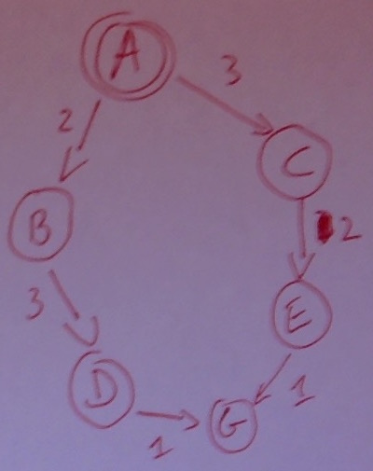
New hint: a UCS example
UCS
A
G
6
A B 2
A C 3
B D 3
C E 2
D G 1
E G 1
[…]
Order in which paths from each state are
Listed:
From A: A->B, A->C, A->D
From B: B->D
From C: C->E
From D: D->G
From E: E->G
UCS returns?

Slide 24
New hint: UCS example
Order in which paths from each state are listed:
From A: A->B, A->C, A->D
From B: B->D
From C: C->E
From D: D->G
From E: E->G
UCS
A
G
6
A B 2
A C 3
B D 3
C E 2
D G 1
E G 1
[…]
Node State g Parent
1 A 0 NIL

Slide 25
New hint: UCS example
Order in which paths from each state are listed:
From A: A->B, A->C, A->D
From B: B->D
From C: C->E
From D: D->G
From E: E->G
UCS
A
G
6
A B 2
A C 3
B D 3
C E 2
D G 1
E G 1
[…]
Node State g Parent
1 A 0 NIL
2 B 2 1
3 C 3 1

Slide 26
New hint: UCS example
Order in which paths from each state are listed:
From A: A->B, A->C, A->D
From B: B->D
From C: C->E
From D: D->G
From E: E->G
UCS
A
G
6
A B 2
A C 3
B D 3
C E 2
D G 1
E G 1
[…]
Node State g Parent
1 A 0 NIL
2 B 2 1
3 C 3 1
4 D 5 2

Slide 27
New hint: UCS example
Order in which paths from each state are listed:
From A: A->B, A->C, A->D
From B: B->D
From C: C->E
From D: D->G
From E: E->G
UCS
A
G
6
A B 2
A C 3
B D 3
C E 2
D G 1
E G 1
[…]
Node State g Parent
1 A 0 NIL
2 B 2 1
3 C 3 1
4 D 5 2
5 E 5 3
“if all else is still equal, newly expanded nodes should be enqueued after (farther in the queue from the queue's front) older ones that were already in the queue.”

Slide 28
New hint: UCS example
Order in which paths from each state are listed:
From A: A->B, A->C, A->D
From B: B->D
From C: C->E
From D: D->G
From E: E->G
UCS
A
G
6
A B 2
A C 3
B D 3
C E 2
D G 1
E G 1
[…]
Node State g Parent
1 A 0 NIL
2 B 2 1
3 C 3 1
4 D 5 2
5 E 5 3
6 G 6 4

Slide 29
New hint: UCS example
Order in which paths from each state are listed:
From A: A->B, A->C, A->D
From B: B->D
From C: C->E
From D: D->G
From E: E->G
UCS
A
G
6
A B 2
A C 3
B D 3
C E 2
D G 1
E G 1
[…]
Node State g Parent
1 A 0 NIL
2 B 2 1
3 C 3 1
4 D 5 2
5 E 5 3
6 G 6 4
Note: here we do not enqueue a node with state G again since we already have one with same cost 6 in the open queue (loop detection).

Slide 30
New hint: UCS example
Order in which paths from each state are listed:
From A: A->B, A->C, A->D
From B: B->D
From C: C->E
From D: D->G
From E: E->G
UCS
A
G
6
A B 2
A C 3
B D 3
C E 2
D G 1
E G 1
[…]
Node State g Parent
1 A 0 NIL
2 B 2 1
3 C 3 1
4 D 5 2
5 E 5 3
6 G 6 4
Solution:
A 0
B 2
D 5
G 6

