Slide 1
Chapter 2: Probability

Slide 2
2.1 Sample Space
chance outcomes
categorical data
Observation
experiment

Slide 3
2.2 Events

Slide 4
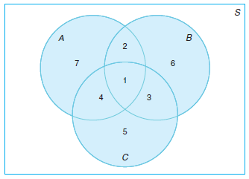
S
A
t
t = 0
t = 5
S
x
8
A
Sample space S,
element x, y, z
event A
z
B
y

Slide 5
Exercises

Slide 6
2.3 Counting Sample Points

Slide 7
Exercises

Slide 8
2.4 Probability of an Event

Slide 9
2.5 Additive Rules

Slide 10
Exercises

Slide 11
2.6 Conditional Probability, Independence, and the Product Rule

Slide 12
Exercises

Slide 13
2.7 Bayes’ Rule

Slide 14
Exercises

Slide 15
Review Exercises

