Slide 1
DSP First, 2/e
Lecture 6
Periodic Signals, Harmonics & Time-Varying Sinusoids

Slide 2
License Info for SPFirst Slides
This work released under a Creative Commons License with the following terms:
Attribution
The licensor permits others to copy, distribute, display, and perform the work. In return, licensees must give the original authors credit.
Non-Commercial
The licensor permits others to copy, distribute, display, and perform the work. In return, licensees may not use the work for commercial purposes—unless they get the licensor's permission.
Share Alike
The licensor permits others to distribute derivative works only under a license identical to the one that governs the licensor's work.
Full Text of the License
This (hidden) page should be kept with the presentation

Slide 3
READING ASSIGNMENTS
This Lecture:
Chapter 3, Sections 3-2 and 3-4
Chapter 3, Sections 3-6 and 3-7
Next Lectures:
Fourier Series ANALYSIS
Sections 3-4 and 3-5

Slide 4
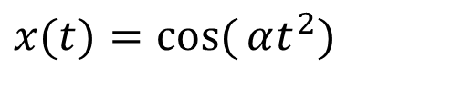
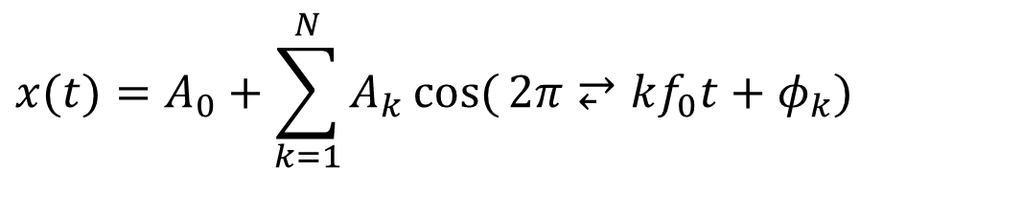
LECTURE OBJECTIVES
Signals with HARMONIC Frequencies
Add Sinusoids with f_{k} = kf₀
$$x(t)=A_{0}+\sum_{k=1}^{N}{A_{k}\cos{(}2π⥂kf_{0}t+φ_{k})}$$
Second Topic: FREQUENCY can change vs. TIME
Introduce Spectrogram Visualization
(spectrogram.m) (plotspec.m)
Chirps:
$$x(t)=\cos{(}αt^{2})$$

Slide 5
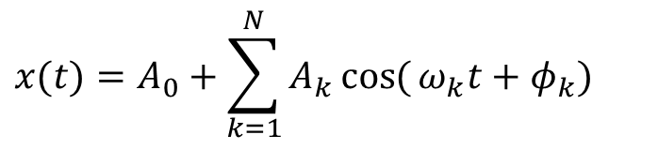
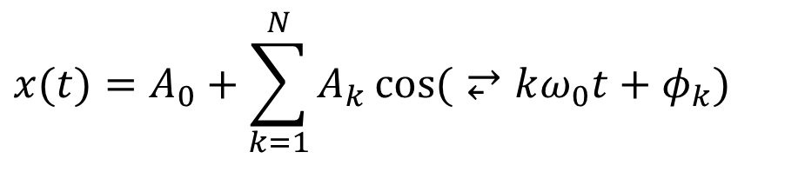
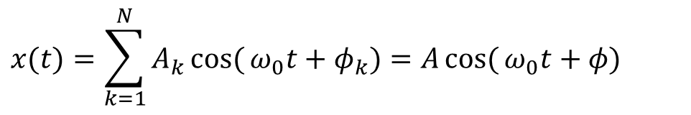
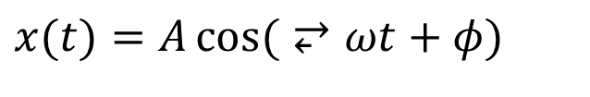
Signals Studied So Far
$$x(t)=A\cos{(}⥂ωt+φ)$$
Sinusoids
Sum of sinusoids of same frequency
General form: (finite) sum of sinusoids
Periodic signals
$$x(t)=\sum_{k=1}^{N}{A_{k}\cos{(}ω_{0}t+φ_{k})}=A\cos{(}ω_{0}t+φ)$$
$$x(t)=A_{0}+\sum_{k=1}^{N}{A_{k}\cos{(}ω_{k}t+φ_{k})}$$
In this lecture
$$x(t)=A_{0}+\sum_{k=1}^{N}{A_{k}\cos{(}⥂kω_{0}t+φ_{k})}$$

Slide 6








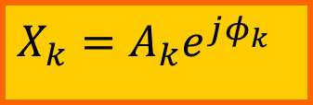
SPECTRUM DIAGRAM
Recall Complex Amplitude vs. Freq
$$\frac{1}{2}X_{k}^{∗}$$
$$10$$
$$\frac{1}{2}X_{k}=a_{k}$$
$$7e^{jπ/3}$$
$$7e^{−jπ/3}$$
$$4e^{−jπ/2}$$
$$4e^{jπ/2}$$
$$X_{k}=A_{k}e^{jφ_{k}}$$
–250
–100
0
100
250
f (in Hz)
$$x(t)=10+14\cos{(}2π(100)t−π/3) \\ +8\cos{(}2π(250)t+π/2)$$

Slide 7
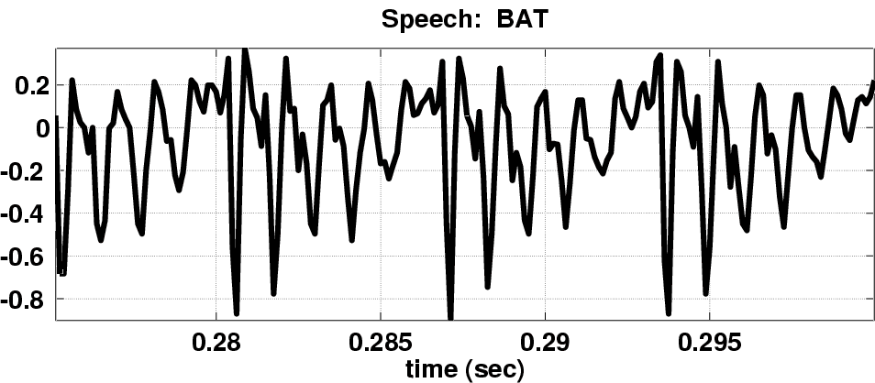
SPECTRUM for PERIODIC ?
Nearly Periodic in the Vowel Region
Period is (Approximately) T = 0.0065 sec

Slide 8

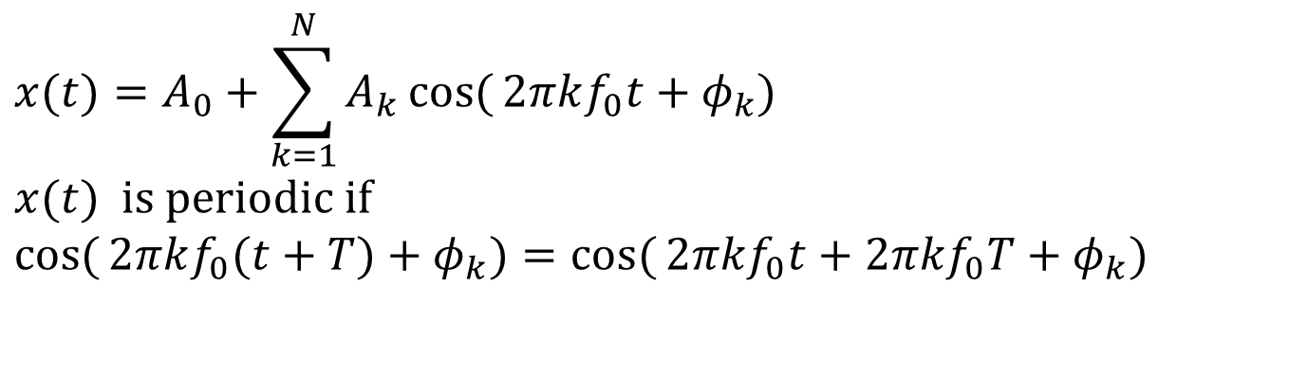
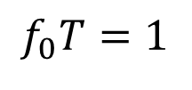
Harmonic Signal
$$\text{Periodic} \text{signal}\text{: }x(t)=x(t+T) \\ \text{Can} \text{only} \text{have} harmonic \text{freqs}:f_{k}=k​f_{0}$$
$$x(t)=A_{0}+\sum_{k=1}^{N}{A_{k}\cos{(}2π​kf_{0}t+φ_{k})} \\ x(t) \text{is} \text{periodic} \text{if} \\ \cos{(}2π​kf_{0}(t+T)+φ_{k})=\cos{(}2π​kf_{0}t+2π​kf_{0}T+φ_{k})$$
$$f_{0}T=1$$

Slide 9
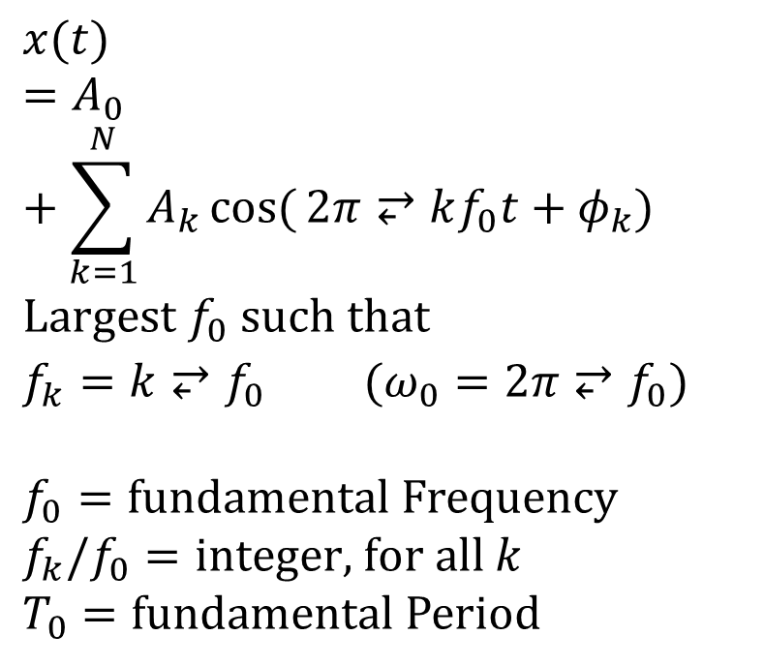
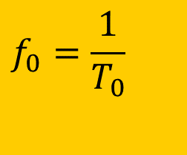
Define FUNDAMENTAL FREQ
$$x(t)=A_{0}+\sum_{k=1}^{N}{A_{k}\cos{(}2π⥂kf_{0}t+φ_{k})} \\ \text{Largest} f_{0} \text{such} \text{that} \\ f_{k}=k⥂f_{0} (ω_{0}=2π⥂f_{0})$$ $$f_{0}=\text{fundamental} \text{Frequency} \\ f_{k}/f_{0}=\text{integer}\text{, }\text{for} \text{all} k \\ T_{0}=\text{fundamental} \text{Period}$$
$$f_{0}=\frac{1}{T_{0}}$$
Main point:
for periodic signals, all spectral lines have frequencies that are integer multiples of the fundamental frequency

Slide 10


Harmonic Signal Spectrum
$$Harmonic \text{freqs}:f_{k}=k​f_{0}$$
$$f_{0}=\frac{1}{T}$$

Slide 11
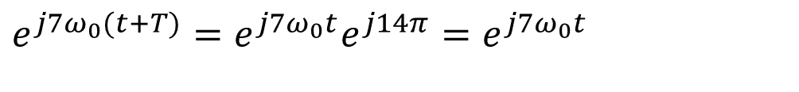
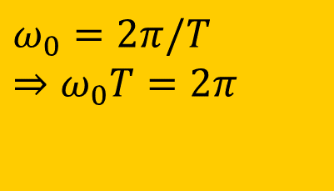
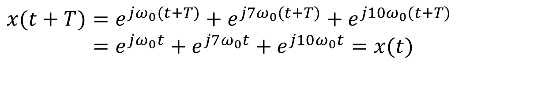
Periodic Signal: Example
$$ω_{0}=2π/T \\ ⇒ω_{0}T=2π$$
Fundamental frequency
$$e^{jω_{0}(t+T)}=e^{jω_{0}t}e^{jω_{0}T}=e^{jω_{0}t}e^{j2π}=e^{jω_{0}t}$$
$$e^{j7ω_{0}(t+T)}=e^{j7ω_{0}t}e^{j14π}=e^{j7ω_{0}t}$$
$$x(t+T)=e^{jω_{0}(t+T)}+e^{j7ω_{0}(t+T)}+e^{j10ω_{0}(t+T)} \\ =e^{jω_{0}t}+e^{j7ω_{0}t}+e^{j10ω_{0}t}=x(t)$$

Slide 12
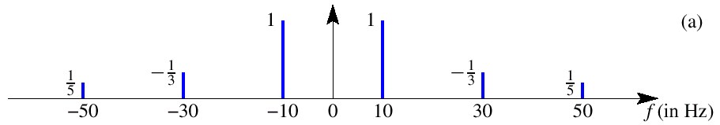
Harmonic Spectrum (3 Freqs)
3rd
5th
What is the fundamental frequency?
10 Hz

Slide 13





POP QUIZ: FUNDAMENTAL
Here’s another spectrum:
$$10$$
$$7e^{jπ/3}$$
$$7e^{−jπ/3}$$
$$4e^{−jπ/2}$$
$$4e^{jπ/2}$$
–24
–10.4
0
10.4
24
f (in Hz)
What is the fundamental frequency?
(0.1)GCD(104,240) = (0.1)(8)=0.8 Hz

Slide 14
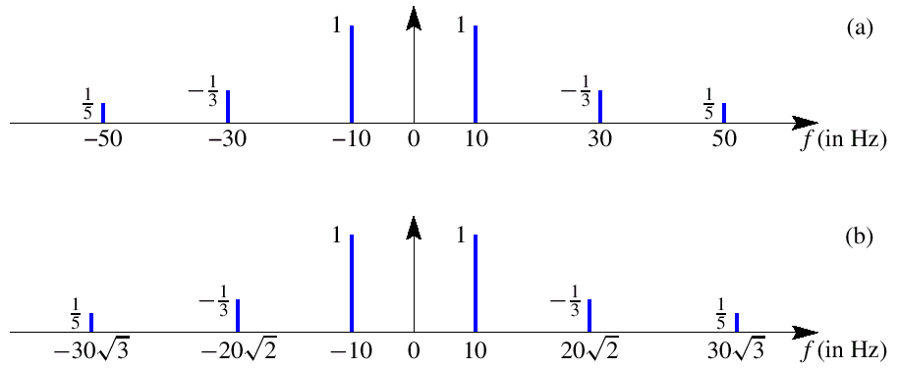
IRRATIONAL SPECTRUM
SPECIAL RELATIONSHIP
to get a PERIODIC SIGNAL
NON-PERIODIC SIGNAL

Slide 15
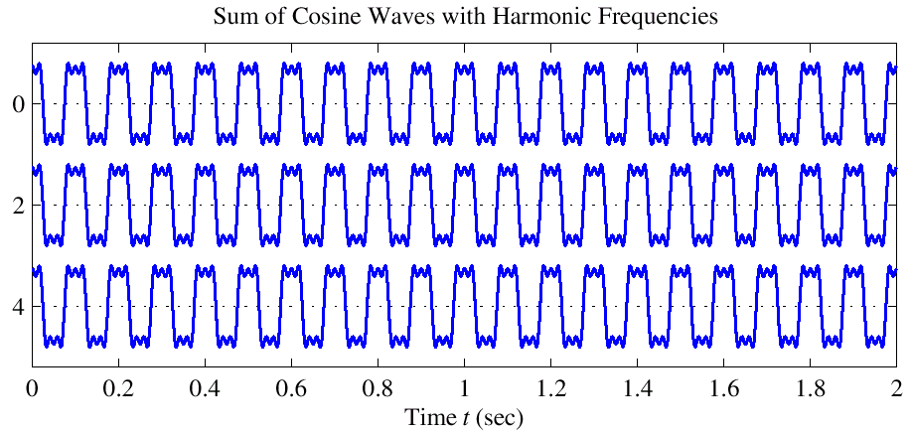
Harmonic Signal (3 Freqs)
T=0.1
PERIODIC

Slide 16
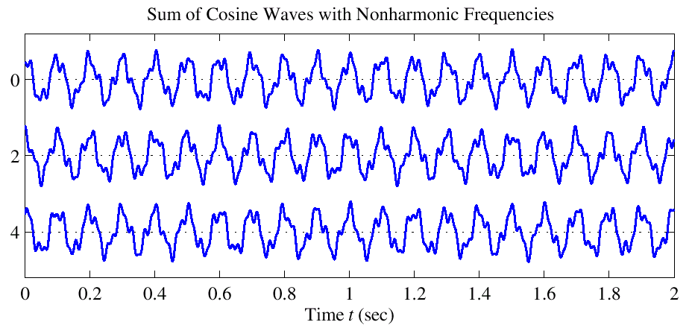
NON-Harmonic Signal
NOT
PERIODIC

Slide 17
FREQUENCY ANALYSIS
Now, a much HARDER problem
Given a recording of a song, have the computer write the music
Can a machine extract frequencies?
Yes, if we COMPUTE the spectrum for x(t)
During short intervals

Slide 18
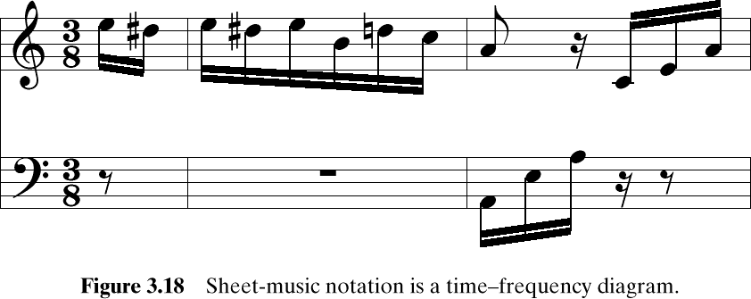
Time-Varying FREQUENCIES Diagram
A-440
Frequency is the vertical axis
Time is the horizontal axis

Slide 19
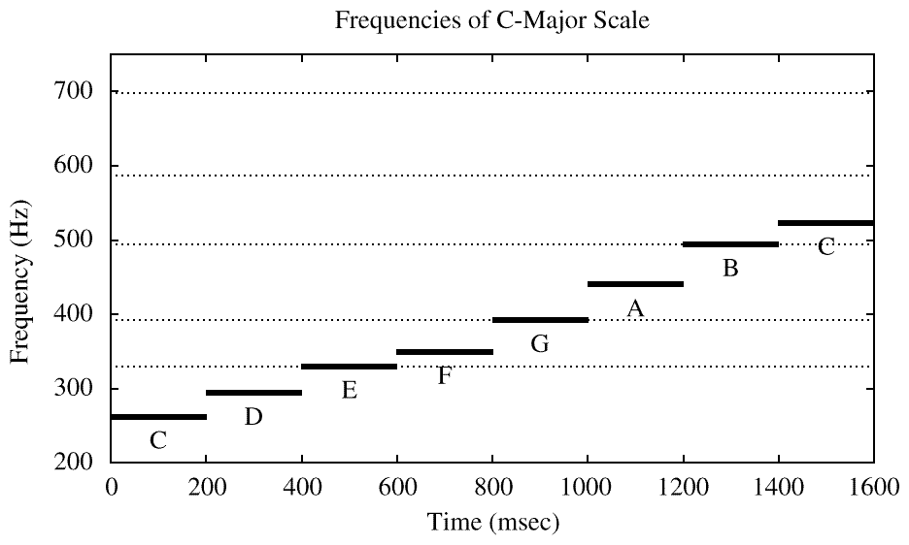
SIMPLE TEST SIGNAL
C-major SCALE: stepped frequencies
Frequency is constant for each note
IDEAL

Slide 20
SPECTROGRAM
SPECTROGRAM Tool
MATLAB function is spectrogram.m
SP-First has plotspec.m & spectgr.m
ANALYSIS program
Takes x(t) as input
Produces spectrum values X_{k}
Breaks x(t) into SHORT TIME SEGMENTS
Then uses the FFT (Fast Fourier Transform)

Slide 21
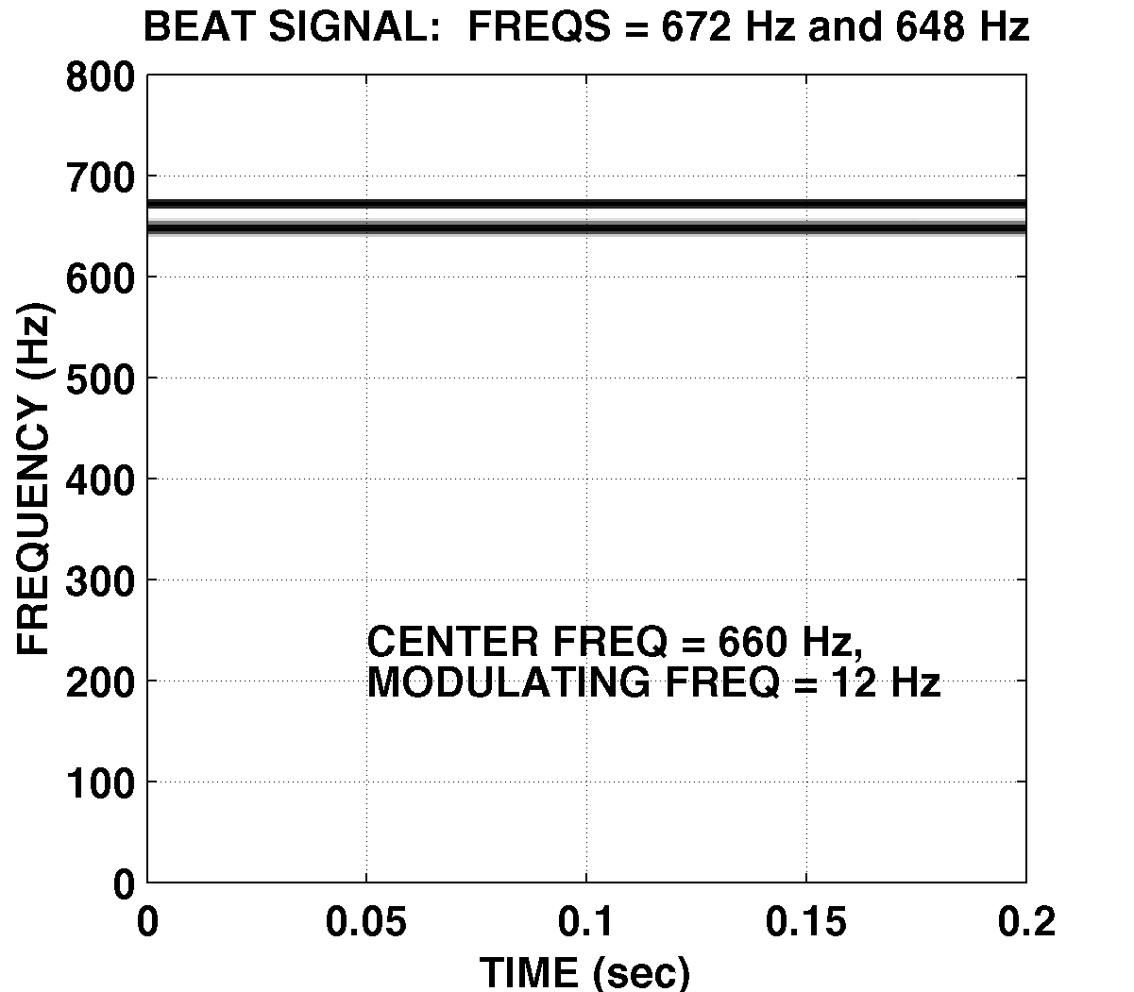
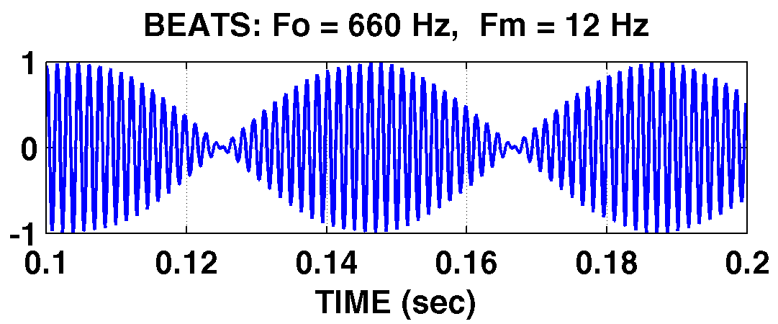
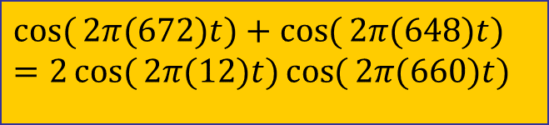
SPECTROGRAM EXAMPLE
Two Constant Frequencies: Beats
$$\cos{(}2π(672)t)+\cos{(}2π(648)t) \\ =2\cos{(}2π(12)t)\cos{(}2π(660)t)$$

Slide 22



AM Radio Signal
Same form as BEAT Notes, but higher in freq
$$\cos{(}2π(660)t)\sin{(}2π(12)t)$$
$$\frac{1}{2}\left(e^{j2π(660)t}+e^{−j2π(660)t}\right)\frac{1}{2j}\left(e^{j2π(12)t}−e^{−j2π(12)t}\right)$$
$$\frac{1}{4j}\left(e^{j2π(672)t}−e^{−j2π(672)t}−e^{j2π(648)t}+e^{−j2π(648)t}\right)$$
$$\frac{1}{2}\cos{(}2π(672)t−\frac{π}{2})+\frac{1}{2}\cos{(}2π(648)t+\frac{π}{2})$$

Slide 23


SPECTRUM of AM (Amplitude Modulation)
SUM of 4 complex exponentials:
$$\frac{1}{4}e^{jπ/2}$$
$$\frac{1}{4}e^{−jπ/2}$$
$$\frac{1}{4}e^{jπ/2}$$
$$\frac{1}{4}e^{−jπ/2}$$
–672
–648
0
648
672
f (in Hz)
What is the fundamental frequency?
648 Hz ?
24 Hz ?

Slide 24
STEPPED FREQUENCIES
C-major SCALE: successive sinusoids
Frequency is constant for each note
IDEAL

Slide 25
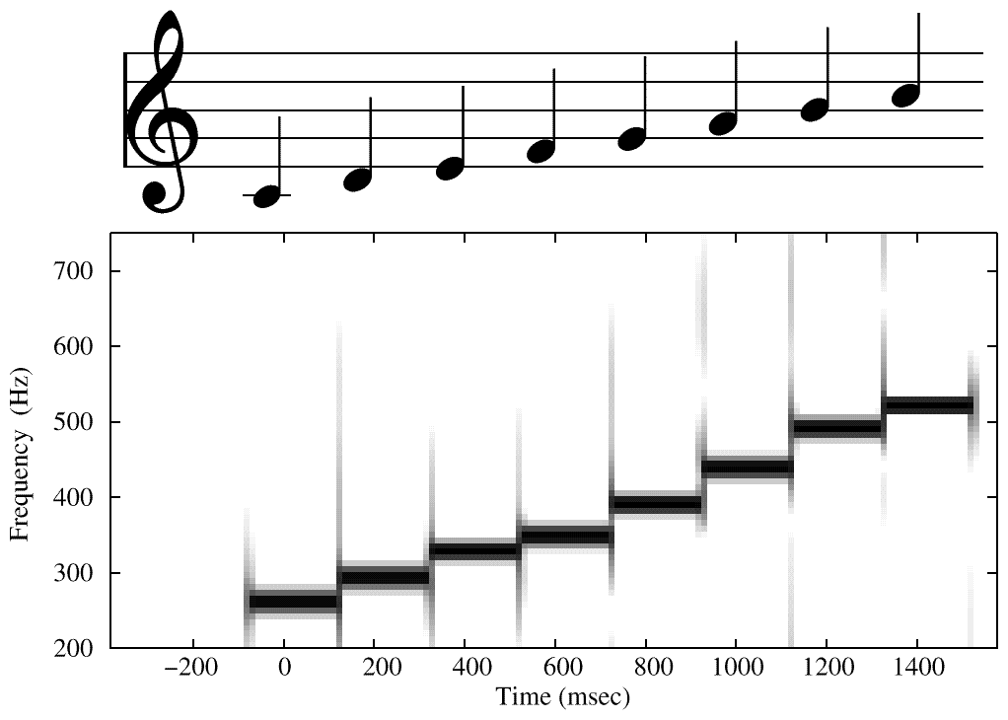
SPECTROGRAM of C-Scale
Sinusoids ONLY
From SPECTROGRAM
ANALYSIS PROGRAM
ARTIFACTS at Transitions

Slide 26
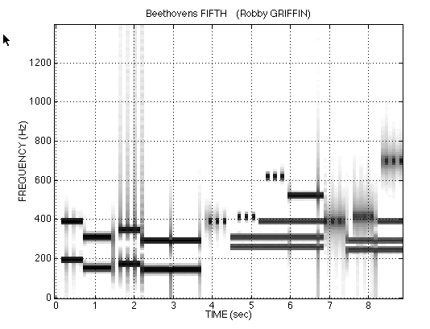
Spectrogram of LAB SONG
Sinusoids ONLY
Analysis Frame = 40ms
ARTIFACTS at Transitions

Slide 27
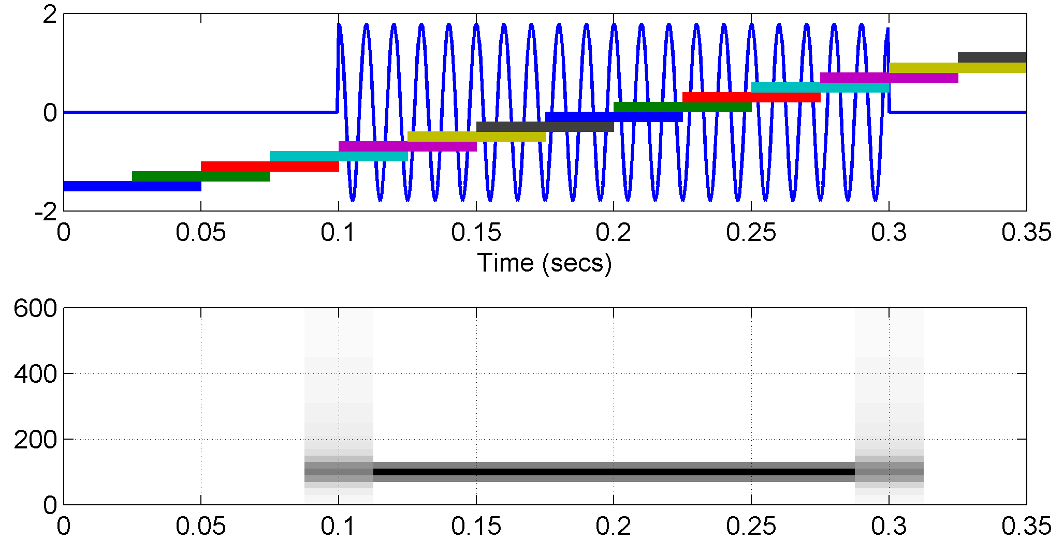
Overlapping Sections in Spectrograms (useful in Labs)
50% overlap is common
Consider edge effects when analyzing a short sinusoid
SECTION
LOCATIONS
MIDDLE of SECTION
is REFERENCE TIME

Slide 28
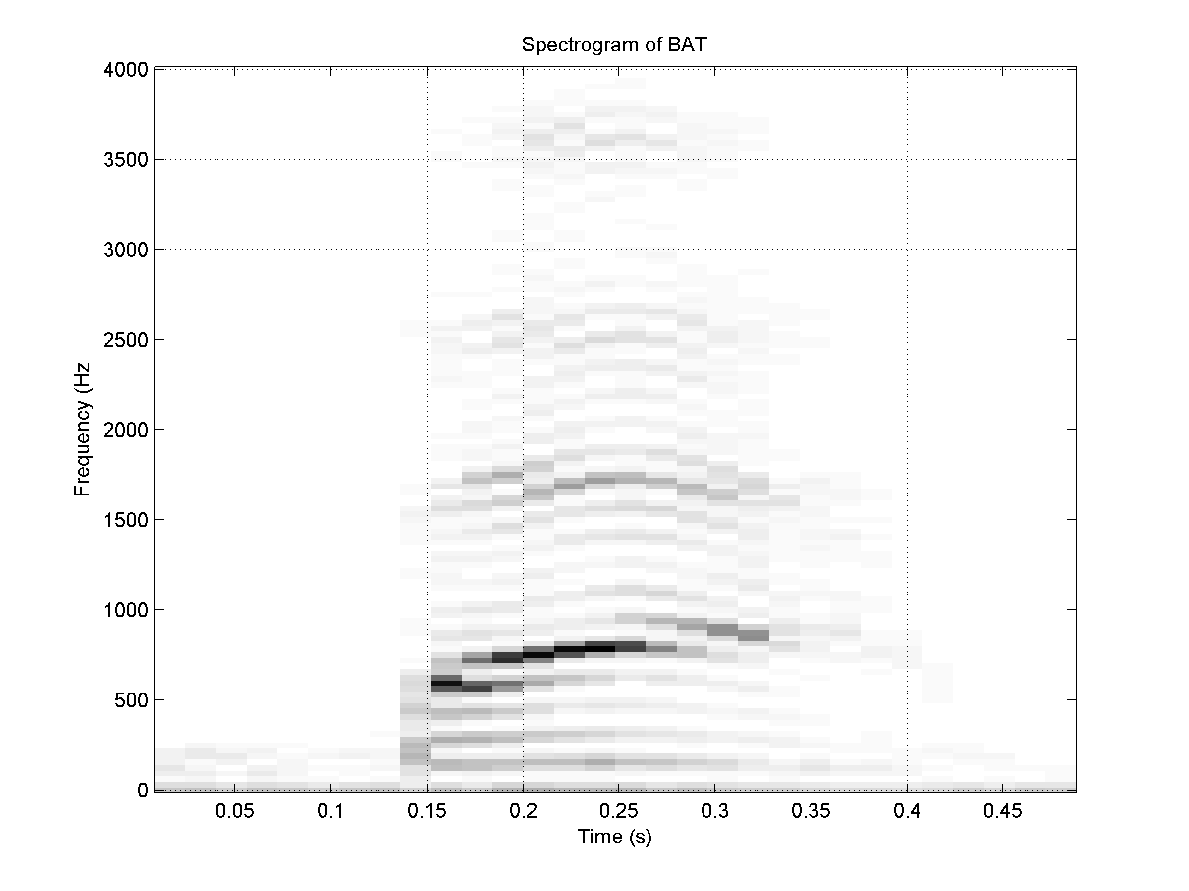
Spectrogram of BAT (plotspec)

Slide 29

Time-Varying Frequency
Frequency can change vs. time
Continuously, not stepped
FREQUENCY MODULATION (FM)
CHIRP SIGNALS
Linear Frequency Modulation (LFM)
$$x(t)=\cos{(}2π⥂f_{c}t+v(t))$$
VOICE

Slide 30

New Signal: Linear FM
Called Chirp Signals (LFM)
Quadratic phase
Freq will change LINEARLY vs. time
Example of Frequency Modulation (FM)
Define “instantaneous frequency”
QUADRATIC
$$x(t)=A\cos{(}αt^{2}+2π⥂f_{0}t+φ)$$

Slide 31


INSTANTANEOUS FREQ
Definition
For Sinusoid:
$$x(t)=A\cos{(}ψ(t)) \\ ⇒ω_{i}(t)=\frac{d}{dt}ψ(t)$$
Derivative
of the “Angle”
$$x(t)=A\cos{(}2π⥂f_{0}t+φ) \\ ψ(t)=2π⥂f_{0}t+φ \\ ⇒ω_{i}(t)=\frac{d}{dt}ψ(t)=2π⥂f_{0}$$
Makes sense

Slide 32

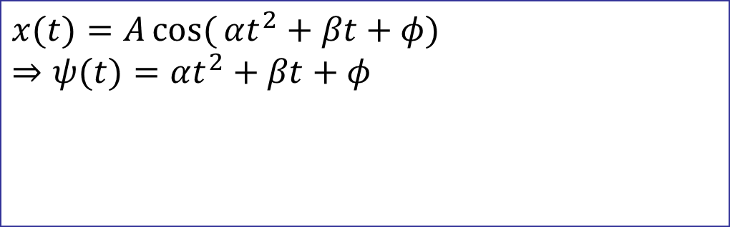
INSTANTANEOUS FREQ of the Chirp
Chirp Signals have Quadratic phase
Freq will change LINEARLY vs. time
$$x(t)=A\cos{(}αt^{2}+βt+φ) \\ ⇒ψ(t)=αt^{2}+βt+φ$$
$$⇒ω_{i}(t)=\frac{d}{dt}ψ(t)=2αt+β⥂$$

Slide 33
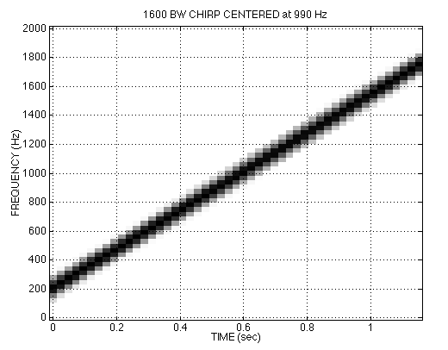
CHIRP SPECTROGRAM

Slide 34
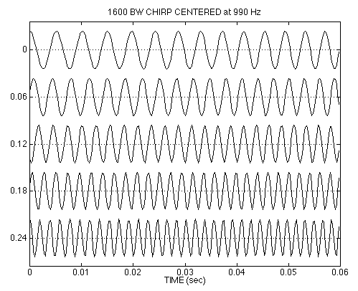
CHIRP WAVEFORM

Slide 35
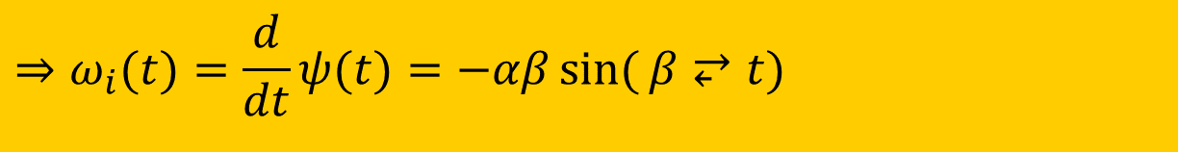

OTHER CHIRPS
ψ(t) can be anything:
ψ(t) could be speech or music:
FM radio broadcast
$$x(t)=A\cos{(}α\cos{(}β⥂t)+φ)$$
$$⇒ω_{i}(t)=\frac{d}{dt}ψ(t)=−αβ\sin{(}β⥂t)$$

Slide 36
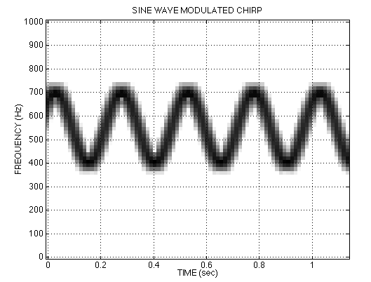
SINE-WAVE FREQUENCY MODULATION (FM)
Look at CD-ROM Demos in Ch 3

Slide 37
Problem Solving Skills
Math Formula
Sum of Cosines
Amp, Freq, Phase
Recorded Signals
Speech
Music
No simple formula
Plot & Sketches
S(t) versus t
Spectrum
MATLAB
Numerical
Computation
Plotting list of numbers

