Slide 1
DSP First, 2/e
LECTURE #2
Phase & Time-Shift
Delay & Attenuation

Slide 2
License Info for DSPFirst Slides
This work released under a Creative Commons License with the following terms:
Attribution
The licensor permits others to copy, distribute, display, and perform the work. In return, licensees must give the original authors credit.
Non-Commercial
The licensor permits others to copy, distribute, display, and perform the work. In return, licensees may not use the work for commercial purposes—unless they get the licensor's permission.
Share Alike
The licensor permits others to distribute derivative works only under a license identical to the one that governs the licensor's work.
Full Text of the License
This (hidden) page should be kept with the presentation

Slide 3
READING ASSIGNMENTS
This Lecture:
Chapter 2, Sects. 2-3 to 2-5
Appendix A: Complex Numbers
Appendix B: MATLAB
Next Lecture: Complex Exponentials

Slide 4
LECTURE OBJECTIVES
Derive Sinusoid Formula from a plot
Relate TIME-SHIFT to PHASE
Signal ENVELOPE defined
ATTENUATION of Decaying Sinusoid

Slide 5
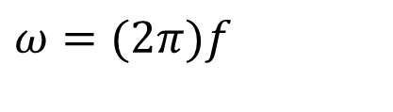

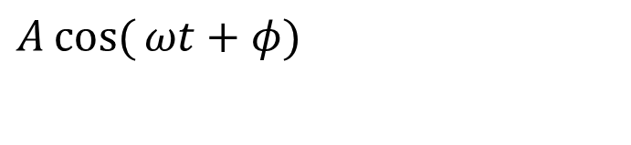



SINUSOIDAL SIGNAL
$$A\cos{(}ωt+φ)$$
FREQUENCY
Radians/sec
or, Hertz (cycles/sec)
PERIOD (in sec)
$$ω$$
$$A$$
AMPLITUDE
Magnitude
PHASE
$$ω=(2π)f$$
$$φ$$
$$T=\frac{1}{f}=\frac{2π}{ω}$$

Slide 6

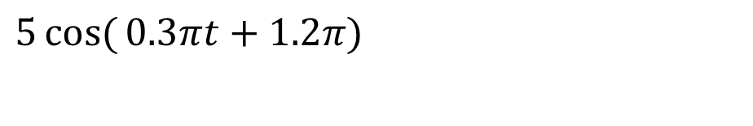

PLOTTING COSINE SIGNAL from the FORMULA
$$5\cos{(}0.3πt+1.2π)$$
Determine period:
Determine a peak location by solving
Peak at t=-4
$$T=2π/ω=2π/0.3π=20/3$$
$$(ωt+φ)=0 \\ 0.3πt+1.2π=0$$

Slide 7
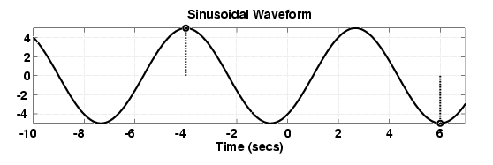
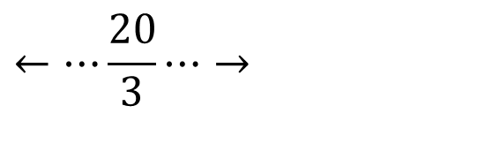
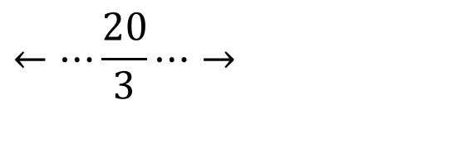

ANSWER for the PLOT
Use T=20/3 and the peak location at t = -4
$$5\cos{(}0.3πt+1.2π)$$
$$←⋯\frac{20}{3}⋯→$$
$$←⋯\frac{20}{3}⋯→$$

Slide 8
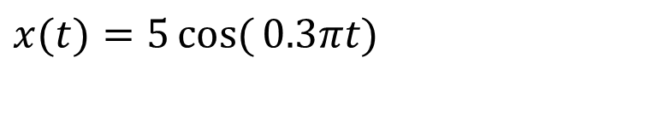
TIME-SHIFTED SINUSOID
$$x(t)=5\cos{(}0.3πt)$$
One peak at t = 0
$$x(t+4)=5\cos{(}0.3π(t+4))=5\cos{(}0.3π(t−(−4))$$
Peak shifts from t=0 to t = -4

Slide 9
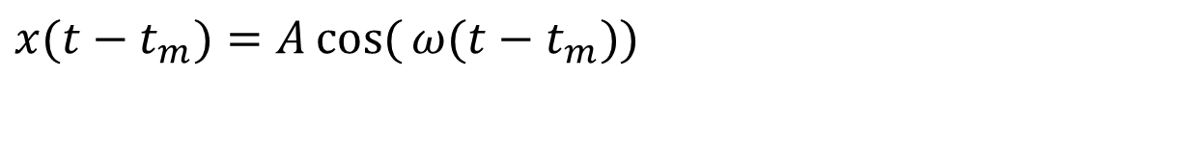
TIME-SHIFT
In a mathematical formula we can replace t with t-t_{m}
Thus the t=0 point moves to t=t_{m}
Peak value of cos(ω(t-t_{m})) is now at t=t_{m}
$$x(t−t_{m})=A\cos{(}ω(t−t_{m}))$$

Slide 10
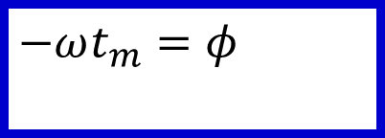
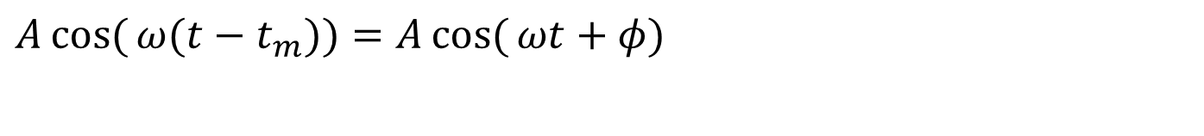

PHASE ←→ TIME-SHIFT
Equate the formulas:
and we obtain:
or,
$$A\cos{(}ω(t−t_{m}))=A\cos{(}ωt+φ)$$
$$−ωt_{m}=φ$$
$$t_{m}=−\frac{φ}{ω}$$

Slide 11
SINUSOID from a PLOT
Measure the period, T
Between peaks or zero crossings
Compute frequency: ω = 2π/T
Measure time of a peak: t_{m}
Compute phase: φ = -ω t_{m}
Measure height of positive peak: A
3 steps

Slide 12
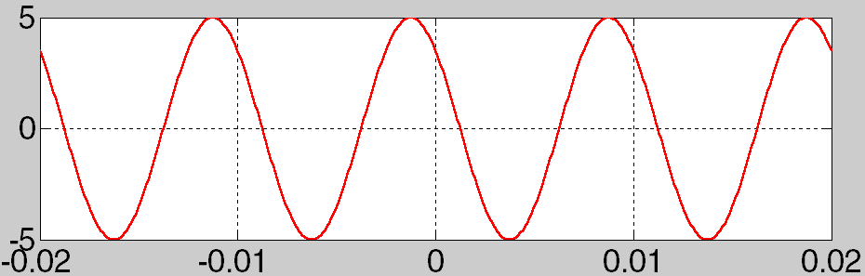
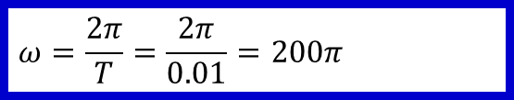


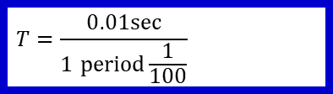
(A, ω, φ) from a PLOT
$$T=\frac{0.01sec}{1 \text{period}\frac{1}{100}}$$
$$ω=\frac{2π}{T}=\frac{2π}{0.01}=200π$$
$$t_{m}=−0.00125sec$$
$$φ=−ωt_{m}=−(200π)(t_{m})=0.25π$$

Slide 13
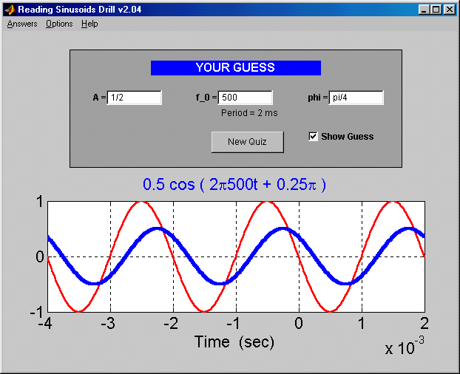
SINE DRILL (MATLAB GUI)

Slide 14
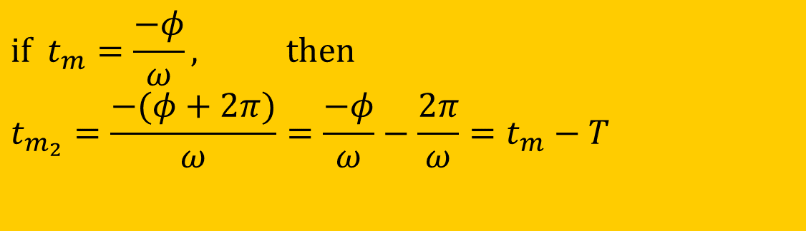
PHASE is AMBIGUOUS
The cosine signal is periodic
Period is 2π
Thus adding any multiple of 2π leaves x(t) unchanged
$$A\cos{(}ωt+φ+2π)=A\cos{(}ωt+φ)$$
$$\text{if} t_{m}=\frac{−φ}{ω}, \text{then} \\ t_{m_{2}}=\frac{−(φ+2π)}{ω}=\frac{−φ}{ω}−\frac{2π}{ω}=t_{m}−T$$

Slide 15
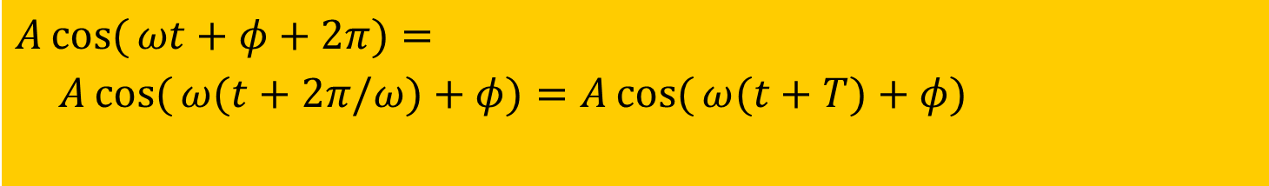
PHASE is AMBIGUOUS
The cosine signal is periodic
Period is 2π
Thus adding any multiple of 2π to the phase leaves x(t) unchanged
Equivalent to time-shifting by one period:
$$A\cos{(}ωt+φ+2π)=A\cos{(}ωt+φ)$$
$$A\cos{(}ωt+φ+2π)= \\ A\cos{(}ω(t+2π/ω)+φ)=A\cos{(}ω(t+T)+φ)$$

Slide 16

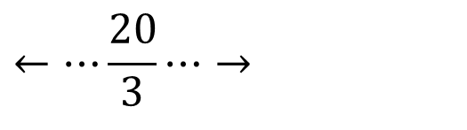

PLOT the SINUSOID
$$5\cos{(}0.3πt+1.2π)$$
=
$$5\cos{(}0.3πt−0.8π)$$
The peak location at t = 8/3 = 2.666
$$←⋯\frac{20}{3}⋯→$$

Slide 17

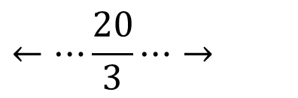



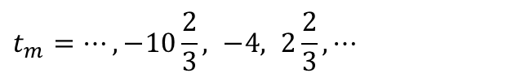
Peak Locations of a Sinusoid Function
$$\cos{(}θ)$$
attains max value at
$$θ=2nπ, n=0,±1,±2,±3,...$$
$$0.3πt+1.2π=2nπ$$
$$5\cos{(}0.3πt+1.2π)$$
$$t_{m}=⋯,−10\frac{2}{3}, −4, 2\frac{2}{3},⋯$$
$$←⋯\frac{20}{3}⋯→$$
Many peaks;
One will be closest to the origin

Slide 18


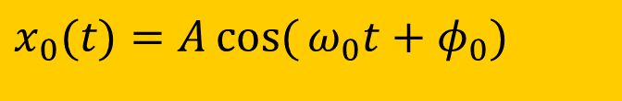


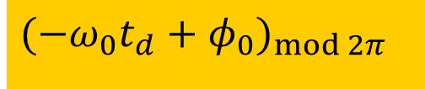
Time Shift and Time Delay
$$d$$
At the origin/source:
$$t_{d}$$
$$x_{0}(t)=A\cos{(}ω_{0}t+φ_{0})$$
The distance between origin/source and destination is d; it takes t_{d} for the wave to travel to the destination:
At the destination:
assuming no attenuation
$$x_{d}(t)=A\cos{(}ω_{0}(t−t_{d})+φ_{0})=A\cos{(}ω_{0}t−ω_{0}t_{d}+φ_{0})$$
Phase at the destination:
$$(−ω_{0}t_{d}+φ_{0})_{\operatorname{mod}{2}π}$$

Slide 19
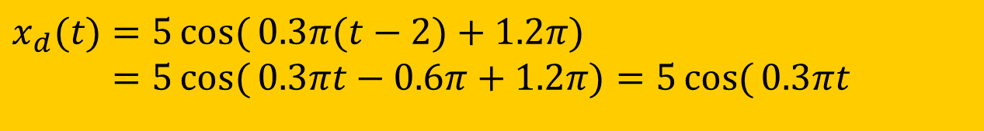

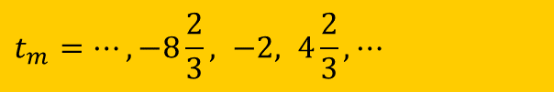
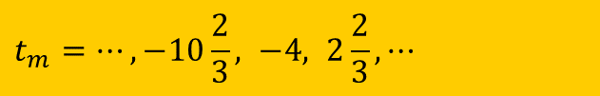
Example
$$x_{o}(t)=5\cos{(}0.3πt+1.2π)$$
Peaks occur at
$$t_{m}=⋯,−10\frac{2}{3}, −4, 2\frac{2}{3},⋯$$
Suppose this is a tonal sound that travels at 1000 ft/s.
And suppose the distance is 2000 ft, which means a time delay of 2s. Then,
$$x_{d}(t)=5\cos{(}0.3π(t−2)+1.2π) \\ =5\cos{(}0.3πt−0.6π+1.2π)=5\cos{(}0.3πt+0.6π)$$
The wave at the destination will have peaks at
$$t_{m}=⋯,−8\frac{2}{3}, −2, 4\frac{2}{3},⋯$$

Slide 20
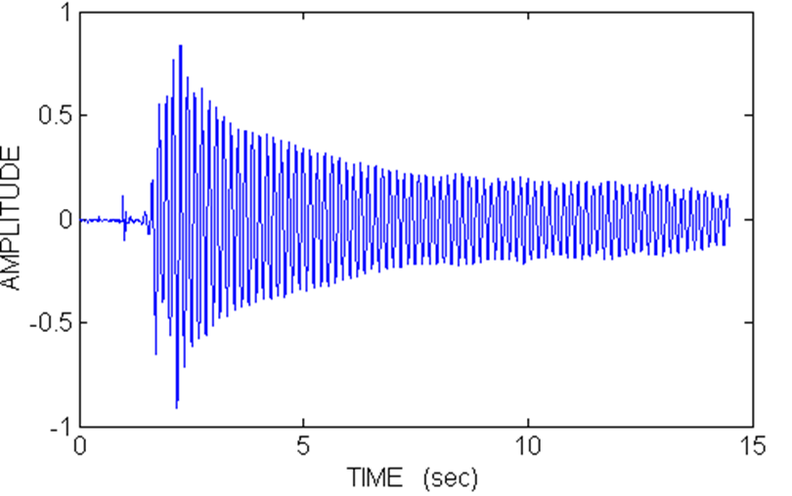


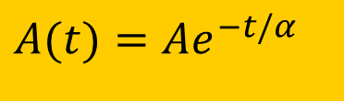

Attenuation
In real waves, there will always be a certain degree of attenuation, which is the reduction of the signal amplitude over time and/or over distance.
$$x(t)=A\cos{(}ωt+φ)$$
In a sinusoid, A is a constant.
However, the amplitude can have exponential decay, e.g.,
$$A(t)≈e^{−(t−2)/2}$$
$$A(t)=Ae^{−t/α}$$
$$x(t)=Ae^{−t/α}\cos{(}ωt+φ)$$

Slide 21

MATLAB Example (I)
Generating sinusoids in MATLAB is easy:
% define how many values in a second
fs = 8000;
% define array tt for time
% time runs from -1s to +3.2s
% sampled at an interval of 1/fs
tt = -1 : 1/fs : 3.2;
xx = 2.1 * cos(2*pi*440*tt + 0.4*pi);
The array xx then contains a “sampled” signal of:
$$x(t)=2.1\cos{(}880πt+0.4π)$$

Slide 22

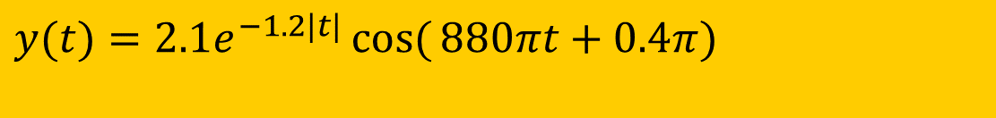
MATLAB Example (II)
Introducing attenuation with time
% fs defines how many values per second
fs = 8000;
tt = -1 : 1/fs : 3.2;
yy = exp(-abs(tt)*1.2);% exponential decay
yy = xx.*yy;
soundsc(yy,fs)
Array yy contains a signal with changing amplitude:
$$y(t)=2.1e^{−1.2|t|}\cos{(}880πt+0.4π)$$
Soundsc lets you hear the signal yy

Slide 23
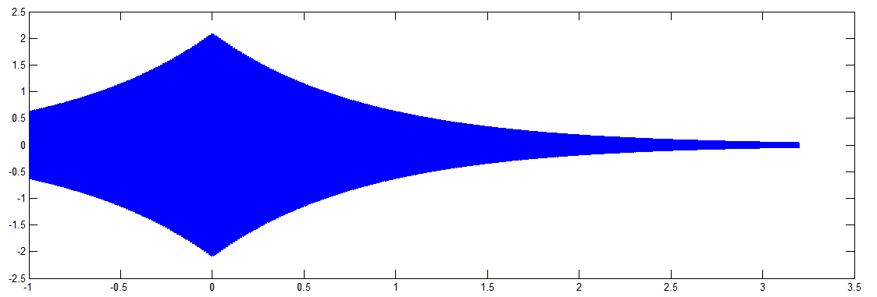
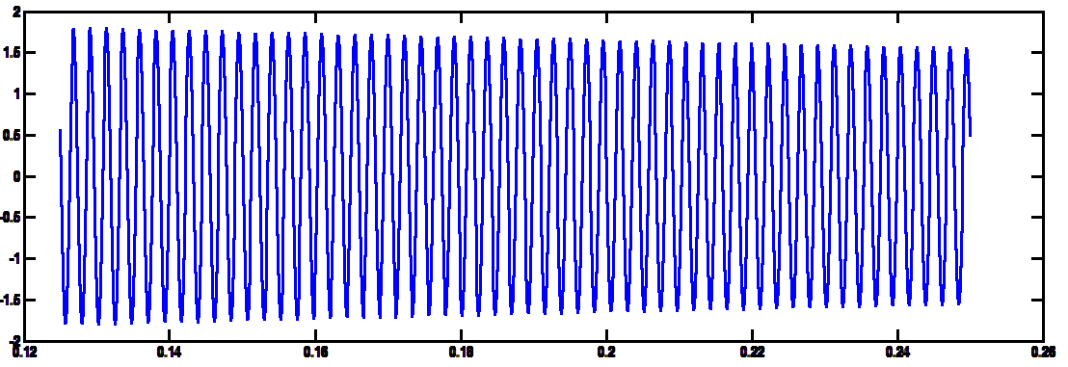
Plotting the Signal
Waveform “envelope”
a short slice

