Slide 1
DSP-First, 2/e
LECTURE #3
Complex Exponentials
& Complex Numbers

Slide 2
License Info for SPFirst Slides
This work released under a Creative Commons License with the following terms:
Attribution
The licensor permits others to copy, distribute, display, and perform the work. In return, licensees must give the original authors credit.
Non-Commerical
The licensor permits others to copy, distribute, display, and perform the work. In return, licensees may not use the work for commercial purposes—unless they get the licensor's permission.
Share Alike
The licensor permits others to distribute derivative works only under a license identical to the one that governs the licensor's work.
Full Text of the License
This (hidden) page should be kept with the presentation

Slide 3
READING ASSIGNMENTS
This Lecture:
Chapter 2, Sects. 2-3 to 2-5
Appendix A: Complex Numbers
Appendix B: MATLAB
Next Lecture: Complex Exponentials

Slide 4
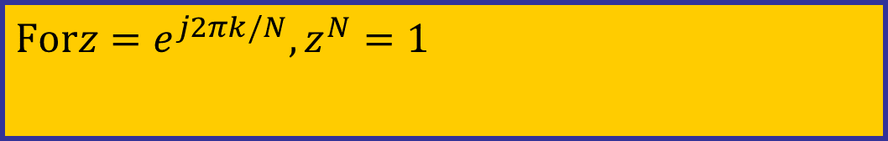
LECTURE OBJECTIVES
Introduce more tools for manipulating complex numbers
Conjugate
Multiplication & Division
Powers
N-th Roots of unity
$$\text{For}z=e^{j2πk/N},z^{N}=1$$

Slide 5
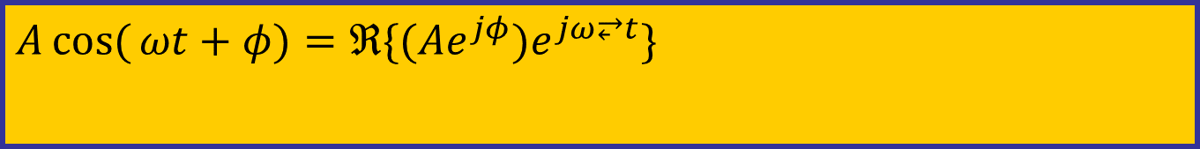
LECTURE OBJECTIVES
Phasors = Complex Amplitude
Complex Numbers represent Sinusoids
$$A\cos{(}ωt+φ)=ℜ\{(Ae^{jφ})e^{jω⥂t}\}$$
Next Lecture: Develop the ABSTRACTION:
Adding Sinusoids = Complex Addition
PHASOR ADDITION THEOREM

Slide 6
WHY? What do we gain?
Sinusoids are the basis of DSP,
but trig identities are very tedious
Abstraction of complex numbers
Represent cosine functions
Can replace most trigonometry with algebra
Avoid all Trigonometric manipulations

Slide 7
COMPLEX NUMBERS
To solve: z² = -1
z = j
Math and Physics use z = i
Complex number: z = x + j y
y
z
Cartesian
coordinate
system
x

Slide 8
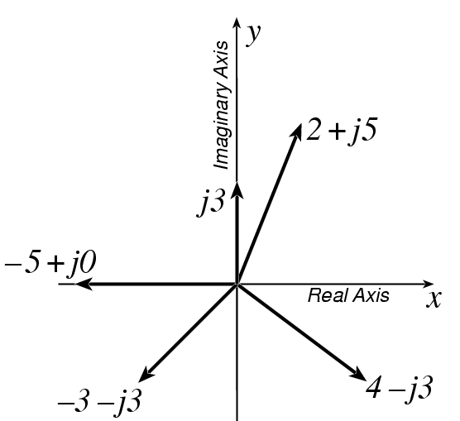



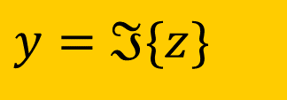
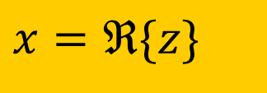
PLOT COMPLEX NUMBERS
$$ℑ\{2+j5\}=5$$
$$ℜ\{2+j5\}=2$$
Real part:
$$x=ℜ\{z\}$$
$$−5=ℜ\{−5+j0\}$$
Imaginary part:
$$y=ℑ\{z\}$$

Slide 9
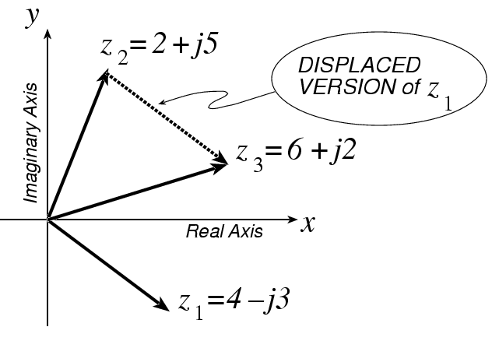

COMPLEX ADDITION = VECTOR Addition
$$z_{3}=z_{1}+z_{2} \\ =(4−j3)+(2+j5) \\ =(4+2)+j(−3+5) \\ =6+j2$$

Slide 10
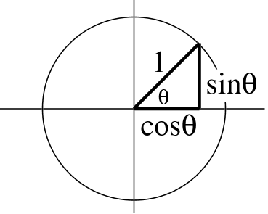
*** POLAR FORM ***
Vector Form
Length =1
Angle = θ
Common Values
j has angle of 0.5π
−1 has angle of π
− j has angle of 1.5π
also, angle of −j could be −0.5π = 1.5π −2π
because the PHASE is AMBIGUOUS

Slide 11

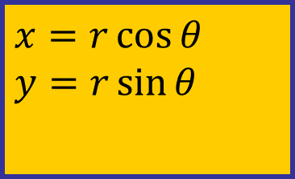

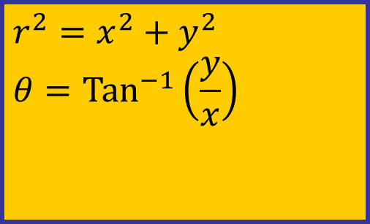


POLAR <--> RECTANGULAR
Relate (x,y) to (r,θ)
$$r$$
$$y$$
$$r^{2}=x^{2}+y^{2} \\ θ=\text{Ta}{\text{n}}^{−1}\left(\frac{y}{x}\right)$$
$$θ$$
$$x$$
$$x=r\cos{θ} \\ y=r\sin{θ}$$
Most calculators do
Polar-Rectangular
Need a notation for POLAR FORM

Slide 12
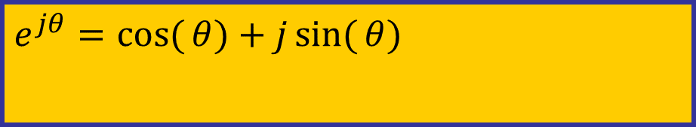
Euler’s FORMULA
Complex Exponential
Real part is cosine
Imaginary part is sine
Magnitude is one
$$e^{jθ}=\cos{(}θ)+j\sin{(}θ)$$

Slide 13
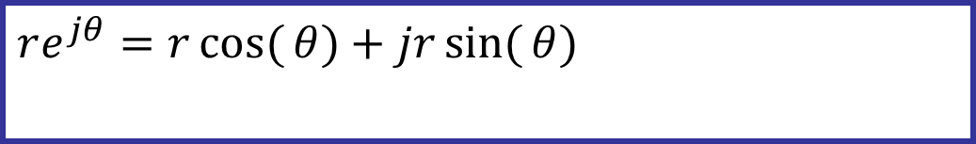

Cosine = Real Part
Complex Exponential
Real part is cosine
Imaginary part is sine
$$re^{jθ}=r\cos{(}θ)+jr\sin{(}θ)$$
$$ℜ\{re^{jθ}\}=r\cos{(}θ)$$

Slide 14

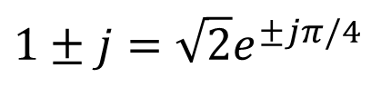


Common Values of exp(jθ)
Changing the angle
$$θ=0→1=1+j0=e^{j0}=e^{j2nπ}$$
$$θ=π→−1=−1+j0=e^{jπ}=e^{j(2n+1)π}$$
$$θ=π/2→j=e^{jπ/2}=e^{j(2n+1/2)π}$$
$$θ=3π/2→−j=e^{j3π/2}=e^{−jπ/2}=e^{j(2n−1/2)π}$$
$$1±j=\sqrt{2}e^{±jπ/4}$$
$$±1+j=?$$

Slide 15
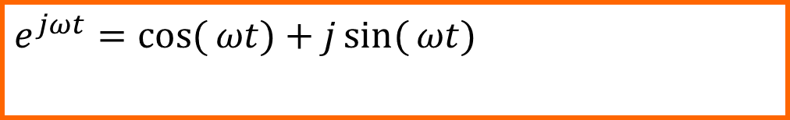
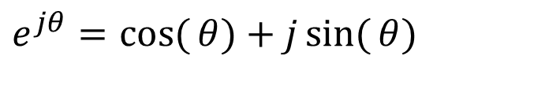
COMPLEX EXPONENTIAL
$$e^{jωt}=\cos{(}ωt)+j\sin{(}ωt)$$
Interpret this as a Rotating Vector
θ = ωt
Angle changes vs. time
ex: ω=20π rad/s
Rotates 0.2π in 0.01 secs
$$e^{jθ}=\cos{(}θ)+j\sin{(}θ)$$

Slide 16
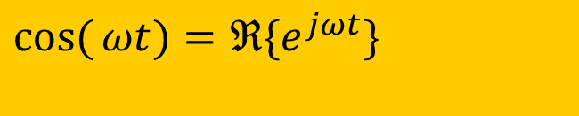
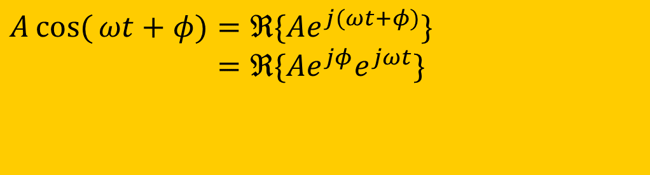
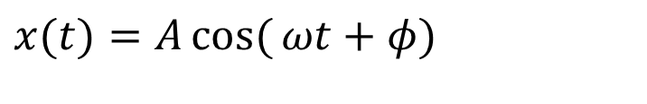
Cos = REAL PART
Real Part of Euler’s
$$\cos{(}ωt)=ℜ\{e^{jωt}\}$$
General Sinusoid
$$x(t)=A\cos{(}ωt+φ)$$
So,
$$A\cos{(}ωt+φ)=ℜ\{Ae^{j(ωt+φ)}\} \\ =ℜ\{Ae^{jφ}e^{jωt}\}$$

Slide 17
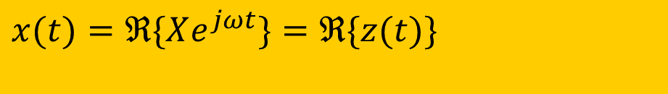
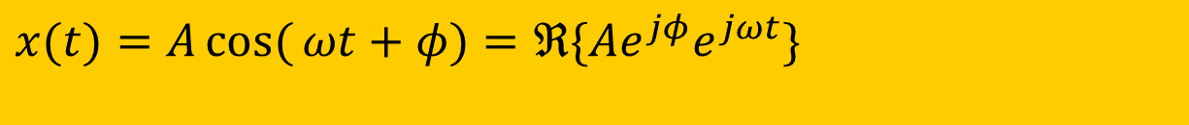
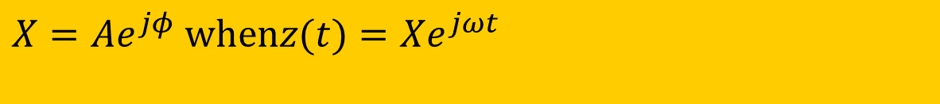
COMPLEX AMPLITUDE
General Sinusoid
$$x(t)=A\cos{(}ωt+φ)=ℜ\{Ae^{jφ}e^{jωt}\}$$
Sinusoid = REAL PART of complex exp: z(t)=(Ae^{jφ})e^{jωt}
$$x(t)=ℜ\{Xe^{jωt}\}=ℜ\{z(t)\}$$
Complex AMPLITUDE = X, which is a constant
$$X=Ae^{jφ} \text{when}z(t)=Xe^{jωt}$$

Slide 18
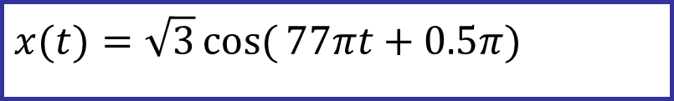
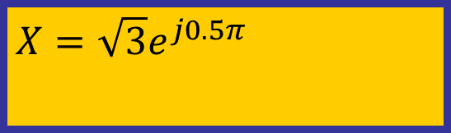

POP QUIZ: Complex Amp
Find the COMPLEX AMPLITUDE for:
Use EULER’s FORMULA:
$$x(t)=\sqrt{3}\cos{(}77πt+0.5π)$$
$$x(t)=ℜ\{\sqrt{3}e^{j(77π⥂t+0.5π)}\} \\ =ℜ\{\sqrt{3}e^{j0.5π}e^{j77π⥂t}\}$$
$$X=\sqrt{3}e^{j0.5π}$$

Slide 19
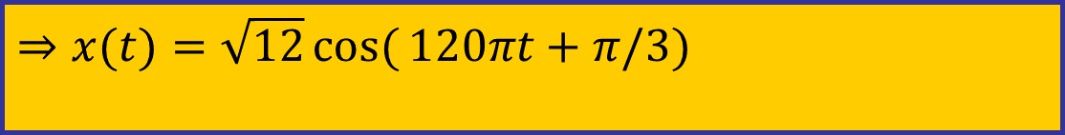
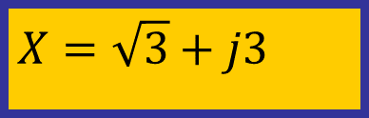

POP QUIZ-2: Complex Amp
Determine the 60-Hz sinusoid whose COMPLEX AMPLITUDE is:
Convert X to POLAR:
$$X=\sqrt{3}+j3$$
$$x(t)=ℜ\{(\sqrt{3}+j3)e^{j(120πt)}\} \\ =ℜ\{\sqrt{12}e^{jπ/3}e^{j120πt}\}$$
$$⇒x(t)=\sqrt{12}\cos{(}120πt+π/3)$$

Slide 20
COMPLEX CONJUGATE (z*)
Useful concept: change the sign of all j’s
RECTANGULAR: If z = x + j y, then the complex conjugate is z* = x – j y
POLAR: Magnitude is the same but angle has sign change

Slide 21
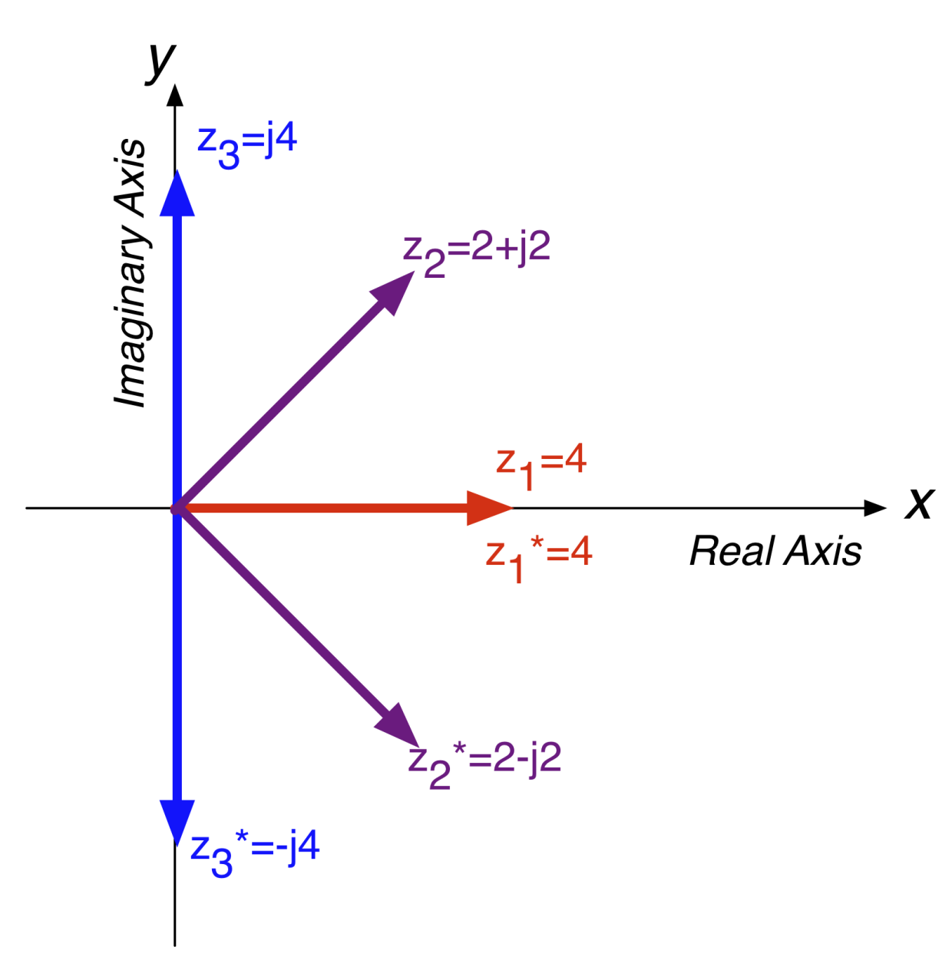
COMPLEX CONJUGATION
Flips vector about the real axis!

Slide 22
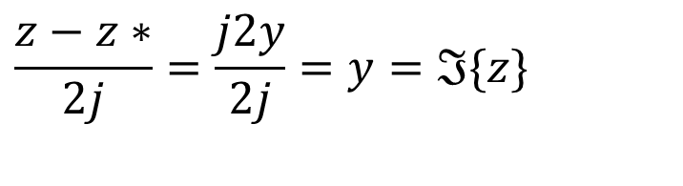
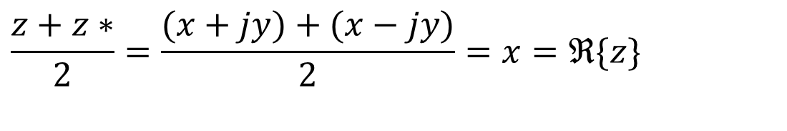
USES OF CONJUGATION
Conjugates useful for many calculations
Real part:
Imaginary part:
$$\frac{z+z∗}{2}=\frac{(x+jy)+(x−jy)}{2}=x=ℜ\{z\}$$
$$\frac{z−z∗}{2j}=\frac{j2y}{2j}=y=ℑ\{z\}$$

Slide 23
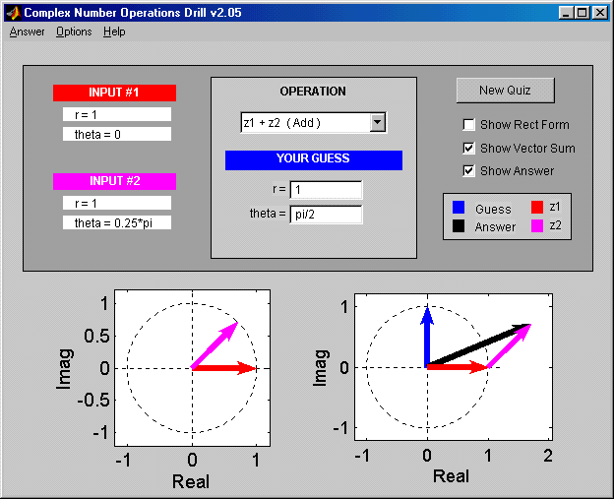
Z DRILL (Complex Arith)

Slide 24

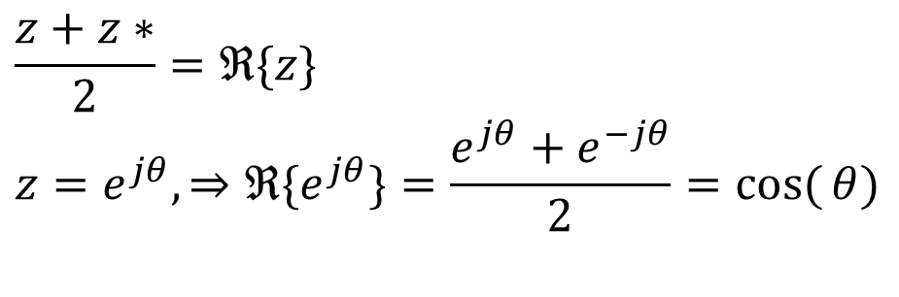
Inverse Euler Relations
Cosine is real part of exp, sine is imaginary part
Real part:
Imaginary part:
$$\frac{z+z∗}{2}=ℜ\{z\} \\ z=e^{jθ},⇒ℜ\{e^{jθ}\}=\frac{e^{jθ}+e^{−jθ}}{2}=\cos{(}θ)$$
$$\frac{z−z∗}{2j}=y=ℑ\{z\} \\ z=e^{jθ},⇒ℑ\{e^{jθ}\}=\frac{e^{jθ}−e^{−jθ}}{2j}=\sin{(}θ)$$

Slide 25
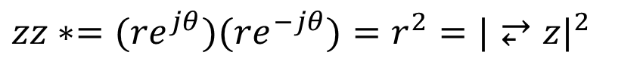
Mag & Magnitude Squared
Magnitude Squared (polar form):
Magnitude Squared (Cartesian form):
Magnitude of complex exponential is one:
$$zz∗=(re^{jθ})(re^{−jθ})=r^{2}=|⥂z|^{2}$$

Slide 26
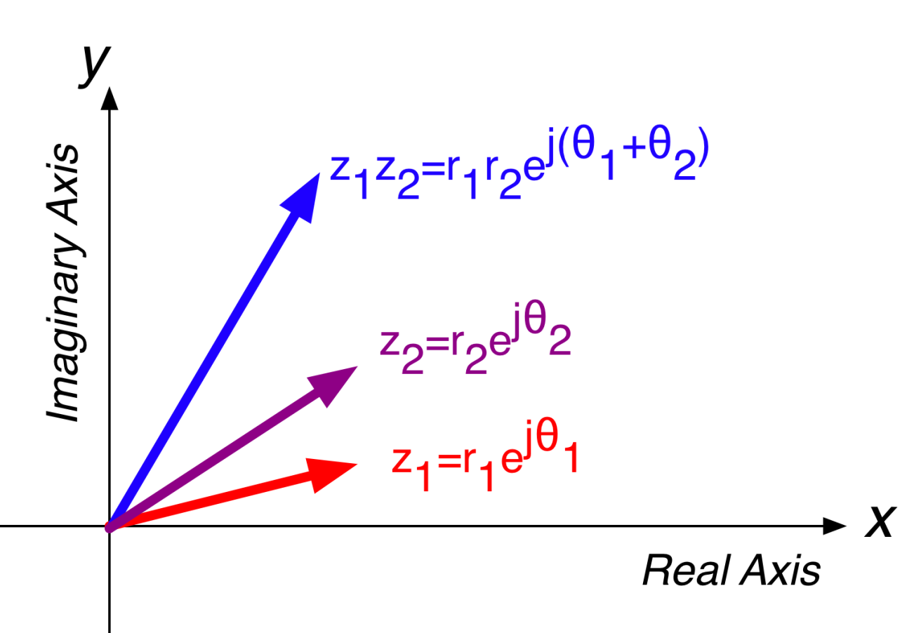
COMPLEX MULTIPLY = VECTOR ROTATION
Multiplication/division scales and rotates vectors

Slide 27
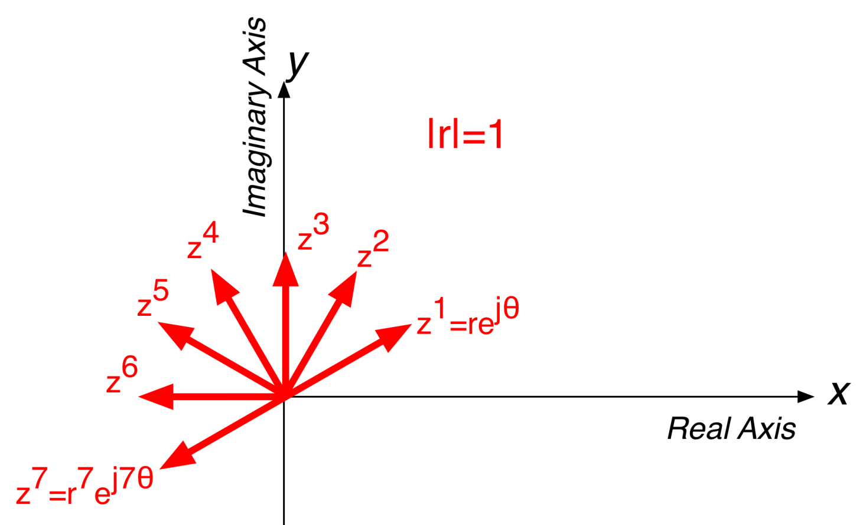
POWERS
Raising to a power N rotates vector by Nθ and scales vector length by r^{N}

Slide 28
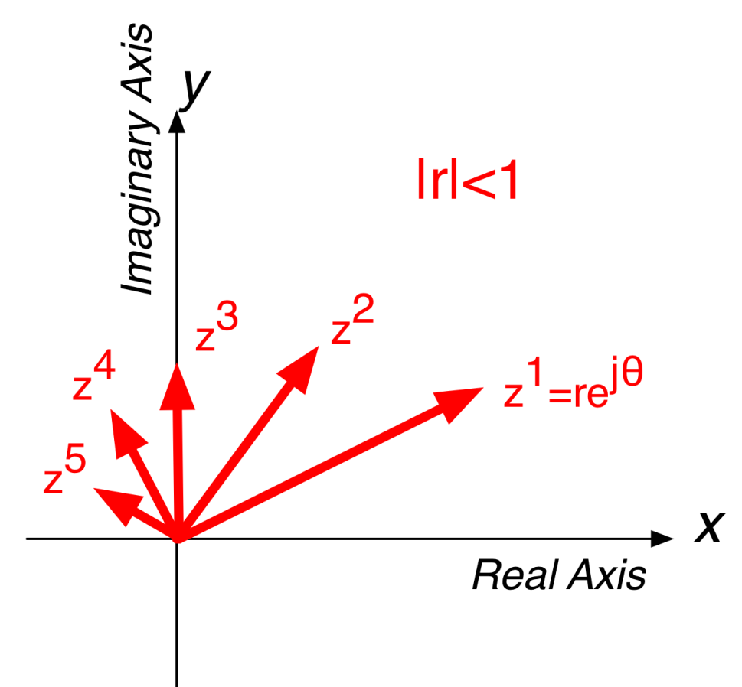
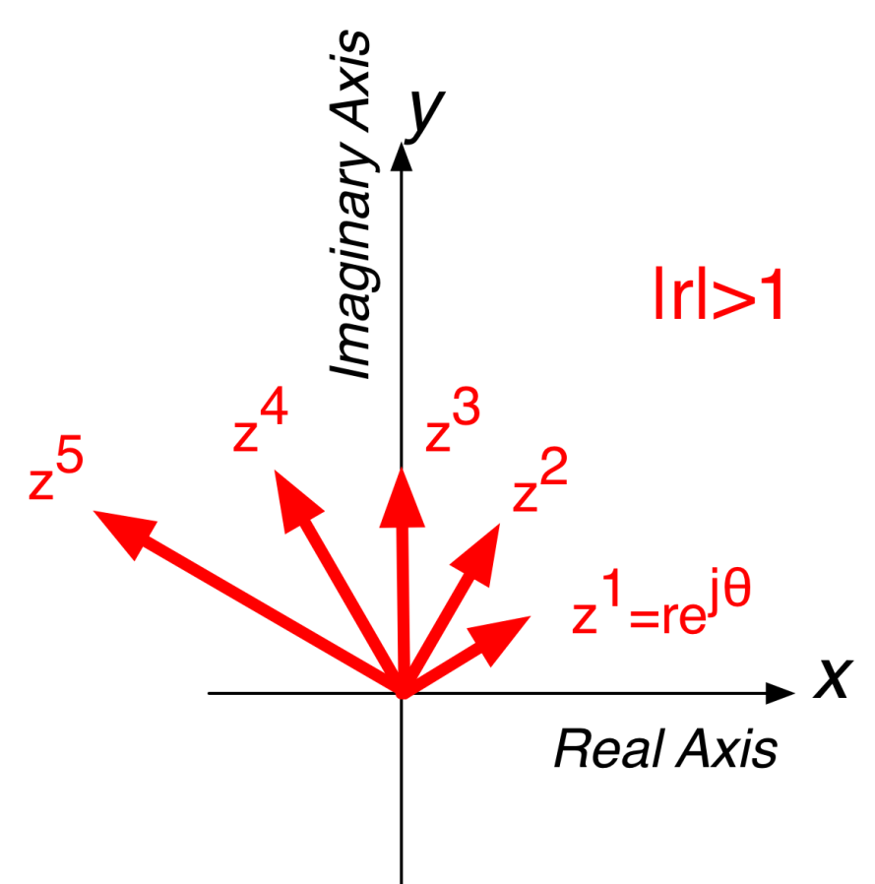
MORE POWERS

Slide 29
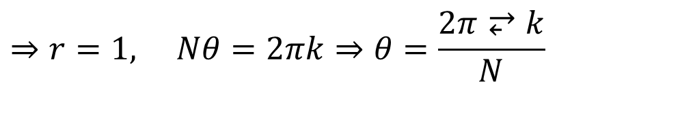
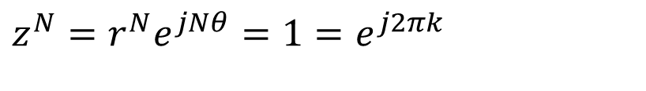
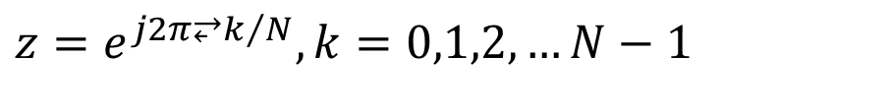
ROOTS OF UNITY
We often have to solve z^{N}=1
How many solutions?
$$z^{N}=r^{N}e^{jNθ}=1=e^{j2πk}$$
$$⇒r=1, Nθ=2πk⇒θ=\frac{2π⥂k}{N}$$
$$z=e^{{j2π⥂k}/N},k=0,1,2,…N−1$$

Slide 30
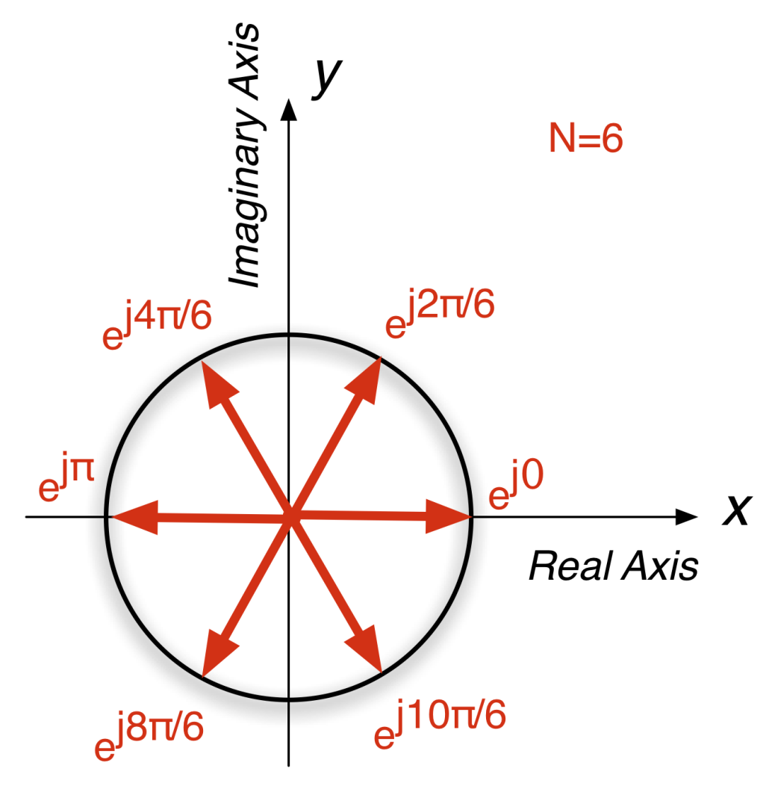
ROOTS OF UNITY for N=6
Solutions to z^{N}=1 are N equally spaced vectors on the unit circle!
What happens if we take the sum of all of them?

Slide 31
Sum the Roots of Unity
Looks like the answer is zero (for N=6)
Write as geometric sum
$$\text{Numerator} 1−r^{N}=1−(e^{j2π/N})^{N}=1−e^{j2π}=0$$

Slide 32
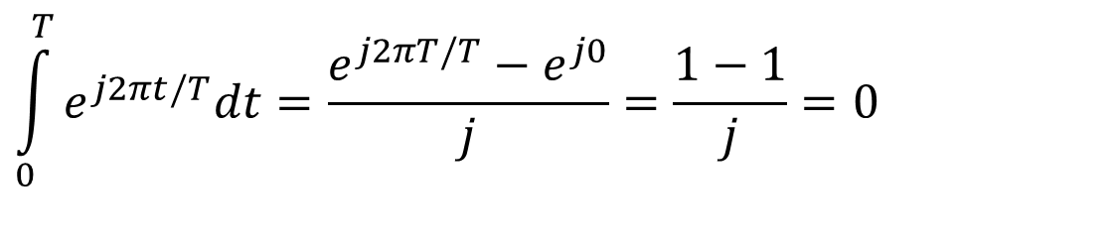
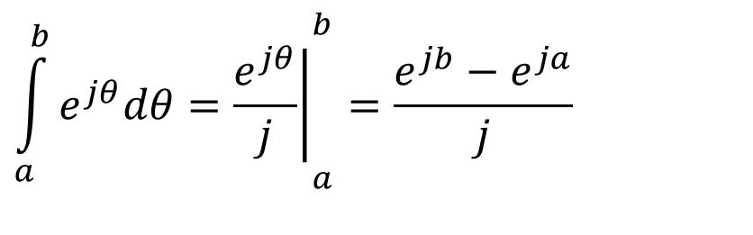
Integrate Complex Exp
Needed later to describe periodic signals in terms of sinusoids (Fourier Series)
Especially over one period
$${\int_{a}^{b}{e^{jθ}dθ=\left.\frac{e^{jθ}}{j}\right|}}_{a}^{b}=\frac{e^{jb}−e^{ja}}{j}$$
$$\int_{0}^{T}{e^{j2πt/T}dt}=\frac{e^{j2πT/T}−e^{j0}}{j}=\frac{1−1}{j}=0$$

Slide 33
BOTTOM LINE
CARTESIAN: Addition/subtraction is most efficient in Cartesian form
POLAR: good for multiplication/division
STEPS:
Identify arithmetic operation
Convert to easy form
Calculate
Convert back to original form

Slide 34
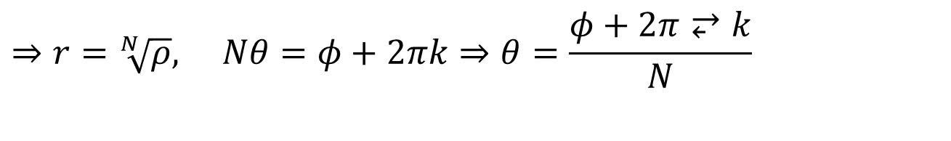
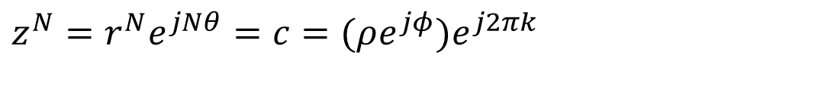
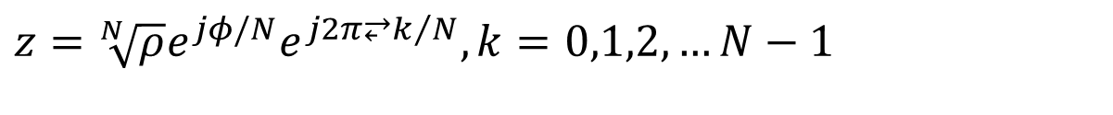
Harder N-th Roots
Want to solve z^{N} = c
where c is a complex number
$$z^{N}=r^{N}e^{jNθ}=c=(ρe^{jφ})e^{j2πk}$$
$$⇒r=\sqrt[N]{ρ}, Nθ=φ+2πk⇒θ=\frac{φ+2π⥂k}{N}$$
$$z=\sqrt[N]{ρ}e^{jφ/N}e^{{j2π⥂k}/N},k=0,1,2,…N−1$$

Slide 35
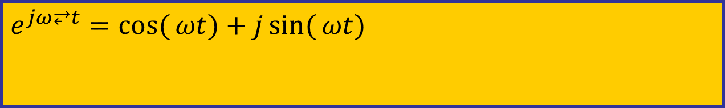
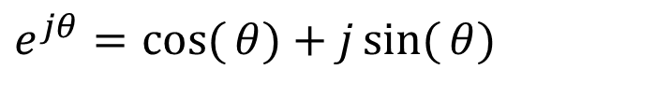
Euler’s FORMULA
Complex Exponential
Real part is cosine
Imaginary part is sine
Magnitude is one
$$e^{jθ}=\cos{(}θ)+j\sin{(}θ)$$
$$e^{jω⥂t}=\cos{(}ωt)+j\sin{(}ωt)$$

Slide 36
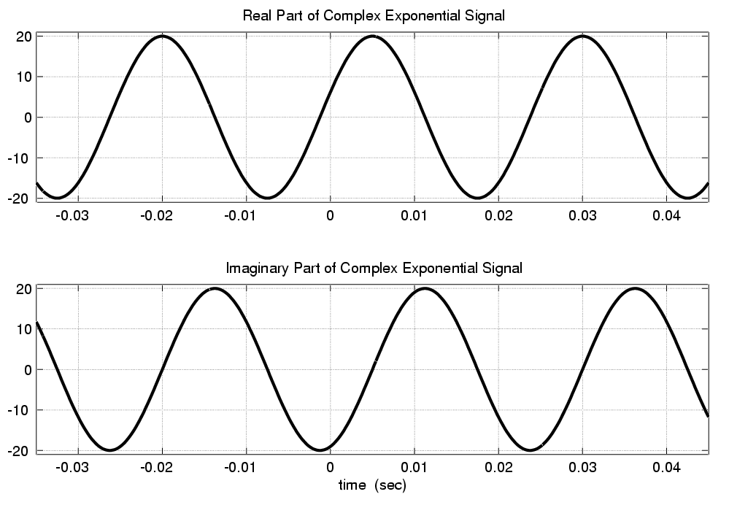
Real & Imaginary Part Plots
PHASE DIFFERENCE = π/2

Slide 37

COMPLEX EXPONENTIAL
$$e^{jωt}=\cos{(}ωt)+j\sin{(}ωt)$$
Interpret this as a Rotating Vector
θ = ωt
Angle changes vs. time
ex: ω=20π rad/s
Rotates 0.2π in 0.01 secs

Slide 38
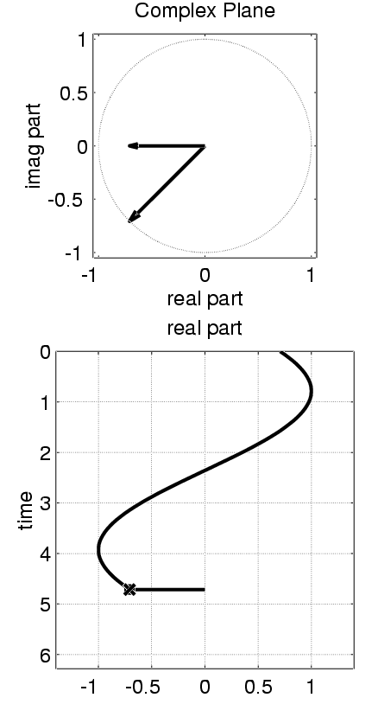

Rotating Phasor
See Demo on CD-ROM
Chapter 2

Slide 39
AVOID Trigonometry
Algebra, even complex, is EASIER !!!
Can you recall cos(θ₁+θ₂) ?
Use: real part of e^{j(θ1+θ2)} = cos(θ₁+θ₂)
$$\cos\left(θ_{1}+θ_{2}\right)=ℜe\{e^{j(θ_{1}+θ_{2})}\}=ℜe\{e^{jθ_{1}}e^{jθ_{2}}\}$$
$$=ℜe\{(\cos{θ_{1}}+j\sin{θ_{1}})(\cos{θ_{2}}+j\sin{θ_{2}})\}$$
$$=(\cos{θ_{1}}\cos{θ_{2}}−\sin{θ_{1}}\sin{θ_{2}})+j(...)$$

Slide 40

MULTIPLICATION
CARTESIAN: use polynomial algebra
POLAR: easier because you can leverage the properties of exponentials
Multiply the magnitudes and add the angles
$$z_{1}×z_{2}=r_{1}e^{jθ_{1}}×r_{2}e^{jθ_{2}}=r_{1}r_{2}e^{j(θ_{1}+θ_{2})}$$

Slide 41

DIVISION
CARTESIAN: use complex conjugate to convert to multiplication:
POLAR: simpler to subtract exponents
$$\frac{z_{1}}{z_{2}}=\frac{(x_{1}+jy_{1})}{(x_{2}+jy_{2})}=\frac{z_{1}z_{2}^{∗}}{z_{2}z_{2}^{∗}}=\frac{z_{1}z_{2}^{∗}}{|z_{2}|^{2}}$$

Slide 42
Complex Numbers
WHY? need to ADD sinusoids
Use an ABSTRACTION
Complex Amplitude, X, has mag & phase
Complex Exponential
Euler’s Formula

