Slide 1
DSP-First, 2/e
LECTURE #4
Phasor Addition Theorem

Slide 2
License Info for SPFirst Slides
This work released under a Creative Commons License with the following terms:
Attribution
The licensor permits others to copy, distribute, display, and perform the work. In return, licensees must give the original authors credit.
Non-Commercial
The licensor permits others to copy, distribute, display, and perform the work. In return, licensees may not use the work for commercial purposes—unless they get the licensor's permission.
Share Alike
The licensor permits others to distribute derivative works only under a license identical to the one that governs the licensor's work.
Full Text of the License
This (hidden) page should be kept with the presentation

Slide 3
READING ASSIGNMENTS
This Lecture:
Chapter 2, Section 2-6
Other Reading:
Appendix A: Complex Numbers
Appendix B: MATLAB
Next Lecture: start Chapter 3

Slide 4
LECTURE OBJECTIVES
Phasors = Complex Amplitude
Complex Numbers represent Sinusoids
Develop the ABSTRACTION:
Adding Sinusoids = Complex Addition
PHASOR ADDITION THEOREM

Slide 5
Adding Complex Numbers
Polar Form
Could convert to Cartesian and back out
Use Calculator that does complex ops !
Use MATLAB
Visualize the vectors

Slide 6
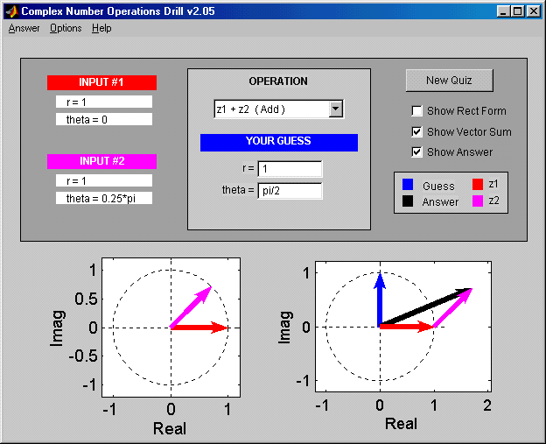
Z DRILL (Complex Arith)

Slide 7
Cos = REAL PART
What about sinusoidal signals over time?
Real part of Euler’s
General Sinusoid
Complex Amplitude: Constant
Varies with time

Slide 8
POP QUIZ: Complex Amp
Find the COMPLEX AMPLITUDE for:
Use EULER’s FORMULA:

Slide 9
POP QUIZ-2: Complex Amp
Determine the 60-Hz sinusoid whose COMPLEX AMPLITUDE is:
Convert X to POLAR:

Slide 10
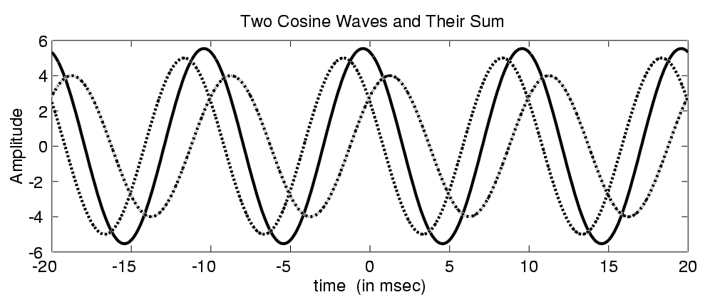
WANT to ADD SINUSOIDS
Main point to remember: Adding sinusoids of common frequency results in sinusoid with SAME frequency

Slide 11
PHASOR ADDITION RULE
Get the new complex amplitude by complex addition

Slide 12
Phasor Addition Proof

Slide 13
POP QUIZ: Add Sinusoids
ADD THESE 2 SINUSOIDS:
COMPLEX (PHASOR) ADDITION:

Slide 14
POP QUIZ (answer)
COMPLEX ADDITION:
CONVERT back to cosine form:

Slide 15
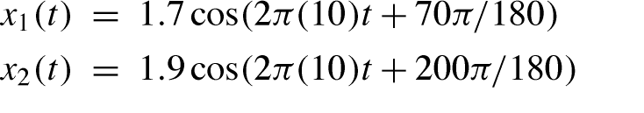
ADD SINUSOIDS EXAMPLE
ALL SINUSOIDS have SAME FREQUENCY
HOW to GET {Amp,Phase} of RESULT ?

Slide 16
Convert Sinusoids to Phasors
Each sinusoid → Complex Amp

Slide 17
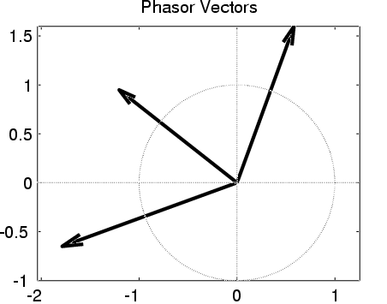
Phasor Add: Numerical
Convert Polar to Cartesian
X₁ = 0.5814 + j1.597
X₂ = -1.785 - j0.6498
sum =
X₃ = -1.204 + j0.9476
Convert back to Polar
X₃ = 1.532 at angle 141.79π/180
This is the sum

Slide 18
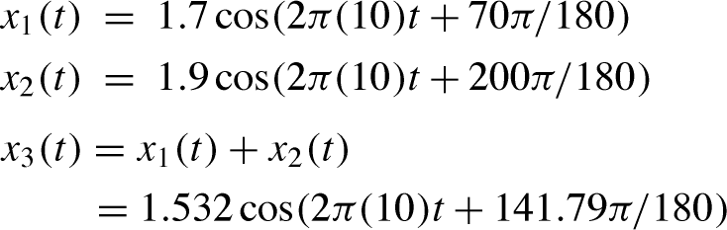
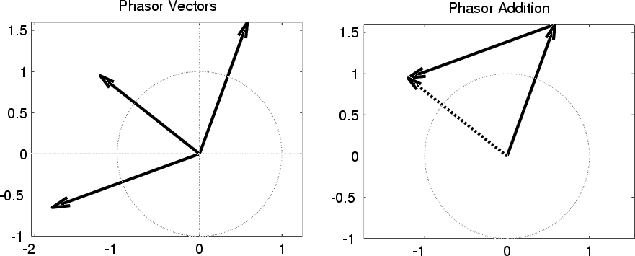
ADDING SINUSOIDS IS COMPLEX ADDITION
X₁
VECTOR
(PHASOR)
ADD
X₃
X₂

Slide 19
Add 20 Sinusoids (MATLAB)
Each sinusoid → Complex Amp
MATLAB
kk=1:20;
SS = sum( sqrt(kk) .* exp(120i*pi*(-0.002)*kk) );
zprint( SS )

Slide 20
Simultaneous Equations-1
Sum of 3 sinusoids is zero
Difference of first two is a cosine
Sum of first and third is a sine
All three have the same frequency

Slide 21
Simultaneous Equations-2
Each sinusoid → Complex Amp
Solve 3 equations in 3 unknowns →

Slide 22
Simultaneous Complex Equations
Write as a matrix:
MATLAB with backslash operator
Zans = [1,1,1;1,-1,0;1,0,1] \ [0;1;-j]

Slide 23
POP QUIZ: Add Sinusoids
ADD THESE 2 SINUSOIDS:
COMPLEX ADDITION:

Slide 24
POP QUIZ (answer)
COMPLEX ADDITION:
CONVERT back to cosine form:

Slide 25
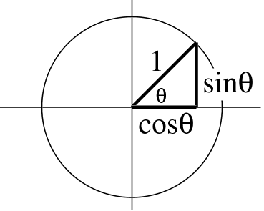
Euler’s FORMULA
Complex Exponential
Real part is cosine
Imaginary part is sine
Magnitude is one

Slide 26
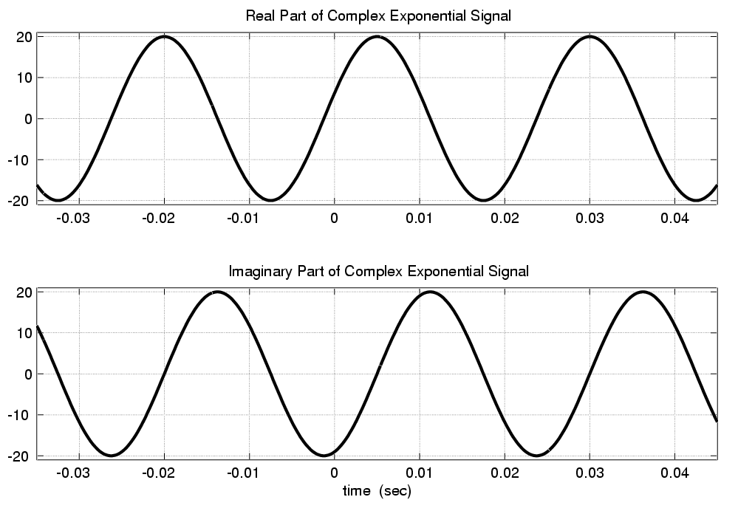
Real & Imaginary Part Plots
PHASE DIFFERENCE = π/2

Slide 27
COMPLEX EXPONENTIAL
Interpret this as a Rotating Vector
θ = ωt
Angle changes vs. time
ex: ω=20π rad/s
Rotates 0.2π in 0.01 secs

Slide 28
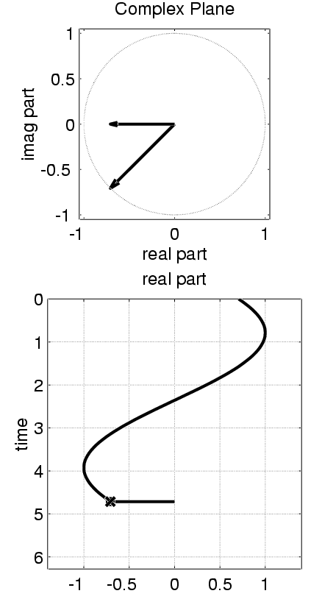
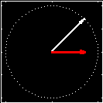
Rotating Phasor
See Demo on CD-ROM
Chapter 2

Slide 29
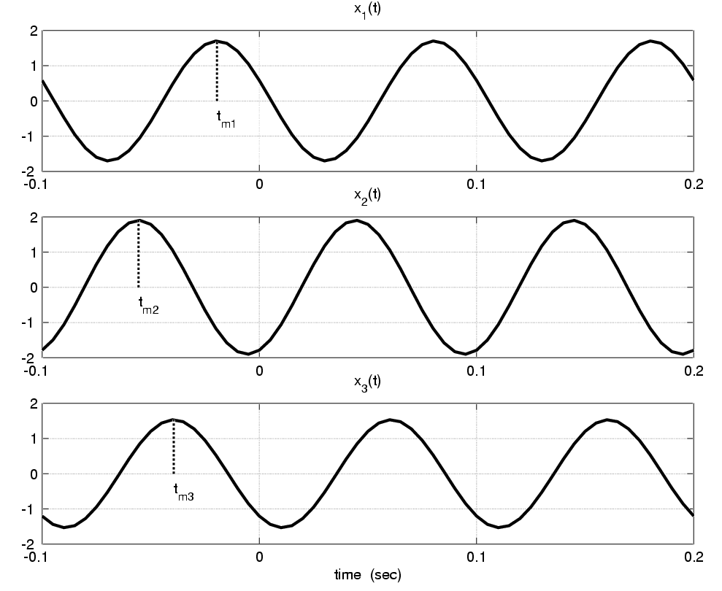
ADD SINUSOIDS EXAMPLE
t_{m1}
t_{m2}
t_{m3}

Slide 30
Convert Time-Shift to Phase
Measure peak times:
t_{m1}=-0.0194, t_{m2}=-0.0556, t_{m3}=-0.0394
Convert to phase (T=0.1)
φ₁=-ωt_{m1} = -2π(t_{m1} /T) = 70π/180,
φ₂= 200π/180
Amplitudes
A₁=1.7, A₂=1.9, A₃=1.532

Slide 31
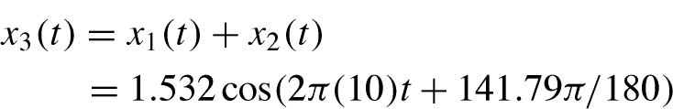
ADD SINUSOIDS: Amp/Phase
ALL SINUSOIDS have SAME FREQUENCY
HOW to GET {Amp,Phase} of RESULT ?

Slide 32
Complex number relations for SCALARS
Cartesian and polar forms
Euler’s formula
Real part of Euler’s

Slide 33
COMPLEX AMPLITUDE
General Sinusoid
Sinusoid = REAL PART of complex exp: z(t)=(Ae^{jφ})e^{jωt}
X is a (complex) constant -> amplitude and phase
Called COMPLEX AMPLITUDE or PHASOR

