Slide 1
DSP First, 2/e
LECTURE #1
Sinusoids

Slide 2
License Info for DSPFirst Slides
This work released under a Creative Commons License with the following terms:
Attribution
The licensor permits others to copy, distribute, display, and perform the work. In return, licensees must give the original authors credit.
Non-Commercial
The licensor permits others to copy, distribute, display, and perform the work. In return, licensees may not use the work for commercial purposes—unless they get the licensor's permission.
Share Alike
The licensor permits others to distribute derivative works only under a license identical to the one that governs the licensor's work.
Full Text of the License
This (hidden) page should be kept with the presentation

Slide 3
READING ASSIGNMENTS
This Lecture:
Chapter 2, Sections 2-1 and 2-2
Chapter 1: Introduction
Appendix B: MATLAB
Review Appendix A on Complex Numbers

Slide 4
CONVERGING FIELDS
Math
Physics
EE
CmpE
Computer
Science
Applications
BIO

Slide 5
COURSE OBJECTIVE
Students will be able to:
Understand mathematical descriptions of signal processing algorithms and express those algorithms as computer implementations (MATLAB)
What are your objectives?

Slide 6
WHY USE DSP ?
Mathematical abstractions lead to generalization and discovery of new processing techniques
Computer implementations are flexible
Applications provide a physical context

Slide 7
Fourier Everywhere
Telecommunications
Sound & Music
CDROM, Digital Video
Fourier Optics
X-ray Crystallography
Protein Structure & DNA
Computerized Tomography
Nuclear Magnetic Resonance: MRI
Radioastronomy
Ref: Prestini, “The Evolution of Applied Harmonic Analysis”

Slide 8
LECTURE OBJECTIVES
Write general formula for a “sinusoidal” waveform, or signal
From the formula, plot the sinusoid versus time
What’s a signal?
It’s a function of time, x(t)
in the mathematical sense

Slide 9
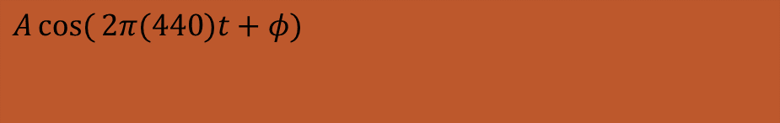
TUNING FORK EXAMPLE
CD-ROM demo
“A” is at 440 Hertz (Hz)
Waveform is a SINUSOIDAL SIGNAL
Computer plot looks like a sine wave
This should be the mathematical formula:
$$A\cos{(}2π(440)t+φ)$$

Slide 10
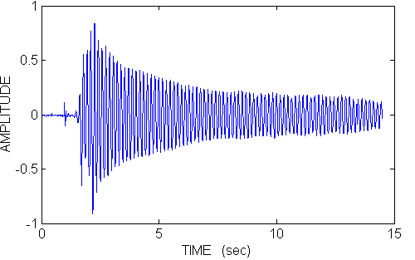
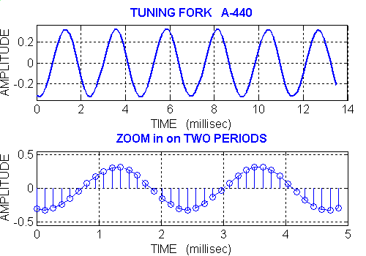
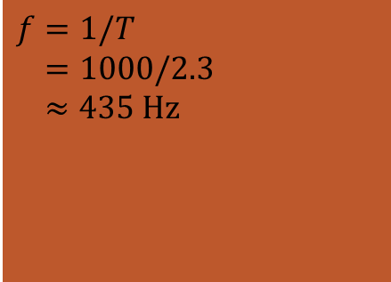

TUNING FORK A-440 Waveform
$$T≈8.15−5.85 \\ =2.3 \text{ms}$$
Time (sec)
$$f=1/T \\ =1000/2.3 \\ ≈435 \text{Hz}$$

Slide 11
SPEECH EXAMPLE
More complicated signal (BAT.WAV)
Waveform x(t) is NOT a Sinusoid
Theory will tell us
x(t) is approximately a sum of sinusoids
FOURIER ANALYSIS
Break x(t) into its sinusoidal components
Called the FREQUENCY SPECTRUM

Slide 12
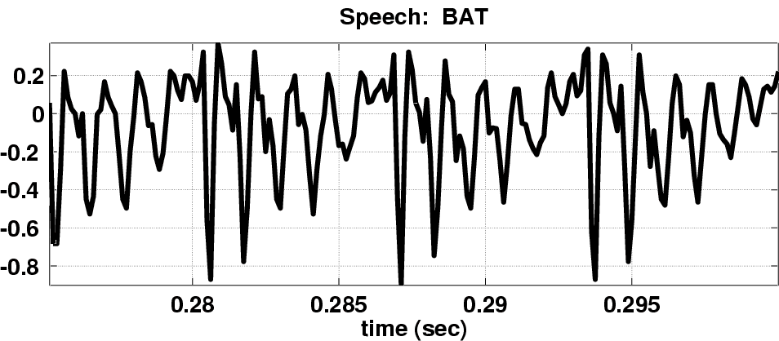
Speech Signal: BAT
Nearly Periodic in Vowel Region
Period is (Approximately) T = 0.0065 sec

Slide 13
DIGITIZE the WAVEFORM
x[n] is a SAMPLED SINUSOID
A list of numbers stored in memory
Sample at 11,025 samples per second
Called the SAMPLING RATE of the A/D
Time between samples is
1/11025 = 90.7 microsec
Output via D/A hardware (at F_{samp})

Slide 14
STORING DIGITAL SOUND
x[n] is a SAMPLED SINUSOID
A list of numbers stored in memory
CD rate is 44,100 samples per second
16-bit samples
Stereo uses 2 channels
Number of bytes for 1 minute is
2 X (16/8) X 60 X 44100 = 10.584 Mbytes

Slide 15
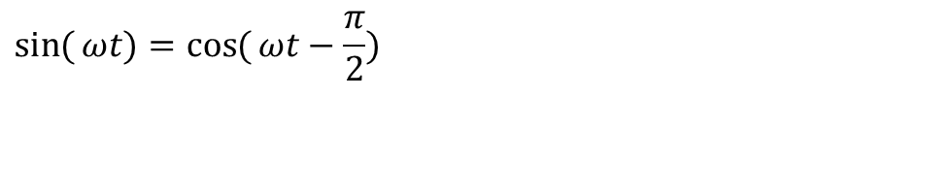

SINES and COSINES
Always use the COSINE FORM
Sine is a special case:
$$A\cos{(}2π(440)t+φ)$$
$$\sin{(}ωt)=\cos{(}ωt−\frac{π}{2})$$

Slide 16
SINUSOIDAL SIGNAL
FREQUENCY
Radians/sec
Hertz (cycles/sec)
PERIOD (in sec)
AMPLITUDE
Magnitude
PHASE

Slide 17
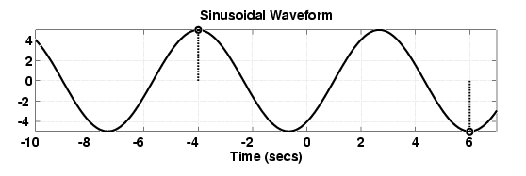
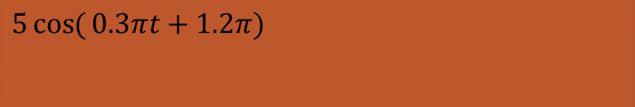
EXAMPLE of SINUSOID
Given the Formula
Make a plot
$$5\cos{(}0.3πt+1.2π)$$

Slide 18
PLOT COSINE SIGNAL
Formula defines A, ω, and φ

Slide 19
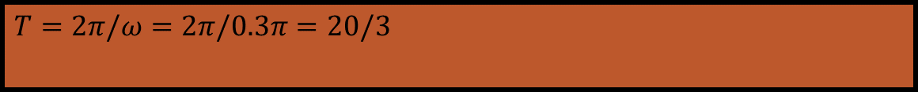
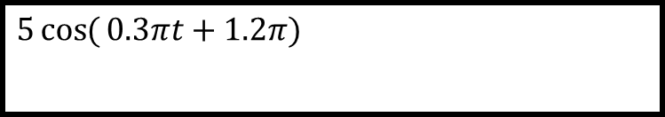
PLOTTING COSINE SIGNAL from the FORMULA
$$5\cos{(}0.3πt+1.2π)$$
Determine period:
Determine a peak location by solving
Zero crossing is T/4 before or after
Positive & Negative peaks spaced by T/2
$$T=2π/ω=2π/0.3π=20/3$$
$$(ωt+φ)=0 ⇒ (0.3πt+1.2π)=0$$

Slide 20
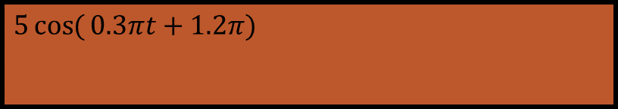
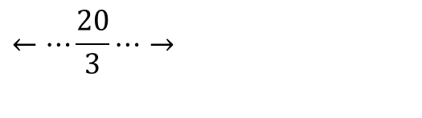
PLOT the SINUSOID
Use T=20/3 and the peak location at t=-4
$$5\cos{(}0.3πt+1.2π)$$
$$←⋯\frac{20}{3}⋯→$$

Slide 21
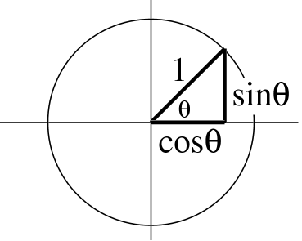
TRIG FUNCTIONS
Circular Functions
Common Values
sin(kπ) = 0
cos(0) = 1
cos(2kπ) = 1 and cos((2k+1) π) = -1
cos((k+0.5) π) = 0

Slide 22
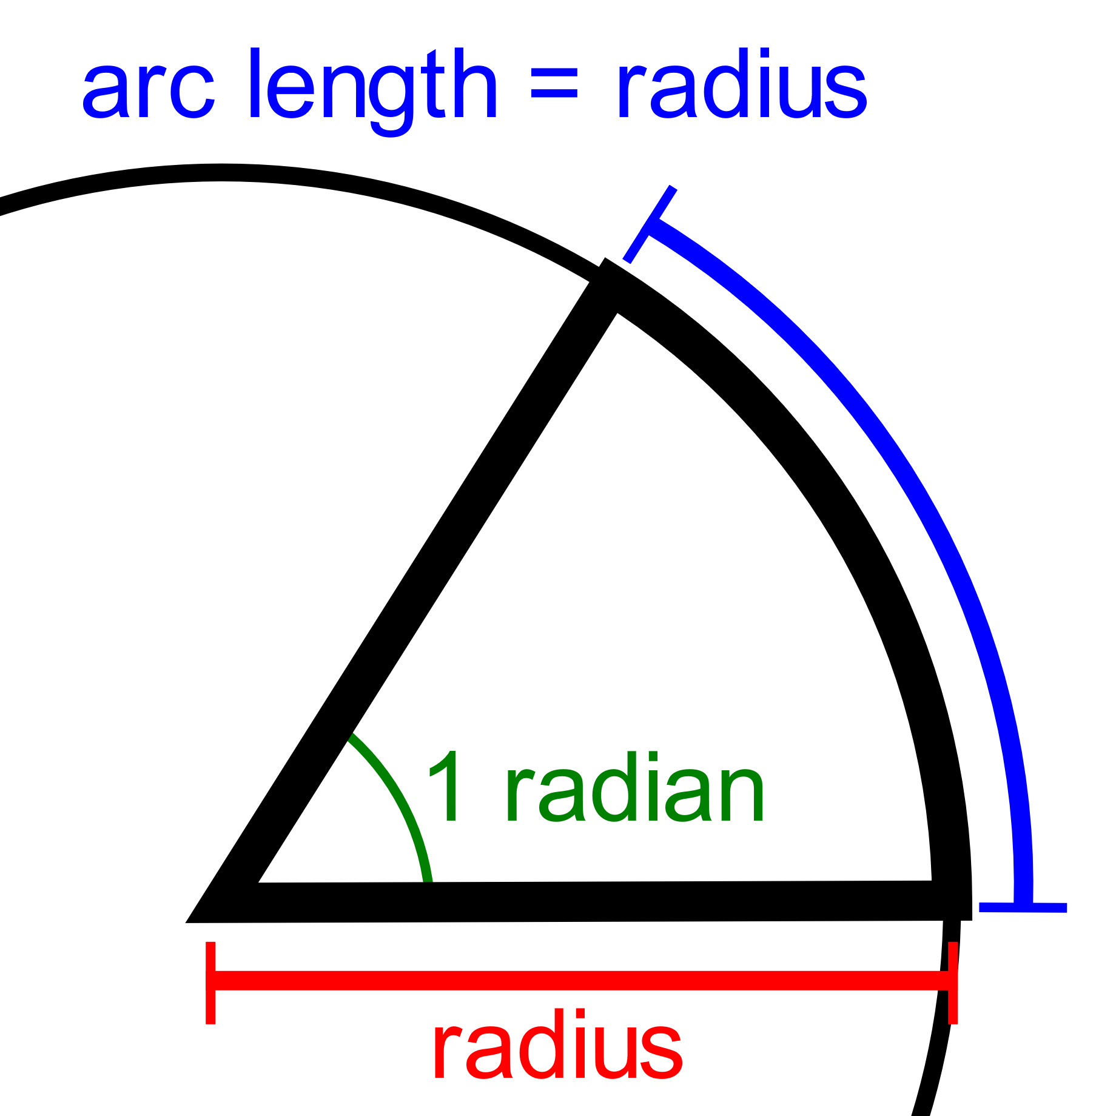
Radian
https://en.wikipedia.org/wiki/Radian
https://en.wikipedia.org/wiki/Radian#/media/File:Circle_radians.gif

Slide 23
Problems:
http://dspfirst.gatech.edu/database/?d=homework&chap=2

